Slide 1
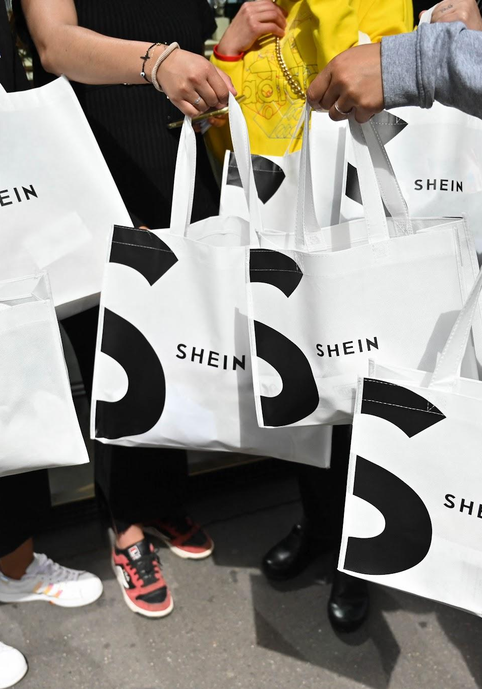
Fast Fashion
Troop 3958 Silver Award Project

Slide 2



Who Are We?
Alice T.
Siena F.
Sara A.
Hola! I have done 8 years of Girl Scouts and I am in 8th grade.
Hi! I am in 8th grade, and this is my 9th year of Girl Scouts.
Hello! I am in 8th grade and this is my 1st year of Girl Scouts.

Slide 3

Table of contents.
01 | What is Fast Fashion?
02 | Why is it bad for people?
03 | Why is it bad for the environment?
04 | What can we do to help?

Slide 4
History of Fast Fashion
01
The fast fashion model emerged in the 1970s when retailers began exporting production to countries, particularly in Asia, where they could pay workers lower wages than in Western countries. It took hold in the 1990s as companies accelerated output to keep up with trends.

Slide 5
What is fast fashion?
02
Fast fashion is when popular styles are mass produced very cheaply and quickly.

Slide 6


Slide 7
The Human Cost of Cheap Clothing
03
Most garment workers are not paid enough to survive and the working conditions make it even harder.

Slide 8
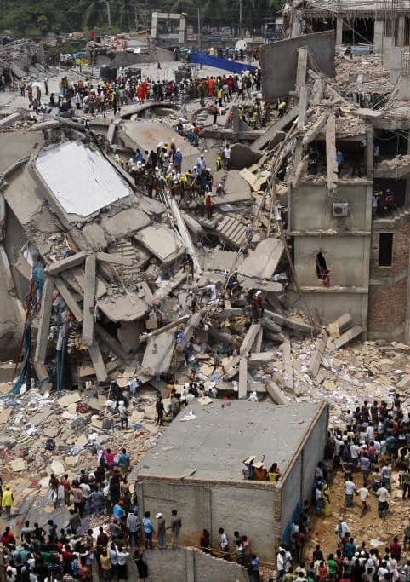
How is fast fashion bad for people?
Use of dangerous chemicals
Poor Working Conditions
Unfairly Treated
Poor Pay
1
2
The factories have very poor working conditions because it costs more to make them safe. Places with the worst conditions include Bangladesh, India, China, and Nicaragua.
The use of dangerous chemicals in the textile factories and cotton farms causes illnesses and respiratory/skin diseases in the workers.
3
4
Most of the workers are abused, forced into mandatory overtime, and cannot get out. When they don’t meet their daily quota they might be beaten, not allowed to take breaks, and/or denied water.
Workers have terrible pay; about $3 a day. They also have families they have to support. Their children also work in the factories to help their siblings so the cycle of poverty never breaks.

Slide 9
Why is fast fashion bad for the environment?
04
The environment is severely impacted by fast fashion. Here’s why.

Slide 10


Slide 11
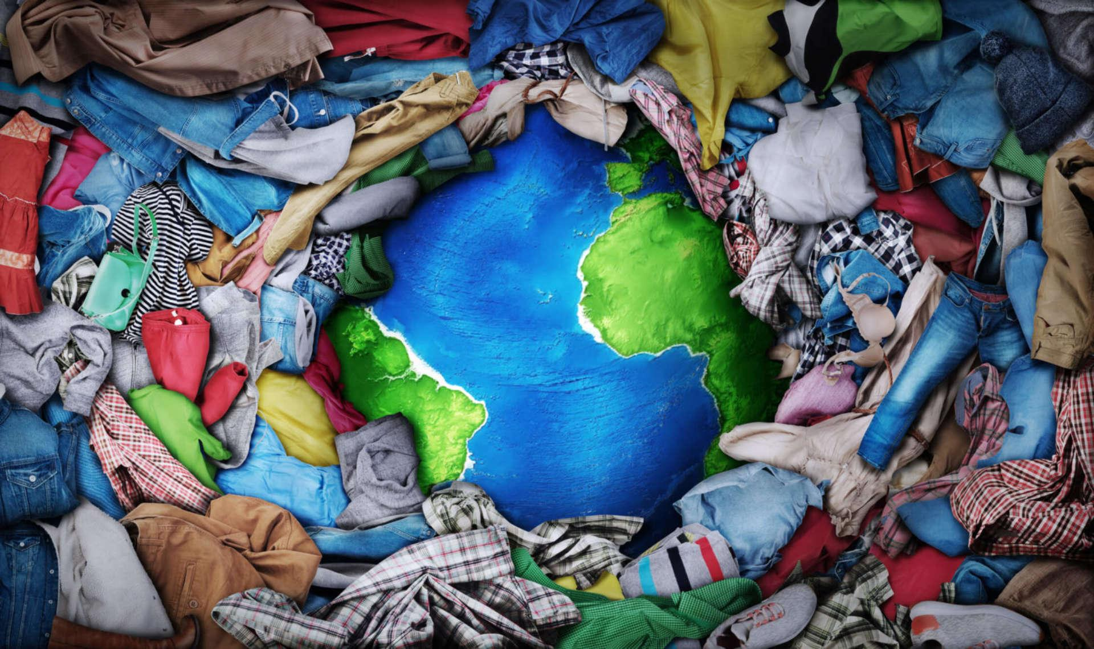
Why is fast fashion bad for the environment?
The fashion industry is one of the largest polluters globally, some of the reasons are:
Excessive Usage of Water
Plastic Microfibers
Excessive Consumption of Clothing
Usage of Viscose (textile harmful to the environment)

Slide 12
What can you do to help?
05

Slide 13
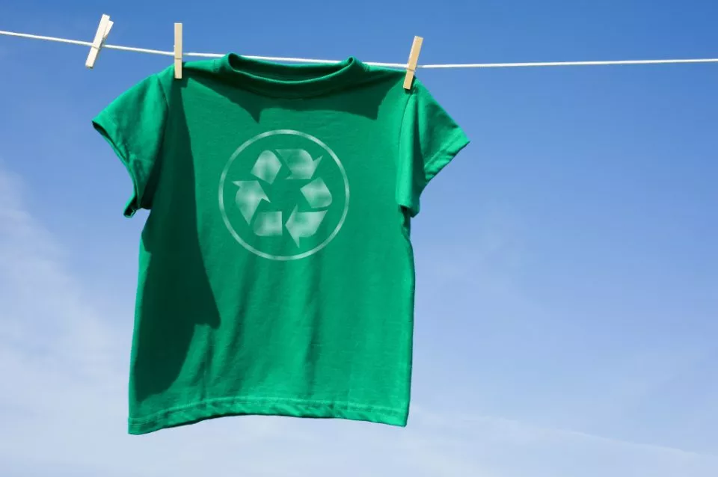
What can we do to help?
Educate yourself
Donate your unwanted clothes
Avoid fast-fashion brands
Buy less and buy better. Instead of buying three cheap tops, buy one top that is of higher quality and wear it more often

Slide 14
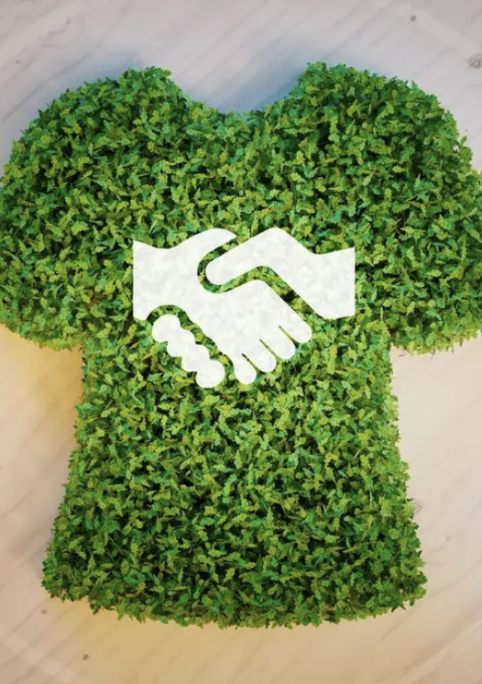
Brands that are Sustainable and not
Some fast fashion brands include: H&M, SHEIN, Zara, Forever 21, and Uniqlo. These stores make clothes out of cheap low-quality material and do not treat their workers well.
Some sustainable brands include: Patagonia, Pact, People Tree, and For Days. These stores make sustainable clothing that is better for the environment. The workers are also treated better.
Although brands like SHEIN may be very cheap, they are terrible for the environment and the workers.

Slide 15
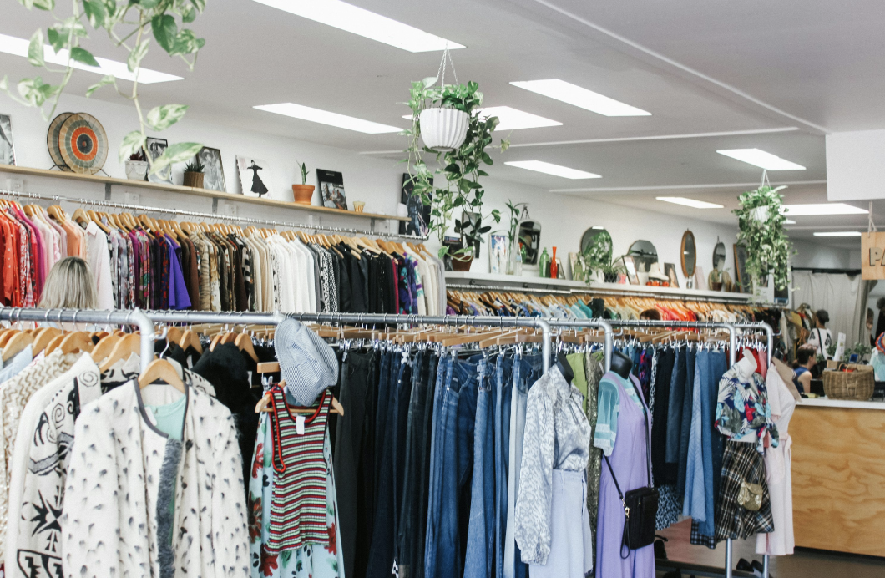
Thrifting
When you want to get cheap clothes but don’t want to support companies like SHEIN, try thrifting! It may not seem like thrift stores will have trendy clothes, but some are very nice and you can even find popular brands. Here are some thrift stores to try: Goodwill, Plato’s Closet and Buffalo Exchange.

Slide 16
To learn more about Fast Fashion…
Watch these movies:
“The Next Black”
“Uditta”
“The True Cost”

Slide 17
Credits.
Presentation Template: SlidesMania
Sample Images: Unsplash
Fonts used in this presentation: Andika and Berkshire Swash.

