Slide 1


Leader Instructions & Meeting Prep:
Senior Voice for Animals Badge
The following slides will walk your troop through a virtual meeting to earn the Senior Voice for Animals Badge. When you share your screen during your meeting, be sure to click “Present” so girls see the full screen. Also, when you are sharing your screen in zoom, google meet, or another meeting app, please make sure you are sharing both picture and audio. For more information on using Zoom, visit gsnw.gl/VirtualMeetingHowTo
Many of the interactive activities included are shared through YouTube videos. Just click on the arrow in the center of the image to play the video, and the girls can see it too! You should try to review the slides before your meeting if possible, so you are familiar with the activities and any supplies needed.
This meeting will typically take approximately 60-90 minutes as written, depending on participation level and number of girls. As always, Girl Scouting is flexible, and troops may select the activities interest them most, add their own activities, or have girls do some of the steps afterward as “homework”.
When you send out your meeting invitation, be sure to let girls and parents know what supplies they should have on hand for the online troop meeting. They are things most girls likely have at home.

Slide 2

Voice for
Animals
Seniors
Brought to you by Girl Scouts of the Northwestern Great Lakes

Slide 3

Girl Scout Promise
On my honor, I will try, To serve God and my Country. To help people at all times, And to live by the Girl Scout Law.

Slide 4


Let’s say the pledge

Slide 5
Voice for Animals Badge
.
Find out about the complex relationship between animals and humans so you can make informed choices and help others make them too.
Find out about domestic animals
Investigate animals used for science
Explore animals in husbandry
Take a look at animals used for sports and entertainment
Look into an animal issue

Slide 6
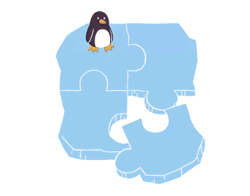
Ice breaker.
Do you own any pets?
If you could be any animal, what would it be?

Slide 7
.Let’s learn about.
domestic animals

Slide 8
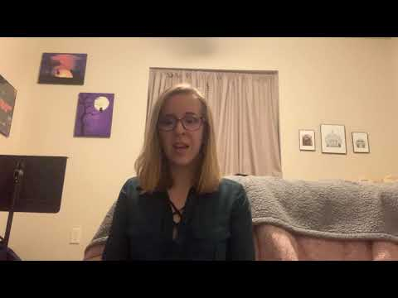
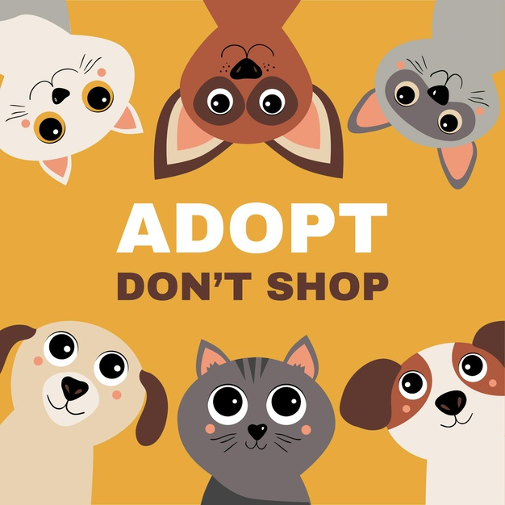
What is the process for adopting a domestic animal?

Slide 9
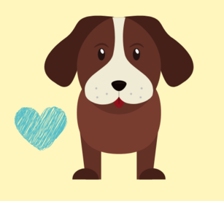
Let’s think about this... .
Adopting an animal is a lot of responsibility!
Let’s take a few moments to brainstorm whether a cat, dog, either, or a different pet would be best for your life right now if you were going to welcome a new furry friend.
If you are allergic or do not want pets, brainstorm advice you would give to a friend or family member looking to adopt.

Slide 10

Let’s think about this…
Whether you adopt or buy from a breeder, is a choice that is up to you!
Things to think about:
Cost
Should you adopt or buy from a breeder?
  Be very careful with backyard breeders and places that sell “puppy mill” pets. Puppy mills breed animals at high rates in usually very unsafe and poor conditions leading to the animal having health conditions.
  Be careful of pet stores that are not partnered with a shelter.
Getting a puppy? Know what you are spending your money on! Make adoption your first option and do your research before buying.
 | Adopting | Reputable Breeder | Backyard Breeder
Fee | $35-300 | $1K-8K | $300-1K
Spay/Neuter | Included | $200-300 | $200-300
Vaccinations | Included | Included | $100
Microchip | Included | Included | $50
Deworming | Included | Included | $20
1st Heartworm Prevention | Included | $20 | $20
Flea Prevention | Included | $15 | $15
Total Fees | $35-300 | $1.5K-1.8K | $1K-2K

Slide 11

Rescue.
Save a life!
Less expensive
Multiple age groups
Unknown history
Breeder.
Specific line of breed
Start from scratch
Known background
More expensive
Rescue vs. Breeder
Let’s discuss…
Why might someone get an animal from a breeder?
From a shelter?
Dig a little into your own community, find peoples opinions and experiences!

Slide 12
.How are animals. .used in.
science & husbandry

Slide 13
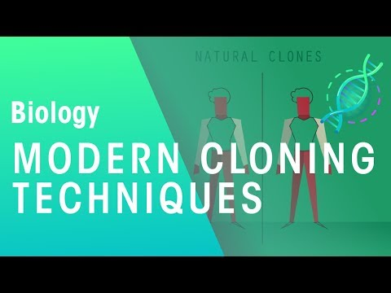
Cloning animals, is this the future?
Let’s take a look at how science clones animals and how it might affect the future!
Is cloning already being used in your community?
After the video, on a piece of paper let’s brainstorm pros and cons of cloning animals and possible ones for cloning humans!

Slide 14
Is cloning good or bad? Both? .
Pros
Allows accelerated reproduction
Safer and healthier food
Protect endangered species
Help infertile and same sex couples have biologically related children
Organ replacement
Selective traits
Cons
Small # of attempts actually results in birth
Surrogates suffer
Animals sometimes grow incorrectly (usually abnormally large)
Designer babies vs unplanned pregnancies (45% are unplanned)
Potential violation of human rights
Cellular degradation can happen after too many clones
Societal impacts – possibly create a new class which may lead to further and new discrimination
If you are interested in learning more about designer babies, click here or check out the movie Gattaca

Slide 15
.How are animals. .used in.
sports & entertainment

Slide 16

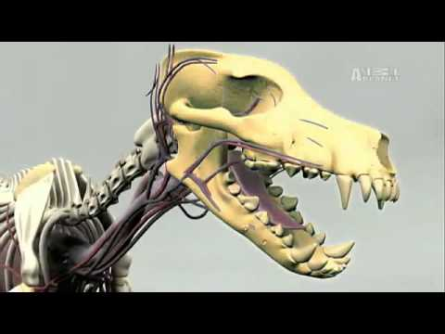
Dog Racing
A sport that was once popular is now on decline.
What happens to retired race dogs? Let’s check it out!
Dog racing is still legal and happens in MI and WI, where or how does it happen in your community? How are animals cared for?

Slide 17

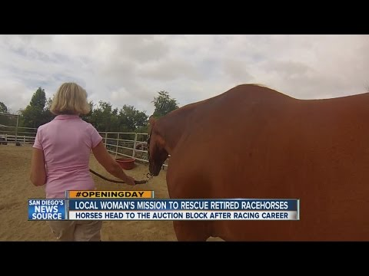
Horse Racing
While Greyhound racing is on a decline, horse racing might be increasing
Although horses have been bred and kept to run and travel, do they receive the best care?
Is racing more harmful than good?
Do you or anyone you know race horses? It can be done safely. How do people do it in your community?

Slide 18
.Let’s be a.
.Voice for animals.
& explore an issue your are passionate about!

Slide 19
Discover & connect issues on your. .community to what we’ve learned..
.
To be a Voice for Animals, it’s important to advocate for them!
Look at which issue you are the most passionate about and look into it and create an advocacy project around it!
What are some of your ideas?
Here are some ideas:
Adoption vs. Breeder
Yes or No to Cloning
Yes or No to Animal Racing
Want to investigate something else?
Cat Declawing or Vegetarianism
Animal shelters almost always need more help and have ideas for ways you can help and help create sustainable change.

Slide 20




Let’s Take Action!.
Maybe . . .
Create a comic or start a blog
Design a website
Organize a panel discussion or debate
Design an exhibit
Organize a volunteer effort
Invent a new process or help change legislature
Perhaps . . .
Explore and promote ethically and locally produced meat and animal products
Work with a local humane society to educate the public about declawing alternatives
Create a direction of resources for people looking to adopt so they can find the right pet!
Notes:
Take at least 10-15 minutes as a troop to talk about and plan your take action step! If you are unsure of what would help you be a voice for animals in your community, talk to your local animal shelter or even zoo!

Slide 21
Great job,.
GIRL SCOUTS!
You have earned the
SPECIAL AGENT Badge

