Slide 1
Senior Space Science Expert

Slide 2
Step 1: Uncover the Stuff You’re Made of
When a massive star explodes at the end of its life- an event called a supernova- the star’s element scatter into space. Over time, elements made during the supernova, including those heavier than Iron, are recycled into new stars and planets. The naturally occurring elements found on Earth were once at he the heart of a star and make up everything around us including yourself.

Slide 3
The nitrogen in our DNA, the calcium in our teeth, the iron in our blood, the carbon in our apple pies were made in the interiors of collapsing stars. We are made of starstuff. - Carl Sagan

Slide 4
Make a stardust Self Portrait
An infographic transforms information from a set of numbers into a compelling visual image to make data more interesting and easier to read.
You are going to make an infographic to represent how your body is made up of elements.
You will calculate or estimate how much space each element should take up and divide and label accordingly.
Label and fill in each area with a different color or pattern. You can make your infographic to an outline of yourself or another shape to represent you.
Info for element breakdown is on the next slide.

Slide 5
Top 4 Elements
Traces that are Collectively .6%
& a Variety of Trace Elements that add up to .3%
Hydrogen (62%) Oxygen (24%) Carbon (12%) Nitrogen (1.1%)
Calcium, Phosphorus, Potassium, Sulfur, Sodium, Chlorine

Slide 6
Step 2:
Explore the Brilliance of the Stars
Scrapbook the lives of Stars

Slide 7
Make a scrapbook comparing the life cycles of stars and humans. Start with the formation stage and end with supernova remnants or planetary nebula. Us the the Life Stages of a Star and the lists of stars on the following slides for reference. Then, go online and use photos as inspiration to draw or paint in your scrapbooks.

Slide 8
Life Stages of a Star
Prenatal: Stars are created in large clouds of gas and dust called “nebula”or stellar nurseries
Birth: When there is enough mass for hydrogen to fuse into helium at its center (or core), a star is born! They’re ready to move out of the could and into their place in the Milky Way Galaxy
Adulthood: A star will spend most of its life steadily converting hydrogen into helium and not changing in size very much. The largest stars have the shortest lifetimes, millions of years, and the smallest have the longest- billions of years.

Slide 9
Life Stages of a Star Cont.
Crisis: When a star runs out of hydrogen fuel, it undergoes rapid structural changes, making the star expand and contract
Death: Different things occur when stars die. A small star ‘s out layers will gently expand as a planetary nebula, a shell of gas, and its center will become a white dwarf. A massive star will have a more violent end- a fiery supernova explosion, with its core becoming either a high density neutron star or compression into a stellar black hole.
.

Slide 10


Slide 11
Examples of Stars
Sellar Nursery/Prenatal
The Orion Nebula (M42), The Rosette Nebula (NGC 2237), The Trifid Nebula (M20), The Cone Nebula (NGC 2264),The Eagle Nebula (M16)
Protostars/Birth
IStar Cluster in the Center of the Rosette (NGC 2244),
The Pleiades (M45), The Wild Duck Cluster (M11)
Main Sequence Stars/Adulthood
The Sun, Alpha Centauri (the nearest star to the Sun), Spica, Vega, M13 Globular Cluster, Proxima centauri
Red Giant and Red Supergiants/Aging Stars
Betelgeuse, Antares;
Red Giant: Aldebaran; Blue Supergiants: Rigel, Deneb
Planetary Nebula/Death
The Ring Nebula (M57), The Helix Nebula
(NGC 7293), The Dumbbell Nebula (M27)
Supernova/Death
The Crab Nebula (M1), The Veil Nebula (NGC 6960
& 6992)

Slide 12
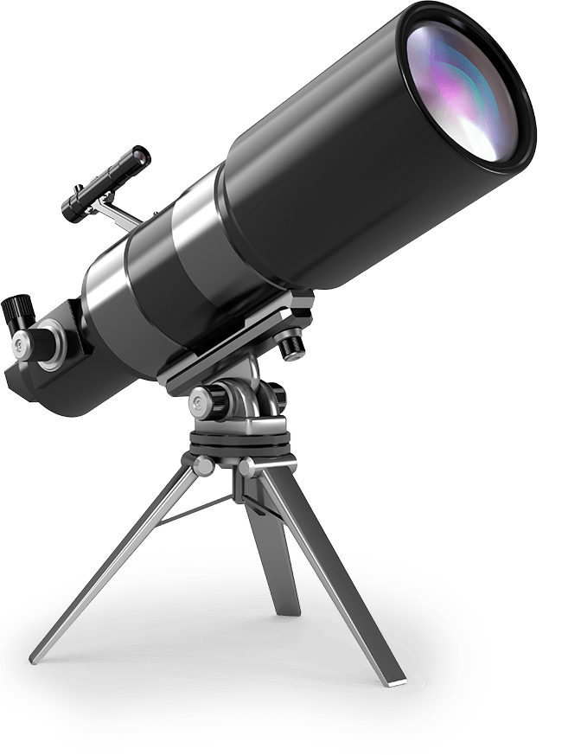
Step 3: Discover telescopes
as light collectors
Telescopes are tools that expand your ability to explore the Universe. They gather more light than just your eyes, enabling higher resolution, and magnify the image you’re observing.

Slide 13
Compare your Eyes to Telescopes
At night, have you noticed that distant cars look like a single light, and as they get closer they “resolve”into two headlights? With someone else in your home, experiment with resolution. Poke two tiny pinholes about one-eighth inch apart in a piece of aluminum foil and wrap the foil over the end of a flashlight—now you're able to project two “stars.”

Slide 14
Compare your Eyes to Telescopes cont.
Have your friend back away while keepingthe flashlight pointed toward you and watch as the “stars” fade away. How far away are they when they merge into one “star”? Measure the distance. Then switch roles and try it again. Is the distance the same?
A telescope with a 6-inch diameter can resolve your “stars” at 875 feet!

Slide 15
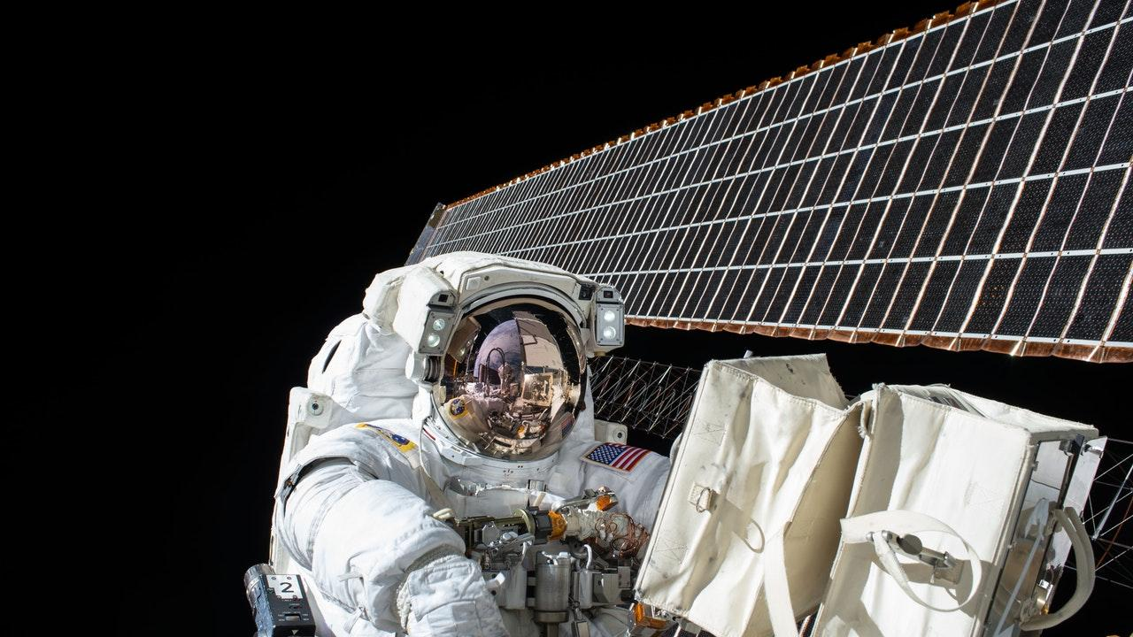
Step 4: Join the Citizen Scientist Movement

Slide 16
Space scientists worldwide collect information—data—as they do their research. With modern technology there is more data than individual scientists can manage alone—they need your help. You can be a part of this people-powered research model. Join Volunteers from all around the world and help scientists comb through data for new discoveries. Dive into modern space science information with your computer and explore the Universe as a citizen scientist. You could map Mars, find the next supernova, discover an odd galaxy, catch the signal of a planet orbiting a distant star, or something completely different! The Universe is yours to explore.
Visit www.girlscouts.org/NASACitizenScientists to get started.

Slide 17
Step 5:
Share Your knowledge
Host a cosmic life cycle performance

Slide 18
Reflect on the lifecycle of stars. Refer to the information in this badge and online resources like NASA’s “The Life Cycles of Stars” article (www.girlscouts.org/LifeCycleofStars), and Jet Propulsion Laboratory’s “Stellar Evolution” infographic (www.girlscouts.org/JPLInfographics) to help get you started.
Then, act out the life cycle of a star in a performance art piece. It could be a dance, mime, or a piece of theater—use your imagination.
.

Slide 19
Need some inspiration?
Each year, a group of highly creative PhD students go
beyond a written dissertation and create “Dance Your Ph.D” videos. Watch a few, and see how they turn complex concepts into friendly and fun video content. Are there any you want to incorporate into your performance?
Check out some of last year’s winners: Here.

Slide 20

You’re Done!

