Slide 1

Science of Style Badge
Senior

Slide 2


When you earn this badge, you’ll learn science behind makeup, perfume, fashion fabrics, and skin care products.

Slide 3

Step 1: Make and test a homemade product
Research a homemade body location. Then, find a store-bought product similar to the one you made. Have your Girl Scout friends and/or family members test out your two products. Be sure you don’t let them know which one is homemade and which is purchased. Record your results. Have them rate the products 1-5 in these categories: texture, smell, skin reaction, and color.
Organic Vanilla Body Cream
2 tbsp. shea butter
2 tbsp. virgin coconut oil
4 tbsp. sweet almond oil
1/2 tsp. essential oil
Blend all of the ingredients together in a small food processor. Spoon into a small, dark jar. Store in the fridge for up to six months.
Yields: approximately 4 oz of cream.

Slide 4

Step 2: Examine the science behind fabrics and accessories
So many of us live a busy life. We go to school, play sports, and volunteer in the community. Different fabrics are used for different clothes. As an alternative to scratchy, heavy wool, scientists came up with synthetic fleece. They, also, developed waterproof outerwear and no-iron shirts. Some are even engineered in a lab! Explore the emerging aspects of the science of fashion.
Find out what waterproof fabric and breathability rating is. What are the properties in waterproof and thermal fabrics? How are fibers designed to draw moisture to the surface of garments? Think about what you would wear for these scenarios: maybe a mountain climb through several climate zones, a winter kayak adventure, and a desert hike.

Slide 5

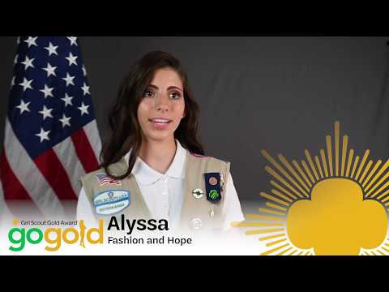
Step 2: More to Explore
Check out how this Gold Award Girl used fashion for her award!

Slide 6


Step 3 Create a Scent
Remove the stem from a flower you like, and combine with odorless oil. Let it sit for a few weeks. Then pour the oil into a small spray bottle. Test the fragrance on your friends. Ask your family and friends to compare your product with commercial colognes and perfumes. How do the ingredients in your scent compare with ingredients from a store-bought fragrance? Based on your results, design a print advertisement or commercial to sell your fragrance.

Slide 7

Step 4: Investigate the sociology of style
In what ways do fashion and beauty mirror our society or reflect social order? Throughout history, fashion and beauty have played significant roles in politics, psychology, and culture.
Find out more. Using the internet put together a swimsuit fashion timeline that shows how the social developments of the 20th century were reflected in the beach styles of the day. Use what you uncover to develop and sketch your vision for 21st century fashion trends in beachwear.
Click Here to check out swimsuits through 100 years!

Slide 8

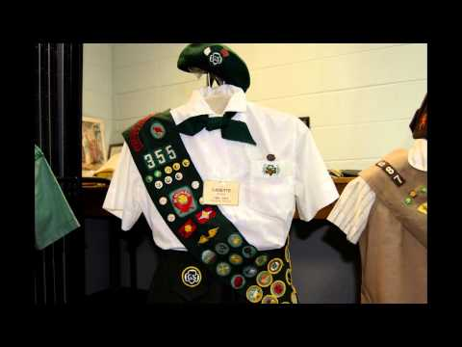
Girl Scouts Uniforms Through the Years
Which uniform did you like the best?

Slide 9

Step 5: Formulate Future Style
Designers and engineers are already coming up with innovative fashion technology products, including smart watches and 3D-printed clothing. Come up with one idea of a fashion product you would develop. Would it be just for looks? Would it meet a need in the sports or healthcare industries? It’s up to you. Draw your design and write up the idea in detail. Share your idea with a Girl Scout Friend.

Slide 10

Congratulations you earned your science of style badge
www.GetYourGirlPower.org

