Slide 1
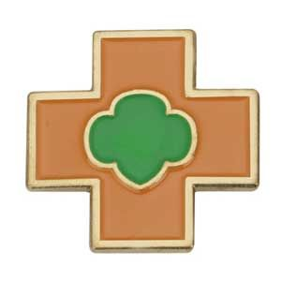
Senior Safety award
Girl Scouts at Home 2020

Slide 2
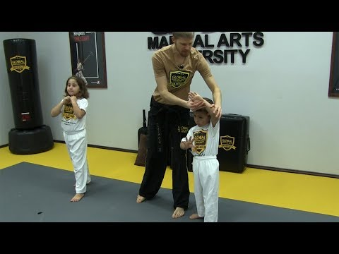
Step 1: learn self defense. Check out this online video about self defense

Slide 3
Step 2. Teach younger kids about safety.
Do you have a younger sibling at home with you? Teach them how to be safe by locking doors, knowing the escape route in case of fire, and stranger danger.

Slide 4
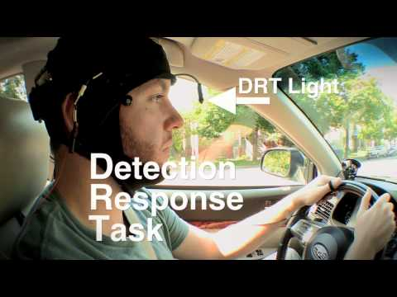
Step 3: distracted driving. Click on the video is see how distractions can hinder our driving skills no matter how good of a driver we think we are.. Parents take notes!

Slide 5

Step 4. Help resolve disagreements. Click on the video to see how to disagree in a peaceful way. This video is funny but true!

Slide 6

Step 5. Drugs and alcohol. Learn about the impact that drugs and alcohol have on our bodies.

Slide 7
Phew! That was a lot of information about how to be safe! Now that you know what to do, don’t forget to get your pin!

Slide 8


