Slide 1

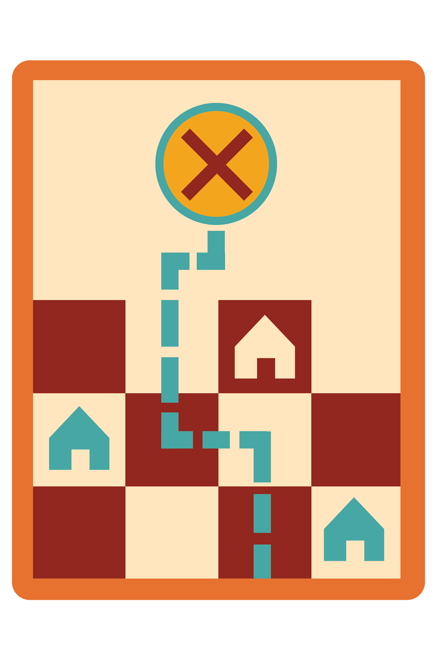
Leader Instructions & Meeting Prep:
Senior Game Visionary Badge
The following slides will walk your troop through a virtual meeting to earn the Senior Game Visionary Badge. When you share your screen during your meeting, be sure to click “Present” so girls see the full screen. Also, when you are sharing your screen in zoom, google meet, or another meeting app, please make sure you are sharing both picture and audio. For more information on using Zoom, visit gsnw.gl/VirtualMeetingHowTo
Many of the interactive activities included are shared through YouTube videos. Just click on the arrow in the center of the image to play the video, and the girls can see it too! You should try to review the slides before your meeting if possible, so you are familiar with the activities and any supplies needed.
This meeting will typically take approximately 60-90 minutes as written, depending on participation level and number of girls. As always, Girl Scouting is flexible, and troops may select the activities interest them most, add their own activities, or have girls do some of the steps afterward as “homework”.
When you send out your meeting invitation, be sure to let girls and parents know what supplies they should have on hand for the online troop meeting. They are things most girls likely have at home.
Senior Game Visionary Badge: :meeting plan supply list::
11 plastic cups ​
Small pieces of food such as goldfish or cereal pieces​
Wax paper, aluminum foil, or large plate
Paper
Something to write with

Slide 2

Game. .Visionary.
Seniors
Brought to you by Girl Scouts of the Northwestern Great Lakes

Slide 3

Girl Scout Promise
On my honor, I will try, To serve God and my Country. To help people at all times, And to live by the Girl Scout Law.

Slide 4

Let’s say the Pledge of Allegiance

Slide 5




Program Pillar: Life Skills
STEM
Outdoors
Entrepreneurship
Life Skills
Girls become better problem-solvers, critical thinkers, get better grades, and see STEM as the foundation for a meaningful and successful future.
Girls discover that they can better problems and overcome challenges, build social bonds, and become team players that care about protecting our environment.
Girls gain new skills, ​
build their confidence ​
and develop an entrepreneurial mindset over time.
Girls gain the skills and the inspiration to accept challenges, overcome obstacles, and take the lead.

Slide 6





Sense of Self Girls have confidence in themselves and their abilities and form positive identities.​
Positive Values Girls act ethically, honestly, and responsibly, and show concern for others.​
5 Outcomes
Challenge Seeking Girls take appropriate risks, try things even if they might fail, and learn from mistakes.​
Healthy Relationships Girls develop and maintain healthy relationships by communicating their feelings directly and resolving conflicts constructively.
Community Problem Solving Girls desire to contribute to the world in purposeful and meaningful ways, learn how to identify problems in the community, and create action plans to solve them.

Slide 7
Game Visionary Badge.
.
This badge is your chance to build friendships and community networks by leading a series of fun, inventive, innovative, and challenging games!​ Making games is about pushing boundaries to surprise yourself and others with your creativity and endless possibilities!​ When you earn this badge, you’ll know how to design and organize games that will bring people together for creative and thoughtful fun! ​
Steps: ​
Break the Ice ​
Imagine all the world’s a board games​
Create a physical challenge​
Get puzzled ​
Make an ultra scavenger hunt ​

Slide 8
.Step 1:.
Break the Ice

Slide 9
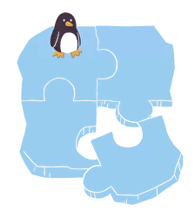
Ice breakers are great way to get to know each other. ​There are many different options for breaking the ice.
Some of them are: ​
.Would You Rather.
.Two Truths and a Lie.
.Personal Trivia.

Slide 10
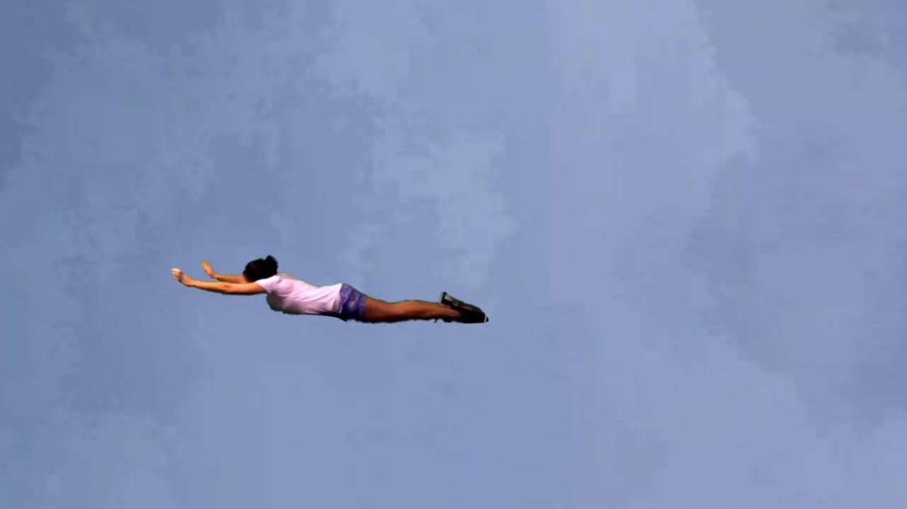

Would you Rather....
Want to fly or be invisible?

Slide 11


Would you Rather....
Be famous or live forever?

Slide 12

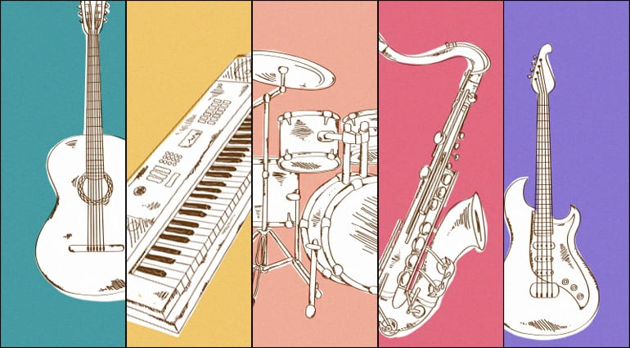
Would you Rather....
Speak every language or play every instrument?

Slide 13

Personal Trivia:.
.What’s your.favorite?.
Food
Color
Thing
Place
Drink
Create your own list! ​
Questions should be thought provoking, challenging and fun ​
Ice Breaker Questions

Slide 14
.Step 2:.
Imagine all the worlds of a board game

Slide 15
Here are some fun. .game ideas to play. .with your friends via. .Zoom:.
Cup Tower
Let’s Go Fishing
Peck Like a Bird
We will watch a video on all three and decide which one we want to play.
With social distancing, Zoom is the new stage!

Slide 16
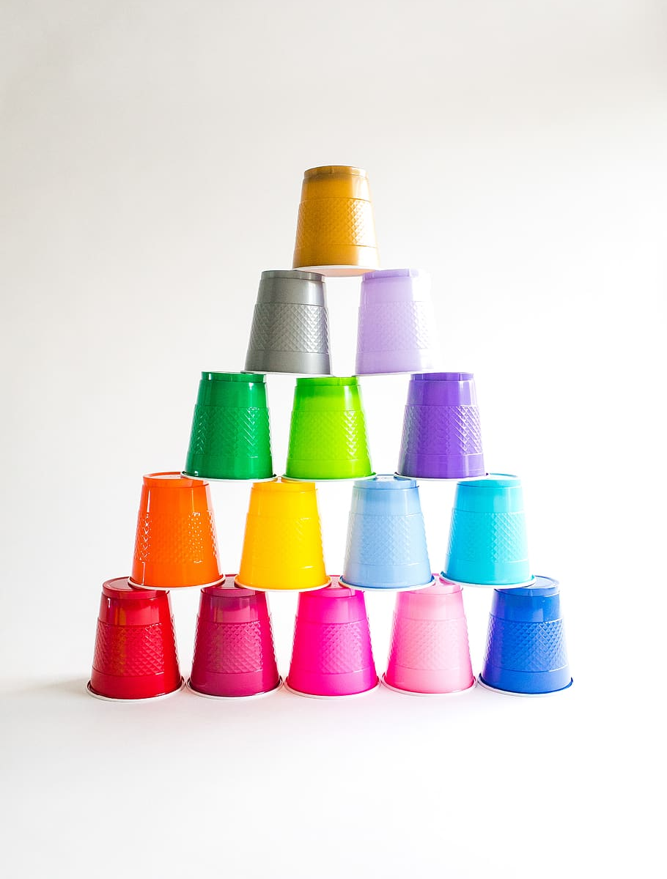
Cup Tower.
What you need: 10 plastic cups ​
How to play:
You’ll need to build a pyramid tower with the cups as fast as you can, stand up, spin around, and take the pyramid tower down cup by cup. ​
The first person to finish yells out done and wins! ​
You can do this in teams of two, or everyone individually

Slide 17


Slide 18

Let’s Go Fishing.
What you need:
1 plastic cup​
Small pieces of food, such as goldfish or cereal (food should be small, easy to chew, and not messy or slimy)

Slide 20

Peck Like a Bird.
What you need:
10 pieces of food such as goldfish or cereal
How to set up:
Place your food on a clean table in a straight line (you can lay down some wax paper, aluminum foil, or large plate down if you do not want to eat straight from the surface)

Slide 22
Poll.
Which game did you like the most?
Cup Tower
Let’s Go Fishing
Peck Like a Bird

Slide 23
.Let’s Play.

Slide 24
.Step 3:.
Create a Physical Challenge

Slide 25
This can be done virtually too!.
All you have to do is follow along to the video that follows!
Let’s get up and get moving!
Remember the game Red Light, Green Light?

Slide 26

Notes:
Take at least 10-15 minutes as a troop to talk about and plan your take action step! If you are unsure of what would help you be a voice for animals in your community, talk to your local animal shelter or even zoo!

Slide 27
.Let’s Play.

Slide 28
.Step 4:.
Get Puzzled

Slide 29

Get Puzzled.
Just like you have to exercise your body, you also have to exercise your mind!
For today’s Get Puzzled challenge, we are going to learn the...

Slide 30
Morse Code.
Morse Code is comprised of dots and dashes
Dots are called “dit” but they are pronounced “di” with a short “I” sound
Dashes are called “dahs” but they are pronounced “da” with a short “a” sound
Dahs = 3 dits _ = …

Slide 31
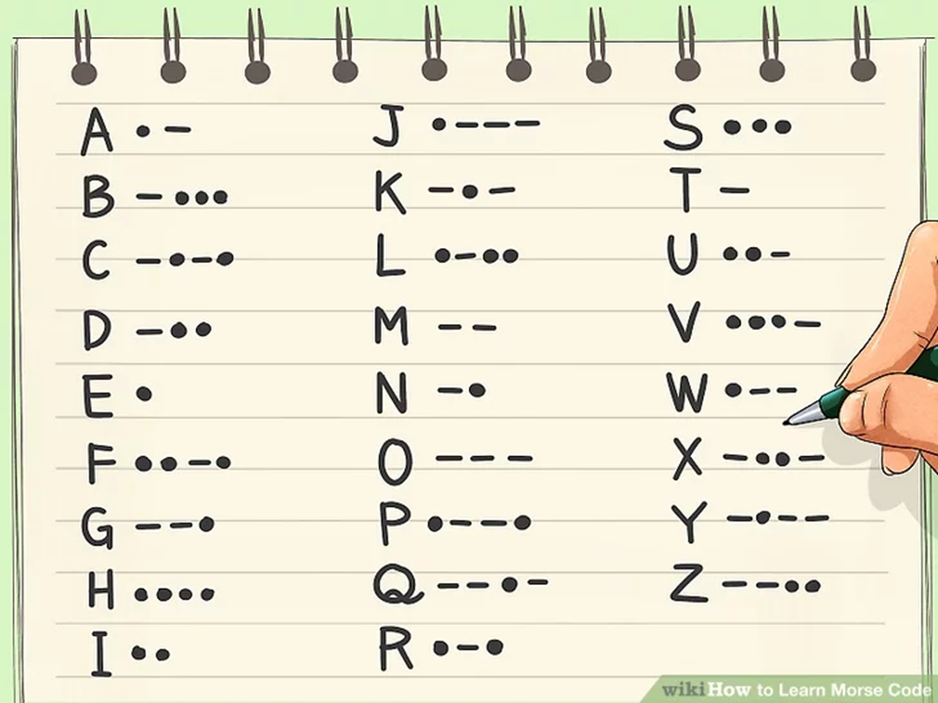

Slide 32

Morse Code Song
Pay attention to the beeping rhythm

Slide 33

Learn how to save yourself.
in Morse Code.
One of the most common universal signs for help is SOS
Using Morse Code to signal to others that you are in danger and need help without talking.
It can save your life!
Let’s practice. S = … O = - - - S = …
Say it out loud: …---… dididi dah dah dah dididi

Slide 34

Let’s create our own codes!.
Use the alphabet code to create your own!
Use words to describe anything you can find around your house. (Some examples can be: red, round, soft, and etc.)

Slide 35

.Let’s take.
.2 minutes.
.to create.
.our codes.

Slide 36
.Step 5:.
Make an Ultra Scavenger Hunt

Slide 37
Come up with short or day long challenges for your friends and family to enjoy!
In the previous activity, you learned Morse Code.
To make a scavenger hunt challenging, you can give your friends and family clues in Morse Code. They will have to decode the clue first and then find it.
For now, let’s find these clues first.

Slide 38


Clue 1:.

Slide 39
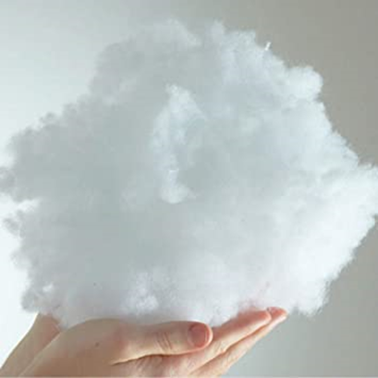
Clue 2:.

Slide 40

Clue 2:.

Slide 41
Great job,.
GIRL SCOUTS!
You have earned the
Game Visionary Badge
Now that you’ve earned this badge, you’ll know how to:
Organize fun games the next time you meet your friends or family either virtually or in person.
Make a grand scale challenge to bring to your next Girl Scout meeting.

