Slide 1


Leader Instructions & Meeting Prep:
Junior Staying Fit Badge
Junior Staying Fit Badge: :meeting plan supply list::
For Frozen banana pops
Knife Plate
Banana Popsicle stick
Peanut butter
Small/Crunched up cereal (such as rice crispy, cheerios, corn flakes, granola, etc)
For Stress balls:
Non-inflated latex balloon, medium to large
Funnel (or cut top 1/3 off of a disposable water bottle to make a funnel
Corn starch Water
Knife Spoon (plastic knife works well)
The following slides will walk your troop through a virtual meeting to earn the Junior Staying Fit Badge. When you share your screen during your meeting, be sure to click “Present” so girls see the full screen. Also, when you are sharing your screen in zoom, google meet, or another meeting app, please make sure you are sharing both picture and audio. For more information on using Zoom, visit gsnw.gl/VirtualMeetingHowTo
Many of the interactive activities included are shared through YouTube videos. Just click on the arrow in the center of the image to play the video, and the girls can see it too! You should try to review the slides before your meeting if possible, so you are familiar with the activities and any supplies needed.
This meeting will typically take approximately 60-90 minutes as written, depending on participation level and number of girls. As always, Girl Scouting is flexible, and troops may select the activities interest them most, add their own activities, or have girls do some of the steps afterward as “homework”.
When you send out your meeting invitation, be sure to let girls and parents know what supplies they should have on hand for the online troop meeting. They are things most girls likely have at home.

Slide 2

Junior Staying Fit Badge
Brought to you by Girl Scouts of the Northwestern Great Lakes

Slide 3

Girl Scout Promise
On my honor, I will try:
To serve God and my country,
To help people at all times,
And to live by the
Girl Scout Law.

Slide 4

Let’s say the Pledge of Allegiance

Slide 5
Figure out what fitness, food, and fun you need to stay strong for life.
Start moving
Keep your fit body fueled
Know how to stress less
Get the truth about health
Help your family stay fit- homework
When you've earned this badge, you’ll know what you need to get strong and stay that way.
Staying Fit Badge Details

Slide 6
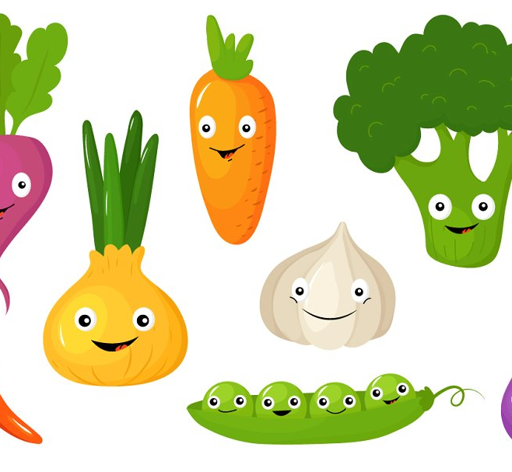
Ice Breaker:.
Share your name and
your favorite vegetable.

Slide 7
Step 1:
Get moving!

Slide 8
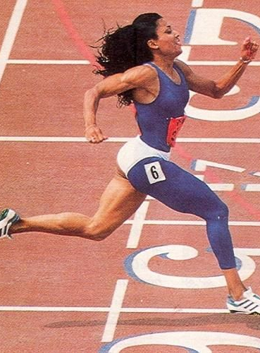
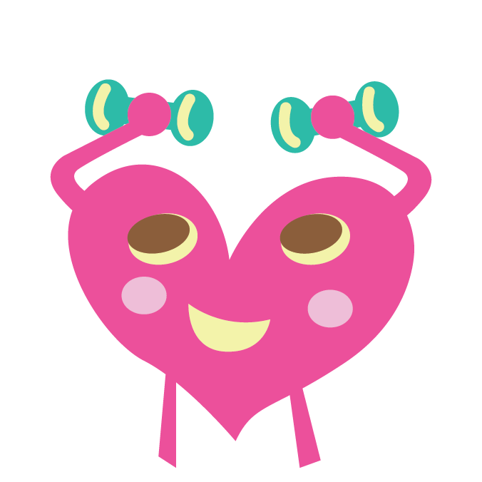
Let’s exercise together!

Slide 9
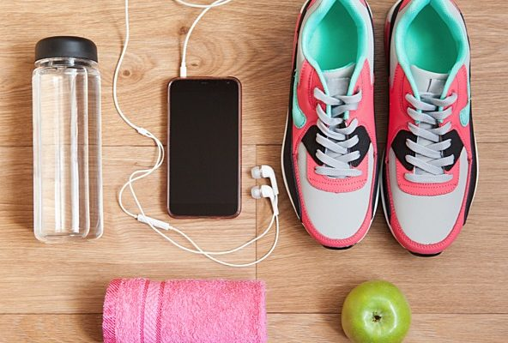
Why do we need to stay fit?
You need a fit body to do all your favorite things, from roller skating to writing in your diary to sharing advice with friends. Being fit means taking care of both your body and your mind- let’s find out how today!

Slide 10
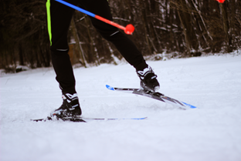

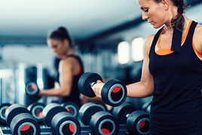
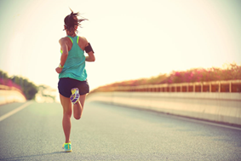
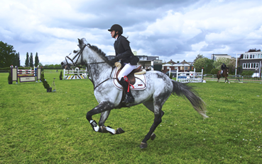
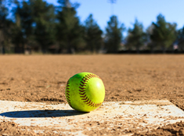
What activities do you like to do?

Slide 11
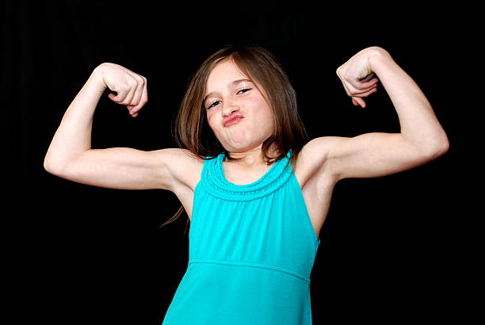
Let’s get moving!
Flex your muscles!
Why do you think muscles are important?
Type your answers in the chat!

Slide 12
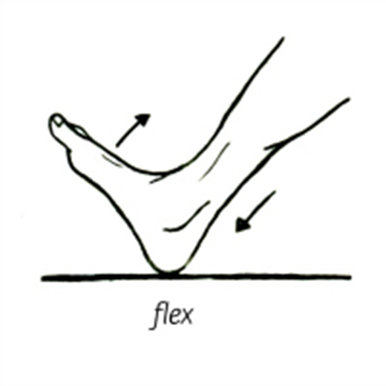
Let’s start moving!
Flex your foot
Move it up and down
How do you think muscles help your bones move?
Type your answers in the chat!

Slide 13
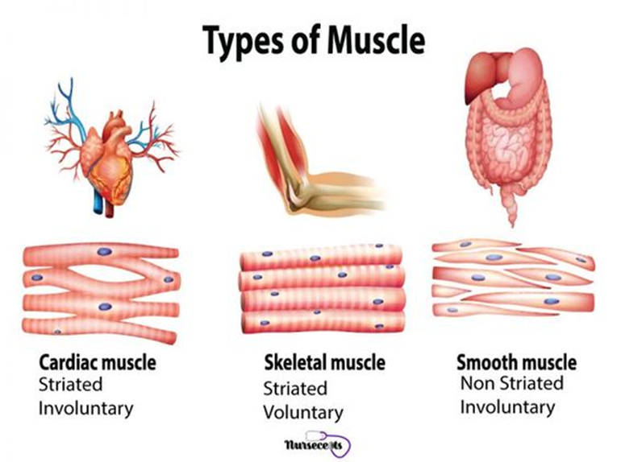
Types of muscles

Slide 14
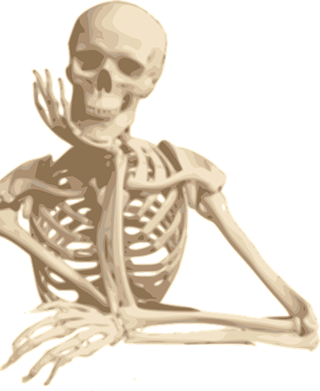
Poll Question:
#1
How many muscles do you think are in your body?
200
400
600

Slide 15
The answer is:
C. 600!

Slide 16

Poll Question:
#2
Who thinks you can control your muscles?
Who thinks your muscles can control themselves?

Slide 17
The answer is:
You’re all right!
Some muscles you can control and some you can’t.

Slide 18
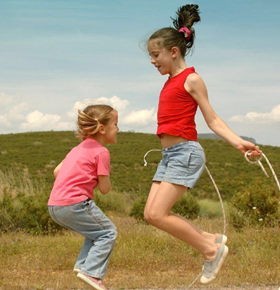
Poll Question:
#3
How many skeletal muscles do you have in your body?
150
215
375

Slide 19
The answer is:
B. 215!

Slide 20

Poll Question:
#4
Now give me a thumbs up and tell me…
How many muscles do you think you have in your thumb?
5
9
13

Slide 21
The answer is:
B. 9!

Slide 22
Now, lie down on the floor and be very still. Can you feel your heart beating? Raise your hand if you think your heart is a muscle?

Slide 23
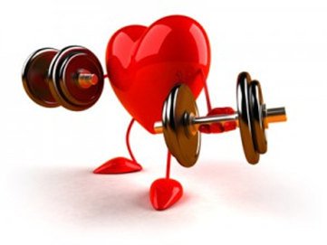
Your heart IS a muscle!
It is a muscle you can’t control. It is called a cardiac muscle.

Slide 24
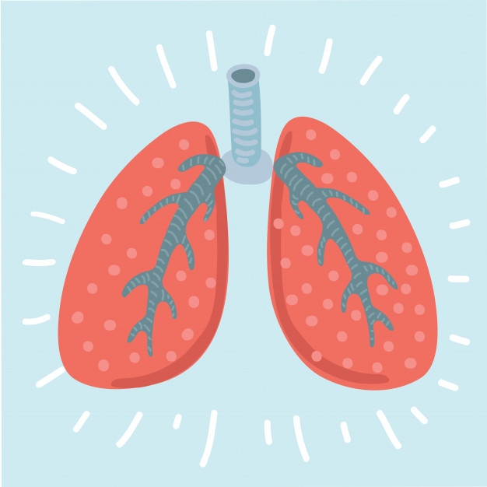
Now, lie still again.
Can you see your chest rise as you breathe in and out? The muscles that line your lungs, stomach, and intestines are called smooth muscles.

Slide 25
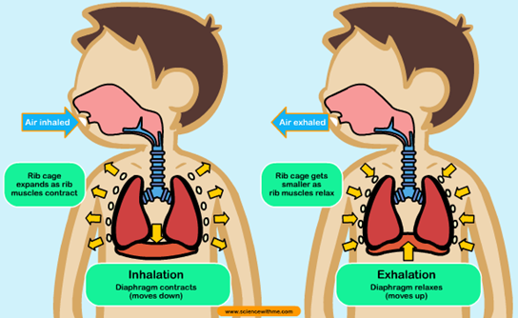
Your Respiratory System at work

Slide 26
What activities do you think will improve your heart health?
Running
Swimming
Biking
All of the above

Slide 27
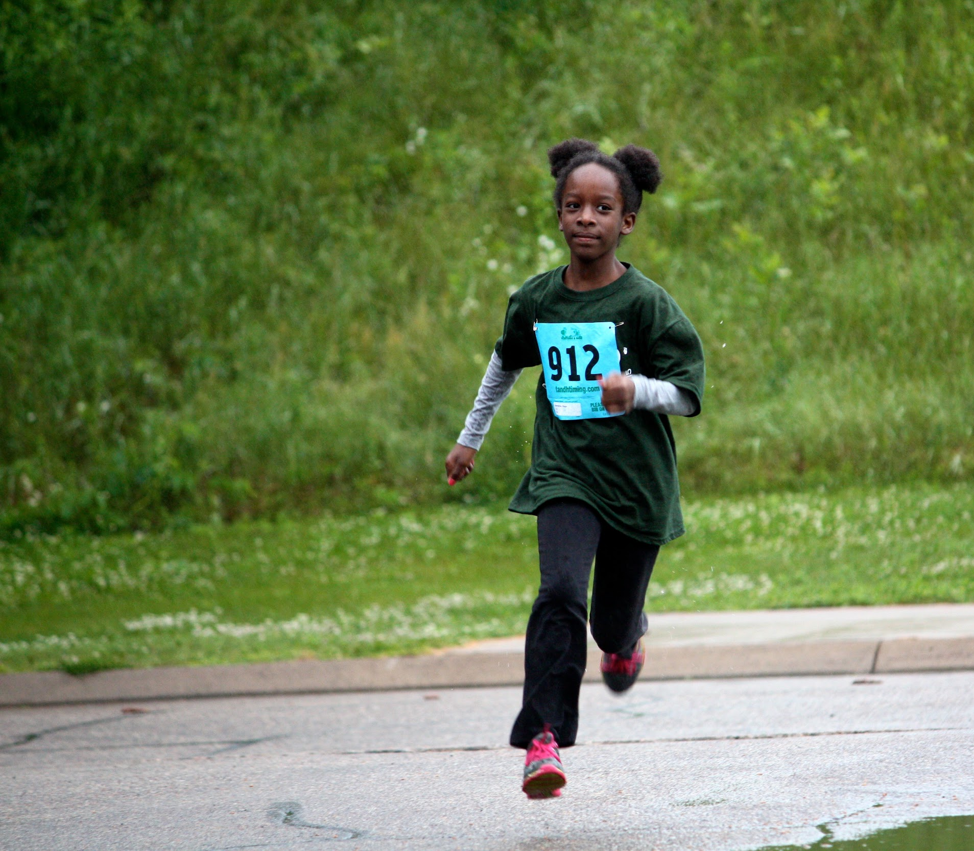
The answer is:
D. All of the above!
Best practice is an hour a day.

Slide 28
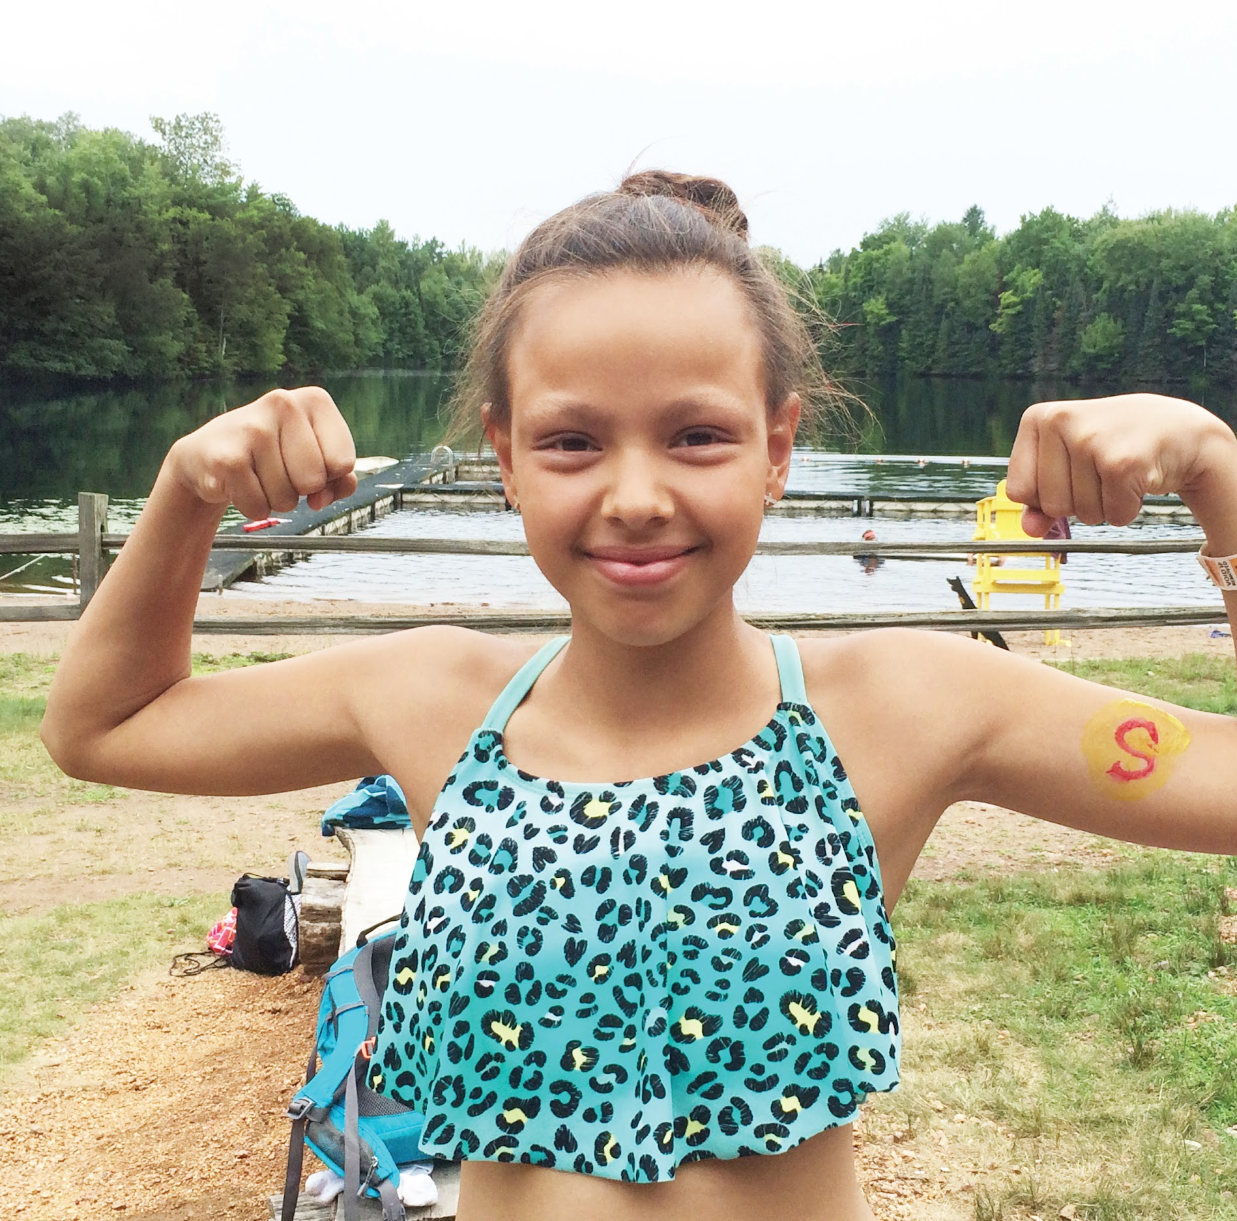
.Let’s work. .those arms!.
If you have weights go grab them. If not grab a can of soup or vegetables. We’re going to work the same 2 muscles 3 different ways.

Slide 29
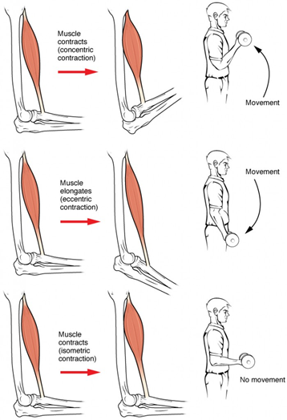
Concentric Contraction:
A concentric contraction is a type of muscle contraction in which the muscles shorten while generating force, overcoming resistance. For example, when lifting a heavy weight or the can of soup, a concentric contraction of the biceps would cause the arm to bend at the elbow, lifting the weight towards the shoulder.
Which Muscle are we really working when we lift the can of soup? The Bicep.

Slide 30
Eccentric Contraction:
An eccentric contraction is a type of muscle elongation. The simplest example of an eccentric contraction is lowering a weight or the can of soup in a biceps curl. Obviously, the biceps muscle contracts to lift the barbell up. But it's also contracting as you lower the weight — if it weren't, you would drop it pretty fast!

Slide 31
Isometric Contraction:
An isometric contraction is a type of muscle contraction. An example of an isometric contraction would be carrying an object in front of you. The weight of the object would be pulling downward, but your hands and arms would be opposing the motion with equal force going upwards. Since your arms are neither raising or lowering, your biceps will be isometrically contracting.

Slide 32
Warming up is important!
Warming up your muscles can help them relax which, in turn, can lead to less injury.
Increased blood flow and oxygen. Having more blood flow helps your muscles get the nourishment they need before launching into more intense work.
Think of your muscles as this balloon. If you try to blow it up without stretching it, it is difficult but if you stretch it first, blowing it up is easier.

Slide 33
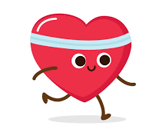
.Time to work. .that heart. .muscle!.
Get ready for the Girl Scout Law scavenger hunt, cardio style.

Slide 34
I will do my best to be
honest and fair,
friendly and helpful,
considerate and caring,
courageous and strong, and
responsible for what I say and do,
and to
respect myself and others,
respect authority,
use resources wisely,
make the world a better place, and
be a sister to every Girl Scout.
Cardio
Girl Scout Law scavenger hunt

Slide 35

I will do my best to be:
Honest & fair
You have 30 seconds to find:
A rule sheet from a game

Slide 36
I will do my best to be:
Friendly & helpful
You have 30 seconds to find:
Something from a friend
Examples are: a gift, a picture, or a friendship bracelet

Slide 37
I will do my best to be:
Considerate & caring
You have 30 seconds to find:
Something with a heart on it

Slide 38
I will do my best to be:
Courageous & strong
You have 30 seconds to find:
A piece of exercise equipment

Slide 39
I will do my best to be:
Responsible for what I say & do
You have 30 seconds to find:
A medal, trophy, or certificate

Slide 40
I will do my best to:
Respect myself & others
You have 30 seconds to find:
A hygiene item

Slide 41
I will do my best to:
Respect authority
You have 30 seconds to find:
Family rules, chore chart, or a picture of a parent/guardian

Slide 42
I will do my best to:
Use resources wisely
You have 30 seconds to find:
Something you repurposed or recycle

Slide 43
I will do my best to:
Make the world a better place
You have 30 seconds to find:
A world or map

Slide 44
I will do my best to:
Be a sister to every Girl Scout
You have 30 seconds to find:
Something you made in Girl Scouts

Slide 45
Step 2:
Keep your body fueled

Slide 46
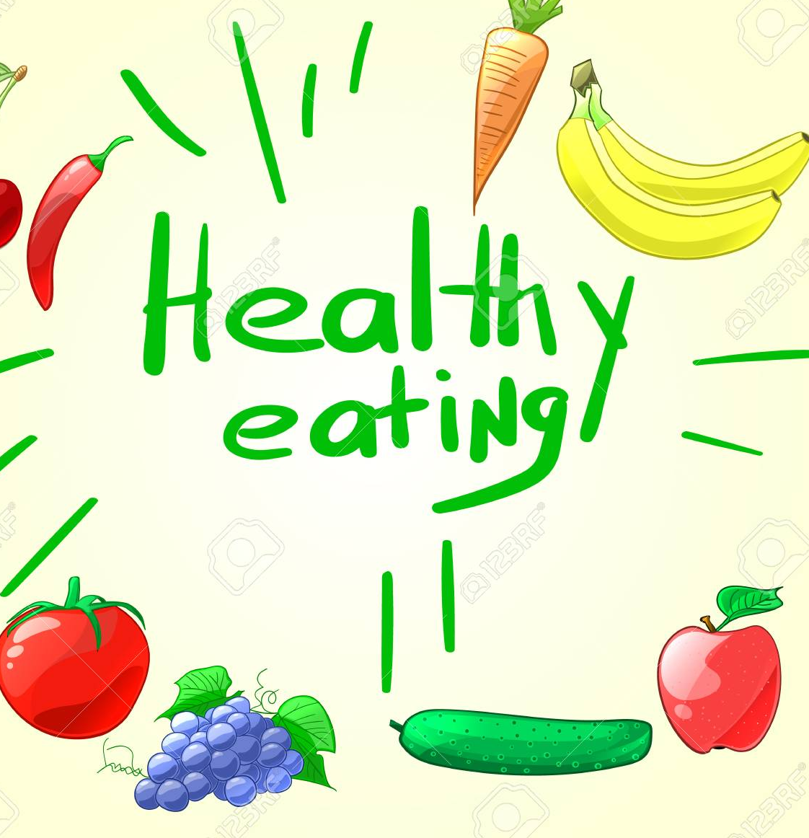
Ok, so we know a little about how our body works, let's look at how we fuel that body of yours.
Proper nutrition is so important to keep your body fit and fueled!

Slide 47
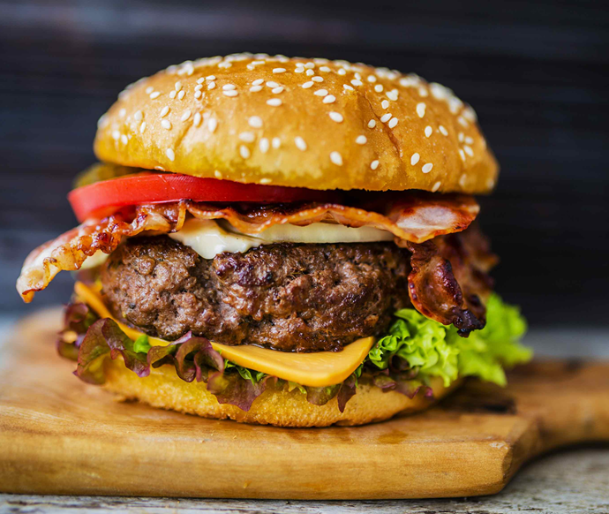
How many servings should you have from the meat, poultry, egg, fish, nut group each day?
1–2
2–3
3–4
5–6

Slide 48
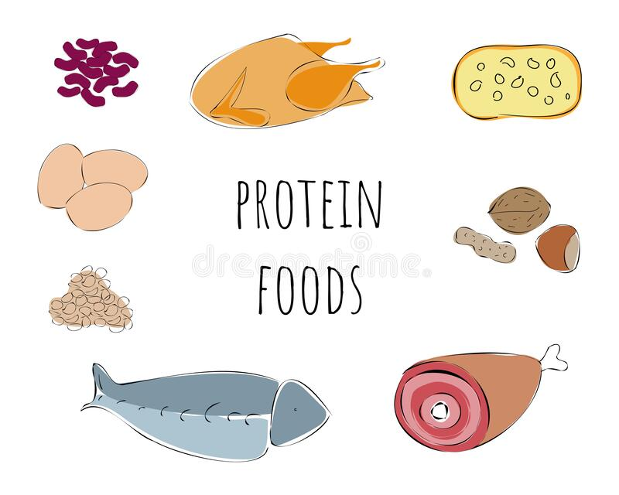
The answer is:
B. 2-3

Slide 49
Digestion of your food begins in your mouth when you chew your food and expose it to saliva. It then travels through the rest of your digestive tract. Fiber is needed to keep your digestive tract healthy. Which of these foods will provide the most fiber per serving?
Fresh fruits and vegetables
Cheese
Chicken
Orange juice

Slide 50
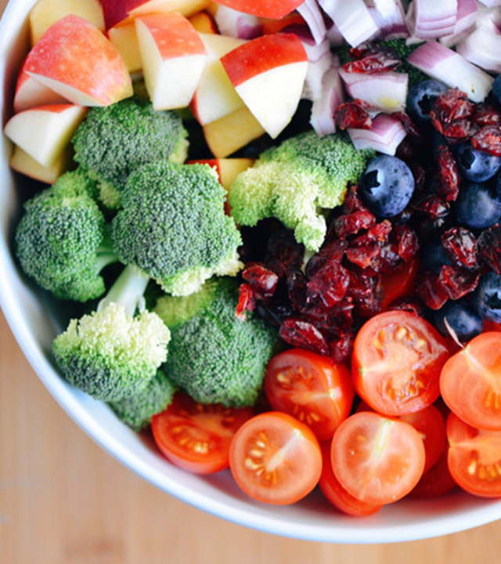
The answer is:
Fruits & vegetables
Note: When fruits and vegetables are made into juice (not smoothies, where the whole fruit is used), you lose the fiber.

Slide 51
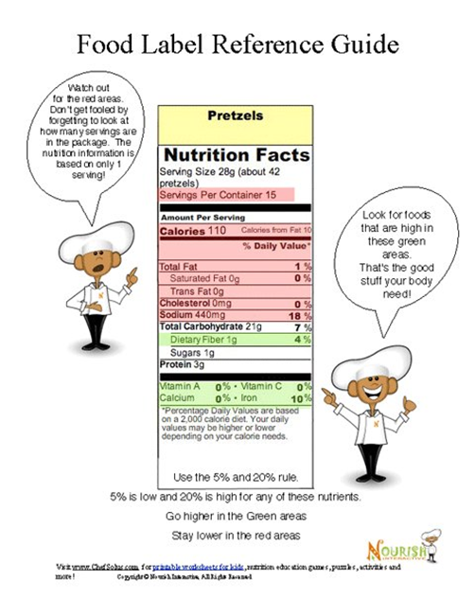
Be a label reader
Notes:
Next time you go to grab your favorite box of cereal out of the pantry, stop and look at the label. The nutrition facts label on your favorite breakfast cereal tells you it's full of vitamins and minerals. So it must be healthy, right?
Just because a food is high in vitamins doesn't mean it's healthy overall. Sure, it's great that your favorite cereal gives you a shot of vitamins and minerals. But what if it's also loaded with sugar?
Eating healthy means choosing lots of different types of food throughout the day to get all the nutrients you need, such as vitamins, minerals, carbohydrates, fiber, and — yes — even fat.
So how do you figure all this out? Thank goodness for food labels!
Food labels are a legal requirement and they are important for many reasons. They help consumers make informed choices about the food they buy, help them to store and use it safely and allows people to plan when they will consume it – all of which help to reduce food wastage

Slide 52
Next time you go to grab your favorite box of cereal out of the pantry, stop and look at the label. The nutrition facts label on your favorite breakfast cereal tells you it's full of vitamins and minerals. So it must be healthy, right?
Just because a food is high in vitamins doesn't mean it's healthy overall. But what if it's also loaded with sugar?
Food labels: Your cheat sheet to good eats.
Notes:
Food labels provide more than just nutrition facts, though. They also tell you what's in a packaged food (i.e., the ingredients). Some food labels also state which country the food came from, whether the food is organic, and certain health claims.

Slide 53
Eating healthy means choosing lots of different types of food throughout the day to get all the nutrients you need, such as vitamins, minerals, carbohydrates, fiber, and — yes — even fat.
So how do you figure all this out? Thank goodness for food labels!

Slide 54
Labels can help you plan your eating habits.
Labels give you information that can help you decide what to choose as part of an overall healthy eating plan.
For example, it may be OK to eat a sugary cereal if you make up for it by not eating much sugary stuff for the rest of the day.
Checking the labels on foods can alert you when a food is high in something like sugar so you can be prepared to make tradeoffs.

Slide 55
.Become a.label.detective!.
Here’s a quick label ready quiz for you. The Magic number is 8.
Use your math skills to figure out which of these snacks and drinks you can eat in a day.
For each label, add up the sugar grams, divide by four and repeat until you come up with something less than eight.
I've included strawberries and bananas to illustrate the difference between natural sugar from fruit and globs of added refined sugar in junk food.
Take just a few minutes to give it a go as we need to go onto our next area of focus.

Slide 56
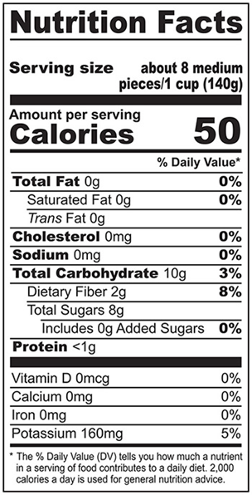
Label 1:
For each label, add up the sugar grams, divide by four.

Slide 57
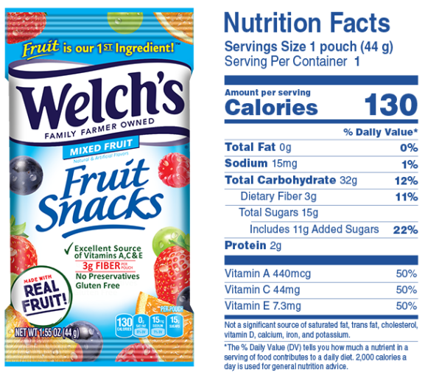
Label 2:
For each label, add up the sugar grams, divide by four.

Slide 58
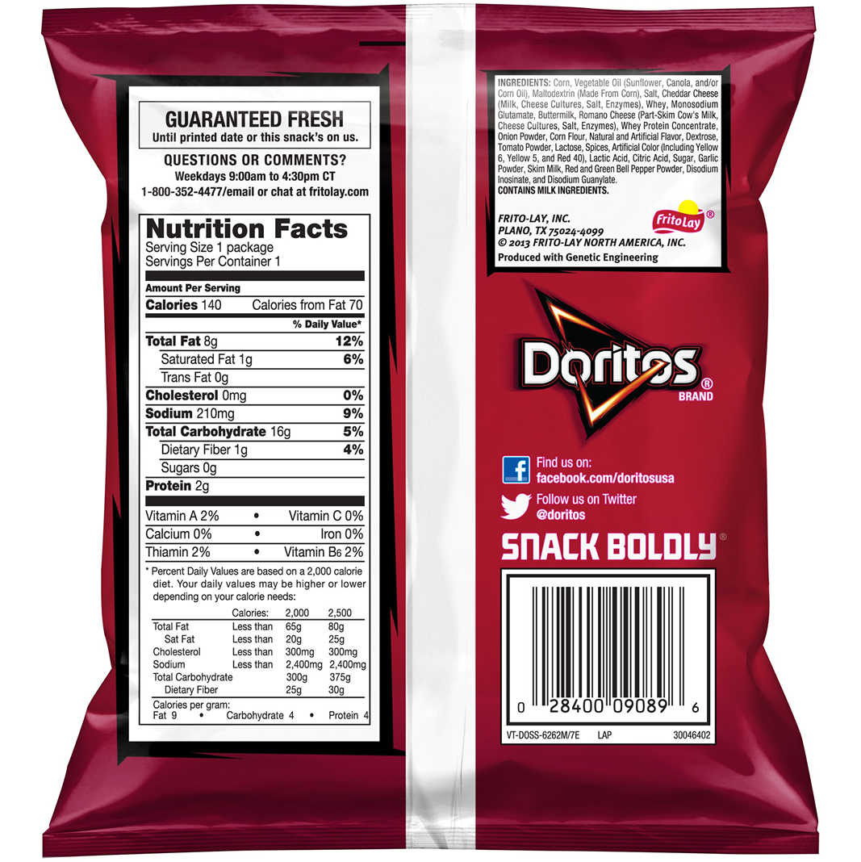
Label 3:
For each label, add up the sugar grams, divide by four.

Slide 59
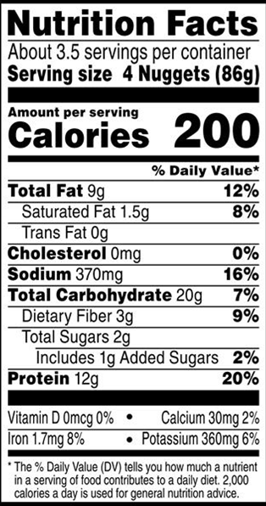
Label 4:
For each label, add up the sugar grams, divide by four.

Slide 60
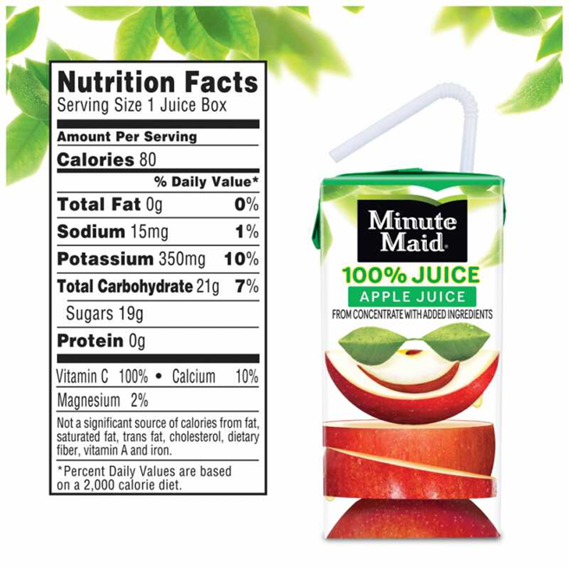
Label 5:
For each label, add up the sugar grams, divide by four.

Slide 61
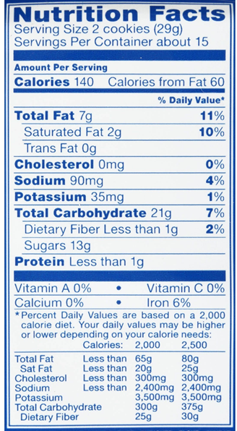
Label 6:
For each label, add up the sugar grams, divide by four.

Slide 62
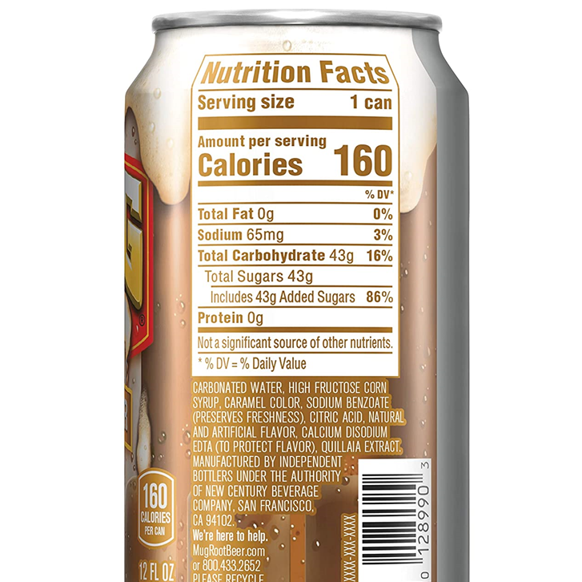
Label 7:
For each label, add up the sugar grams, divide by four.

Slide 63
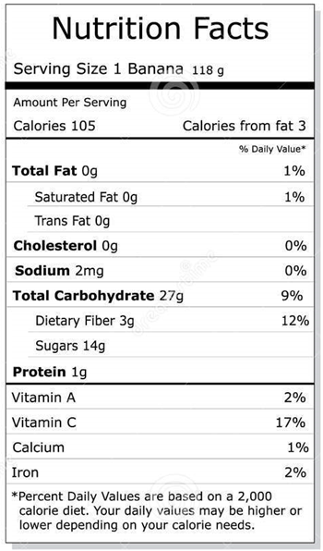
Label 8:
For each label, add up the sugar grams, divide by four.

Slide 64

Let’s make a healthy treat!
Frozen Banana Pops

Slide 65


Slide 66
What you need:
Bananas
Popsicle sticks
Knife
Plate
Peanut butter
Crunched up cereal

Slide 67
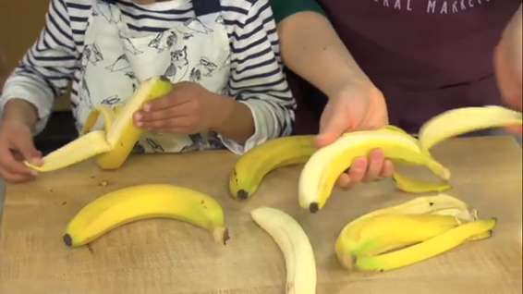
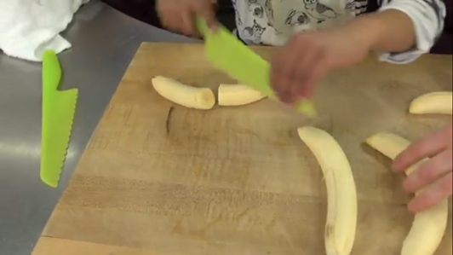
Let’s make our own frozen banana pops!
.Step 1:.
Peel the bananas and cut them in half

Slide 68
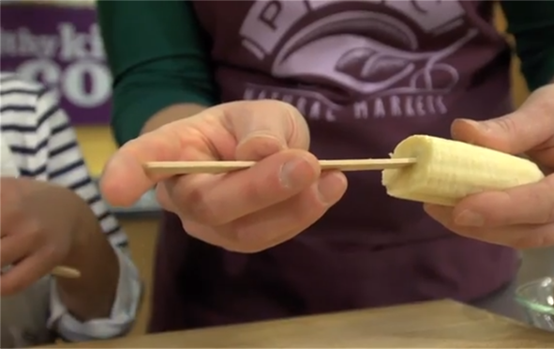
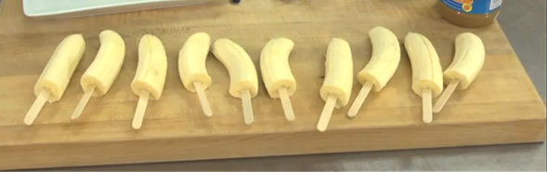
Let’s make our own frozen banana pops!
.Step 2:.
Stick popsicle sticks into each banana half

Slide 69
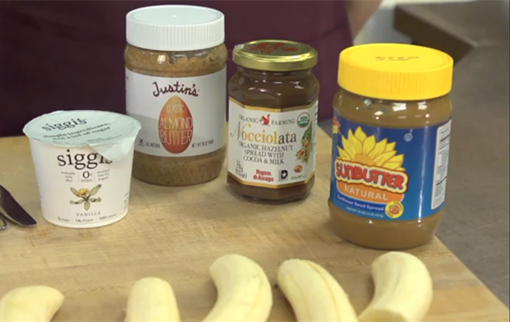
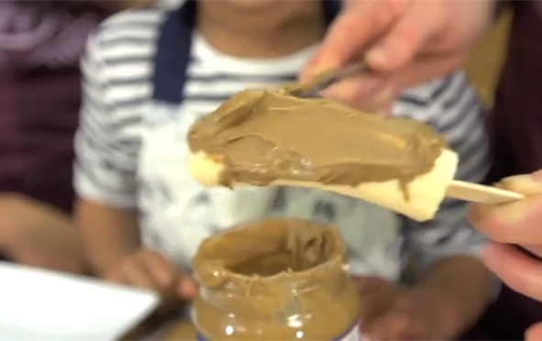
Let’s make our own frozen banana pops!
.Step 3:.
Spread the peanut butter over the banana halves

Slide 70
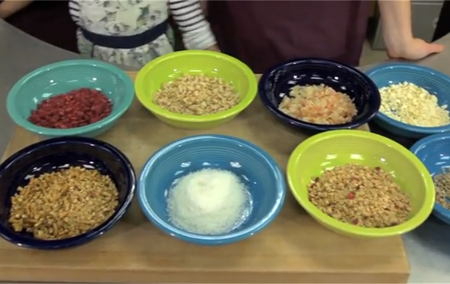
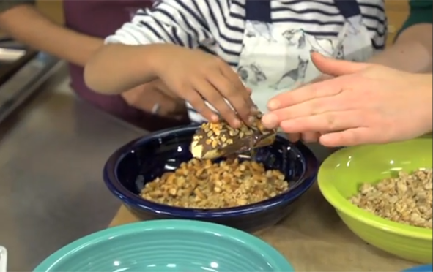
Let’s make our own frozen banana pops!
.Step 4:.
Add your toppings

Slide 71
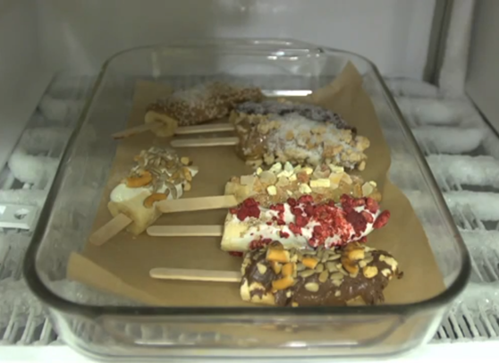
Let’s make our own frozen banana pops!
.Step 5:.
Put your banana pops on a plate and in the freezer for at least 3 hours

Slide 72
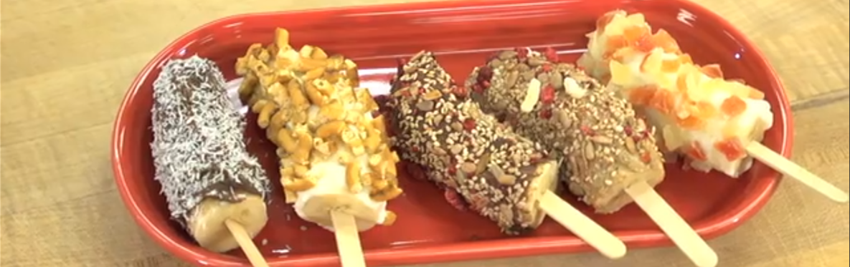
.Step 6: ENJOY!.

Slide 73
Step 3:
Let’s learn how to stress less

Slide 74
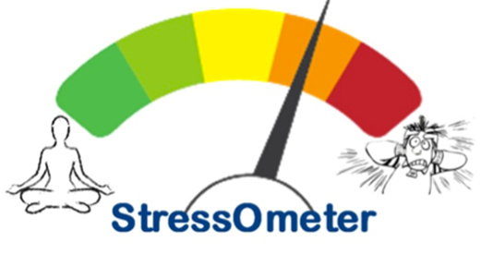
Stress is defined as the body's reaction to any change that requires an adjustment or response.
The body reacts to these changes with physical, mental, and emotional responses. Stress is a normal part of life. You can experience stress from your environment, your body, and your thoughts
Doesn’t sound like much based on the definition but if you have experienced stress…you know it’s not that fun!
What is stress?

Slide 75

What stresses you out? Add to the chat log.
Being under lots of pressure.
Facing big changes.
Worrying about something.
Not having much or any control over the outcome of a situation.
Having responsibilities that you're finding overwhelming.
Not having enough work, activities or change in your life.
Times of uncertainty.
What are your stressors?

Slide 76

What does stress feel like?
Emotional symptoms of stress include: Becoming easily agitated, frustrated, and moody. Feeling overwhelmed, like you are losing control or need to take control. Having difficulty relaxing and quieting your mind.

Slide 77
How do you manage stress?
Keep a positive attitude.
Accept that there are events that you cannot control.
Be assertive instead of aggressive.
Learn and practice relaxation techniques; try meditation, yoga, or tai-chi for stress management.
Exercise regularly.
Eat healthy, well-balanced meals.

Slide 78
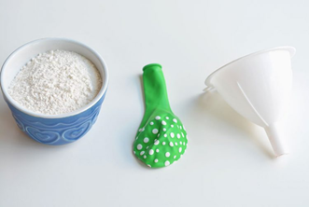
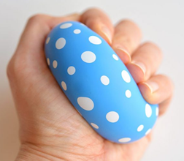
Let’s make a stress ball to help you manage stress.
What you need:
12 inch balloon
1 cup of flour
Water
Funnel OR you can cut off the bottom of a water bottle
Pen or pencil

Slide 79
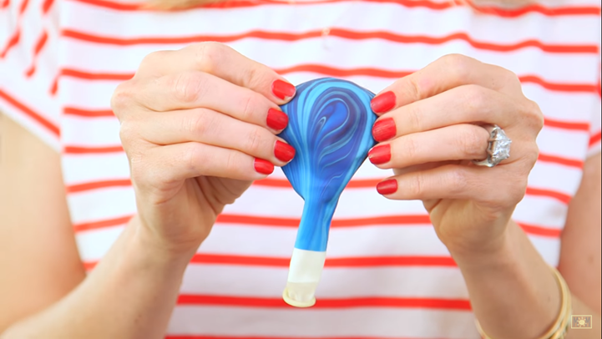
Step 1:
Blow up the balloon and then deflate it before you start. This stretches the balloon which makes it easier to fill it with the flour.

Slide 80
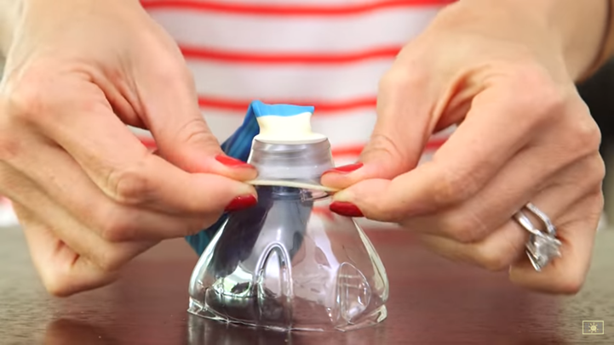
Step 2:
Pull the end of the balloon up over the end of a funnel or a cut off water bottle (you may need to get an adult to help you with this part if using a water bottle top)

Slide 81
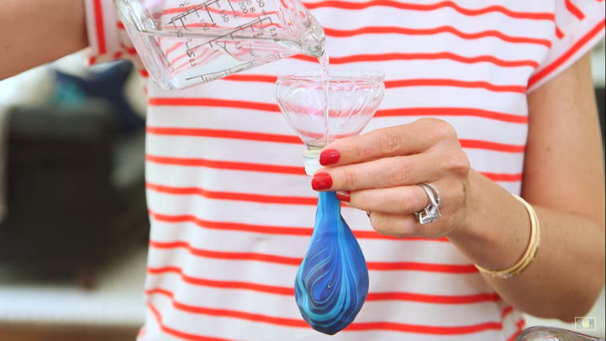
Step 3:
Carefully pour water into the funnel and balloon.

Slide 82

Step 4:
Now, add your flour to the funnel and balloon.
Shake the funnel back and forth and tap the side of it to get the flour to go down into the balloon.

Slide 83

Step 4, continued:
If the flour doesn’t seem to go through the funnel, use a pencil or pen to push it through.
Keep adding more and more flour to the funnel and balloon until you’re happy with the size.

Slide 84

Step 5:
If the balloon is running out of space to add more flour, pinch the opening of the balloon closed, then use your fingers to press down the flour in the balloon right below the funnel.
Press and shape the balloon down and outwards to make space for more flour. You'd be surprised how much flour you can fit into the balloon just by pressing it down like this!

Slide 85


Step 6:
Remove the funnel and tie a knot in the balloon. Try to get the knot as close to the base of the balloon as you can.
Your stress ball is done!

Slide 86
Yoga time!

Slide 87


Slide 88
Stress busters challenge
Try it for a week :)
Music Monday: Slow down and play soothing music. Playing calming music can have a positive effect on the brain and body, can lower blood pressure, and reduce cortisol, a hormone linked to stress.
Tranquil Tuesday: Getting enough sleep is essential to reducing stress. Also try relaxation techniques like yoga and meditation.
Workout Wednesday: A short walk around the school or simply standing up to stretch can offer immediate stress relief. Getting your blood moving releases endorphins and can improve your mood almost instantaneously.
Take A DEEP Breath Thursday: Deep breathing increases the supply of oxygen to your brain and stimulates the parasympathetic nervous system, which promotes a state of calmness.
Fun Friday: Laughter releases endorphins that improve mood and decrease levels of stress causing hormones cortisol and adrenaline
Notes:
Here is a Stress Buster Challenge we would like for you to try for a week. We will send it out to you as a follow up to this meeting.

Slide 89
Step 4: Get the truth about health

Slide 90

Fitness trends and fads
Fitness is constantly evolving. Over the past 80 years, we have gone through a variety of fitness phases, some of which laid the foundation for modern-day exercise routines. Let’s take a walk through some of the most popular fitness trends over the decades!

Slide 91
Fitness trends and fads
Fitness fads aren't anything new. In fact, they've been around as early as the '50s. Some of these products and exercises are still popular today, while others have been shunned or forgotten.
See if you can recognize these workout machines?

Slide 92

A hot commodity in the '50s and '60s, the vibrating belt was used to shake your waist, legs, arms, and butt into shape.
According to The Washington Post, the machine was marketed as a way to vibrate fat and make it easier for the body to "flush it away."
Scientists eventually discovered that you can't vibrate fat off of your body, causing this trend to die down.
We all know there is no substitute for diet and exercise!
Vibrating Belts

Slide 93

Hula Hoops
Before it was a toy, it was used as an exercise tool!

Slide 94

Hula Hoop
History
Wham-O founders heard about twirling hoops that were gaining popularity in Australia, according to Hulahooping.com.
They started making their own version of the product in 1958, and even held demonstrations on how to use it.
History.com reports that an estimated 25 million hula-hoops were sold in the first four months of production.

Slide 95

Hula Hoops in America
The hula hoop was a toy trend that caught fire the moment it hit America.
More than 400,000 were sold by 1957!
Granted, it was classified as a toy when it first hit stores, but hula hooping for 30 minutes can be a great full-body workout.
Nowadays, adults can use a weighted hula hoop as opposed to a plastic one if they want to feel the burn!
The Mayo Clinic reports that 30 minutes of hula-hooping can even burn between 165 to 200 calories.

Slide 96
Step 5: Help your family stay fit
Badge Homework: Plan and help cook a healthy dinner for your family, or plan and lead a fitness activity for your family to do together.

Slide 97
Way to go, Girl Scouts! You have earned your Junior Staying Fit badge.

