Slide 1


Staying Fit
Junior
www.GetYourGirlPower.org

Slide 2
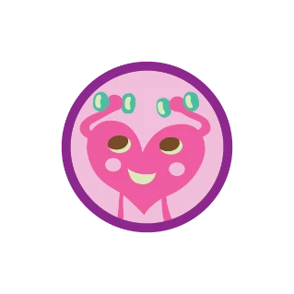
You need a fit body and mind to do all your favorite things, from roller skating to writing in your diary to sharing advise with friends. Jump into this badge to figure out what fitness, food, and fun you need to stay strong for your life.

Slide 3

Step 1: Start Moving
Grab your comfy clothes and sneakers and let's get moving! You are going to be exercising and wearing the wrong clothing will make this uncomfortable and could potentially cause an injury. Try three different forms of getting moving this week. Have each exercise answer these questions.
1.How do you feel? Are you out of breath?
2. Take your pulse. Check out the link -> How to check your pulse?
3. Which exercise did you like the best?
4. Share your favorite exercise with a Girl Scout Friend.

Slide 4
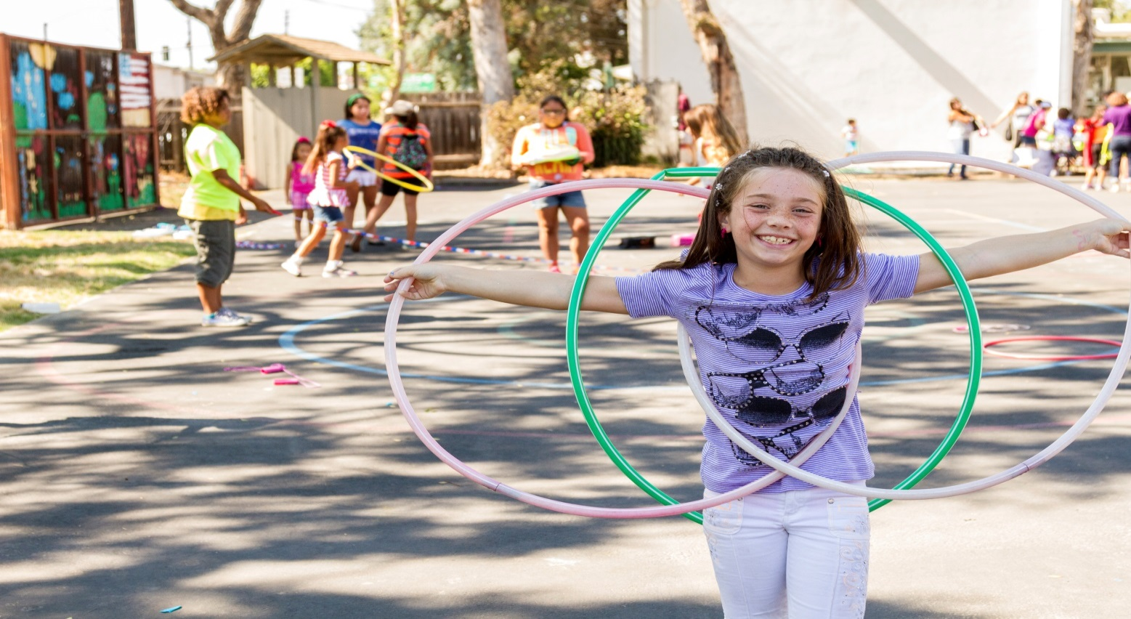
Step 1: Pick three activities
The most important part of healthy living is staying active. And to stay active, you have to find your favorite ways to move, so you’ll want to keep going!
Join the GSCI virtual dance party on Tuesdays at 4:30 streaming live on FaceBook! Girl Scouts of Central Illinois FaceBook
Line dance!
Do a 15-30 minute Yoga Video
Go for a Brisk walk around your neighborhood
Set-up an obstacle course with hula-hoops, cones, jump ropes, and a beach ball.
Following along an aerobics class online

Slide 5


Step 2: Keep Your Fit Body Fueled
You can’t stay fit without the fuel to move! Learn what your body needs to stay strong and fit! Brainstorm a list of healthy foods and what benefits they provide your body. Use choosemyplate.gov as a resource.

Slide 6

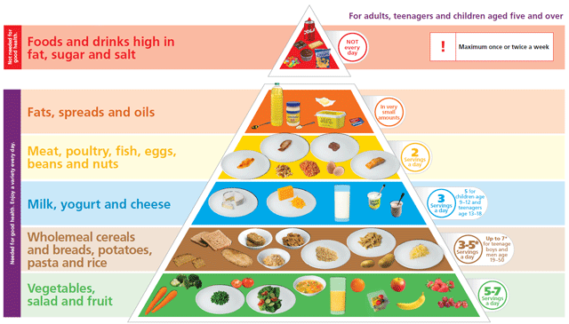
Step 2 Activity
Head to your refrigerator and pantry! Find healthy food for each letter of the alphabet and write it down.
What letters are you missing?
Do you have foods in each food pyramid category?
What types of food do you have the most?

Slide 7

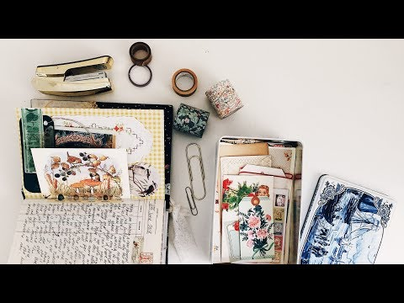
Step 3: Know How To Stress Less
Sometimes just writing down your emotions can help you feel better. For one week, write down or draw how you feel each day. Take a week off, and then record your feelings for another week.
Ask Yourself:
What differences did you have?
Did you feel different during the week you didn’t record?
How have your entries changed?

Slide 8


For More Fun!
Write down something that makes you stressed. The next time it makes you feel that way, rip up that piece of paper and throw it away! Did it make you feel better?

Slide 9

Step 4: Get The Truth About Health
There are a lot of health ideas floating around-between friends, in the media, at school. Search online for the answer to a healthy question. There are probably many! How healthy are you? Take a health quiz! Do you know how the body works? Do you have a question for an expect? Ask the expert! Learn the truth about your health! Share what you learn with three Girl Scout Friends.

Slide 10

Step 5: Help Your Family Stay Fit
Why should you be the only one having all the fun? Help your family become fit. Teach them some ideas you’ve learned through this badge. Have a family dance party! Have a “slow food”dinner.
What is Slow Food? “slow food”is the name of a movement started in Italy in 1989. It celebrates the opposite of fast food. Slow fooders slow down to pay attention to what they eat, how it tastes, where it comes from, and who grows it. It now has more than 150 members counties. Maybe there’s a chapter in your area!

Slide 11
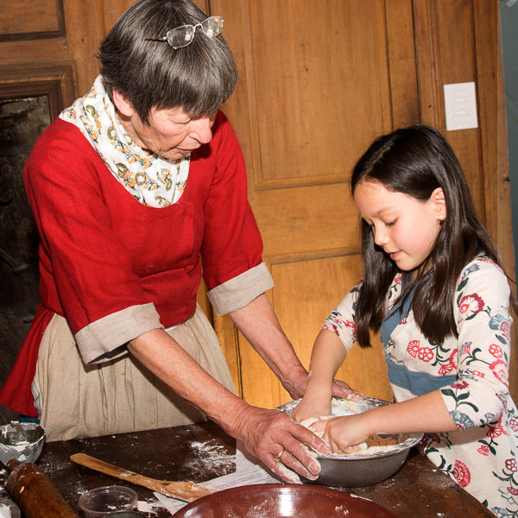
Step 5: Slow Dinner
Help make a healthful dinner. Create the menu together, shop in your pantry, take time to focus on food and eat together. Talk about your favorite flavors.
Don’t know what to make with the food in your pantry? Click Here for some help!

Slide 12

Congratulations you earned your
Stay Fit Badge!
www.GetYourGirlPower.org

