Slide 1
Space Science Investigator
Junior
Girl Scouts of Central Illinois

Slide 2
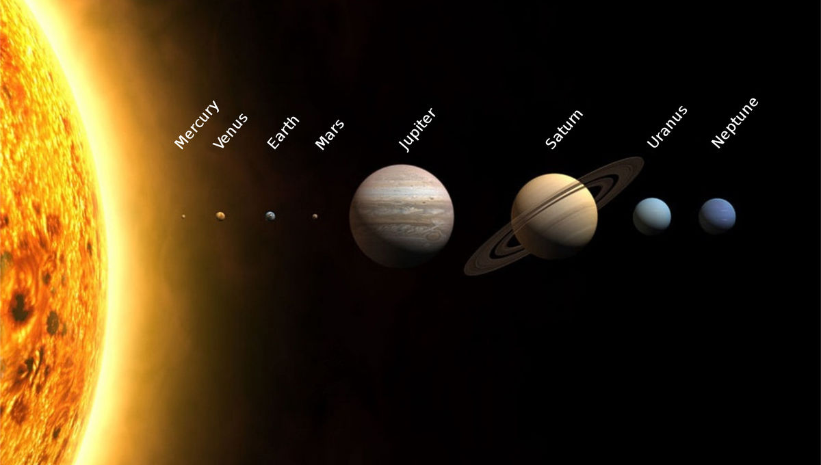
Step 1: Model the Solar System
What is a
scale model?
Scientists and engineers
use models for both their
research and to help
communicate discoveries.
A scale model is a copy
of an object that is either
larger or smaller than
the original object it is
“modeled” after. Each part
of the object is adjusted in
the same way. Architects
create small scale models
of the buildings they are
going to build and scientists
make large scale models of
insects so that they can
more easily study them.

Slide 3
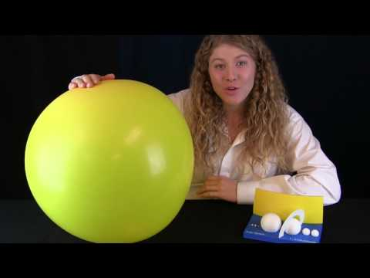

Slide 4
Step 2: Circle the Sun
What is a year? How do we measure a year? The Earth orbits (moves around) the Sun, and one orbit is equal to one year— actually it takes the Earth 365.24+ days. How many times have you orbited the Sun?
Find your age on other planets!
Your age is the number of orbits you have taken around the Sun, but each planet is a different distance from the Sun, and they all orbit at different speeds. Today you’re going to discover how old you would be on other planets by using a website such as www.girlscouts.org/SpaceSciencePlanetAges
How old are you on Mars? Jupiter? Did any of your discoveries surprise you?

Slide 5
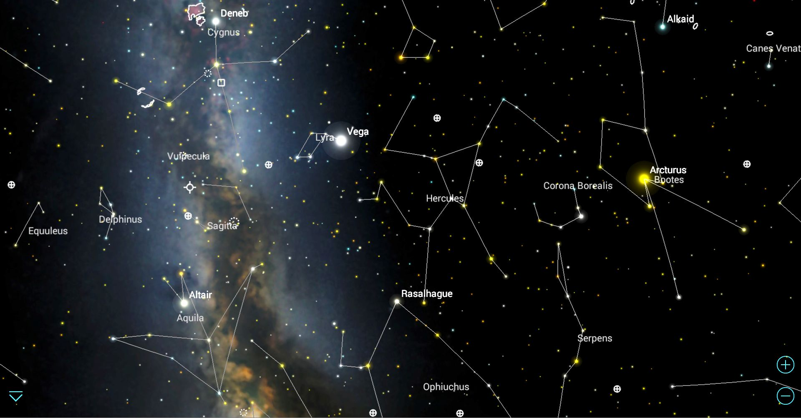
Step 3: Discover the Stars
Objects in space are very far away. The Moon—the closest object to Earth—is about 240,000 miles away. If you could drive a car to the Moon at 60 miles per hour, it would take more than five and a half months to get there! The Sun is about 400 times farther away—roughly 93 million miles—and it’s the closest star to us. Scientists measure space with a different ruler marked in “light-years.” A light-year (ly) is the distance that light travels in one year at 186,000 miles per second—one light-year is about 6 trillion miles.

Slide 6
Ursa Major (the Big Dipper)
The brightest star in the sky
Aldebaran (the Red Giant)
The Moon
Canis Major (the large dog)
Cygnus (the swan)
Pegasus (the flying horse)
Leo (the lion)
Scorpius (the scorpion)
A Planet
Go on a night sky scavenger hunt!
You can use your eyes, a star wheel, a smartphone app, or this website to help you identify the stars, constellations, or planets in the night sky. With an adult, use the list to the right—or make up your own! Keep in mind that not everything is visible in the sky on the same night or time of year. That’s part of the fun! Just mark off what you can find, and keep going outside on different nights to search the sky.

Slide 7
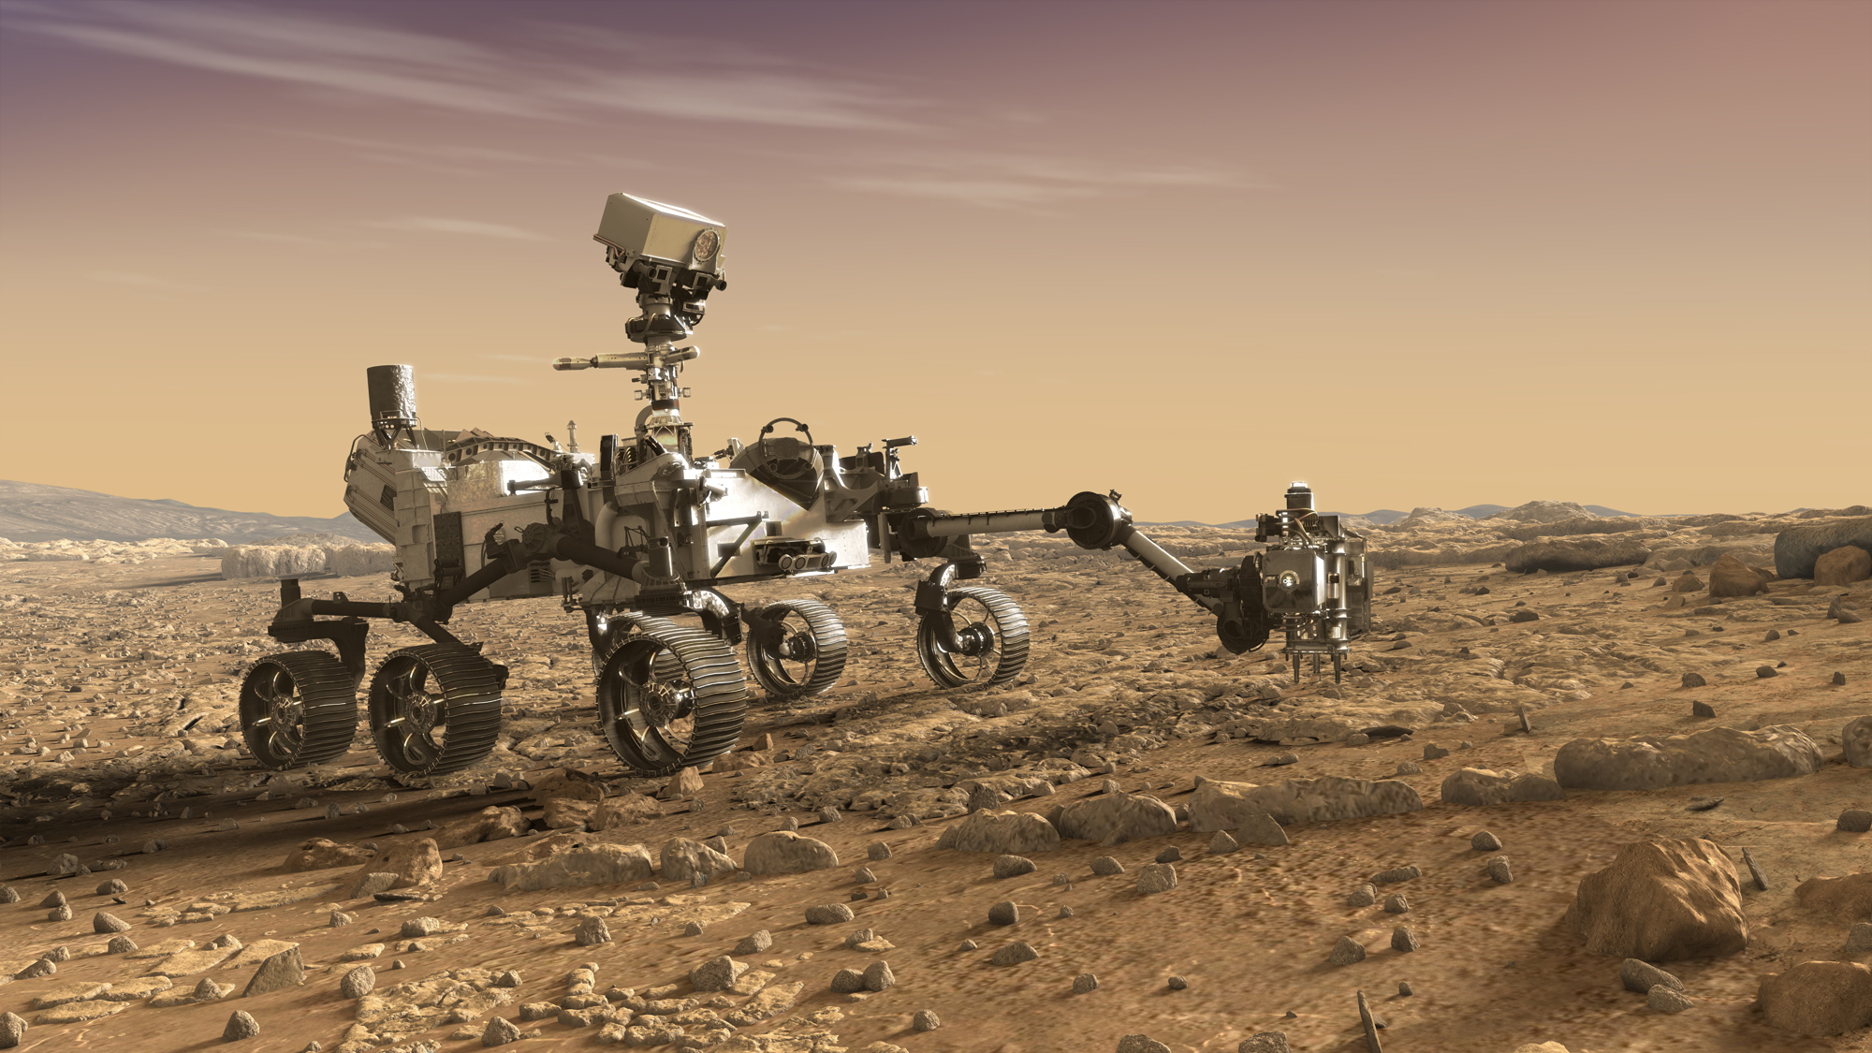
Step 4: Use tools to Explore
Make a Mars rover! NASA is exploring Mars with rovers— robotic vehicles that explore other planets. Today, your challenge is to design the next rover to land on Mars! Think about what you’d like to discover and the tools you’d need to accomplish this. As part of your brainstorm, check out www.girlscouts.org/SpaceScienceMarsTrek and explore the surface of Mars. When you’re finished making your model, explain how your rover works to a friend or family member. Learn more about NASA’s Missions to Mars online at www.girlscouts.org/SpaceScienceNASAMissions

Slide 8
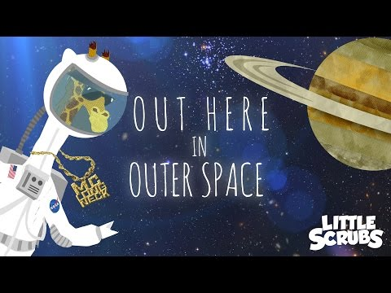
Step 5: Share your Sky
Create a space show! This might be a song or rap, a skit, a video, a short story, or poem. Create something that will inspire and teach others about the wonders of space science, and present or perform it for your family and friends.

Slide 9

Congratulations! You earned your Space Science Investigator badge!

