Slide 1
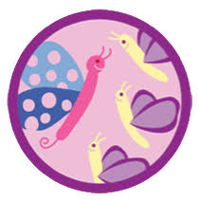
Social Butterfly Junior Badge
Girl Scouts of Central Illinois Home Addition 2020
Manners are a sensitive awareness of the feelings of others. If you have that awareness, you have good manners, no matter what fork you use.
-Emily Post
American author on etiquette

Slide 2
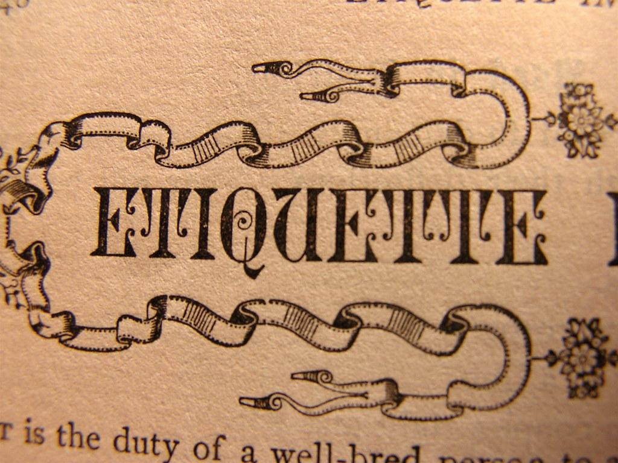
Have you ever found yourself in a group or place where you didn’t know how to act? It happens to everyone. In this badge, have fun practicing the social style and good manners that will make you comfortable in any situation.

Slide 3
Step 1. Hold a conversation
It’s easy to have a conversation with your best friend, but what about people you don’t know well? Conversation skills will help you in your job one day and make you seem more open to new friends!

Slide 4
Step 1 Activity: Choose one of these three options:
Practice conversation starters. First, make a list of 10 great questions to start a conversation. Think about the different situations you might have: with one new person, a group of new people, or an adult friend of your parents’. Then, role-play with your questions to practice starting and continuing a conversation.
Invite an expert to come talk about conversations. Some people specialize in helping talk to one another. Ask a psychologist, motivational speaker, life coach or other knowledgeable person to show you how to introduce yourself and begin a conversation in different situations
Make a poster with 10 conversation tips. Look in books, online, or in magazines. Remember, body language is an important part of conversations, too. Some of your tips can be smiling and other friendly gestures that can help everyone feel at east. Then, hang your poster in a good sharing place.
Charming persons are almost never self-centered, but have wide interests in persons and things and can forget about themselves.
-Girl Scout Handbook, 1933

Slide 5
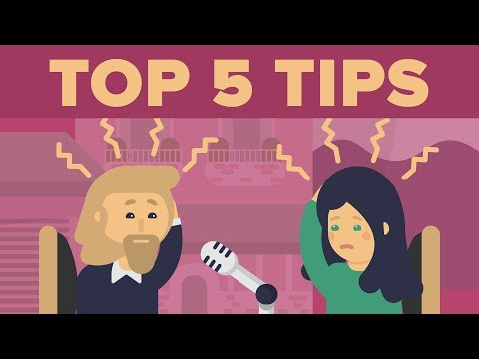
Tips on how to never run out of things to say during a conversation

Slide 6
Step 2. Use table manners
Good manners are just a way to showing other people that we have respect for them.
Robert Kelly

Slide 7
Step 2 Activity: Choose one of these three options:
Brainstorm five things not to do at the table. For each one, list a good substitution. Here’s one to start you off: “Don’t criticize the food! Instead, find something you like about it.” Pick three good table manners from your list to practice in the next two weeks.
Set the table. Find out where silverware, glasses, napkins, and plates go. Make paper “reminder” place mats that show outlines where everything should go – one for a formal dinner, and one for a casual meal. You might make the place mats from fabric and trace your “cheat sheet” on the back! Then, try setting the table for a week.
Study table manners from other countries. In the United States, many people use a fork, and knife to eat, but in other places, it’s more common to use chopsticks or eat with your hands. Learn about mealtime customs from another culture, then, have a meal using manners from that place
Manners are a basic building block of a civilized society
- Alexander McCall Smith

Slide 8
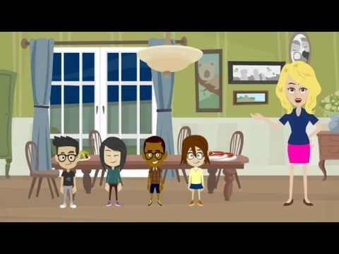
Tips on how to set a table

Slide 9
Step 3. Be prepared for special occasions
There are exactly as many special occasions in life as we choose to celebrate.
Robert Breault

Slide 10
Special occasions all have their own rituals. When you know what they are, you know how to act! Step 3 Activity: Choose one occasion below & find its proper etiquette.
Wedding.
Funeral or wake.
Coming-of-age ceremony,like a bat mitzvah, confirmation, or a quinceanera.
Girl Scout Ceremony
Special Occasion Questions:
Why is the ceremony held?
What important rituals are in the ceremony?
How should you dress?
What’s one helpful skill you should know before attending?
When is the occasion usually held?
Is there something that is especially nice to say (or wish to) the host or guest(s) of honor?

Slide 11
Step 4. Say thank you
The more you are thankful, the more you attract things to be thankful for.

Slide 12
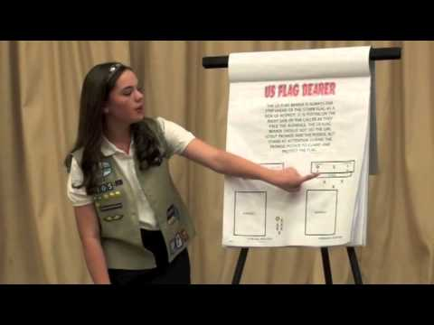
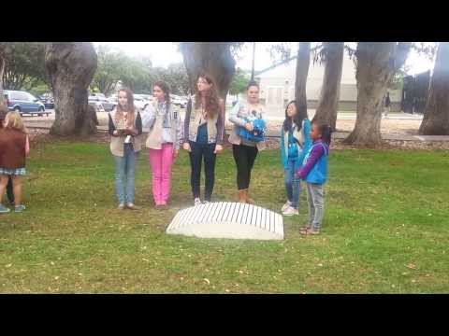
Tips for Girl Scout Ceremonies and Rituals
Girl Scout Flag Ceremony
Girl Scout Bridging Ceremony

Slide 13
Step 4 Activity: Choose one of these three options:
Thank the host. When someone has invited you over for a dinner or a party, find the host before you leave and say thanks. Tell them what you most enjoyed. Practice in a role-play or skit. In many places, gifts are given to the host of a party as a thank-you. Find some examples and make a host gift of your own.
Handwrite a thank-you note.Kind words written by hand show you took time to share your thanks. Handwrite three thank-you notes in the next month. (You might even make your own note card!) Include why you are thankful. If it’s for a gift, tell the giver how you use it, or your favorite thing about it.
Make a thank-you gift. The next time you feel really thankful to someone, give a thank-you gift, like a bouquet of flowers, a drawing of a bag of trail mix. Gifts you make yourself often have the most meaning. Think about thanking people who help you every day, like your crossing guard or a teacher. Or, thank someone for a smaller gesture, like making your feel comfortable in a new situation.
Happiness is homemade.

Slide 14
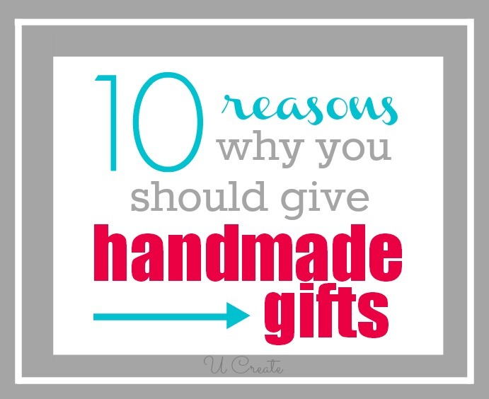
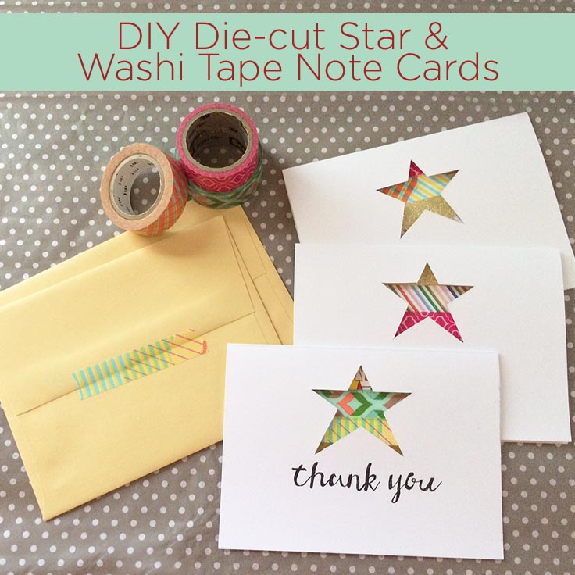
Tips on when to give handcrafted gifts here .
Tips on making Thank You cards here .

Slide 15
Step 5. Practice being at ease
Life should not only be lived, it should be celebrated.
- Osho

Slide 16
Hold a party to practice all you’ve learned. Invite people with whom you aren’t that close so you can really practice being at ease. Make introductions, make conversation, show good table manners, and thank guests for coming. Step 5 Activity:
Pick a group to invite from the list below, and start partying!
Other Girl Scouts. Grow your skills by inviting younger and older girls.
Your friends and their parents.Make a point of chatting with some adults!
Everyone in your class.Think about classmates you don’t know very well and come up with some conversation starters ahead of time.
More to EXPLORE: Make it a dance party. Girls earning their Social Dancer badge in 1963 had to “develop some ideas for getting a dance party off to a quick start, be able to teach an icebreaker, and know several ways to help guests mingle.” Try these skills yourself!

Slide 17


