Slide 1

Leader Instructions & Prep
Junior Simple Meals Badge
Supply List:
Oven mit or pot holders
1 ½ quart saucepan
Spatula and cooking spoon
½ cup, 1 cup, ¼ cup measuring cups
Tablespoon and teaspoon
9x13 inch baking pan
Medium mixing bowl.
½ cup granulated sugar
¼ cup orange juice
¼ cup water
2 cups fresh cranberries
1 tablespoon orange peel grated – optional
½ teaspoon ground cinnamon
¾ cup packed brown sugar
½ cup butter softened
1 ½ cups old fashioned oats
1 cup all-purpose flour
¼ teaspoon salt
The following slides will walk your troop through a virtual meeting to earn the Junior Simple Meals Badge. When you share your screen during your meeting, be sure to click “Present” so girls see the full screen. Also, when you are sharing your screen in zoom, google meet, or another meeting app, please make sure you are sharing both picture and audio. For more information on using Zoom, visit gsnw.gl/VirtualMeetingHowTo
Many of the interactive activities included are shared through YouTube videos. Just click on the arrow in the center of the image to play the video, and the girls can see it too! You should try to review the slides before your meeting if possible, so you are familiar with the activities and any supplies needed.
This meeting will typically take approximately 60-90 minutes as written, depending on participation level and number of girls. As always, Girl Scouting is flexible, and troops may select the activities interest them most, add their own activities, or have girls do some of the steps afterward as “homework”.
When you send out your meeting invitation, be sure to let girls and parents know what supplies they should have on hand for the online troop meeting. They are things most girls likely have at home.

Slide 2

Junior Simple Meals Badge
Brought to you by Girl Scouts of the Northwestern Great Lakes

Slide 3
Girl Scout Promise
On my honor, I will try:
to serve god* and my country,
to help people at all times,
and to live by the girl scout law.

Slide 4


Let’s say the pledge

Slide 5




Program Pillar: Life Skills
STEM Girls become better problem-solvers, critical thinkers, get better grades, and see STEM as the foundation for a meaningful and successful future.
Outdoors Girls discover that they can better problems and overcome challenges, build social bonds, and become team players that care about protecting our environment.
Entrepreneurship Girls gain new skills, build their confidence, and develop an entrepreneurial mindset over time.
Life Skills Girls gain the skills and the inspiration to accept challenges, overcome obstacles, and take the lead.
Notes:
In Girl Scouts, everything we do is either about STEM, Outdoors, Entrepreneurship, or Life Skills. This month we are going to focus Life Skills!

Slide 6





Sense of Self
Girls have confidence in themselves and their abilities and form positive identities.
Positive Values
Girls act ethically, honestly, and responsibly, and show concern for others.
Challenge Seeking
Girls take appropriate risks, try things even if they might fail, and learn from mistakes.
Healthy Relationships
Girls develop and maintain healthy relationships by communicating their feelings directly and resolving conflicts constructively.
Community Problem Solving
Girls desire to contribute to the world in purposeful and meaningful ways, learn how to identify problems in the community, and create action plans to solve them.
5
Outcomes: Sense
of Self
Notes:
The whole point of Girl Scouts is to build 5 outcomes. The one we are going to work on today is Sense of Self which means we want you to have confidence in yourself and your abilities!

Slide 7
Junior Simple Meals Badge
Badge Details:
Make amazing meals and learn to create a whole meal of your own.
Step up your skills with a pro
Whip up a great breakfast - prework
Fix a healthy lunch or dinner - homework
Create a delicious dessert
Make your own meal - homework
When you've earned this badge, you'll know how to serve up a meal for your family and friends.
Notes:
So we are going to get right into the badge work today, so that we can get baking and then have some time for fun stuff after! Like I mentioned before, today’s badge is Simple Meals.
In order to earn this badge….
***Read through badge details**
Note that the Breakfast was the eggs dish in the supplies/prework email
Healthy lunch is homework along with make your own meal!
In this meeting we will learn some skills from a pro, learn about kitchen safety and you will make a delicious dessert!
Let’s get started!

Slide 8
Prework
Step 2: Make Scrambled Eggs

Slide 9
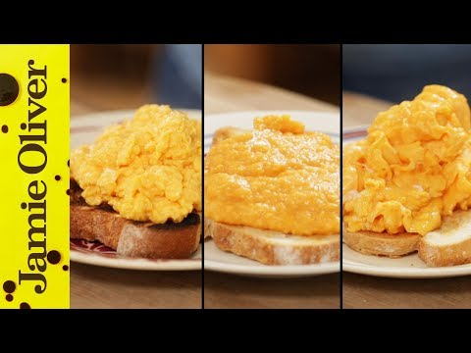
Prework: Make Scrambled Eggs

Slide 10
Prework:
English Scrambled Eggs
Ingredients:
4 eggs
1 tablespoon butter
1 teaspoon salt
1 dollop (spoonful) of sour cream (optional)
Instructions:
Crack four eggs into a bowl
Put your pot on the stove burner over medium heat, eggs cook quickly and do not need high heat. Put a knob (tablespoon) of butter into the pot.
While that warms up, use a fork to whisk your eggs in your bowl for just a few seconds (count to 15). Add a dash of salt to the eggs in the bowl.
Put the eggs straight into the pot.
Use a spatula to constantly stir the eggs and make sure you get it off of the sides and bottom with each stir.
You can add a dollop of sour cream here or a dash of milk if you choose.

Slide 11
Prework:
French Scrambled Eggs
Ingredients:
4 eggs
1 tablespoon butter
1 teaspoon salt
Instructions:
Get a glass bowl that is larger than your pot, fill your pot with a good inch to an inch and a half of water, heat on medium until it starts boiling.
Crack the four eggs into the glass bowl and add salt right away, use a whisk and whisk the eggs, set the bowl on top of the pot and whisk off and on, for a few minutes this should take longer than the English way.
Once you see curds start to form add your knob (tablespoon) of butter and switch to using a spatula to stir the eggs.
Keep stirring until it has the same consistency as the video, do not overcook. Do not touch the glass bowl once you’ve placed it on the pot, only use the pot handle, ask a parent for help. Serve eggs on a plate with toast.

Slide 12
Prework:
American Scrambled Eggs
Ingredients:
4 eggs
1 tablespoon butter
1 teaspoon salt
1 Tablespoon of milk (optional)
Instructions:
Use a frying pan for this recipe, place it over medium heat and add your knob (1 tablespoon) of butter straight into the pan.
Crack your 4 eggs into a separate bowl, add salt and whisk with a fork.
You can add a dash of milk while you whisk if you want.
Pour them in the pan.
Do not stir, you want to fold them into the center of the pan (watch video) until they are cooked as shown in the video, just a couple of minutes, serve on plate with toast!

Slide 13
Kitchen Scavenger Hunt
Can you find the following items in your kitchen?

Slide 14

1 cup measuring cup
Oven mitt
Spatula
Teaspoon
Mixing Bowl
Notes:
Do one at a time; give the girls 20 seconds to find it.
You guys are going to put all these items in your cooking prep area for when you make your dessert!

Slide 15
Safety in the Kitchen

Slide 16
What safety tips come to mind? Type them in the chat!

Slide 17
Great Job! Let’s go over any kitchen safety tips we didn’t mention.
Always cook with an adult near.
Ask questions if you are not sure.
Pull back long hair into a pony tale.
Wash your hands! Before you cook, while you cook and again before eating, especially if you are touching raw meat.
Read through instructions before cooking to ensure you have everything ready!
Use oven safe mitts when placing your baking sheet into the oven and when pulling it out.
Set your hot pot/pan/baking sheet on a safe surface; ask an adult to know where is okay!
Do not lick your fingers while cooking! If you do, wash your hands before touching the next ingredient.
Only taste fully cooked food.
Your cooking area should be clean & tidy.

Slide 18
Step 4: Create a delicious dessert

Slide 19
You will need a 1 ½ quart saucepan, spatula, cooking spoon, ½ cup, 1 cup, and ¼ cup measuring cups, tablespoon, teaspoon, 9x13 inch baking pan, medium mixing bowl.
Cranberry Filling:
1/2 cup granulated sugar
1/4 cup orange juice
1/4 cup water
2 cups fresh cranberries
1 tablespoon orange peel grated – optional
Crust:
1/2 teaspoon ground cinnamon
3/4 cup packed brown sugar
1/2 cup butter softened
1 1/2 cups old fashioned oats
1 cup all-purpose flour
1/4 teaspoon salt
Let’s bake!
We will read through the instructions before we start.
Gather your ingredients.

Slide 20
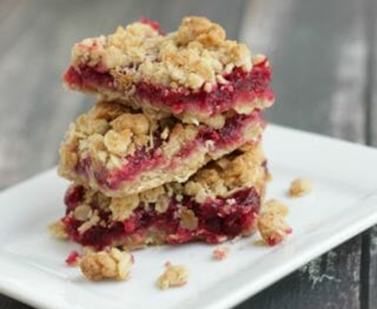
Cranberry Crumble Bars
Preheat the oven to 400 ºF
Cranberry Filling Instructions
In 1 1/2-quart saucepan, mix granulated sugar and water. Heat to boiling over high heat.
Stir in your 2 cups of rinsed cranberries, add orange juice and orange zest if you want. If you don’t have orange juice, add another ¼ cup of water.
Simmer over medium heat about 10 minutes (set a timer!), stirring occasionally, until thickened; remove from stove top to cool.

Slide 21
Cranberry Crumble Bars While the cranberries cook, we will make the crust.
Crust Instructions
In medium bowl, mix brown sugar and softened butter.
Stir in all ground cinnamon, oats, flour and salt until crumbly.
Scoop half of the crumbly mixture and put it in ungreased 9x13" rectangular pan. Press it cover the bottom evenly.
Spread the cranberry filling over the bottom crust and then top with remaining crumbly mixture as evenly as you can; press lightly.
Bake about 20 minutes or until light brown. Set a timer!
Let cool for 5-8 minutes, but while it’s still warm, cut into 6 rows by 4 rows. Then let it cool to room temperature before serving (about 30-45 minutes).
Notes:
Guess what? You can freeze these bars! Make up a batch to have on hand for any sort of holiday gathering or just because. Store them in an airtight container with layers of waxed paper so you can pull out what you want when you want them and enjoy any time.

Slide 22
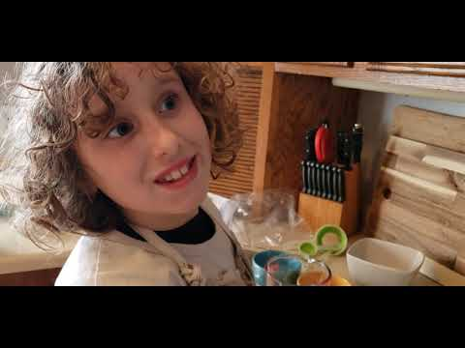
Let’s watch the step by step videos as we bake our dessert

Slide 23
Cranberry Filling: Step 1
On the stovetop in a 1 ½ saucepan, mix sugar and water. Boil on high.

Slide 24
Cranberry Filling: Step 2
While you let the sugar and water boil, make your orange zest (optional).

Slide 25
Cranberry Filling: Step 3
Add 2 cups of rinsed cranberries.

Slide 26
Cranberry Filling: Step 4
Optional: Add orange juice and zest

Slide 27
Cranberry Filling: Step 5
Reduce heat and cook for 10 minutes.

Slide 28

Crust: Step 1
In a large mixing bowl, add ¾ cup brown sugar and a whole stick of softened butter and mix them together.

Slide 29
Check and stir your cranberries!

Slide 30
Crust: Step 2
Mix brown sugar and butter until it’s smooth. You can wash your hands and mix it with your hands for better grip.

Slide 31
Crust: Step 3
Stir in all ground cinnamon, oats, flour and salt until crumbly.

Slide 32
Check your cranberries again!

Slide 33
Crust: Step 4
Scoop half of the crumbly mixture and put it in ungreased 9x13" rectangular pan. Press it cover the bottom evenly.
Spread the cranberry filling over the bottom crust and then top with remaining crumbly mixture as evenly as you can; press lightly.

Slide 34
Crust: Step 5
Spread the cranberry filling over the bottom crust and then top with remaining crumbly mixture as evenly as you can; press lightly.

Slide 35
Crust: Step 6
Spread rest of crust mixture on top of cranberry filling.
Make sure to cover the entire filling.

Slide 36
Baking
Grab your oven mitts
Put the dish in the oven
Set timer for 20 minutes
Tip: Wipe the sides of the dish before putting it in the oven.

Slide 37
While we wait, let’s play
This or That
Notes:
Girls can either type their response in the chat or say it out loud.

Slide 38

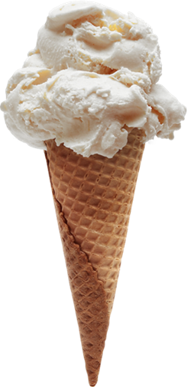
This
That

Slide 39
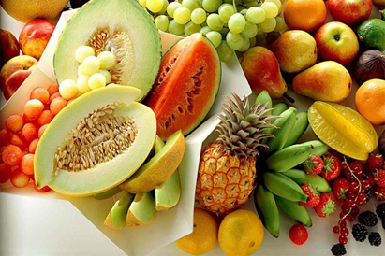
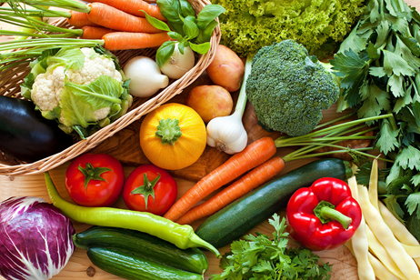
This
That

Slide 40
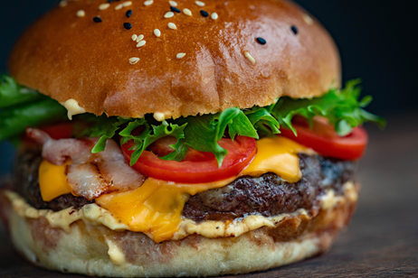
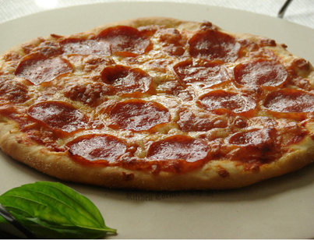
This
That

Slide 41
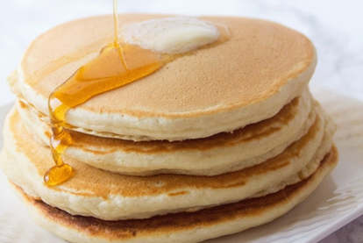
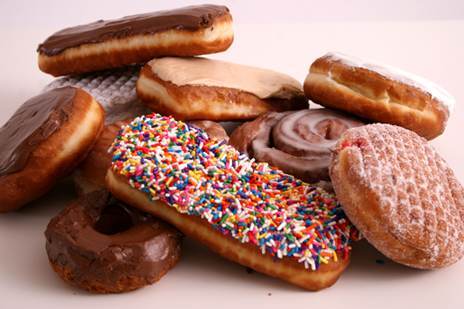
This
That

Slide 42
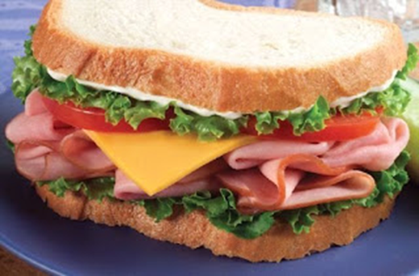
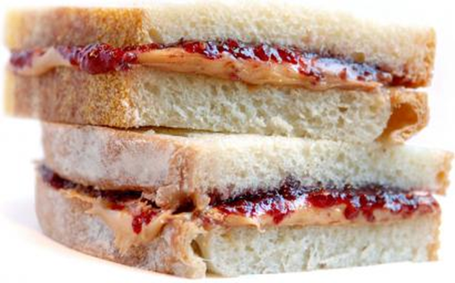
This
That

Slide 43
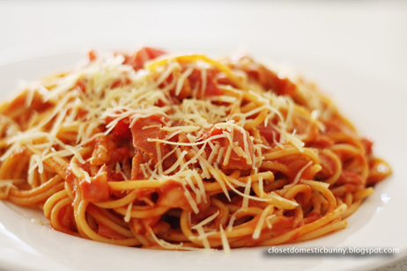
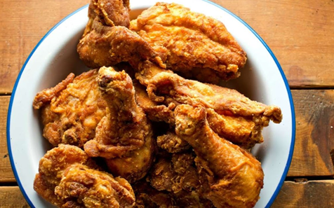
This
That

Slide 44
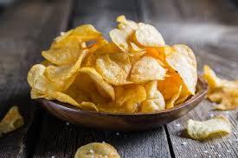

This
That

Slide 45
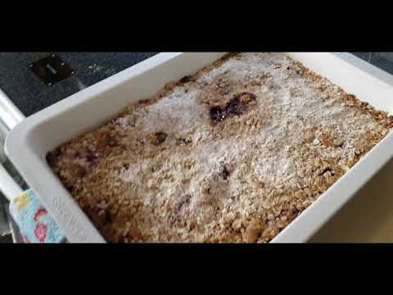
Let’s check your Cranberry Crumble Bars!
Remember to use oven mitts and to set the pan on a safe surface.

Slide 46
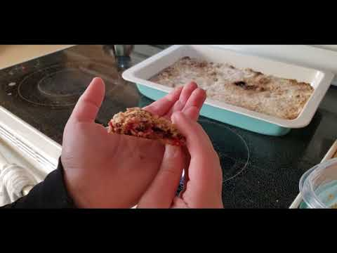
Serving
your bars
With an adult, cut into squares (like brownies)
Either eat them right away or freeze for later.

Slide 47
Homework
Complete badge steps 3 & 5
Make a tasty lunch | Create your own meal
Notes:
This is a very big badge with lots of steps to do in your own kitchen. You completed the first step by making scrambled eggs, we’ve completed two more steps today and you will have to wrap up the last two at home. Step 3 is to make a tasty lunch; 2 recipe ideas are in the follow up email, and to create your own meal!

Slide 48
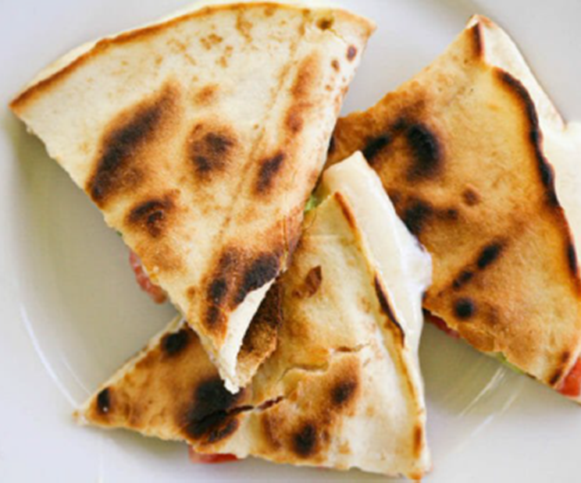
Step 3:
Make a
tasty lunch
Classic Mexican Cheese Quesadilla

Slide 49
Classic
Mexican
Cheese
Quesadilla
Large flour tortillas
Grated cheese - either mild or sharp cheddar, or Monterey Jack
Olive oil or butter
Optional:
Sliced mushrooms
Green onions
Black olives, sliced
Fresh tomatoes, diced
Chicken pieces
Avocado
Lettuce
Apple cider vinegar
Salt

Slide 50
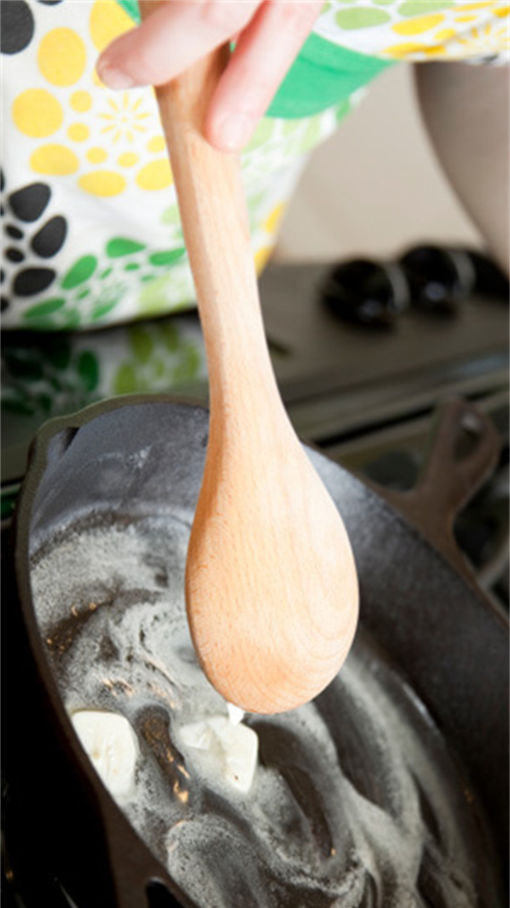
Instructions Step 1:
Heat a large skillet (cast iron works great) on medium high heat.
Add a small amount of oil (about 1/2 teaspoon) or butter (1-2 teaspoons) and spread it around the bottom of the pan with a spatula.

Slide 51
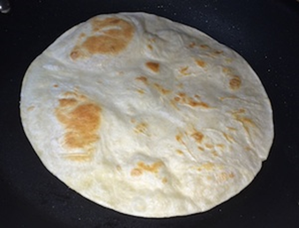
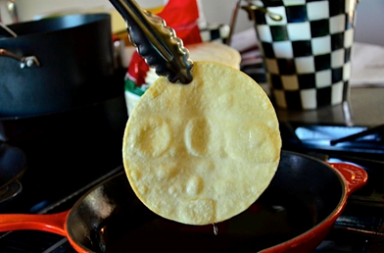
Instructions Step 2:
Take one large flour tortilla and place it in the pan.
Flip the tortilla over a few times, 10 seconds between flips.
Air pockets should begin to form within the tortilla.

Slide 52
Instructions Step 3:
When pockets of air begin to form, take a handful of grated cheese, sprinkle over the top of the tortilla, making sure that the cheese does not land on the pan itself.
Add whatever additional ingredients you choose - green onion, sliced mushrooms, olives, tomatoes, etc.
If you would like your quesadilla to be a chicken quesadilla, add some diced cooked chicken.
Make sure to add thin layers of ingredients so it doesn’t get too thick, and everything falls out of it.

Slide 53
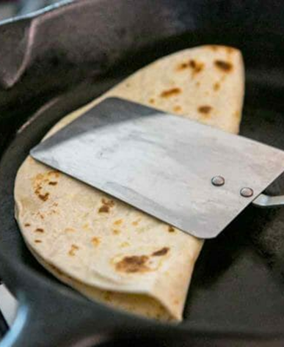
Instructions Step 4:
When the cheese is melted, use a spatula to lift one side of the tortilla over and fold it on top of the other side (as if you were making an omelette).
The tortilla should now be slightly brown. If it’s not, turn the heat up a little and keep flipping it every 10 seconds until it’s brown.

Slide 54
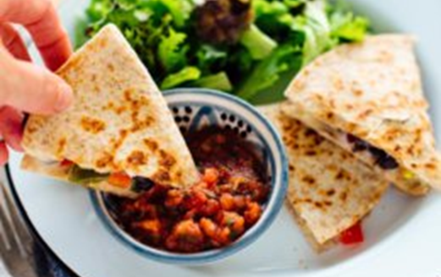
Instructions Step 5:
Use a spatula to remove the quesadilla from the pan
Put it onto a plate
Have an adult help you to use a knife and cut it into wedges
You can eat it on its own or serve with lettuce, salsa, sour cream or guacamole

Slide 55
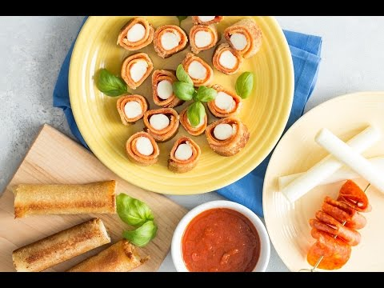
Or try...
Grilled Pizza Rollups

Slide 56
Grilled Pizza
Rollups
4 slices sandwich bread
4 mozzarella cheese sticks or 1/2 cup grated mozzarella
4 pepperoni, diced optional
1/2 cup marinara sauce, warmed
1 tablespoon butter

Slide 57
Instructions:
Cut the crusts off the bread.
Using a rolling pin, roll out the pieces of bread until flat.
Place a cheese stick or 2 tablespoons of cheese on the edge of the bread closest to you and add the diced pepperoni if desired.
Tightly roll up the bread pressing the seam/end down to adhere.
Heat butter in a sauté pan over medium heat and cook the roll ups seam side down for 1-2 minutes or until golden.
Continue sautéing the rollups on each side until golden all over.
Cut each roll up into 4 “sushi rolls” and serve with marinara sauce.

Slide 58
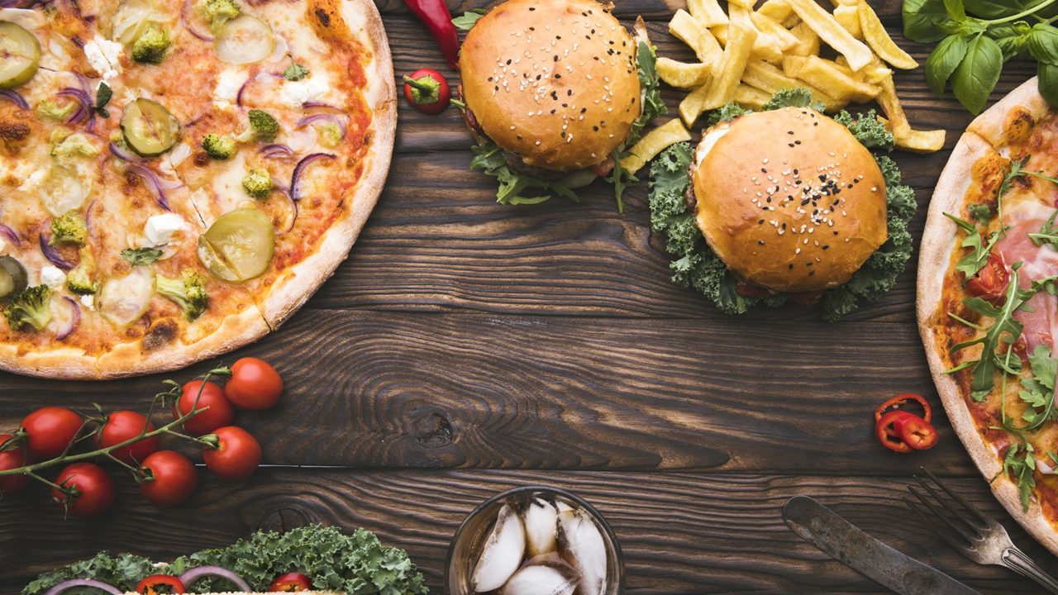
Step 5:
Create your own meal!
Now that you’ve followed other people’s recipes, come up with your own healthy recipe
What will you put in it? Meat? Vegetables? Salad?
Will it be a healthy sandwich? Pasta? Soup?
Get an adult to help you think of a healthy recipe and cook it!

Slide 59
Congrats! You have earned your
Junior Simple Meals Badge!

Slide 60
Now that I’ve earned this badge, I can give service by:
Making my family breakfast in bed
Cooking a delicious dish for a holiday or a celebration
Baking a cake for a friend’s birthday
Helping out in the kitchen

