Slide 1
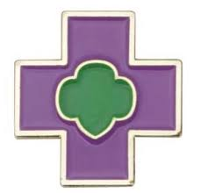
Junior Safety Award
Girl Scouts of Central Illinois
Home Edition 2020

Slide 2
Step 1 Activities
Find out what the most common injuries are for kids your age. Make a list of how you can prevent them. Find the cause of children injury and prevention here .
Do a home safety audit to check for dangers around the house. Find how to conduct a home audit here .

Slide 3
Step 2 Activities
Conduct an emergency evacuation drill of your home and/or Girl Scout troop meeting place. In case of a fire, know where the main exit is located, and plan an alternative way to get out if the fire exit is blocked.
Learn more about planning for a home/building emergency evacuation plan here .

Slide 4
Step 3 Activities
Find out how to read weather signs so you know when to head indoors and get to safety. Learn how to predict weather using nature signs here .
You can download weather apps on your “smart phone” and it will send emergency weather alerts. Learn common weather icons here .

Slide 5
Step 4 Activities
Explore bicycle safety. Learn best practices when bicycling here .
Research why bike helmets are important and how to check if a helmet fits you properly. Learn how to choose and correctly use a bicycle helmet here .

Slide 6
Step 5 Activities
Go on a hazard-identification walk along a local hiking trail, bike trail, or horse trail.
Find a list of bicycle paths in Illinois here .
Reserve a Girl Scouts of Central Illinois Camp and hike their trails here .

