Slide 1
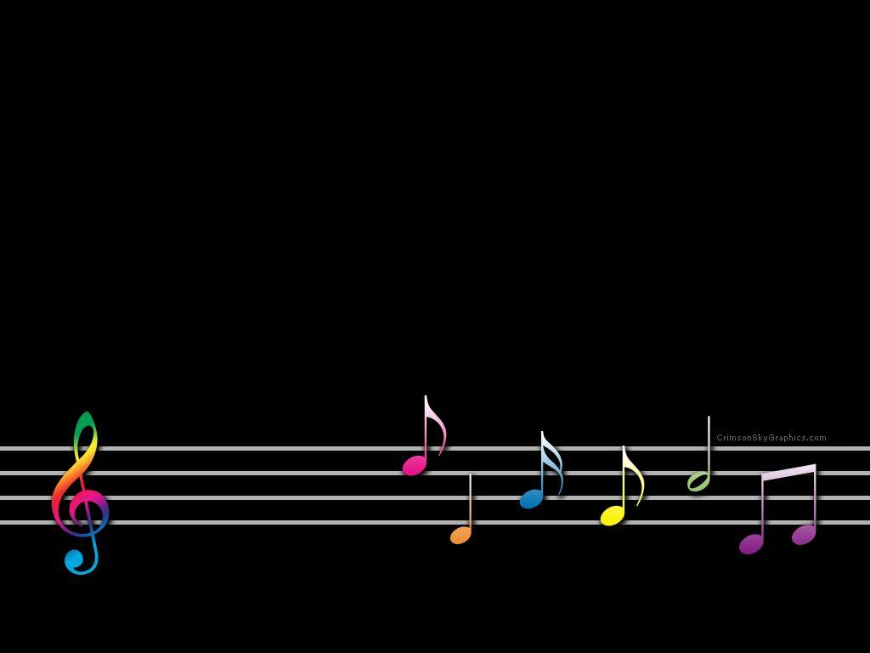
Junior Musician Badge
Home Edition 2020
Girl Scouts of Central Illinois Getyourgirlpower.org

Slide 2

Just about everyone loves music. And making it is as fun as listening to it. Whether you’re already a musician, or you just want to see what it’s like to make sounds on an instrument, there’s something for you in this badge.

Slide 3
Step 1 - Explore How Music is Madesic

Slide 4
Choose one
of these
three
options:
Find out about three different musical instruments.
Be a conductor. A conductor guides musicians through the music by keeping count & telling various instruments to start, stop and play loudly or softly.
Get in the musical mood. Find songs from orchestra, choir, opera, pop, jazz, blue grass, marching band and etc. Move to the music of as you listen.

Slide 5
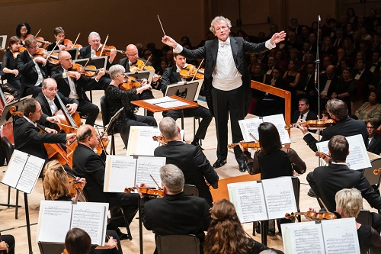

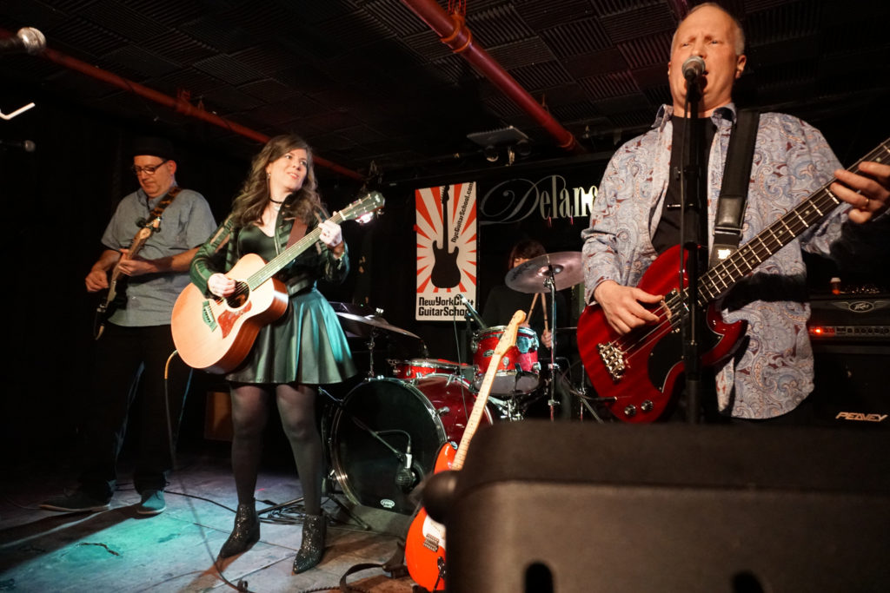

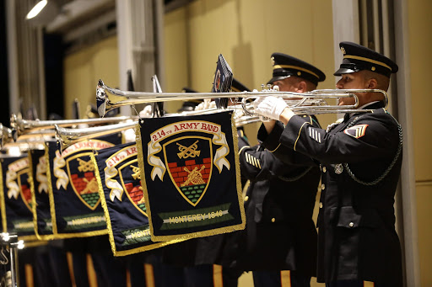
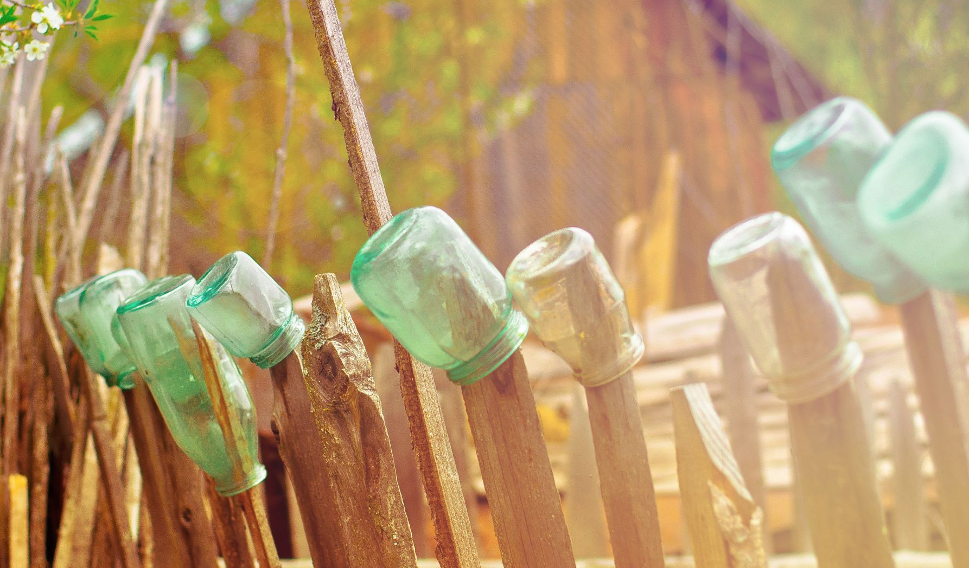
Step 1 Tips:
Get familiar with instruments
Test your knowledge of musical instruments with an fun quiz . For the answers, scroll down to the comment section.
Play Orchestra Instrument Bingo . Learn the distinctive sound of each instrument.
Watch a Concert Band . .

Slide 6
Musical Terms
Musical symbols are placed on a set of five lines and four spaces called STAFF. (That’s why paper on which music is written is called “staff paper.”)
A clef defines the pitch range of a piece of music. The most common are bass clef and treble clef.
A tie shows that two or more notes should be played together as one note.
Symbols placed next to the note tell you if it should be flat or sharp.
A measure is the section of the staff that comes between two bar lines.
A note symbol shows its length – how many beats it covers in a measure.
Some symbols indicate how a note should be played:
A lower case f stands for forte, which means the note should be loud. Three fs? Extremely loud!
The symbol for crescendo shows that the volume of a note should slowly get louder.
A rest shows a pause in the music.
A staccato dot means that the note should be played short and quick.

Slide 7
Step 2 - Travel Around the World of Musicsic

Slide 8
Choose one
of these
three
options:
Listen to one pop song from three different countries. Talk about what you think of the songs and how they’re similar or different to other music you’ve heard.
Find out more about three composers and their music. As part of your three, choose one modern and one historic composer. Listen to one piece from each.
Oh say, can you see? The anthem for the United States is “The Star-Spangled Banner.” Listen to and compare the U.S. anthem with anthems from three other countries. When and why are the anthems played? What do they have in common? And, how do they make you feel?

Slide 9
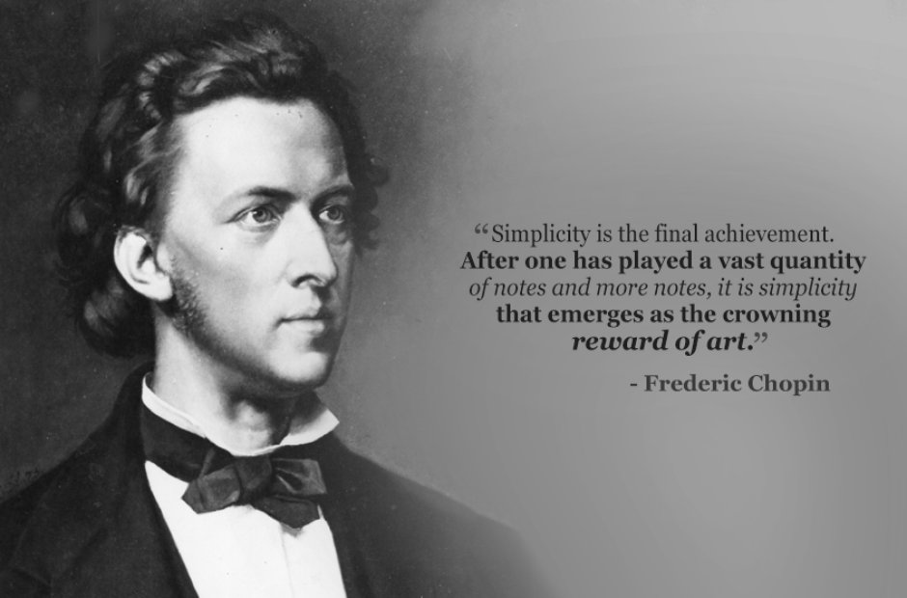
Step 2 Tips: Find music you might recognize from other countries
Listen to stereotypical music from around the World here .
A songs that everyone knows is Happy Birthday. Listen to Happy Birthday in the Styles of 10 Classical Composers here .
Listen to the top 10 National Anthems from around the World here .
.

Slide 10
Step 3 - Check out the music in your lifesic

Slide 11
Choose one
of these
three
options:
Take a music poll. Ask five members of your family or friends what their favorite type of music is and why. Also, ask them to play (or sing) you their favorite song and tell you why they like it.
Go to a live musical performance. Team up with an adult and your friends to attend a local music event. If you can’t go in person, find your favorite artist on Youtube or their website.
Interview someone with a job in music. It might be a performer, a sound engineer, a music critic, or a music teacher. Find out why they became interested in music, and why they like their job. Again, find virtual sources if you can’t meet.

Slide 12
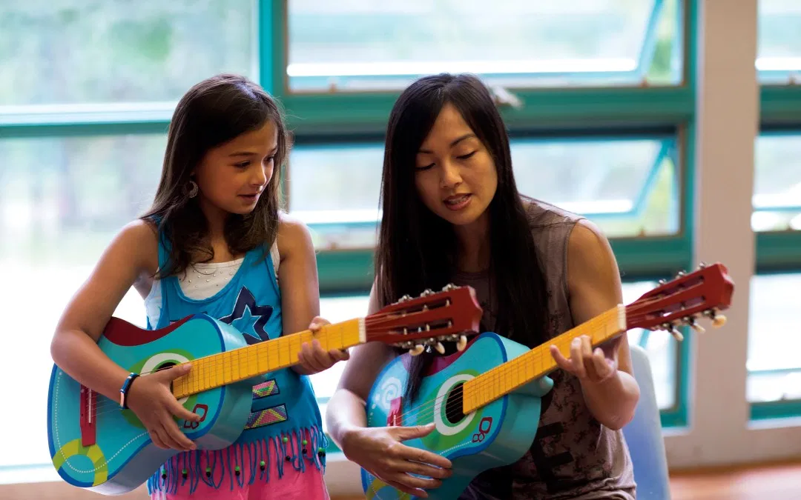
Step 3 Tips: Find out how music sets a mood
Get to know different genres of music here and here .
Watch an interview with a music producer here . Watch an interview with a music video director here . Watch an interview with a film scoring composer here .
Watch how movies make you “feel” with music here..

Slide 13
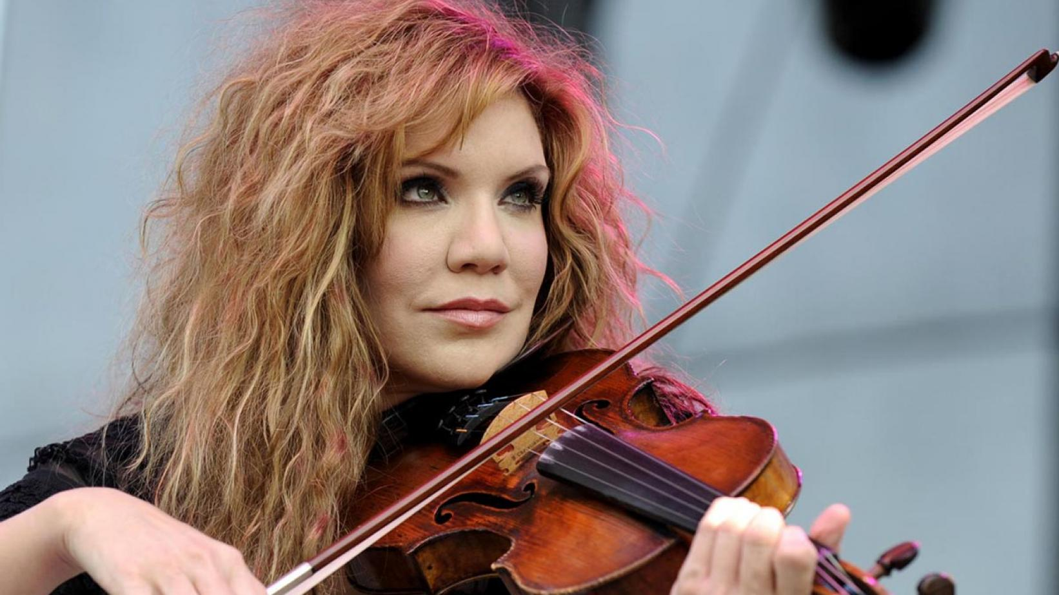
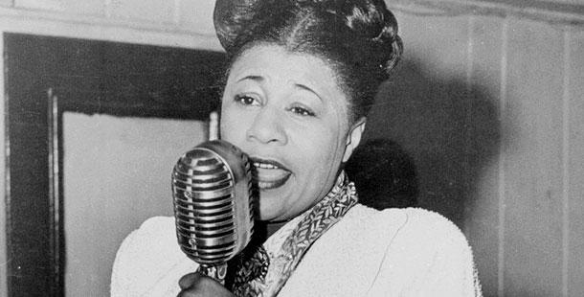
Famous Female Musicians
Alison Krauss was born in Decatur, Illinois, in 1971. She began classical violin lessons at age five, and then switched to bluegrass when she got a little older. When Alison was 13, the Society for the Preservation of Bluegrass Music of America called her the “Most Promising Fiddler in the Midwest.” Today, she holds the record for the female artist with the most Grammy awards in history.
Ella Fitzgerald was born in Newport News, Virginia, in 1917. She lived in an orphanage after her mother died in 1932, but she always loved to dance and sing. When Ella was 17, she sang at the Apollo Theater in Harlem, New York. The audience loved her. She won 14 Grammy awards in her career, earning the nickname “The First Lady of Song.” She died in 1996 at the age of 79, but her legacy lives on.

Slide 14
Step 4 - Make your own music

Slide 15
Choose one
of these
three
options:
Make a simple instrument. You might make musical glasses, maracas, or a drum. Play a simple song or keep a basic rhythm on your instrument.
Compose your own song. Writing music takes a lot of training, but you can start in a simple way. If you play an instrument, write a melody of at least eight measures. Show notes, key, tempo, and dynamics. Try to teach someone to play your piece – or make it a duet and practice the song together!
Make up lyrics to a song. The words in a song are called lyrics. Using the tune of a song you know, make up new words and write them down. Most lyrics rhyme, so see if yours can, too!

Slide 16
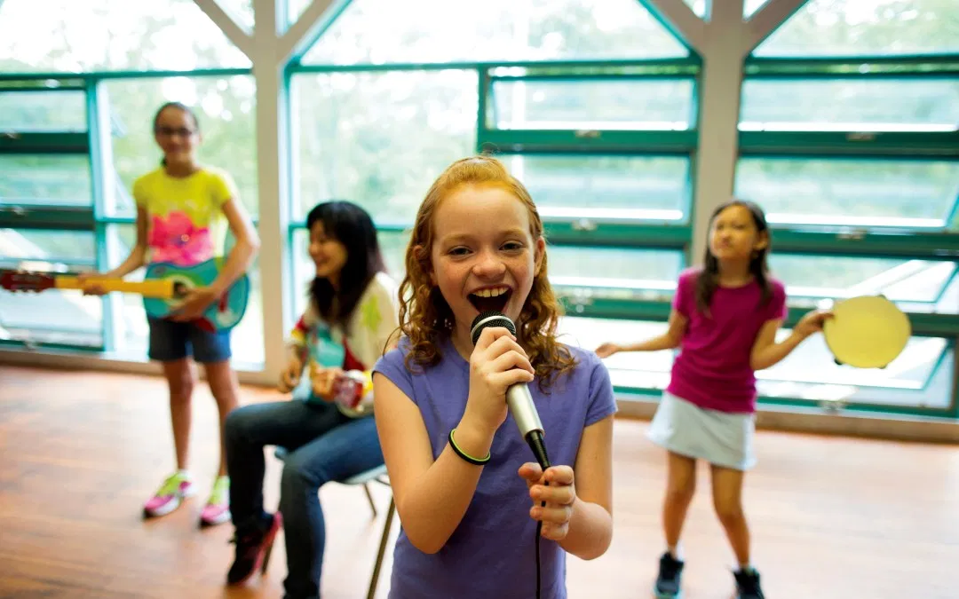
Step 4 Tips: Get creative with DIY music making
Learn how to make several musical instrument crafts at home here . Learn how to make an acoustic guitar from cardboard here .
Write your own Girl Scout song - perhaps an energetic summer camp song or jazzy song about your troop. Listen to examples of Girl Scout troops remaking their favorite pop songs into cookie selling masterpieces here and here and here .

Slide 17
Step 5 - Perform Your Own Music

Slide 18
Choose one
of these
three
options:
Create a performance. Use your new instrument, new composition, or reworded song from the previous step. Video your performance until you can play in a group and use everyone’s musical talent together.
Perform in a musical event. It could be a school play, recital, band concert, or a church choir. Invite your Girl Scout friends to come and watch your perform or make a video to share.
Add to your skills. It you’re a seasoned musical performer, try to take a solo in a concert, conduct a group, help others in the band practice their parts, or record background sounds or a soundtrack for a play.

Slide 19

Share your progress and final performance:

