Slide 1


Leader Instructions & Meeting Prep:
Junior Girl Scout Way Badge
Junior Girl Scout Way Badge: :meeting plan supply list::
For S.W.A.P.S.: (**If you don’t think girls would have these items at home, you could just have them watch this video for ideas, then use whatever craft supplies they do have on hand to make up their own SWAP!)
Medium size craft pompoms
Medium and Small safety pins
Small piece of white ribbon
Glue
For Creative S’mores: (If you think girls likely do not have these items on hand or making these together virtually could be difficult, you could just have girls discuss and come up with their own unique recipes—to be made later!)
Graham crackers
Marshmallows
Chocolate
Creative Items to make your own unique s’more twist
The following slides will walk your troop through a virtual meeting to earn the Junior Girl Scout Way Badge. When you share your screen during your meeting, be sure to click “Present” so girls see the full screen. Also, when you are sharing your screen in zoom, google meet, or another meeting app, please make sure you are sharing both picture and audio. For more information on using Zoom, visit gsnw.gl/VirtualMeetingHowTo
Many of the interactive activities included are shared through YouTube videos. Just click on the arrow in the center of the image to play the video, and the girls can see it too! You should try to review the slides before your meeting if possible, so you are familiar with the activities and any supplies needed.
This meeting will typically take approximately 60-90 minutes as written, depending on participation level and number of girls. As always, Girl Scouting is flexible, and troops may select the activities interest them most, add their own activities, or have girls do some of the steps afterward as “homework”.
When you send out your meeting invitation, be sure to let girls and parents know what supplies they should have on hand for the online troop meeting. They are things most girls likely have at home.

Slide 2


Welcome to our Virtual
Troop Meeting!
Brought to you by Girl Scouts of the Northwestern Great Lakes

Slide 3


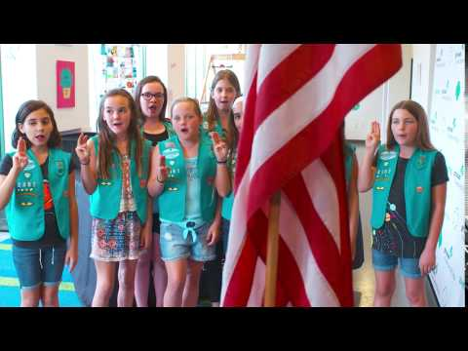
Let’s start our meeting with the Girl Scout Promise
Girl Scout Promise
On my honor, I will try:
To serve God and my country,
To help people at all times,
And to live by the Girl Scout Law.

Slide 4


Let’s say the Pledge

Slide 5
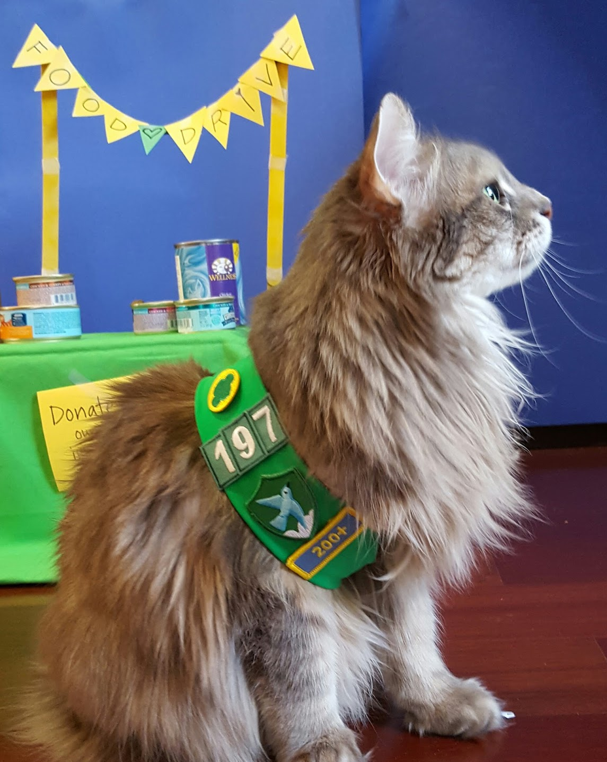
Earning the
Girl Scout Way badge
Celebrate Girl Scout History
Match Girl Scout Songs to an occasion.
Celebrate Girl Scout Sisterhood
Try out a Girl Scout tradition
Leave a place better than when you found it.

Slide 6
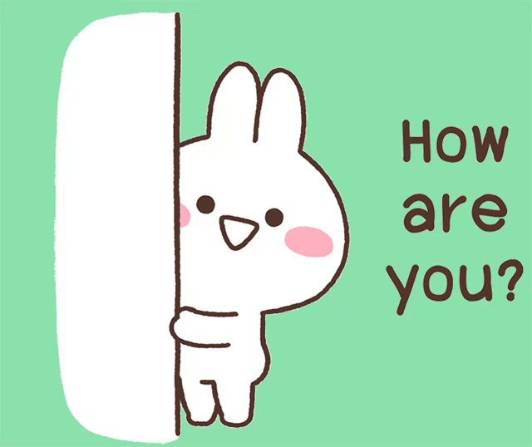
Check in:
Tell us one thing that was fun or special about this week, and one thing that was a challenge.

Slide 7

Girl Scout
History Trivia!

Slide 8
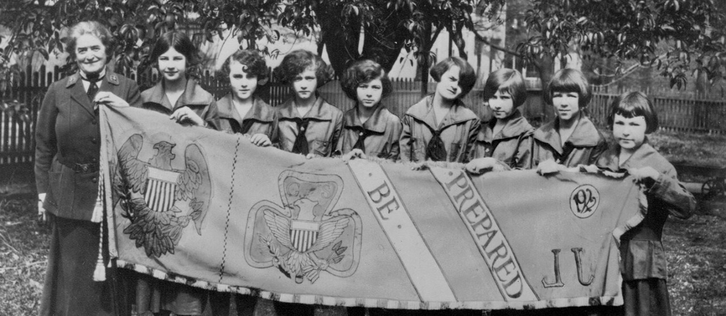
Who was the founder of Girl Scouts?

Slide 9
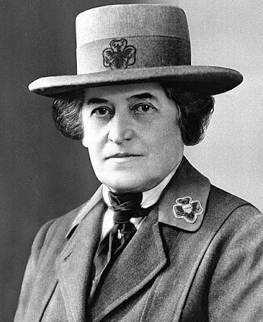

Juliette Gordon Low

Slide 10
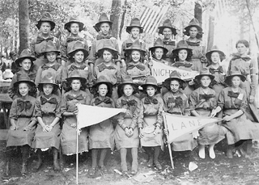
What Year was Girl Scouts Founded?

Slide 11
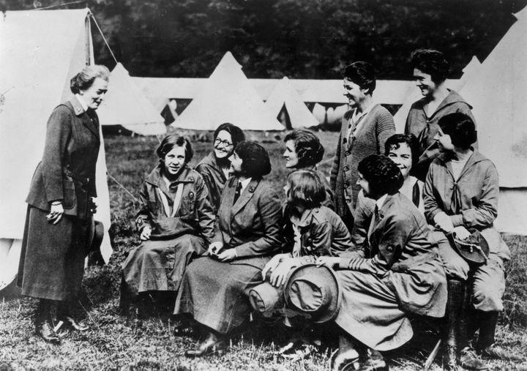
1912

Slide 12
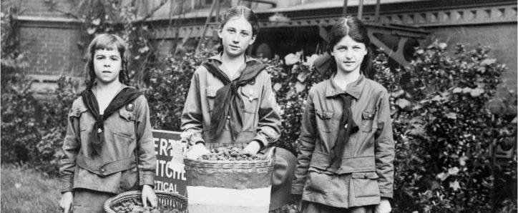
What were Girl Scouts called when they first started?

Slide 13
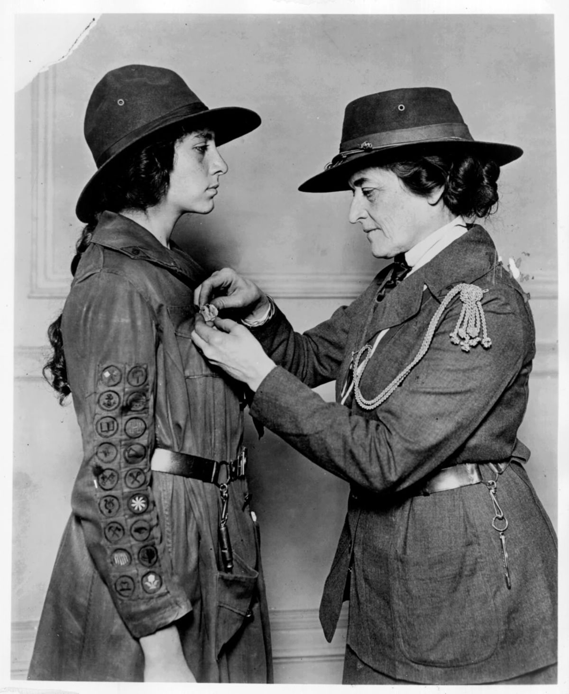
Girl Guides

Slide 14
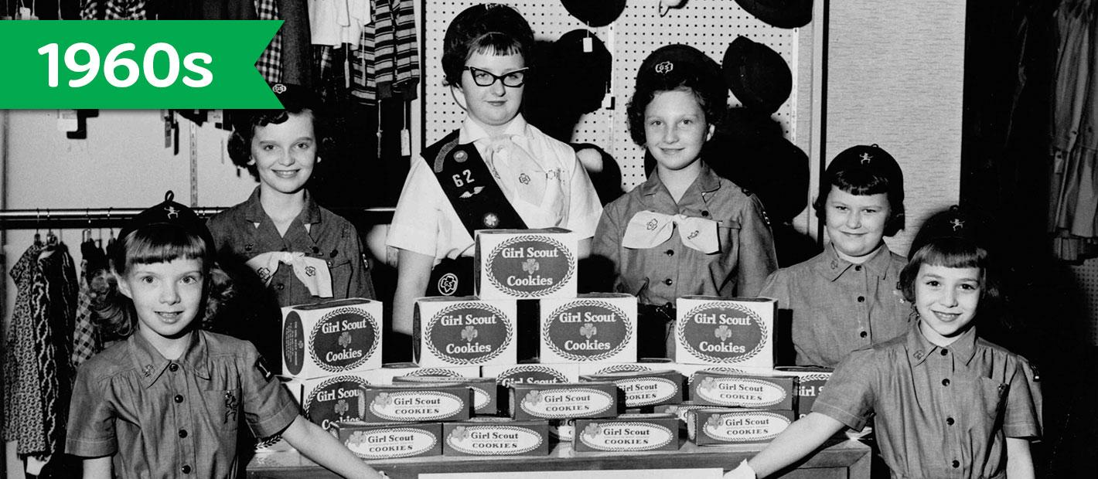
What year did Girl Scouts start selling cookies?

Slide 15






1917

Slide 16
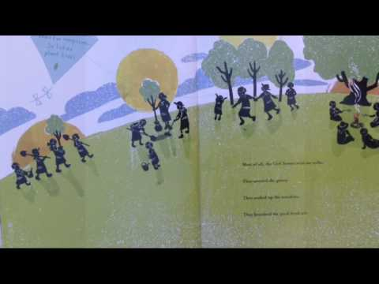
Meet Juliette Gordon Low!
Here Come The Girl Scouts!
Let’s listen to a story about how Girl Scouts began!

Slide 17
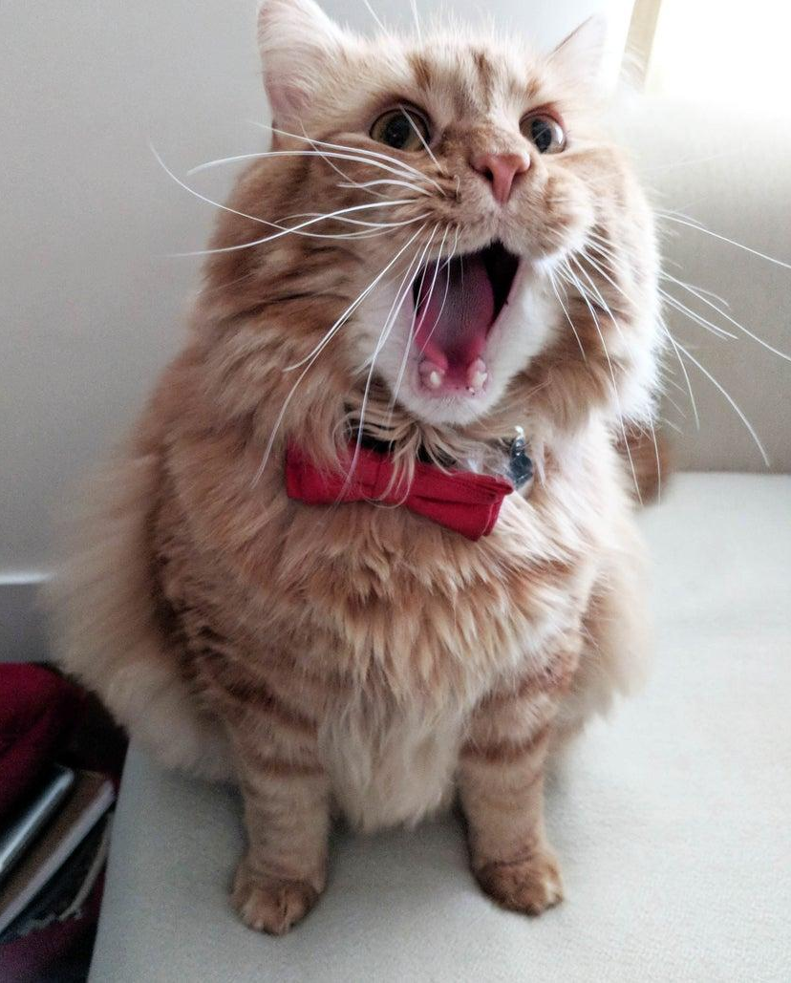
Girl Scout Songs
Do you know any?
Why do Girl Scouts sing songs?
Different songs are sung for all different occasions. Let’s learn some songs along with some Enthusiastic Girl Scouts – then, let’s think about when would be great times to sing these songs.

Slide 18
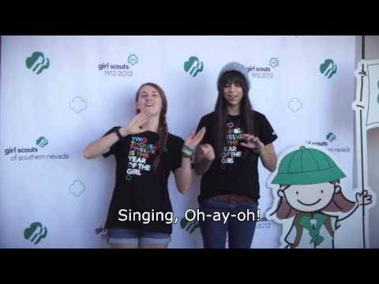
Great Big Moose

Slide 19
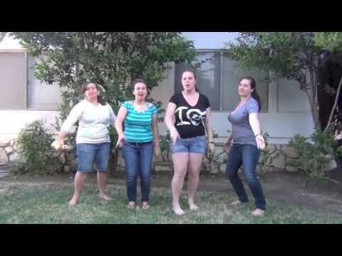
The Banana Song

Slide 20
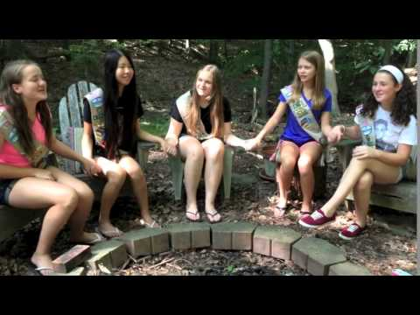
Make New Friends

Slide 21
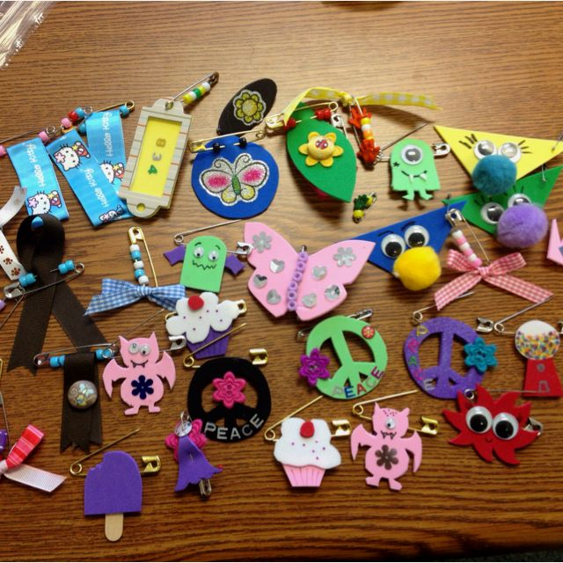
Celebrating Sisterhood,
Girl Scout Style
S.W.A.P.S.

Slide 22
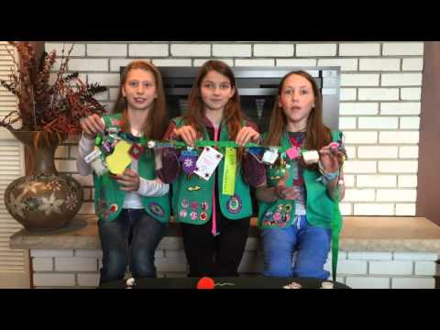

Slide 23
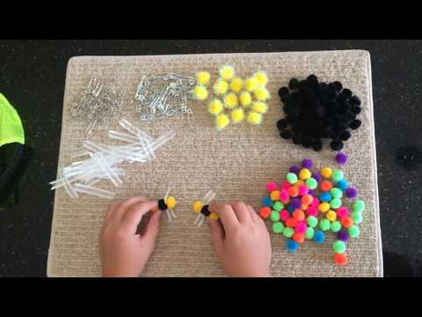
Make your own S.W.A.P

Slide 24
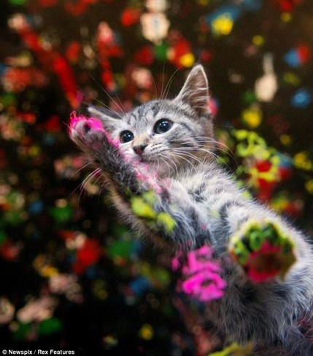
Create your own S.W.A.P. design!
S.W.A.P.S. can be anything! Use your imagination and craft supplies you have at home and create your own S.W.A.P. design.
Swaps are usually:
Small enough to be pinned on hats, packs, etc. easily
Usually have a safety pin attached, so they can be added to a collection
Usually have a tiny card attached, that shows the first name and troop number of the creator and year it was made.

Slide 25
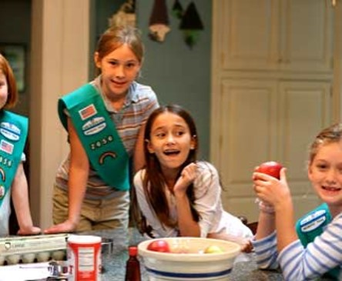
Virtual Snack Time!
When you think about Girl Scout snacks, what is one snack you might have heard about Girl Scouts eating?
Hint: It’s NOT Girl Scout Cookies!

Slide 26


S’MORES

Slide 27
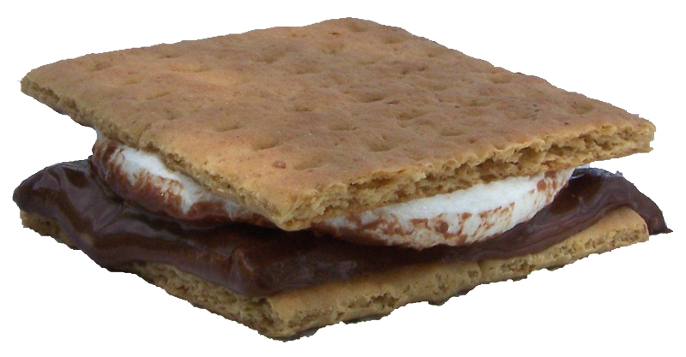
S’mores Challenge
Now – take the classic Girl Scout s’more recipe, and make it even better!
What ideas do you have for adding or changing ingredients to make it even better?

Slide 28
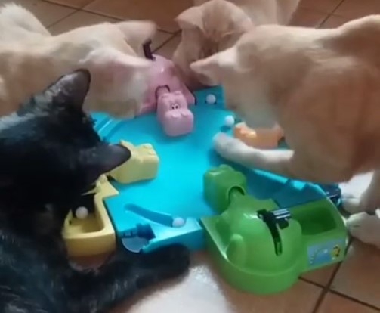
Play a Traditional
Girl Scout Game
Kim’s Game:
Show each picture for just 20 seconds and let’s see how many items we can remember!

Slide 29
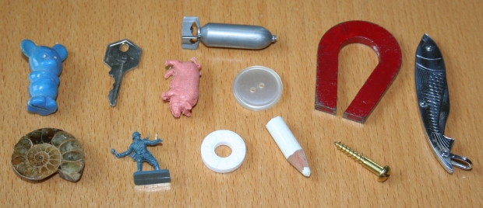

Slide 30
How many things can you remember?
?

Slide 31
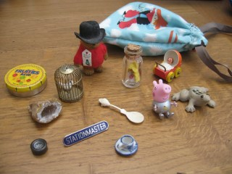

Slide 32

What did you see?
?

Slide 33
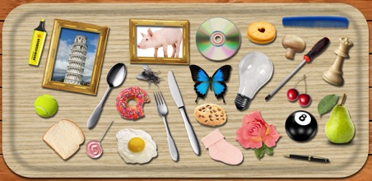

Slide 34

How many things can you remember?

Slide 35
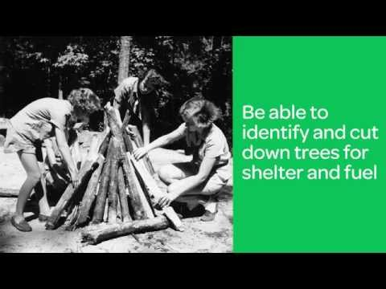
Do you have what it takes to earn the very first Girl Scout badges?
The Pioneer Badge:

Slide 36

The Flyer Badge:

Slide 37

Juliette always said...
Leave a place better than you found it!

Slide 38
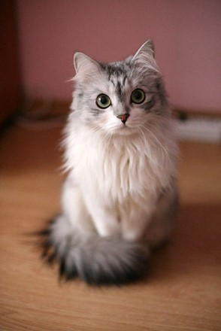
Badge Homework
Leave a place better than you found it.
What place will you improve?
Ideas:
Clean out a room at home, such as a bedroom or toy room, and find at least 10 things that you can donate to charity.
Do some yard work
Or, come up with your own idea!

Slide 39
See you next time!

