Slide 1
Junior Entertainment Technology

Slide 2
Step 1:
Animate Your Own Artwork!
For our first step you are going to create your own stop motion film. Supplies you are going to need are:
A Smart Phone
The app Stop Motion Studio
A poseable doll or clay figure

Slide 3
1.
What is stop motion?
It is a type of animation made up of photos where the character is moved slightly between each picture then shown quickly to make it look like its moving
Stop Motion Animation was used for
Caroline
The Nightmare before Christmas
The Little Prince
King Kong
James and the Giant Peach

Slide 4
Making your animation
With by deciding what scene you want to film with your “actor”. You will want it to be a very short scene as it takes many photos to make an animation
You will want to make your camera as steady as possible. If your camera is in the same place for all of your photos, the animation will come out smooter.
Set up your first pose

Slide 5
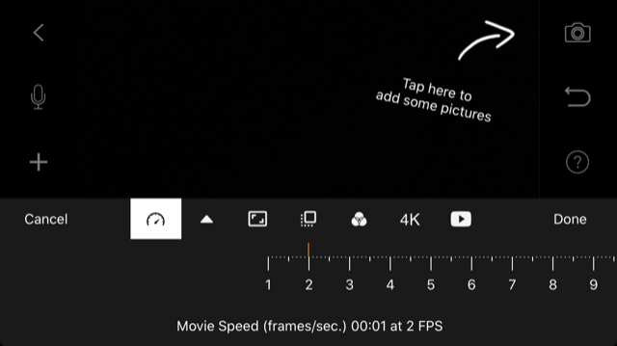
Making your animation cont.
Open the Stop Motion Studio App and select new movie
Choose the gear on the bottom left side of the screen to open setting. We are going to lower the frames per second for your movie. It may make the animation a little choppier, but it means you will have to take a lot less photos.
                Switch your movie speed to 2 frames per second as in the photo.

Slide 6
Making your animation cont.
Now, take your pictures!
Click on the camera on the right side of the screen and take your photos moving your “actor” slightly between each. You will want the phone to be landscape.
You can watch your progress by hitting the play button under the red button.
When you are done, the back button is on the top right.

Slide 7
Adding audio (optional)
If you want to add sound to your animation, you can click on the microphone on left hand side of your screen and record from there.
Tip: Make sure you have the first photo selected before you click on audio, that way your sound starts at the beginning.

Slide 8
Save your video
When you are done with your video, click the back arrow in the top left corner.
Click the select button in the top right corner, then on your movie
The second button from the left that is now blue, will bring down a menu you can export movie.
Once you’ve chosen export movie, scroll down to save video and now your video is saved on the phone.

Slide 9
What stop-motion does best is present real objects magically brought life in a very imperfect situation;the hand of the artist is there, the electricity of someone touching, massaging and torturing themselves to get life out of an inanimate object.
-Henry Selick- creator of Nightmare before Christmas

Slide 10
Step 2: Dig into Video Game Development
Watch the video on the next slide and think about these questions.
What kind of skills do you need to work in video games?
What kinds of things do you like to make?
What type of video game would you like to make?

Slide 11
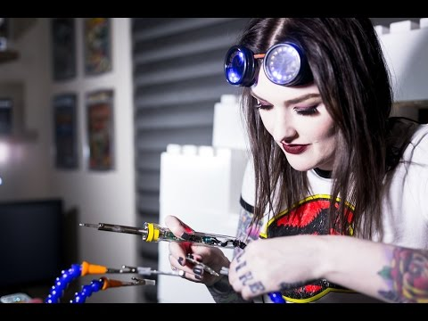

Slide 12
Step 3:
Try the science of amusement park rides.
In this step you will create your own roller coaster with materials you find around your house.
You will need a marble or other small ball to act as the cart on your coaster.
You will need whatever supplies you want to create the track of your coaster and tape to keep it together.

Slide 13
1.
What materials can you use?
You can be creative! Some ideas are:
Cardstock, cardboard or paper with the edges folded up (so the marble stays on)
Toliet paper or paper towel rolls cut in half
The edges of paper plates cut off

Slide 14
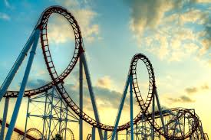
Building your coaster
Since our coasters doesn’t have any mechanics, you will need to start up higher. You are going to using gravity to give your rollercoaster energy.
Try expirementing with different heights of hills for your coaster and then try adding turns and even loops

Slide 15
A couple of things to keep in mind
Make it smooth
Don’t go too extreme
Keep the energy going
If you put to sharp of drops or turns in your rollercoaster, your marble will likely go flying off the track. Things like to go in the same direction that they are already going and won’t react well to sudden change. This is Newton’s 3rd Law.
If there are jumps between your parts of the track your marble will go flying. Use your tape to piece it together as smoothly as possible.
Make sure to put enough hills in to keep your marble going. If the track is flat for too long, it will stop moving.

Slide 16
Step 4:
Create your own special effects
For this step we are going to look at stage makeup. When in a live performance, all of the actors on stage wear some makeup so their expressions can be seen under the bright stage lights, but they can also do some cool special effect makeup to change how they look.

Slide 17
What is stage makeup used for?
Two of the most common kinds of special effect stage makeup you’ll find are aging makeup and for injuries/scars.
Injuries/scars
Uses different colors to create scars or bruises to make it look like an actor has been hurt. Can also you add ons to make it look like the skin is raised for a cut or scar.
Age Makeup
Uses darker and lighter makeup to create shadows so it looks like the actor has wrinkles

Slide 18


Slide 19
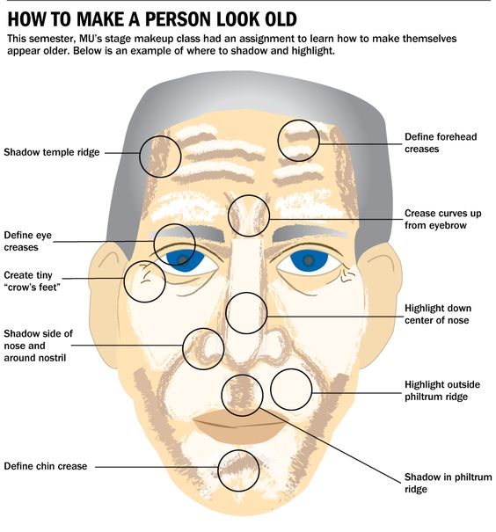
Give it a try!
Try and give yourself a make older. Take your time and focus on creating shadows for your wrinkles. Eyeshadows, brow pencils, bronzers and different shades of foundation are all good tools to use just make sure ask before you use it.

Slide 20
Step 5:
Surf a Soundwave
Often times the sounds we hear in a movie or on radio are not what they seem. Sound designers will you sound effects to create the sound they want if it isn’t practical or safe to get the actual sound or if the actual sound isn’t loud enough or sounds right to the director.

Slide 21
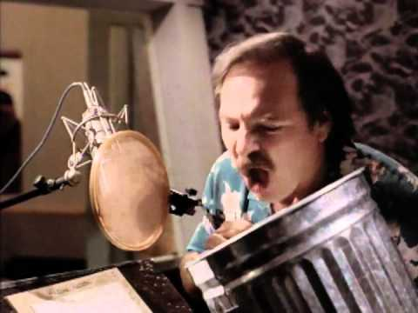
1.
What makes the lions’ roar?
Sound affects like these are often associated with radio, but if you’ve ever seen Disney’s Lion King you’ve heard them. Lion’s roars were intense enough for the film makers and are dangerous to get so they used tiger sounds, jets and a guy with trash can.

Slide 22
Try and make your own sound effects!
A Crackling Fire
Crumble a piece of cellophane or wax paper
Walking on Snow
Put cornstarch on the ground and press shoes into it.
Howling Wind
Seal up a ziplock full of air except for a small hole. Place the bag on a flat surface and push all of the air out.
Horse Hooves
Use two plastic cups and tap them against the table with the top of the cup down. Alternate them to sound like walking.
Birds Flapping
Wave leather or rubber gloves to get the sound of wings flapping
Town Bell
Tap a metal pan witha stick.

Slide 23

Congrats! You’ve Earned Your Junior Entertainment Technology Badge!
Use this hashtag to share with us what you did!

