Slide 1
Junior Eco Camper Badge
Girl Scouts of Central Illinois

Slide 2
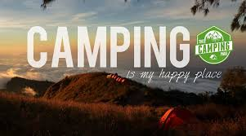
Whenever you step outdoors, you are a guest in nature’s home. This is especially true when it comes to camping. Whether or not you’ve been camping before, you will earn this badge by learning how to protect the environment on your trip. It will shape the way you camp forever!

Slide 3

Purpose: When I’ve earned this badge, I’ll have learned skills for minimal impact camping and know how to protect the environment when I go outdoors.
Steps
1. Learn the Leave No Trace Seven Principles
2. Plan meals with the environment in mind
3. Prepare a minimal impact campsite
4. Have fun with Leave No Trace
5. Take a conservation hike

Slide 4
Learn the Leave No Trace Seven Principles
Learn and be prepared to use the Leave No Trace Seven Principles to help protect the environment on your trip:
Plan ahead so you leave nothing behind. Get to know the area you’ll visit. Repackage and store food in reusable containers. Travel and camp on durable surfaces. Walk only on existing trails and camp on surfaces that are already impacted or are durable enough to withstand repeated trampling. Dispose of waste properly: Carry out what you carry in—never dump anything on a campsite or into a water source. Leave nature as you find it—don’t collect or take anything from the outdoors. Minimize campfire impacts: Instead of using firewood and building campfires, pack a lightweight cooking stove and lantern. Respect wildlife by checking them out at a distance. Never approach, feed, or follow them. Be considerate of other visitors. Remember you’re not alone in the wilderness. Keep your voices down and let nature be the loudest sounds you hear.

Slide 5
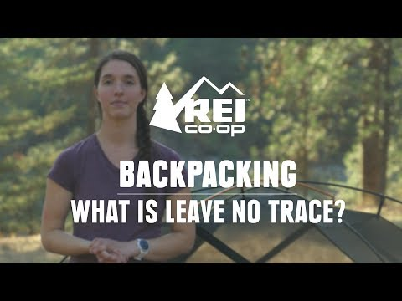
Step 1: Use Your Knowledge
Use what you just learned about the Leave No Trace Seven Principles and conduct an interview! You may call an experienced camper, park ranger or camp director and ask how they use these principles. Then plan to take their advice on your next adventure! Enjoy this video to learn more!

Slide 6
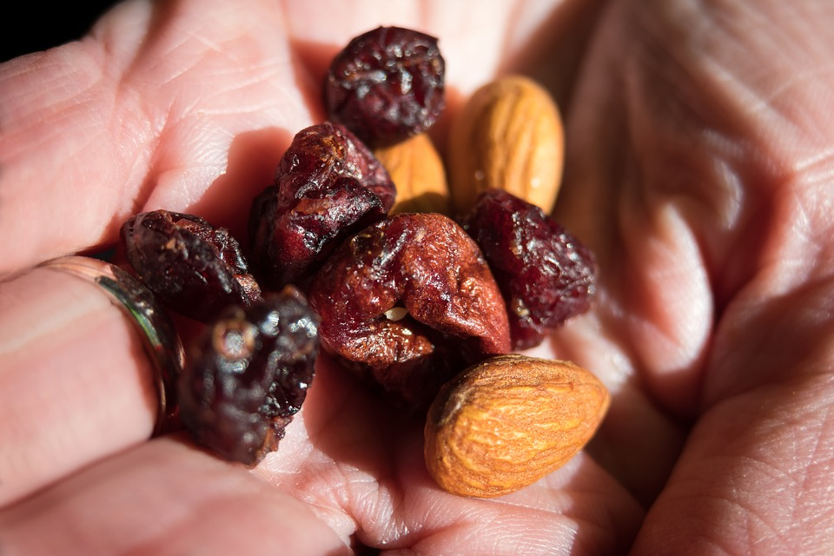
Plan meals with the environment in mind
Your next challenge is to pack and prepare food that will leave the least amount of waste on a campground. Choose one of the following examples to make and enjoy:
Trail mix-use your favorite items!
Cream cheese roll ups with veggies
Fresh fruit and yogurt parfait

Slide 7
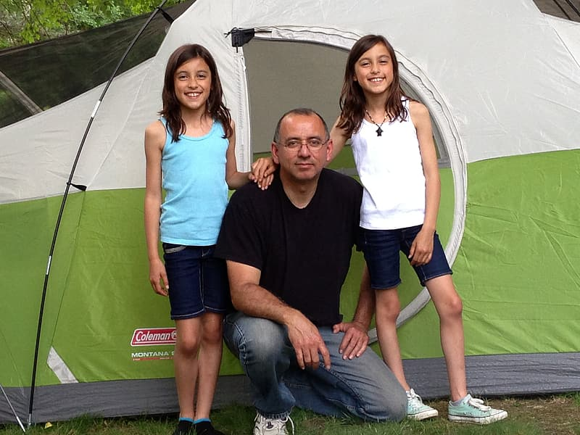
Prepare a minimal impact campsite
Browse the Leave No Trace website for blogs, videos and fun activities!
Leave No Trace Website
Then, pretend you are going camping this weekend! Check the weather forecast and make a list of items you will need, depending on the weather. For example, if rain is in the forecast, you will need to pack ponchos and tarps. If it will be extra warm, you should pack sunscreen and hats! Use the above website to find more items to pack!

Slide 8
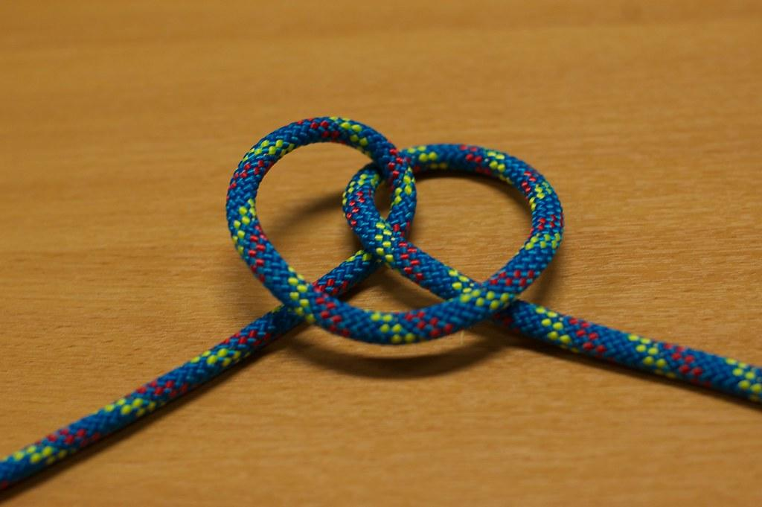
Have fun with Leave No Trace
Time to practice your knot-tying skills! There are 10 examples on this link to Girlscouts.org. Please choose at least 5 to try, or try them all!
10 Essential Knots

Slide 9

Take a conservation hike
Take a walk with your family and record wildlife! Record sounds you hear, and photograph, film or sketch what you see in a journal. Look for animal tracks. Do you see a nest where an animal has rested? Be sure to keep your distance. At the end of your walk, share your recordings, images or journal sketches with your friends or family!
Here are 2 websites to review animal tracks, as well as, birds and their sounds! Have fun!
Animal Tracks
Birds and Sounds

Slide 10

You have earned the
Junior Eco Camper Badge!
Please take a moment to complete the following survey!
Survey Link
Thank you!

