Slide 1


Leader Instructions & Meeting Prep:
Junior Detective Badge
Junior Detective Badge: :meeting plan supply list::
Pencils
Paper
Baking Soda
Tablespoon
Cup to mix solutions in
Q tips
Lemon juice
Grape juice
Paintbrushes
Nail file
Scotch tape
Clear glass drinking class or bowl
The following slides will walk your troop through a virtual meeting to earn the Junior Detective Badge. When you share your screen during your meeting, be sure to click “Present” so girls see the full screen. Also, when you are sharing your screen in zoom, google meet, or another meeting app, please make sure you are sharing both picture and audio. For more information on using Zoom, visit gsnw.gl/VirtualMeetingHowTo
Many of the interactive activities included are shared through YouTube videos. Just click on the arrow in the center of the image to play the video, and the girls can see it too! You should try to review the slides before your meeting if possible, so you are familiar with the activities and any supplies needed.
This meeting will typically take approximately 60-90 minutes as written, depending on participation level and number of girls. As always, Girl Scouting is flexible, and troops may select the activities interest them most, add their own activities, or have girls do some of the steps afterward as “homework”.
When you send out your meeting invitation, be sure to let girls and parents know what supplies they should have on hand for the online troop meeting. They are things most girls likely have at home.

Slide 2

Junior
Detective Badge
Learn to solve mysteries and fight crime!
Brought to you by Girl Scouts of the Northwestern Great Lakes

Slide 3
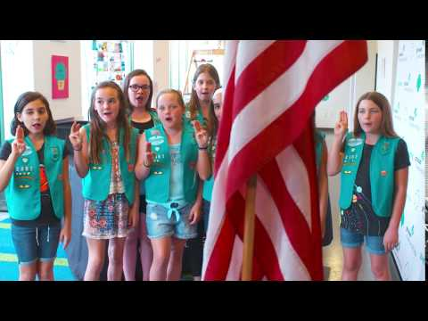

Let’s start with the
Girl Scout Promise!

Slide 4


Pledge of
Allegiance.

Slide 5
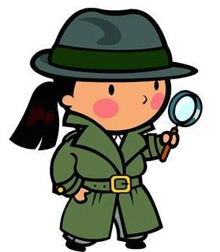
Icebreaker!
Most detectives have cool names and secret identities. What’s your detective name?

Slide 6

Step 1:
Detectives have
To be very
Observant. Test
your powers of
observation!

Slide 7
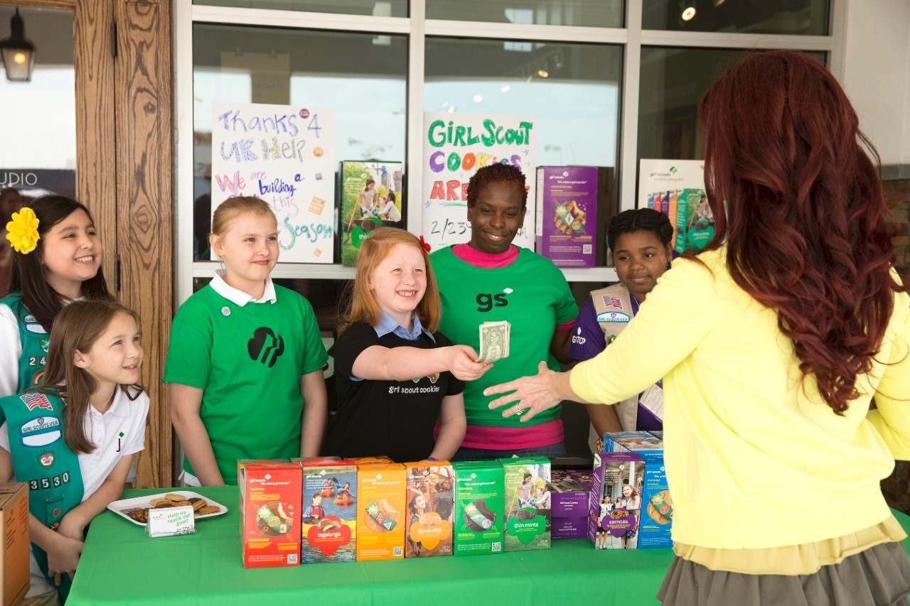
Look at this picture for 30 seconds.

Slide 8
Do you remember?
How many Girl Scouts were selling cookies?
What level was this troop?
What color was the customer’s shirt?
How many people in the picture were wearing glasses?
What color was the flower in the picture?
What kind of cookies was the customer buying?
What color hair did the Girl Scout who was making change have?

Slide 9

Step 2: Create a secret message!

Slide 10
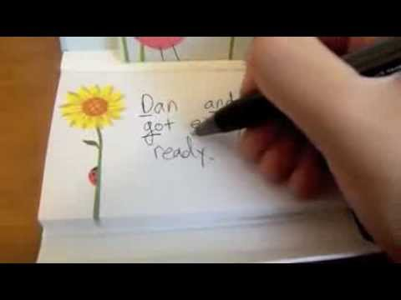

Slide 11
Now, using this same pattern, make your own coded message. Then, let’s try to solve them!

Slide 12
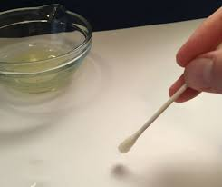
Invisible Ink
Recipe 1: Mix 4 tablespoons baking soda with four tablespoons water.
Dip a q-tip or paintbrush into your mixture, and write a message on white paper.
Allow your message to dry for about 20-30 mins.
After it has dried, paint over your message with grape juice, and see it reappear!
Recipe 2: Dip a q-tip or paintbrush in lemon juice and let it dry.
Then, (with an adult helper) use a hair dryer on a low setting, or hold near a light bulb to heat up the paper and reveal your message!

Slide 13
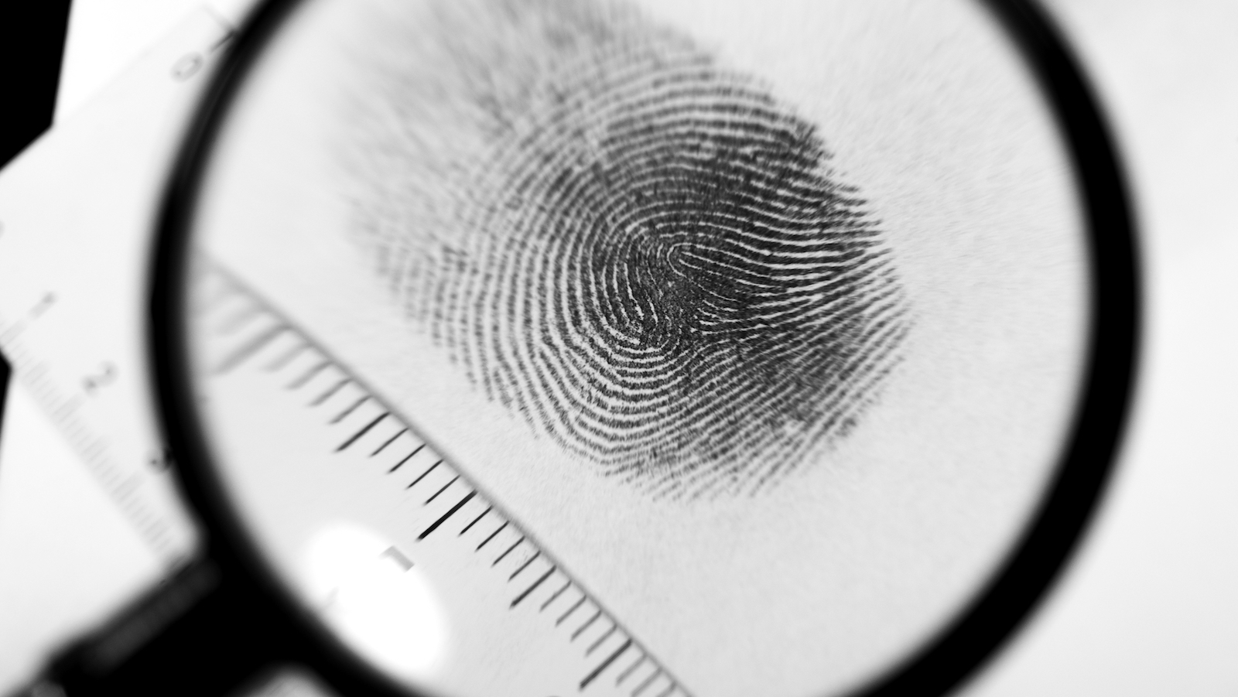
Step 3: Fingerprints

Slide 14
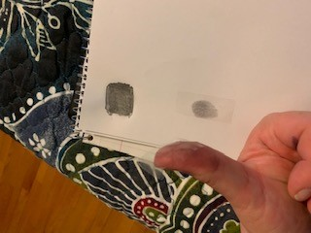
Fingerprint yourself!
Draw a small square on a piece of paper, and color it in with a pencil, as dark as you can.
Press your finger down on it, as though you were being fingerprinted
Put a piece of clear tape on the end of your finger, covering the print
Then gently remove the tape, and attach it to the paper so you can see your print clearly.
Repeat for each finger.

Slide 15
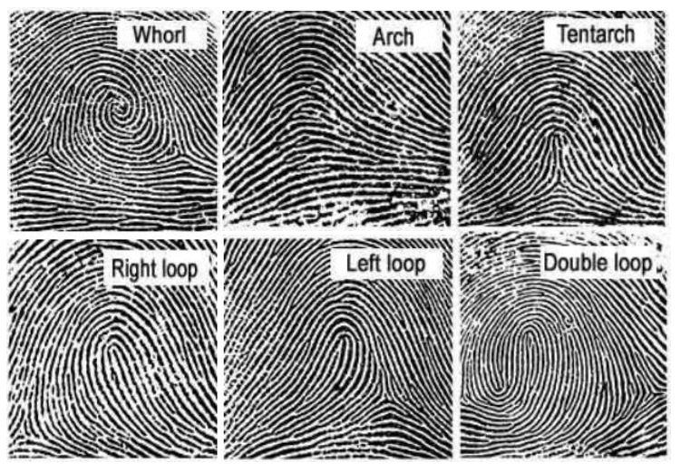
Type of fingerprints.
What types do you have?

Slide 16

Dust for prints!
How do detectives gather prints at a crime scene?

Slide 17
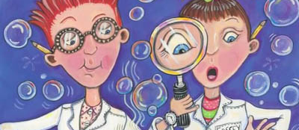
Step 4: Try out Detective Science

Slide 18
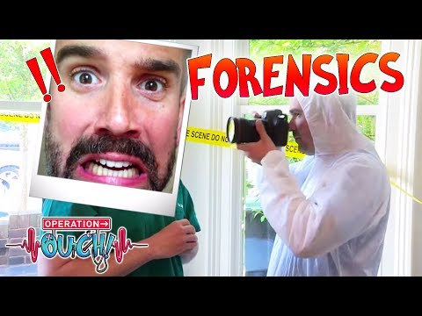
Forensic Science
What is evidence? Write down all the evidence you see in this video.

Slide 19

Step 5: Look for clues

Slide 20

To finish Step 5...
At home, hide a mystery object or secret message. Create at least 5 clues that will help a family member in your home find it! Then, have them create a clue hunt for you!

Slide 21
You have officially earned the
Detective Badge

