Slide 1
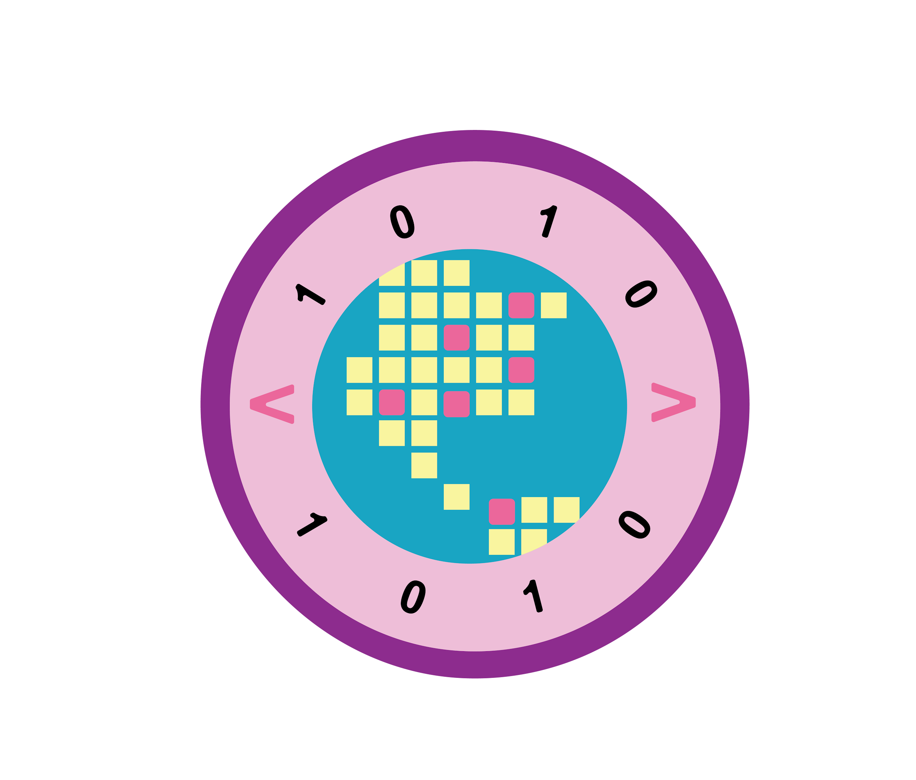

Leader Instructions & Meeting Prep:
Junior Coding: Basics Badge
Junior Coding Basics Badge: :meeting plan supply list::
Something to write with, pen or pencil
Paper to write on
The following slides will walk your troop through a virtual meeting to earn the Junior Coding Basics Badge. When you share your screen during your meeting, be sure to click “Present” so girls see the full screen. Also, when you are sharing your screen in zoom, google meet, or another meeting app, please make sure you are sharing both picture and audio. For more information on using Zoom, visit gsnw.gl/VirtualMeetingHowTo
Many of the interactive activities included are shared through YouTube videos. Just click on the arrow in the center of the image to play the video, and the girls can see it too! You should try to review the slides before your meeting if possible, so you are familiar with the activities and any supplies needed.
This meeting will typically take approximately 60-90 minutes as written, depending on participation level and number of girls. As always, Girl Scouting is flexible, and troops may select the activities interest them most, add their own activities, or have girls do some of the steps afterward as “homework”.
When you send out your meeting invitation, be sure to let girls and parents know what supplies they should have on hand for the online troop meeting. They are things most girls likely have at home.

Slide 2

Coding: Basics
Junior Badge
Brought to you by Girl Scouts of the Northwestern Great Lakes

Slide 3




Program Pillar: Life Skills
STEM
Outdoors
Entrepreneurship
Life Skills
Girls become better problem-solvers, critical thinkers, get better grades, and see STEM as the foundation for a meaningful and successful future.
Girls discover that they can better problems and overcome challenges, build social bonds, and become team players that care about protecting our environment.
Girls gain new skills, ​
build their confidence ​
and develop an entrepreneurial mindset over time.
Girls gain the skills and the inspiration to accept challenges, overcome obstacles, and take the lead.
Notes:
In Girl Scouts, everything we do is either about STEM, Outdoors, Entrepreneurship, or Life Skills. This month we are going to focus STEM – Science, Technology, Engineering, and Math

Slide 4





5 Outcomes
Sense of Self Girls have confidence in themselves and their abilities and form positive identities.​
Positive Values Girls act ethically, honestly, and responsibly, and show concern for others.​
Challenge Seeking Girls take appropriate risks, try things even if they might fail, and learn from mistakes.​
Healthy Relationships Girls develop and maintain healthy relationships by communicating their feelings directly and resolving conflicts constructively.
Community Problem Solving Girls desire to contribute to the world in purposeful and meaningful ways, learn how to identify problems in the community, and create action plans to solve them.
Notes:
The whole point of Girl Scouts is to build 5 outcomes. The one we are going to work on today is Challenge Seeking, which means we want you to feel comfortable taking risks even if you are afraid of making a mistake.

Slide 5
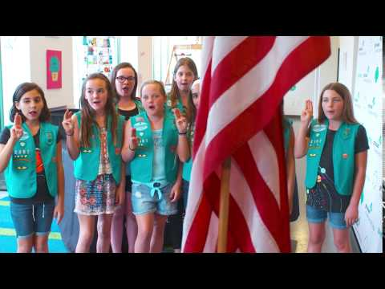

Join in the
Girl Scout Promise!

Slide 6


Pledge of
Allegiance.

Slide 7
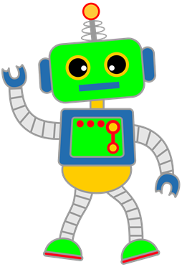

Icebreaker: Would you rather?
Build a robot
Build a airplane
Notes:
In order to annotate, go to the top of your screen (might have to click more) then ANNOTATE, you should be able to see all the different ways to write or stamp on the powerpoint.
tell us what you would rather do… you can stamp/write your name/draw

Slide 8

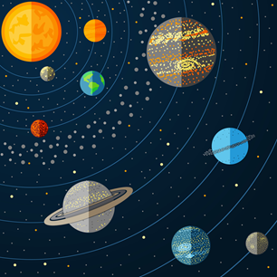
Icebreaker: Would you rather?
Do a science experiment
Learn about space
Notes:
Using annotation, tell us what you would rather do…

Slide 9
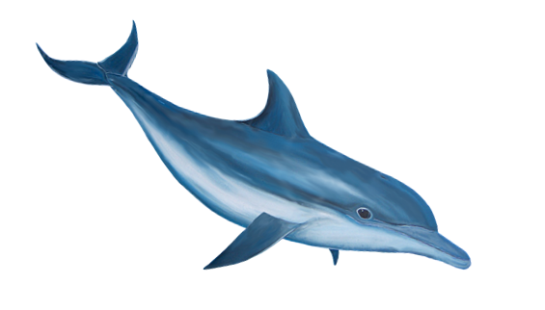
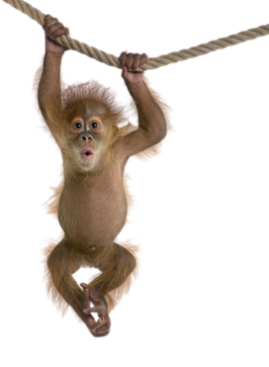
Icebreaker: Would you rather?
Have a dolphin
Have a monkey
Notes:
Using annotation, tell us what you would rather do…

Slide 10
Girl Scout History
Some Fun Facts
Notes:
Leader: Make polls for the highlighted words, they have to guess the correct answer…

Slide 11

Founder Juliette Gordon Low’s nickname was ________?
Daisy
Peanut Butter
Cookie

Slide 12
Her nickname was
DAISY

Slide 13
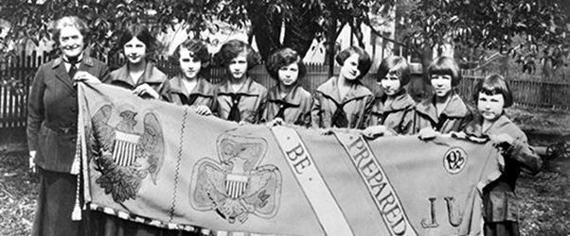
Where was the first troop formed in 1912?
Green Bay, WI
Miami, FL
Savannah, GA

Slide 14
The first troop was formed in
SAVANNAH, GA
This troop had 18 girls in it.
Notes:
Presenter: Make polls for highlighted words, they have to guess the correct answer…

Slide 15
In 1917, a troop in Oklahoma became the first to ________ as a fundraiser.
Sell SWAPS
Bake & sell cookies
Sell popcorn

Slide 16
They were the first to
BAKE & SELL COOKIES
Other troops followed their lead, and in 1935, troops began to sell commercial Girl Scout cookies.

Slide 17
The Girl Scout Motto is ________?
Be Prepared
Lead the Way
Do Your Best

Slide 18
The Girl Scout motto is
BE PREPARED

Slide 19
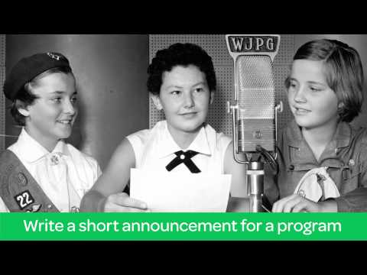
One of the first Girl Scout Badges to earn was Radio & Television!
How is this similar OR different from how we earn badges now?

Slide 20

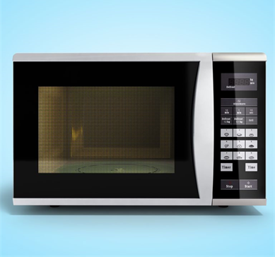
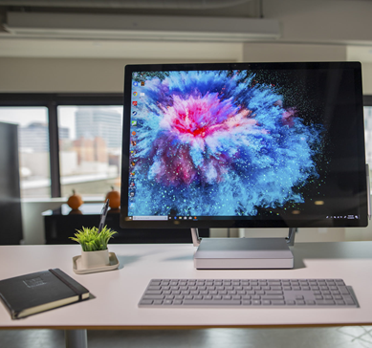
Types of Computers
Notes:
A car's computer and electrical system operates everything from air conditioning, radios, the braking systems, air bags, alarm systems, engine controls and so much more!
A microprocessor chip, a basic version of a computer, controls the heating and timing functions of the microwave while taking input from the control panel and various sensors.
A computer is a machine composed of hardware and software components. A computer receives data through an input unit based on the instructions it is given and after it processes the data, it sends it back through an output device

Slide 21
When it comes to computers, EXACT directions are important!
Giving directions to a computer can be tricky.
A computer can only do exactly what it is told. In the exact order you say.
If a direction is unclear, the computer can’t ask questions or figure it out on its own.

Slide 22
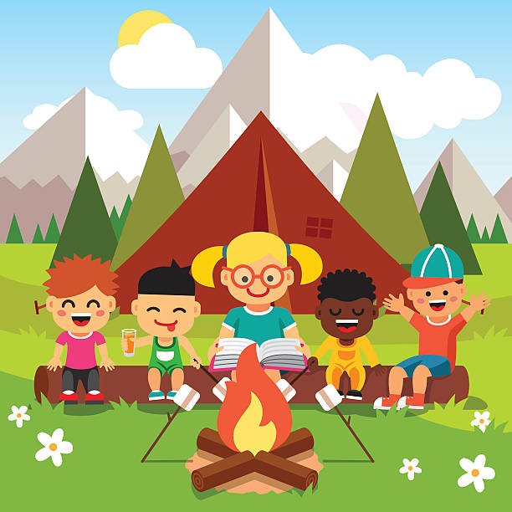
Computers use algorithms to take direction from us.
An algorithm is a process or set of rules to be followed.
Anything can be an algorithm, even directions to building a campsite.
  For example: Find a flat space and clear the rocks BEFORE you set up the tent, otherwise the floor of the tent will be lumpy.

Slide 23
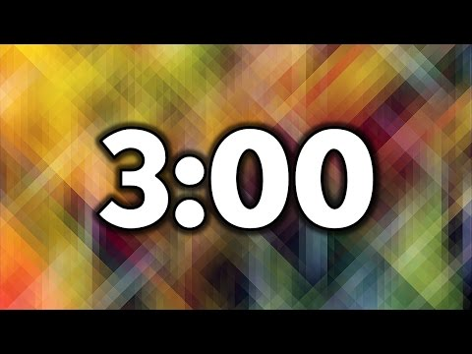
Let’s try making our own algorithm for building a campsite.
You’ll have 3 minutes to create a list of instructions to tell us how you would set up your campsite. Be as specific as possible.
What will it have? A tent? A fire?
How will you set these things up?

Slide 24
1
Creating an algorithm for a computer that follows a sequence
The directions that programmers write is called an algorithm. The order of the directions is called a sequence.
Sometimes the order matters, sometimes it does not.
Think back to your campsite algorithm.
Let’s try it out with Scratch! https://scratch.mit.edu/projects/editor/?tutorial=getStarted
Notes:
Presenter: Click the link to go through an algorithm with the girls. https://scratch.mit.edu/projects/editor/?tutorial=getStarted
The next slides will give you more instruction on what to add to your algorithm to make it more complex

Slide 25
2
Use loops to improve your algorithm
A loop, is when your algorithm/set of instructions, is repeated.
When you take turns and follow the rules of a game over and over again, that’s a loop.
Create a loop on Scratch:
In control, find repeat
Add repeat
Right Click
Duplicate (repeat 1x)

Slide 26
3
Adding conditionals
Keep your code interesting with conditionals
Programmers code conditional statements to get computers to react to different situations. They’re written with IF/ELSE statements: IF something happens, THEN do this. ELSE, do something else.

Slide 27
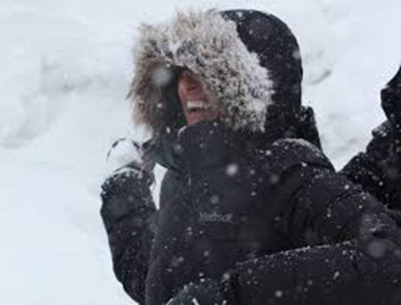
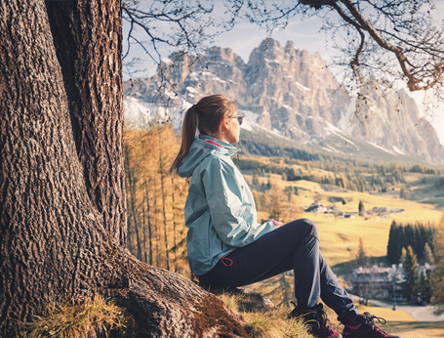
Examples of conditionals
IF it’s snowing, wear a warm coat
ELSE, wear a light jacket

Slide 28
Why conditionals are important
If you only give one command such as wear a coat, the only option will be to wear the same coat over and over.
Imagine wearing just a raincoat when it’s snowing outside. You’ll freeze.
With conditional statements, you can give the options to wear different coats depending on the whether.
This way, programmers can make coding more interesting and more flexible.

Slide 29
4
Adding commands
Create your own set of commands that use conditionals
When computer programmers write conditionals in their code, they think about different situations and tell the computer what to do IF that situation comes up.

Slide 30
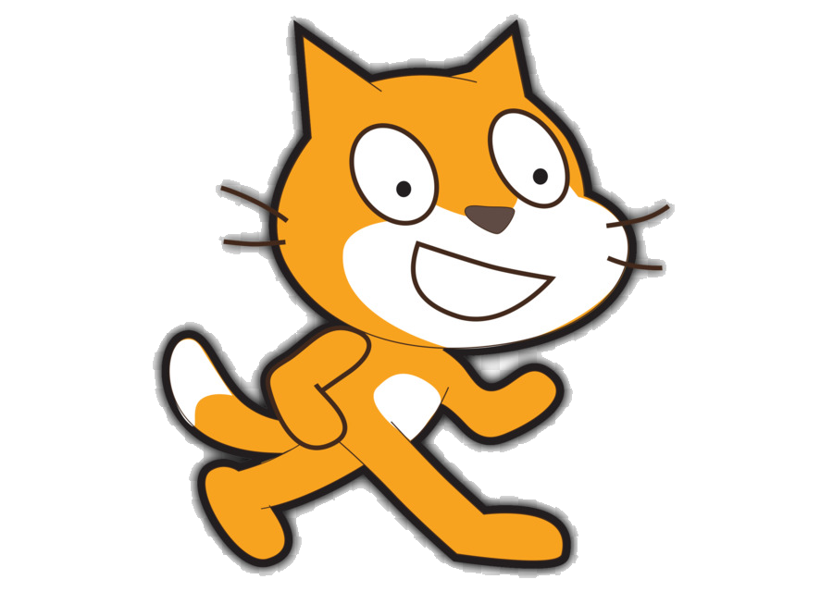

How to use conditionals and commands in Scratch
Go to control, add IF, then, ELSE
Add any commands in there
IF (this), then (that), ELSE (something else)
Make sure to fill it out completely for it to work

Slide 31

Let’s get some wiggles out!

Slide 32
Now it’s time to learn about
Women in Computer Science
Women have played a key part in the history of coding.
Notes:
Presenter: Let the girls know what to do next.
The next slide will have pictures and descriptions of three women and what they did with computer programming.
The girls job is to match the picture with the correct description.

Slide 33
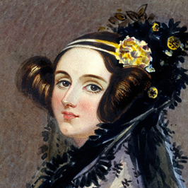
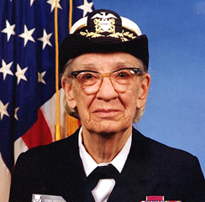
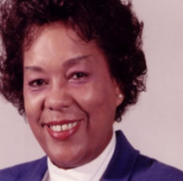
1
2
3
Ada Lovelace
Grace Hopper
Ray Montague
Wrote the first computer program when she was only 17 years old. She created the code for the first mechanical computer, invented by Charles Babbage in the early 1800s.
In the 1970s, she was the first person to figure out how to design a ship using a computer—then she designed one in less than 24 hours!
This woman and her team created some of the first electronic computers, like Mark 1, in the 1940s. The computers were huge—the size of whole rooms. She predicted that someday people would be able to hold a powerful computer in their hands.
Notes:
Presenter: Read the descriptions outloud for the girls

Slide 34
1
2
3
Ada Lovelace
Grace Hopper
Ray Montague
Wrote the first computer program when she was only 17 years old. She created the code for the first mechanical computer, invented by Charles Babbage in the early 1800s.
In the 1970s, she was the first person to figure out how to design a ship using a computer—then she designed one in less than 24 hours!
This woman and her team created some of the first electronic computers, like Mark 1, in the 1940s. The computers were huge—the size of whole rooms. She predicted that someday people would be able to hold a powerful computer in their hands.

Slide 35
Congratulations,
You have earned your Junior Coding Basics Badge!

