Slide 1
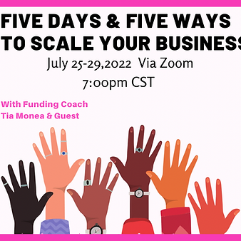
5 Days &
5 Ways To Scale Your Business
By Tia Monea

Slide 2
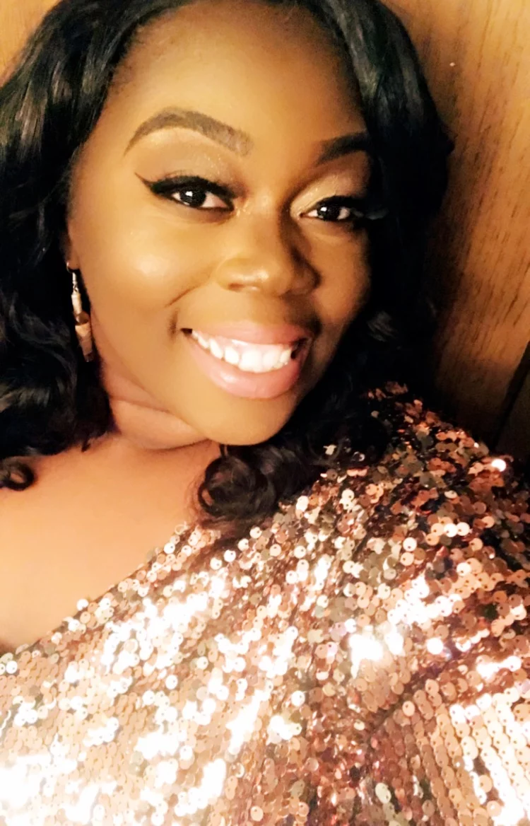
Tia Monea
Tia Monea is a multi entrepreneur from Springfield Illinois. She obtained her Communication Degree at the University of Illinois at Springfield. She has twenty plus years of experience with working with children and has a passion for helping others. She currently has five amazing businesses that she operates. She’s been in business for ten years and enjoys helping entrepreneurs reach their full potential. Her faith is very important to her and in her spare time she enjoys manifesting.

Slide 3
5 Days & 5 Ways To Scale Your Business
Why- As a small business owner finding resources for your business can be challenging and overwhelming.
Who- Anyone interested in Growth!
Rules
Be yourself
Have fun
Participate
Be Respectful

Slide 4
DAY 1. Pitch
Introductions
What is a pitch
Why are pitches important
Different types of pitches
Types of pitches
Elevator Pitch - Short to the Point
Pitch Deck - Visual presentation usually to investors
Sales Pitch - To sell a product tells a story

Slide 5
Time to PITCH
P- Purpose
I- Is It believable
T- Target, Who’s your audience
C- Clear vs. Clever
H- How will it be given

Slide 6
Time to Work!
Tell Your Story Activity

Slide 7
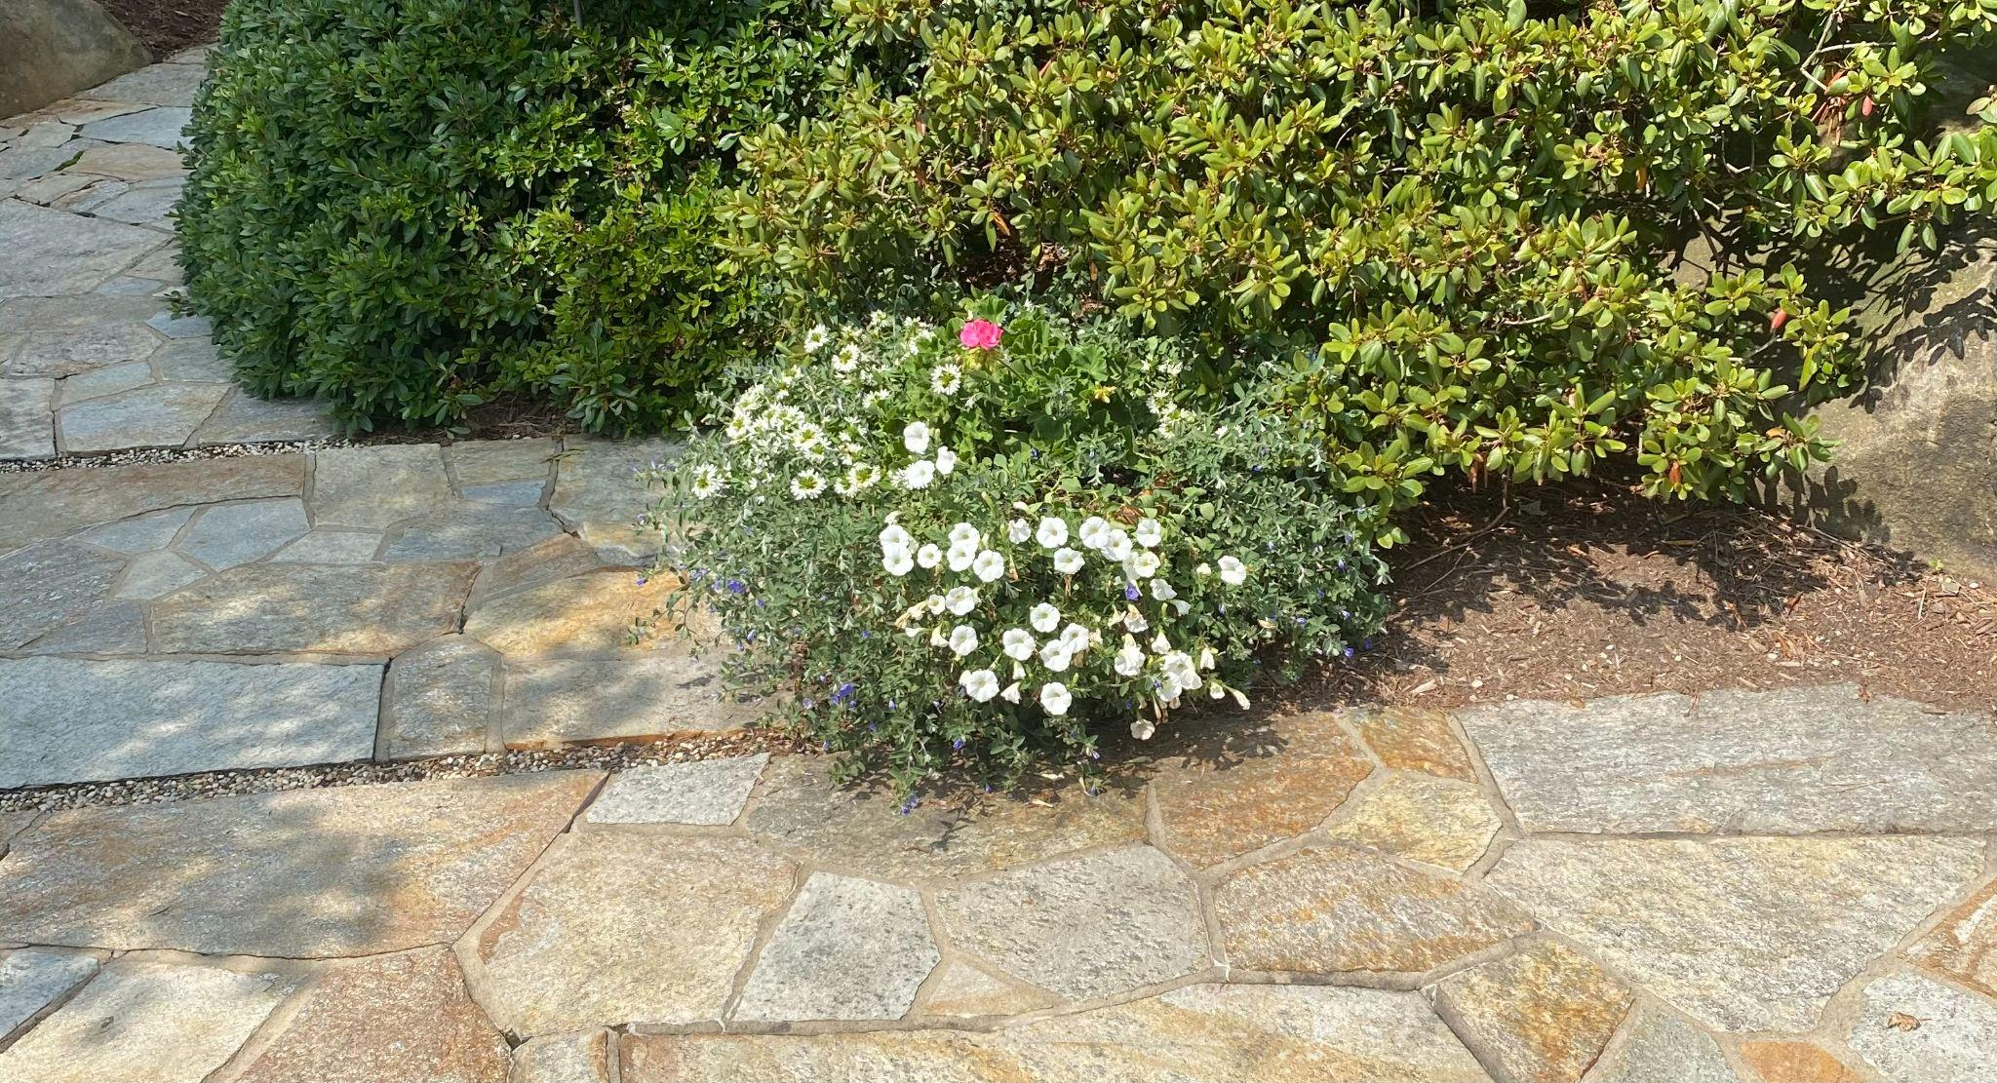
Purpose
Why- 7 whys
Pink Flower

Slide 8
Is it Believable
You don’t want it to be gimmicky
Be real

Slide 9

Target Market
Be clear on who your target is. You want to drill your target down as much as possible.

Slide 10

Clear Vs Clever
It’s not a time to be clever and confusing. Tell your audience what you want them to know. My example of my pitch-

Slide 11

How will you present your pitch
Email
Audio
In Person
How effective will it be.

Slide 12
Your Scale Assignment 1
Make a video or go live in the Made by Monea Millionaires group doing a 1 min pitch on who you’re and what your business offers.
Use hashtag #tmonea
Once you complete this save it! You can use this to send to new clients and future investors
Due by tomorrow !

Slide 13

Questions?
Tia Monea
tmonea@madebymonea.com
www.madebymonea.com
217-751-8120

Slide 14
Day 2 - Content Creation
Jaleesa Davis is a Licensed Nail Technician and the Owner of Glaze Nail Salon in Springfield, IL. She graduated in 2011 with a bachelor’s degree in Business Administration and Management. Jaleesa has a passion for helping other, she started a Non-Profit called Girls Glory where she braids young girls’ hair for free to help boost their confidence. In her spare time she loves helping others and spending time with her family.

Slide 15
Day 2 - Scale Assignment
Create a post using your brand colors asking your clients a question?
Emotions -
Action-
Ex- Have you recently had a bad day where you felt like giving up on your business?
Yes or no question
What would your business do with an extra 10k?

Slide 16
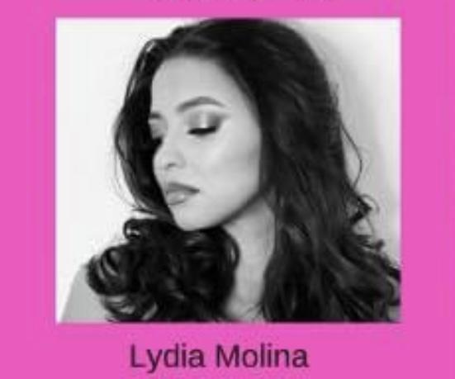
Day 3 Social Media for Small Business
Lydia Molina- Litty Made LittyMade Makeup is a movement. Members are encouraged to live as a Lucrative, Intelligent, Talented, Tenacious Young Boss. Makeup provides a safe space for all and when you look good you feel good, enough to be L.I.T.T.Y.
My services provide mobile makeup services to every client.

Slide 17
Hash Tags
what are the Types
of Hashtags?
Product or Service Hashtags: basic keywords
to describe your product or service
Niche Hashtags: keywords or phrases that
show where you fit in your industry
Industry Hashtags: what is your industry?
Just with a # in front
Special events/seasons/days: holidays,
events or just silly days hashtags
Location hashtags: local (State, City,
County/Parish,) tags that can reach your
near-audience
Branded Hashtags: a hashtag dedicated to
vour brand

Slide 18
Day 3 Scale Assignment
Visit Link Tree and see if will be beneficial for your business
https://linktr.ee
Make a post in the Made by Monea Millionaires group using your own unique hashtag
Showcasing your reason of why you became an entrepreneur
Ex- Hi my name is Tia Monea I’m the owner of Made by Monea I became an entrepreneur to break generational curses #mbm3 #tmonea

Slide 19
Day 4 Scale Assignment
Share something that you learned today in the workshop!
Use the hashtag #fivedaysandfiveways

Slide 20
Step 1 Explore Businesses You Might Like to Start Someday
Here’s some questions you can ask yourself to determine what type of business you would like to start.
What do you like to do in your spare time?
What are you passionate about?
Would you like to start a business to help other?

Slide 21
5 Days and 5 Ways How to Implement Business Programs To Grow Your Business II

Slide 22

Introduction Time!
Who are you?
Where you from?
Tell us a little bit about your business
Why do people need your business?

Slide 23

Why are you here?
Business programs can make or break your business.
It’s ok to ask for help
Business programs can add value to your business
In this 5 day program you will learn how to implement programs to make your business more efficient

Slide 24
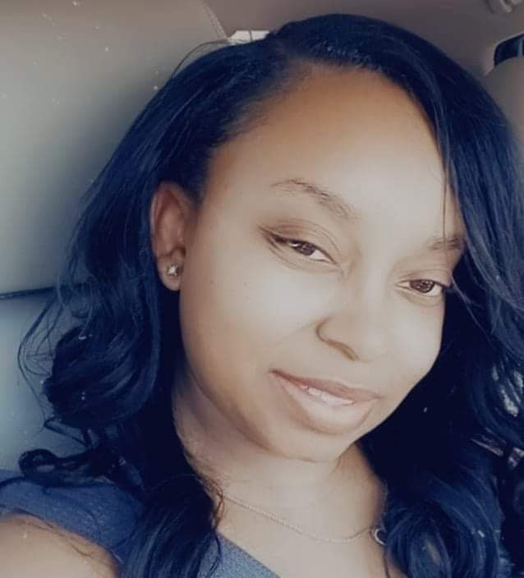
Meet Diya
Diya Lewis is an entrepreneur from Houston, Texas. She is the owner of Swift Tax Associates and DJL Solutions LLC. She has a degree in Liberal Arts and Accounting. She has over 15 years of Accounting and Tax experience. She specializes in full service Accounting, Bookkeeping and Tax Services. She is the person you call on when you need help organizing and maintaining your business finances. She is extremely passionate about Accounting and wants to help you reach your finance goals.

Slide 25
Quick Books
Why
How
Tips for Quick Books

Slide 26
Quick Books
https://quickbooks.intuit.com/

Slide 27
Excel
Why ?
How ?
Tips for Excel

Slide 28


Questions ?

Slide 29
Day 1 Task
View excel and Quick Books. Determine which one you feel is most useful for your business. Post why business owners should have either Quick Books or excel in Made By Monea millionaires group and use hashtag #fivedaysfiveways

Slide 30
How to create a Free Website on Wix
Why do you need a website
What’s a domain
How can a website scale your business

Slide 31
How to create a Free Website on Wix
https://youtu.be/g8zvCJ1A9X8

Slide 32

Task Takeaway - Website
Every great website has a bio!
Create a short bio introducing yourself and your business post it!
And use hashtag #fivedaysfiveways

Slide 33
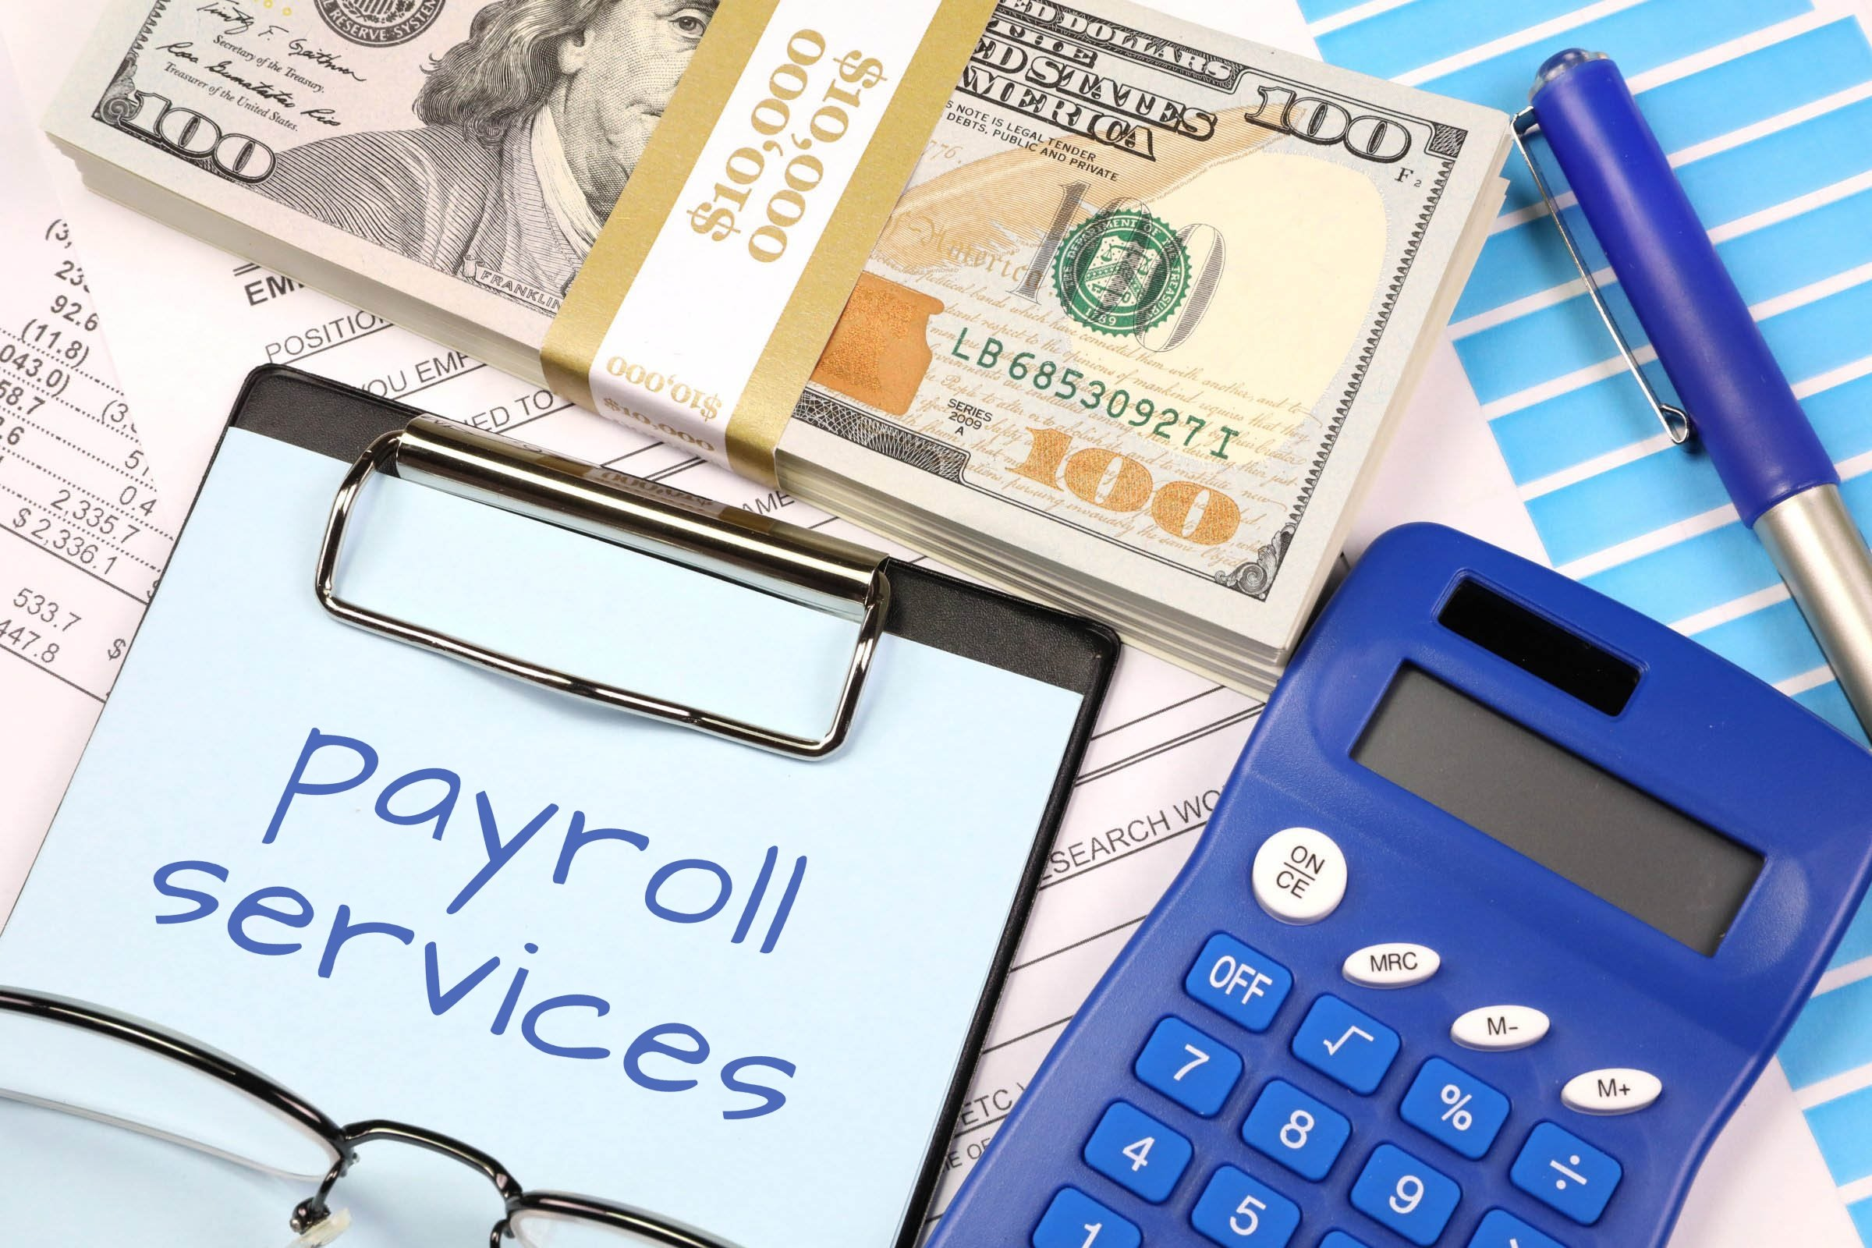
Day 2! Payroll
My experience
Why payroll is important
Guest Speaker Emily with Paychex

Slide 34

Day 2 Take Away
Would you hire someone that was __________ , explain? Insert an adjective good or bad that starts with the first letter of your name. For example, Would you hire someone who is talkative? Yes or No explain?
#fivedaysfiveways

Slide 35
Day 3
Trello W Ashley

Slide 36
Day 4
Honey books

Slide 37
Day 5 - How to Utilize Canva
Get advertising tool
Content tool
Graphic Arts
How to generate income from Canva

Slide 38

Canva for beginners
Free Design Tool: Presentations, Video, Social Media | Canva

Slide 39
Payhip
https://payhip.com/MadebyMonea

Slide 40
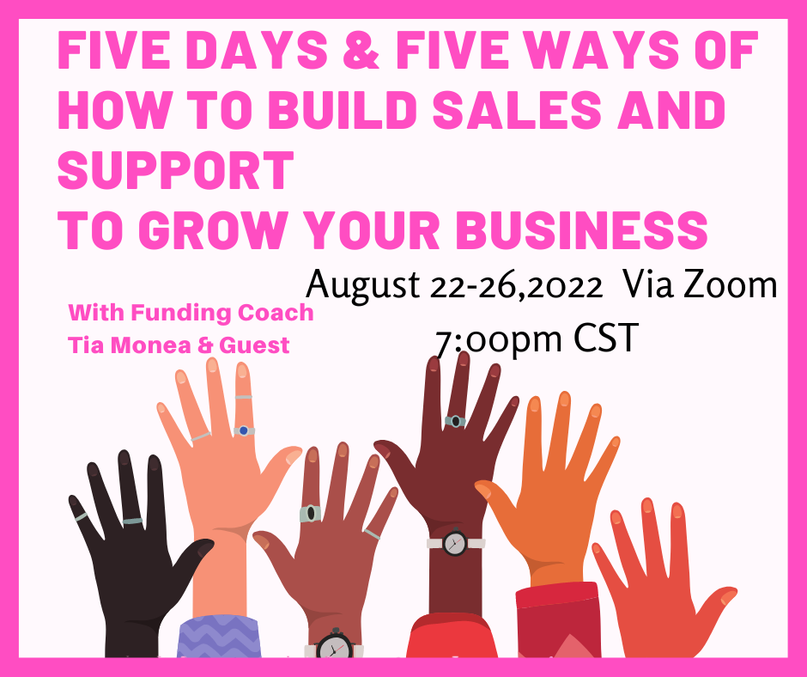
Thank You and We look forward to seeing you at our next workshop

Slide 41
Day 5 Takeaway
Create a content image on canva to drive support or sales and post it in the group for a free advertising piece.

Slide 42

Step 2 Learn the Basics of Running a Business
Here’s a great video to watch of young entrepreneurs.
What did you learn from this video?
https://youtu.be/NEecXIjvInc

Slide 43
Step 3 Find Out What Kind of Support is Available for Small Business Owners
Contact your local bank and SBA( Small Business Association) to see what type of business funding opportunities are available for young business owners.

Slide 44
Step 4 Investigate What Makes Great Customer Service
Interview someone in customer service profession.
Here’s some sample questions
What do you like most about customer service?
What would you change about the customer service job?
Tell me of a time when you had to deal with a not so pleasant customer?

Slide 45
Step 5 Understand the Importance of Consumer Research
Create a survey to see if there’s a need for the type of business you would like to open.

Slide 46
Good Job and good luck !

