Slide 1


Leader Instructions & Meeting Prep:
Junior Automotive Design Badge
Junior Automotive Design Badge: :meeting plan supply list::
¾ cup Water
¾ cup Salt
2 cup Flour
1 Mixing Bowl
1 Spoon
1 Large Ziplock Bag
The following slides will walk your troop through a virtual meeting to earn the Junior Automotive Design Badge. When you share your screen during your meeting, be sure to click “Present” so girls see the full screen. Also, when you are sharing your screen in zoom, google meet, or another meeting app, please make sure you are sharing both picture and audio. For more information on using Zoom, visit gsnw.gl/VirtualMeetingHowTo
Many of the interactive activities included are shared through YouTube videos. Just click on the arrow in the center of the image to play the video, and the girls can see it too! You should try to review the slides before your meeting if possible, so you are familiar with the activities and any supplies needed.
This meeting will typically take approximately 60-90 minutes as written, depending on participation level and number of girls. As always, Girl Scouting is flexible, and troops may select the activities interest them most, add their own activities, or have girls do some of the steps afterward as “homework”.
When you send out your meeting invitation, be sure to let girls and parents know what supplies they should have on hand for the online troop meeting. They are things most girls likely have at home.

Slide 2

Juniors
Automotive Design Badge
Brought to you by Girl Scouts of the Northwestern Great Lakes

Slide 3
.Welcome!.
Girl Scouts!

Slide 4




Program Pillar: Life Skills
STEM
Outdoors
Entrepreneurship
Life Skills
Girls become better problem-solvers, critical thinkers, get better grades, and see STEM as the foundation for a meaningful and successful future.
Girls discover that they can better problems and overcome challenges, build social bonds, and become team players that care about protecting our environment.
Girls gain new skills, ​
build their confidence ​
and develop an entrepreneurial mindset over time.
Girls gain the skills and the inspiration to accept challenges, overcome obstacles, and take the lead.
Notes:
In Girl Scouts, everything we do is either about STEM, Outdoors, Entrepreneurship, or Life Skills. This month we are going to focus STEM – Science, Technology, Engineering, and Math

Slide 5





5 Outcomes
Sense of Self Girls have confidence in themselves and their abilities and form positive identities.​
Positive Values Girls act ethically, honestly, and responsibly, and show concern for others.​
Challenge Seeking Girls take appropriate risks, try things even if they might fail, and learn from mistakes.​
Healthy Relationships Girls develop and maintain healthy relationships by communicating their feelings directly and resolving conflicts constructively.
Community Problem Solving Girls desire to contribute to the world in purposeful and meaningful ways, learn how to identify problems in the community, and create action plans to solve them.
Notes:
The whole point of Girl Scouts is to build 5 outcomes. The one we are going to work on today is Challenge Seeking, which means we want you to feel comfortable taking risks even if you are afraid of making a mistake.

Slide 6

Girl Scout Promise
On my honor, I will try, To serve God and my Country. To help people at all times, And to live by the Girl Scout Law.

Slide 7


Let’s say the pledge

Slide 8

Icebreaker
What is your favorite make of car?
Notes:
Use annotate on the next slide to allow girls to type/write on the screen

Slide 9
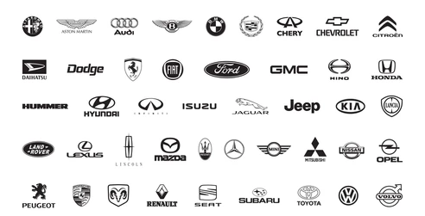

Slide 10
Icebreaker
What color car do you want when you are older?
Notes:
Use annotate on the next slide to allow girls to type/write on the screen

Slide 11



Slide 12
Badge Details:
Discover how to create vehicles by sketching and sculpting a model.
Steps:
Explore mobility across time
Conduct automotive market research
Create your vehicle’s design criteria and then sketch your vehicle to meet your criteria
Sculpt and share your vehicle
When you've earned this badge, you'll know about innovation and market research. You’ll know how to create criteria, sketch, and sculpt a vehicle.

Slide 13
.Explore Mobility.
Across Time
Step 1:

Slide 14
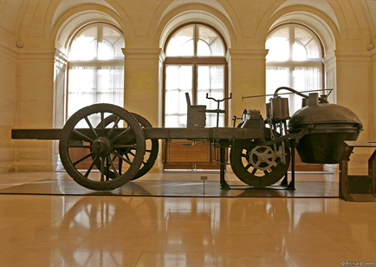
What year was the Steam Car invented?
A. 1805
B. 1769
C. 1685

Slide 15
The answer is:
B. 1769
This vehicle ran off of steam instead of gasoline like our cars today.

Slide 16
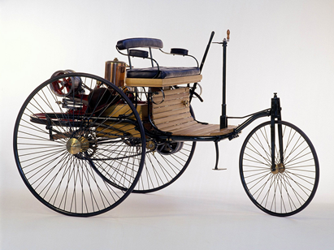
What year do you think the Benz Patent Motorwagen was invented?
A. 1800
B. 1855
C. 1885

Slide 17
The answer is:
C. 1885
This was the first vehicle powered by gasoline like we have today!

Slide 18
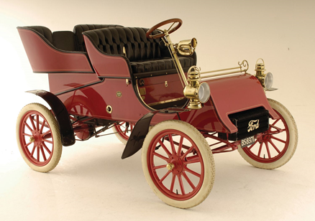
What year do you think the Ford Model T Car was invented?
A. 1890
B. 1908
C. 1950

Slide 19
The answer is:
B. 1908
This car was considered a universal car that put the world on wheels.

Slide 20
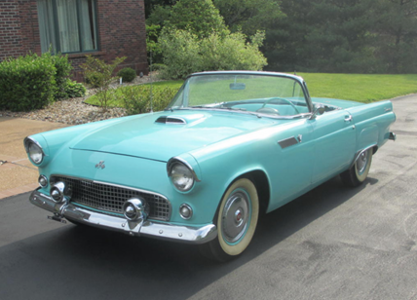
What year do you think the Ford Thunderbird was invented?
A. 1930
B. 1955
C. 1983

Slide 21
The answer is:
B. 1955
Although the Model T and the Thunderbird were from the same company, in just 52 years they made a lot of changes - especially for the comfort of the driver.

Slide 22
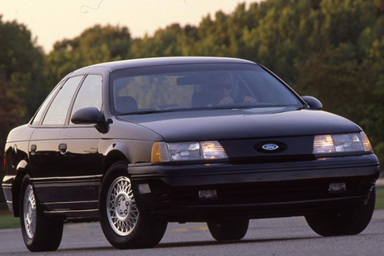
What year do you think the Ford Taurus was introduced?
A. 1980
B. 1990
C. 2010

Slide 23
The answer is:
B. 1990

Slide 24
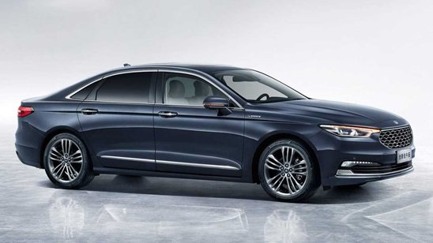
What year do you think the improved model of the Ford Taurus was introduced?
A. 2005
B. 2010
C. 2020

Slide 25
The answer is:
C. 2020
As you can see these are the exact same type of car that has been upgraded and changed based off of feedback from those that drive it. Although these two vehicles are only 30 years apart, they look completely different!

Slide 26

.Dance.
.break!.

Slide 27
.Parts of.
a Car

Slide 28
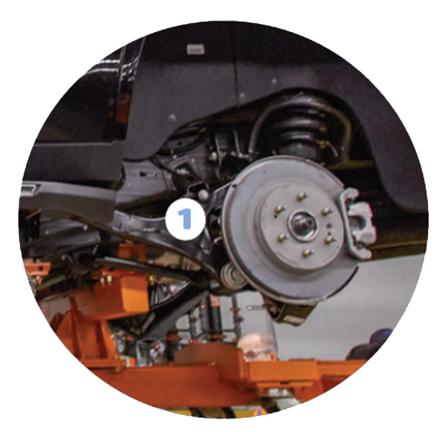
Drive Axle
The axles connect the two wheels and allow them to spin when driving.
1

Slide 29
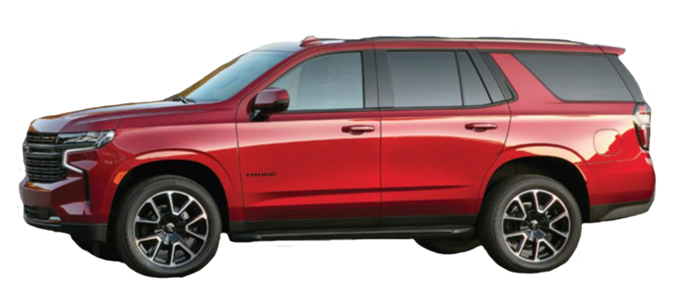
Body
Outside shape of the car.
2

Slide 30
Bumpers
Protective covers that protect the front and back end of the car.
3

Slide 31
Doors & Windows
Doors open and close to let people in and out.
Windows let people see where they were going.
4

Slide 32
Headlights
Lights in the front of the car that help the driver see at night.
5

Slide 33
Taillights
Lights in the back of the car that help other drivers see the car at night and when the car is slowing down and stopping.
6

Slide 34
Hood
The hood protects the engine. The hood can be opened to take care of the engine and all the parts under the hood.
7

Slide 35
Trunk
The cars storage space for cargo.
8

Slide 36
Wheels
Most cars have 4 wheels that roll while the car is driving allowing it to move forward and backward.
9

Slide 37
Windshield
Window in front of the car that let the driver see where to go.
10

Slide 38
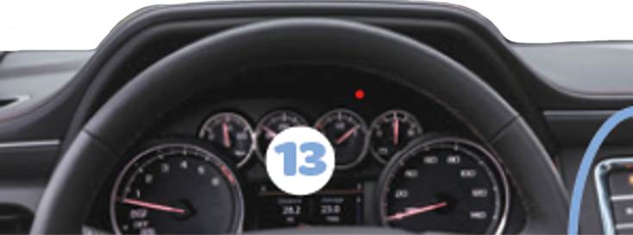
Dashboard
Shows the driver vehicle information such as speed, how much fuel the car has, and what gear it’s in.
12

Slide 39
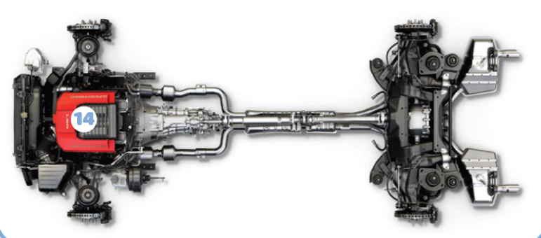
Drive Train
Transfers energy from the engine to the axles and wheels, making the vehicle go.
13

Slide 40
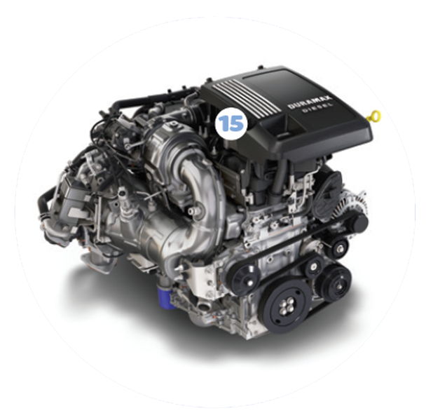
Engine
The engine powers the vehicle to make it go.
14

Slide 41
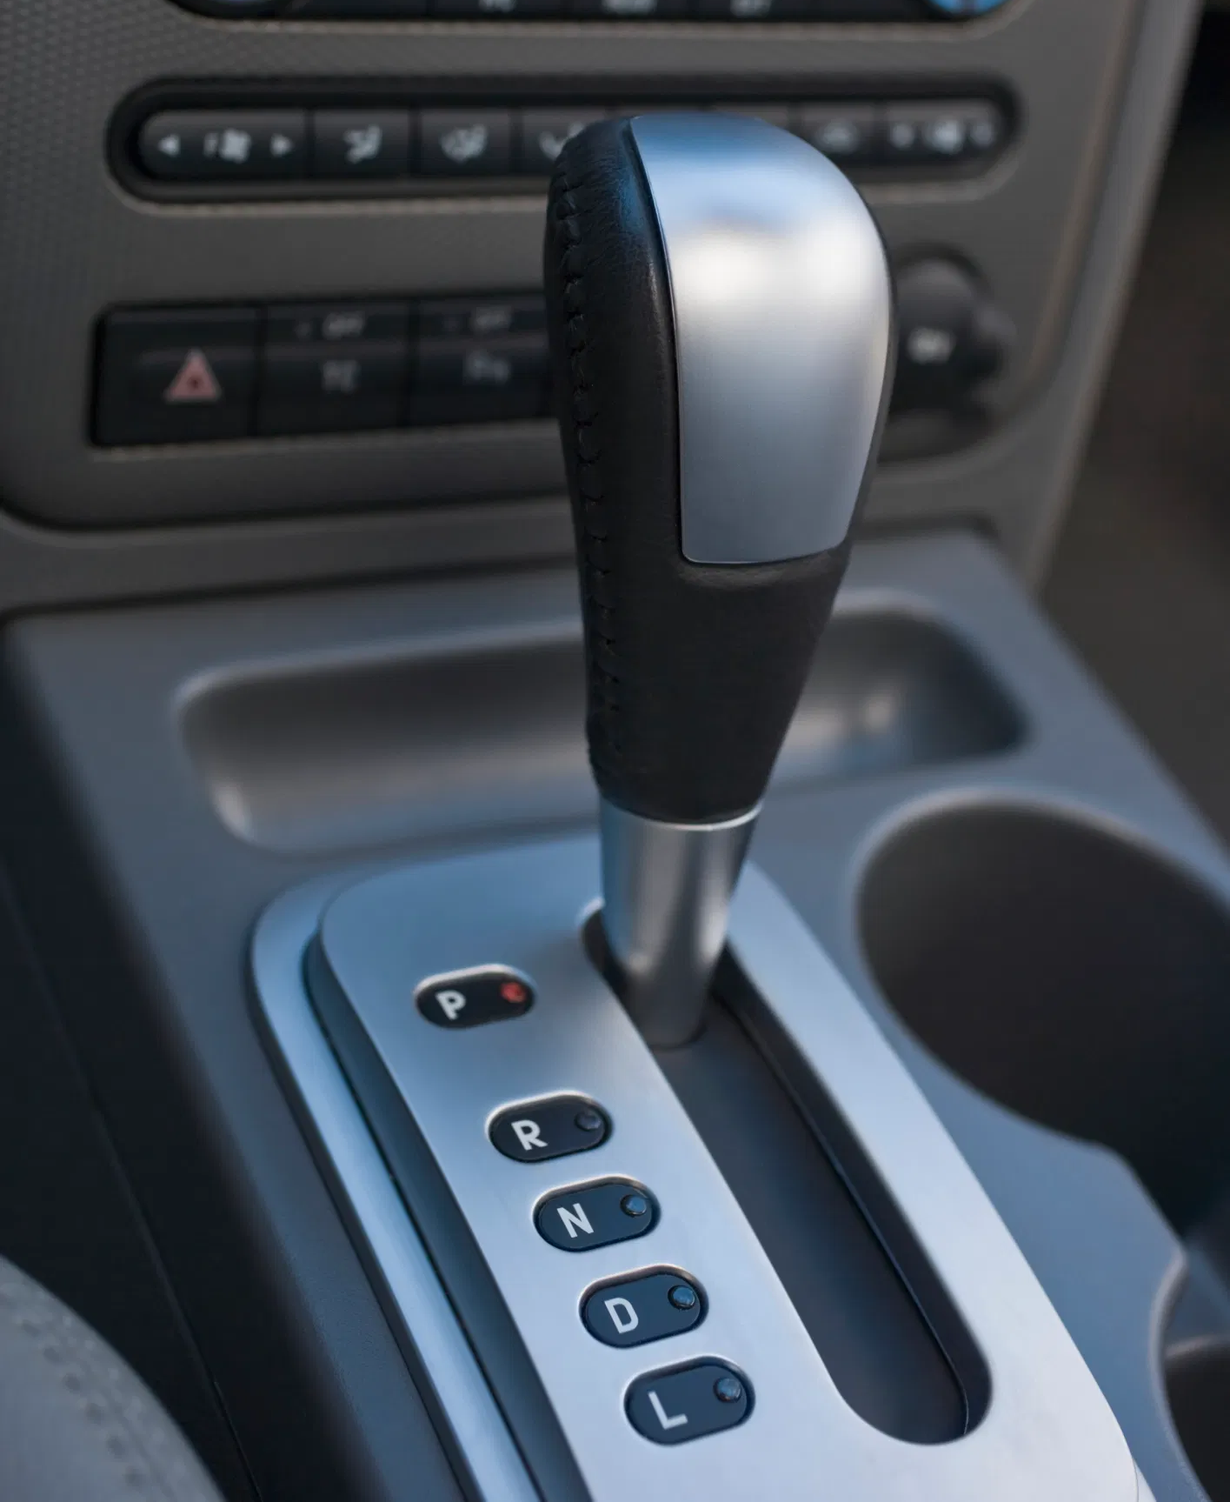
Gear Shaft
The driver uses a gear shift to make the car go forward, backward or park.
15

Slide 42
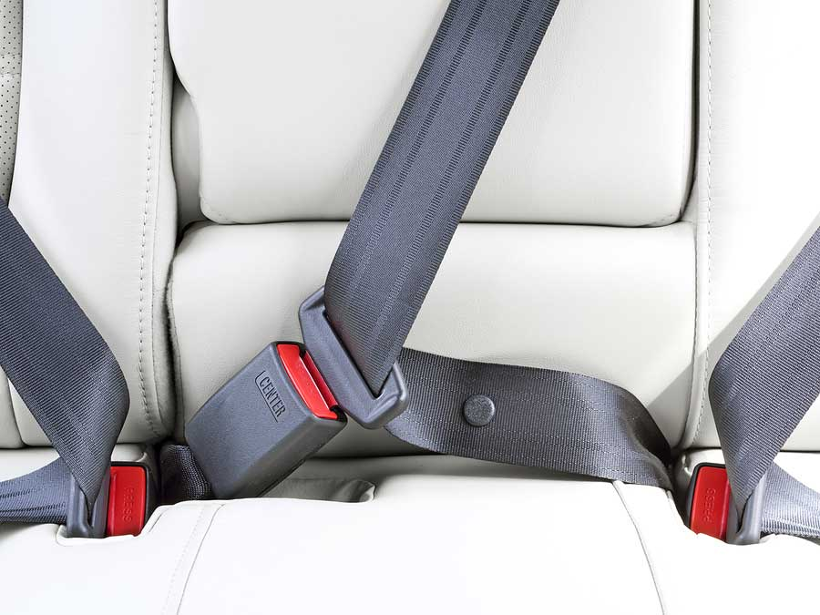
Seats & Seat Belts
Each passenger sits on a seat and wears a seat belt to protect them from accidents.
16

Slide 43
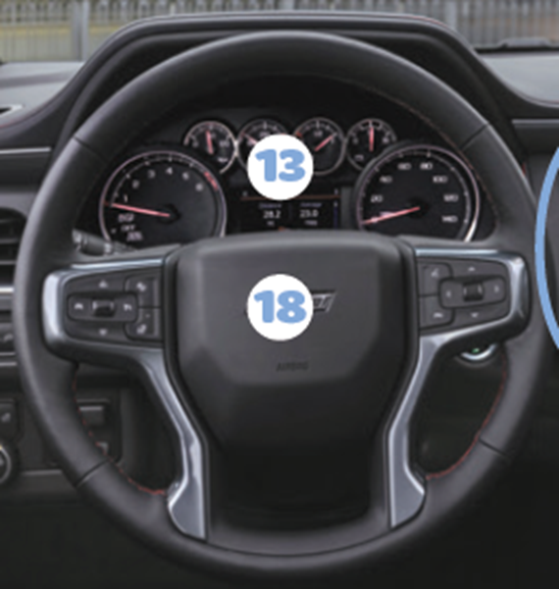
Steering Wheel & Horn
Steering wheel rotates and the lets driver turn. The horn in the middle makes a noise to signal other drivers.
17
18

Slide 44
.Automotive.
Market Research
Step 2:

Slide 45
Market Research: Collecting Data
We just took a look the different parts of cars. Automotive designers come up with an idea using these parts, test it out and see if the consumers (those who drive cars) like it or not, and then adjust from there.

Slide 46
Let’s do some Market Research
Ask an adult family member or other adults what they like best about their vehicle and what they dislike the most.
Ask what they want their ideal car would look like.
Ask what features their ideal car would have.
Ask any other questions you can think of.
Comment your answers in the chat box!

Slide 47
.Create.
Design Criteria
Step 3:

Slide 48
What are Creative Designers?
People who imagine what new vehicles will look like.
They have the job of choosing the design criteria for new vehicles.
The criteria include the parts all vehicles have, like an engine, wheels, and axles, and other parts, or design features, to make the new vehicle especially useful, fun, or different from other vehicles.

Slide 49
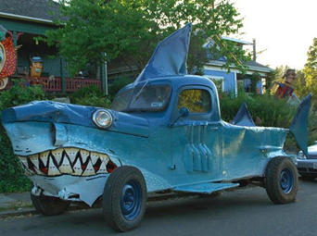
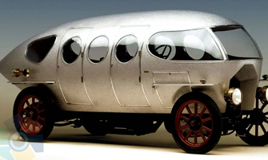
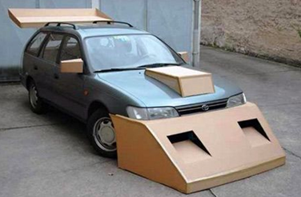
Let’s create our own design criteria!
Using your market research from those you know to design the best vehicle ever!

Slide 50
.Let’s take.
5 Minutes to Draw
Think about if you want big or little wheels, how do you want it powered (gas, electric, other), what fun/extra things should it have? Be creative!

Slide 51
.Sculpt & Share.
Your Vehicle
Step 4:
We will be making DIY clay and sculpting our vehicle out of it!

Slide 52
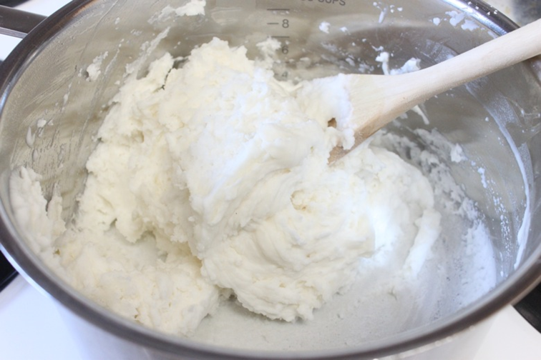
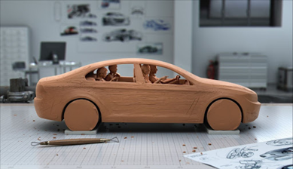
DIY Clay
Gather your supplies:
¾ cup Water
¾ cup Salt
2 cup Flour
1 Mixing Bowl
1 Spoon
1 Large Ziplock Bag
Let’s make our clay!

Slide 53
.Let’s Sculpt.
Notes:
As the leader, you can decide on how long to give the girls.

Slide 54
.Let’s Share!.

Slide 55
Now that you’ve earned this badge, you can give service by:
Teaching others how vehicles are designed.
Listening to what others want and need and using what you learn to help them.
Using what you learned about working as a team to help with a group project at school or a Take Action project with my troop.
WOW, you have earned your badge!

