Slide 1


Leader Instructions & Meeting Prep:
Daisy What Robots Do Badge
Daisy What Robots Do Badge: :meeting plan supply list::
Piece of Blank Paper
Pencil
The following slides will walk your troop through a virtual meeting to earn the Daisy What Robots Do Badge. When you share your screen during your meeting, be sure to click “Present” so girls see the full screen. Also, when you are sharing your screen in zoom, google meet, or another meeting app, please make sure you are sharing both picture and audio. For more information on using Zoom, visit gsnw.gl/VirtualMeetingHowTo
Many of the interactive activities included are shared through YouTube videos. Just click on the arrow in the center of the image to play the video, and the girls can see it too! You should try to review the slides before your meeting if possible, so you are familiar with the activities and any supplies needed.
This meeting will typically take approximately 60-90 minutes as written, depending on participation level and number of girls. As always, Girl Scouting is flexible, and troops may select the activities interest them most, add their own activities, or have girls do some of the steps afterward as “homework”.
When you send out your meeting invitation, be sure to let girls and parents know what supplies they should have on hand for the online troop meeting. They are things most girls likely have at home.

Slide 2


What Robots Do
A Daisy Girl Scout Badge

Slide 3
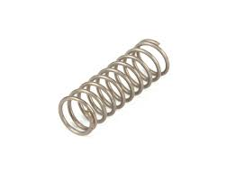

Girl Scouts is so happy you’re here!
Let’s get started with the Girl Scout Promise

Slide 4

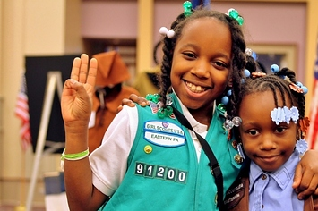
On my honor, I will try: To serve God and my country, To help people at all times, and to live by the Girl Scout Law.

Slide 5


Let’s say the Pledge

Slide 6
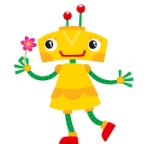
Today we will be working on the What Robots Do badge
If you LOVE robots, you can also work on other badges too! Like:
How Robots Move and/or
Design a Robot

Slide 7
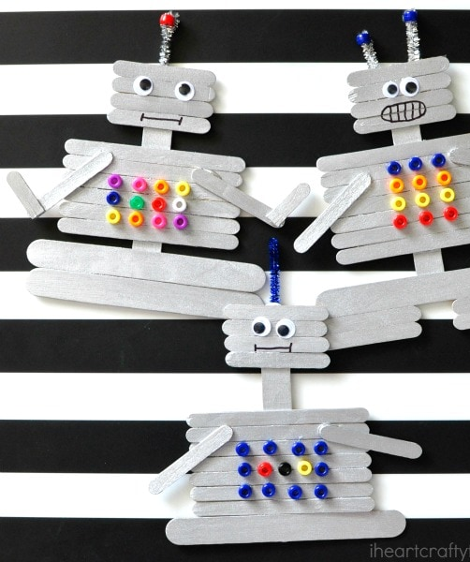
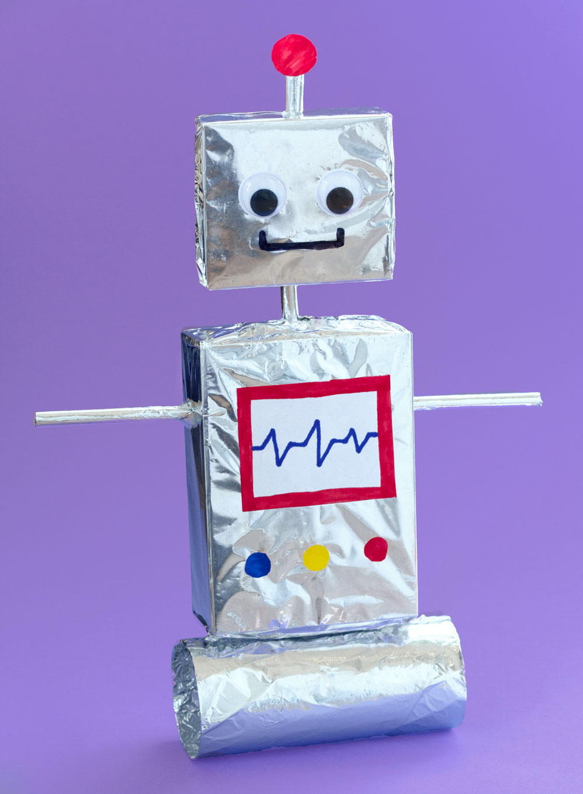
Who is here with us today?
Please say your first name and also if you could build a robot, what would it be made of?

Slide 8
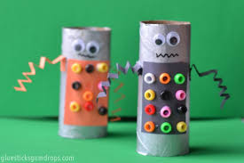
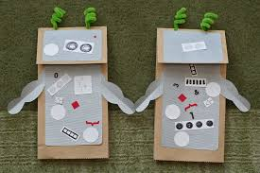
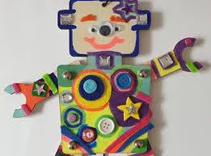
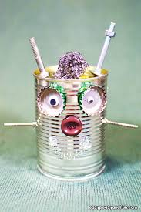

You’re right!
Robots can be made out of all sorts of different materials!

Slide 9


Step 1:
A robot is a machine that can do lots of different things automatically. Think of a vacuum. You turn it on and it automatically sucks dust up.
What other things do you believe a robot can do?
Let’s try to think of 3 or more together!
Learn about robots

Slide 10
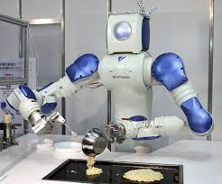
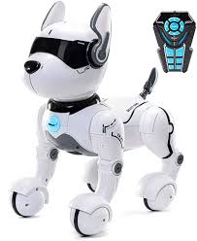

Did you get stuck? Or did you come up with some of these?

Slide 11
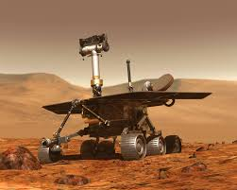
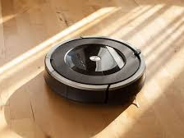
Or how about these cool robots?
Robots are becoming apart of our lives, more and more everyday.

Slide 12
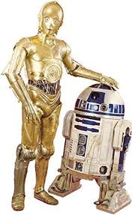
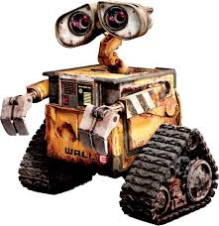
Do you know these
famous robots?
As you see, sometimes robots look like humans or other animals.
AND
Sometimes, robots even do the same things as humans or other animals.

Slide 13
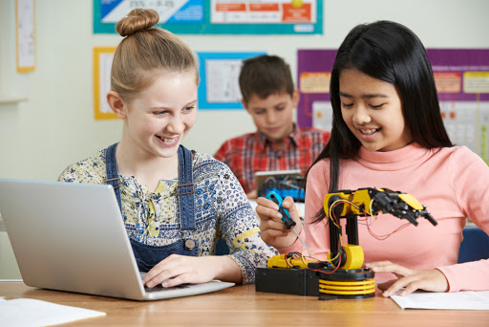


All of these examples are super cool, but who makes these robots? Have you ever thought of that? The person is called an engineer !
An Engineer does the following steps when making a robot:
Figure out if there is a problem
Brainstorm how to make it easier
Come up with an idea for a robot to help

Slide 14

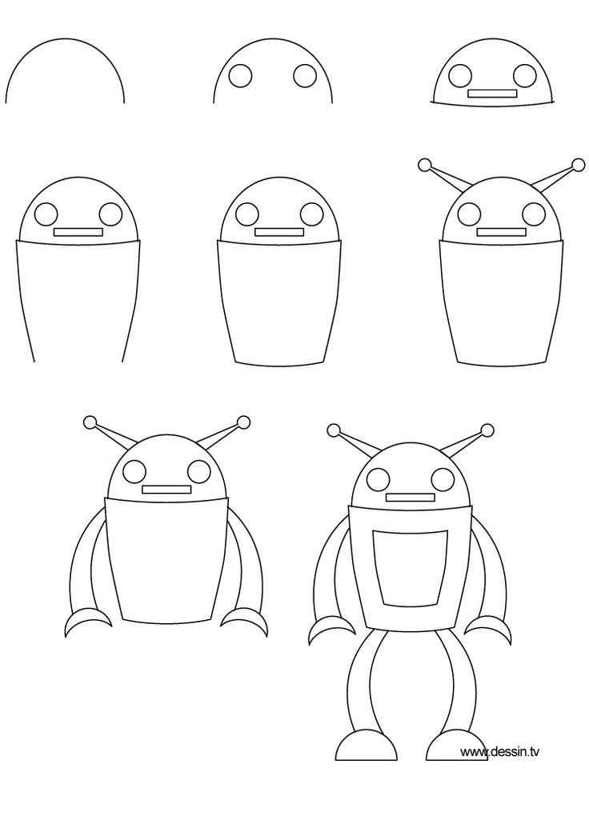

Let’s be an engineer and figure out this robot drawing together!
1.
2.
Supplies needed:
Pencil
Paper
3.

Slide 15
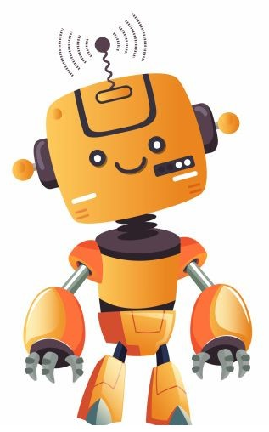

Step 2:
Find out what robots can do

Slide 16

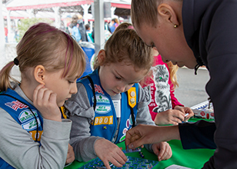
Robots are designed to solve problems BIG and small
Problem solving is a wonderful tool to have. Let’s see if we can be problem solvers on the next two puzzles

Slide 17
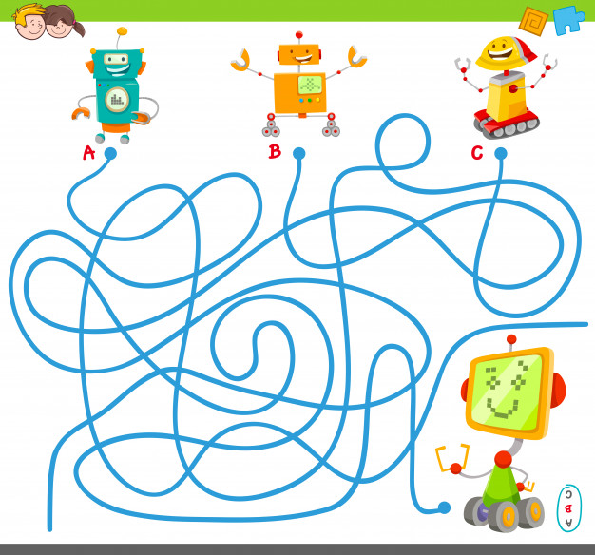

What do you think?
A?
B?
C?

Slide 18
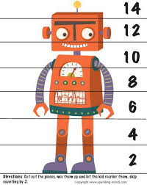
What do you think?
How tall are the robots knees?
How tall are the robots eyes?
How tall is the robots antennae?

Slide 19


Step 3:
Design your robot
Check out these cool robots that girls, just like you, have created!

Slide 20

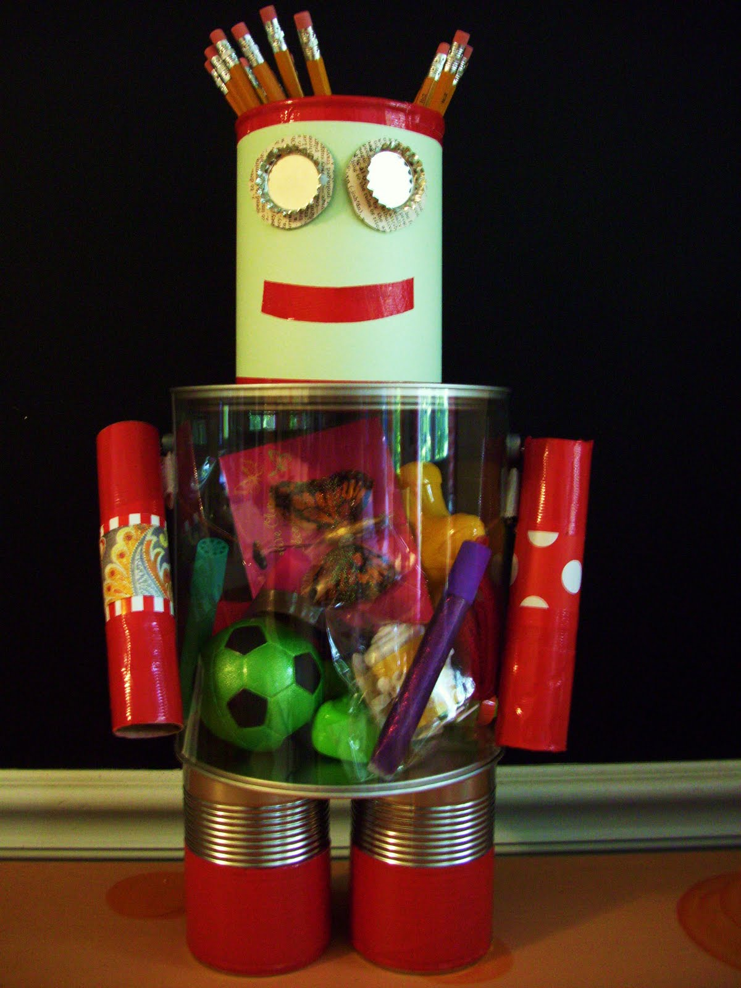

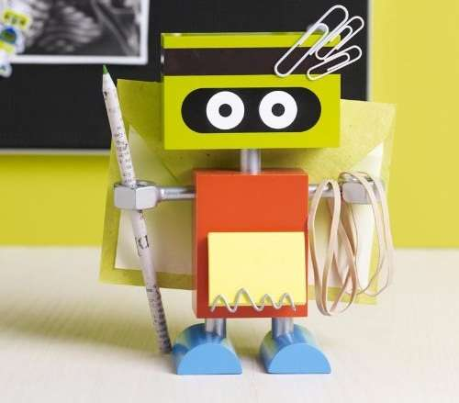

Slide 21
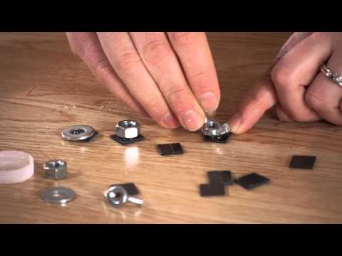

There are so many ways to be creative!
Check out this neat video and start getting ideas today.

Slide 22
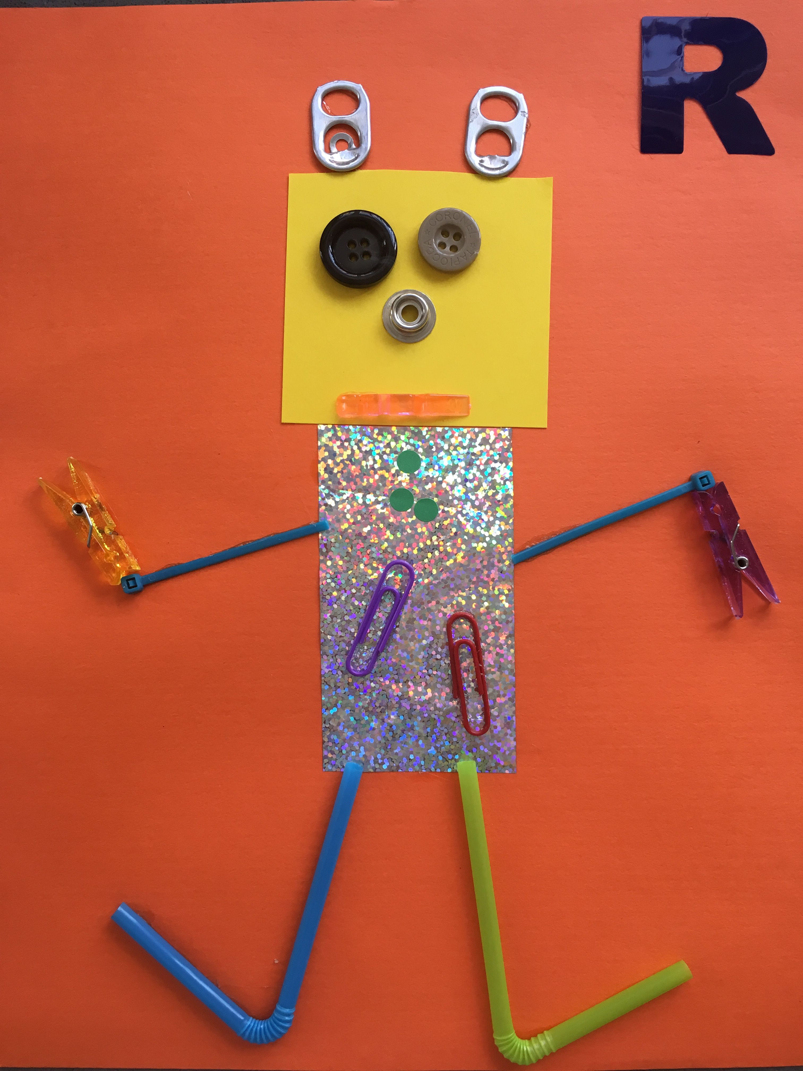
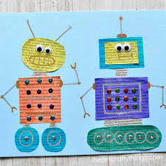
Challenge time!
After our meeting locate some fun items around your own home and make your own robot!

Slide 23
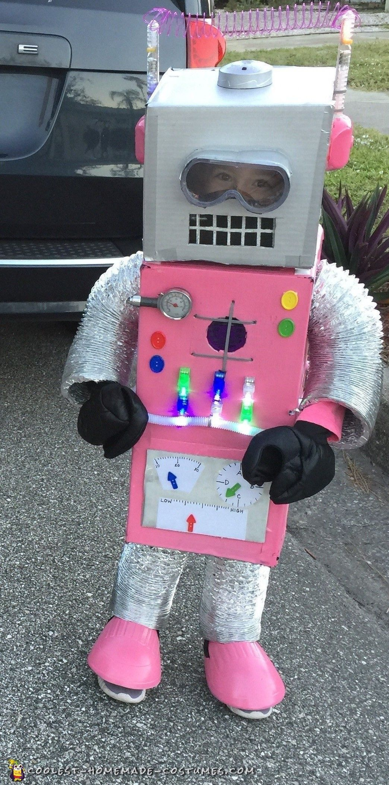
That’s a wrap! Congratulations!
You’ve earned your, What Robots Do badge.
Totally
Awesome!
Totally
Awesome!

Slide 24
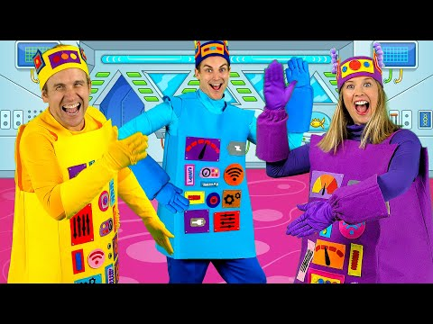
See you next time Girl Scouts!

