Slide 1


Leader Instructions & Prep
Daisy Toy Business Designer Badge
Supply List:
Paper
Pens, crayons, markers
The following slides will walk your troop through a virtual meeting to earn the Daisy Toy Business Designer Badge. When you share your screen during your meeting, be sure to click “Present” so girls see the full screen. Also, when you are sharing your screen in zoom, google meet, or another meeting app, please make sure you are sharing both picture and audio. For more information on using Zoom, visit gsnw.gl/VirtualMeetingHowTo
Many of the interactive activities included are shared through YouTube videos. Just click on the arrow in the center of the image to play the video, and the girls can see it too! You should try to review the slides before your meeting if possible, so you are familiar with the activities and any supplies needed.
This meeting will typically take approximately 60-90 minutes as written, depending on participation level and number of girls. As always, Girl Scouting is flexible, and troops may select the activities interest them most, add their own activities, or have girls do some of the steps afterward as “homework”.
When you send out your meeting invitation, be sure to let girls and parents know what supplies they should have on hand for the online troop meeting. They are things most girls likely have at home.

Slide 2


Daisy Toy Business Designer Badge
Brought to you by Girl Scouts of the Northwestern Great Lakes

Slide 3
Girl Scout Promise
On my honor, I will try:
to serve god* and my country,
to help people at all times,
and to live by the girl scout law.

Slide 4


Let’s say the pledge

Slide 5
Daisy Toy Business Designer
Badge Details:
Come up with an idea for a toy.
Make your idea even better.
Pitch your idea.

Slide 6
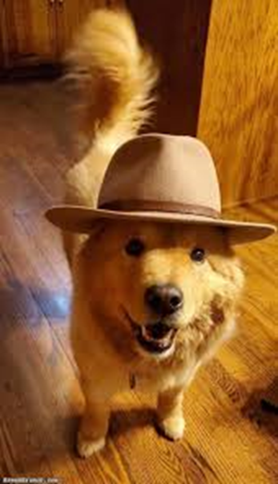
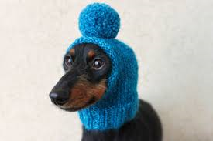
Get those thinking caps warm up &
let the brainstorming begin!

Slide 7
Examine your toys

Slide 8
Examine your toys
What toys do you love?
We will be making a new toy, but this will help us understand what we want in our new creation!
2. What is missing?
3. What would make the toy better?

Slide 9
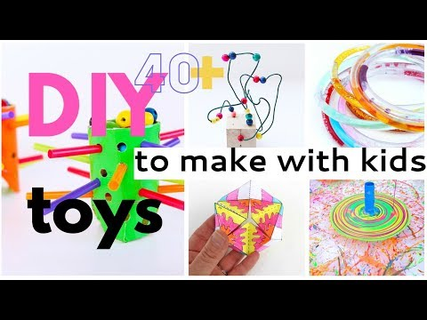
Let’s do some more brainstorming

Slide 10

Let’s share our ideas!
What type of toy did you come up with?
Did you modify a current toy?
Did you create a new toy?

Slide 11
Let’s design your toy idea!

Slide 12
Let’s design your toy idea!
Sketch out what your new toy would look like! Don’t forget to add color!

Slide 13
Let’s share our sketches!

Slide 14
Now it’s time to pitch your idea

Slide 15
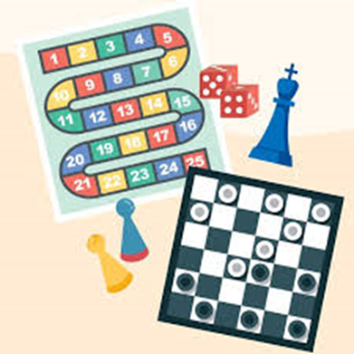
What is a pitch?
Let’s take 30 seconds to think about what we might way when we pitch a great idea for a new board game.
Pitches are short, persuasive stories that target a specific audience.

Slide 16


Slide 17
What did you like about the kids’ pitches?
Were they long or short?
Did they get to the point or did they trail off?
What
worked or didn’t work?

Slide 18
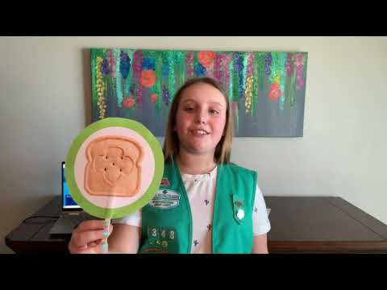

Slide 19
What did you like about Molly’s pitch?
Is there anything you would change?
What ideas do you have for your pitch?
What
worked or didn’t work?

Slide 20
Let’s create our pitch

Slide 21
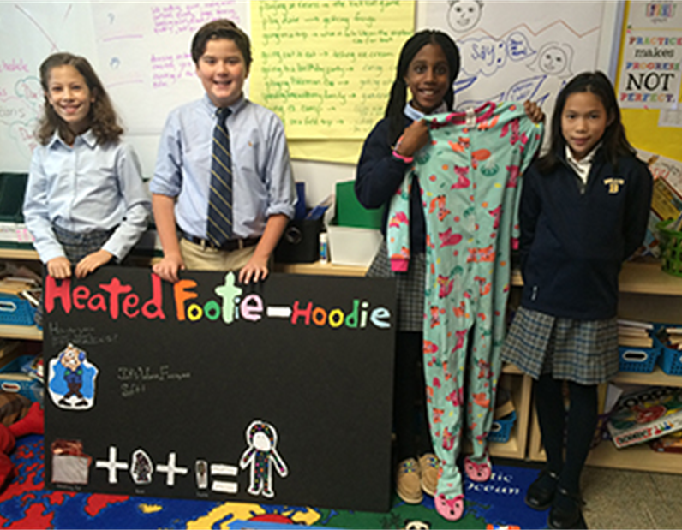
Great job with all the brainstorming! Let’s take a few minutes to come up with a pitch for your idea.
When we’re done, we’re going to go around, and each give our pitch!

Slide 22
Congratulations, you have earned the
Daisy Toy Business Designer Badge!

