Slide 1


Leader Instructions & Meeting Prep:
Daisy Space Science Explorer Badge
Daisy Space Science Explorer: :meeting plan supply list::
Paper Plate OR Paper
Yellow, Orange, or White Paper
Markers
Scissors
Tape or Glue
Empty Toilet Paper or Paper Towel Tube
Stickers
Toothpicks OR Pretzel Sticks
Mini Marshmallows or cotton balls
The following slides will walk your troop through a virtual meeting to earn the Daisy Space Science Explorer Badge. When you share your screen during your meeting, be sure to click “Present” so girls see the full screen. Also, when you are sharing your screen in zoom, google meet, or another meeting app, please make sure you are sharing both picture and audio. For more information on using Zoom, visit gsnw.gl/VirtualMeetingHowTo
Many of the interactive activities included are shared through YouTube videos. Just click on the arrow in the center of the image to play the video, and the girls can see it too! You should try to review the slides before your meeting if possible, so you are familiar with the activities and any supplies needed.
This meeting will typically take approximately 60-90 minutes as written, depending on participation level and number of girls. As always, Girl Scouting is flexible, and troops may select the activities interest them most, add their own activities, or have girls do some of the steps afterward as “homework”.
When you send out your meeting invitation, be sure to let girls and parents know what supplies they should have on hand for the online troop meeting. They are things most girls likely have at home.

Slide 2


Daisy Space Science Explorer
Brought to you by Girl Scouts of the Northwestern Great Lakes

Slide 3


Welcome to Daisy
Girl Scouts!

Slide 4

Let’s say the
Girl Scout Promise
On my honor, I will try: To serve God and my country, To help people at all times, and to live by the Girl Scout Law.

Slide 5

Let’s say the Pledge

Slide 6
Daisy
Space Science Explorer
Badge Details:
Explore and observe the sky like a real space scientist.
1. Explore the Sun
2. Observe the Moon
3. Meet the Stars
When you’ve earned this badge, you’ll have explored and observed the Sun, Moon, and stars.

Slide 7

What are some
things you do during the day?
What are some
things you do during the night?

Slide 8
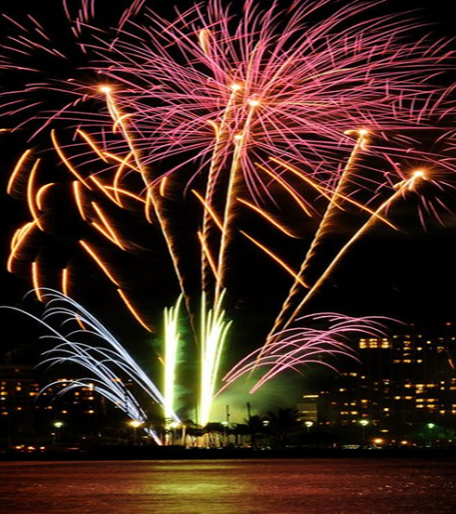
Day or Night Activities?
Do you watch fireworks...
During the Day? (Raise your Hand)
During the Night? (Jump)

Slide 9

Day or Night Activities?
Do you hike more...
During the Day? (Raise your Hand)
During the Night? (Jump)

Slide 10
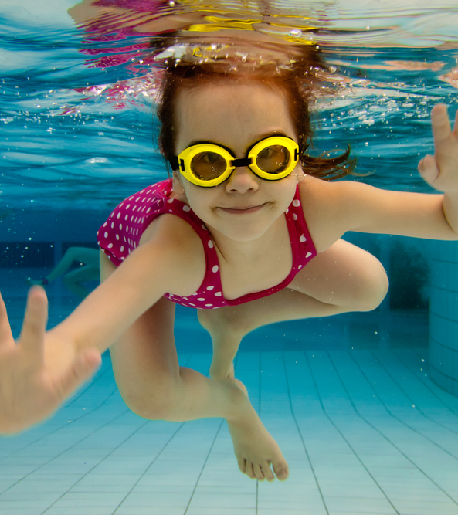
Day or Night Activities?
How about swimming?
During the Day? (Raise your Hand)
During the Night? (Jump)

Slide 11
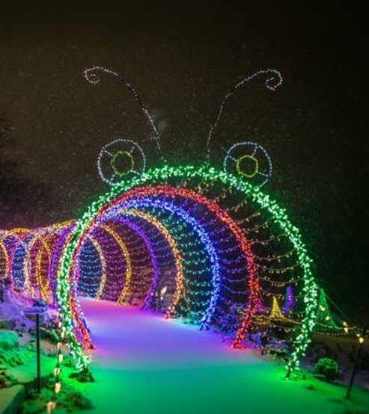
Day or Night Activities?
Do you look at holiday lights...
During the Day? (Raise your Hand)
During the Night? (Jump)

Slide 12
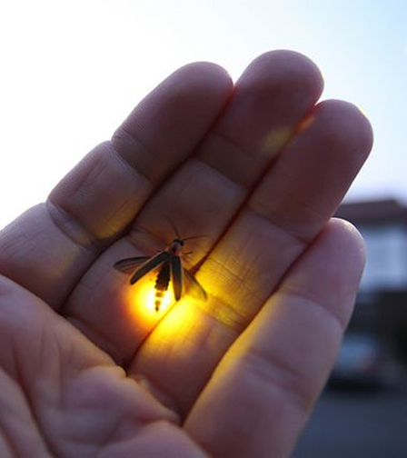
Day or Night Activities?
Do you catch fireflies...
During the Day? (Raise your Hand)
During the Night? (Jump)

Slide 13
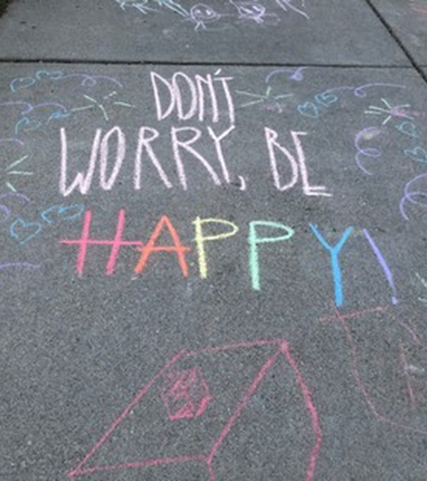
Day or Night Activities?
Do you color with chalk...
During the Day? (Raise your Hand)
During the Night? (Jump)

Slide 14
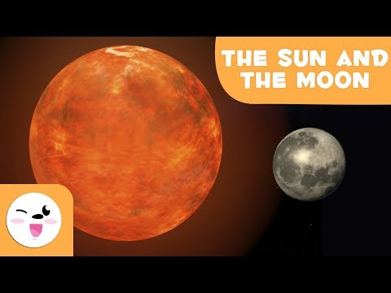
Let’s learn about the sun and the moon

Slide 15
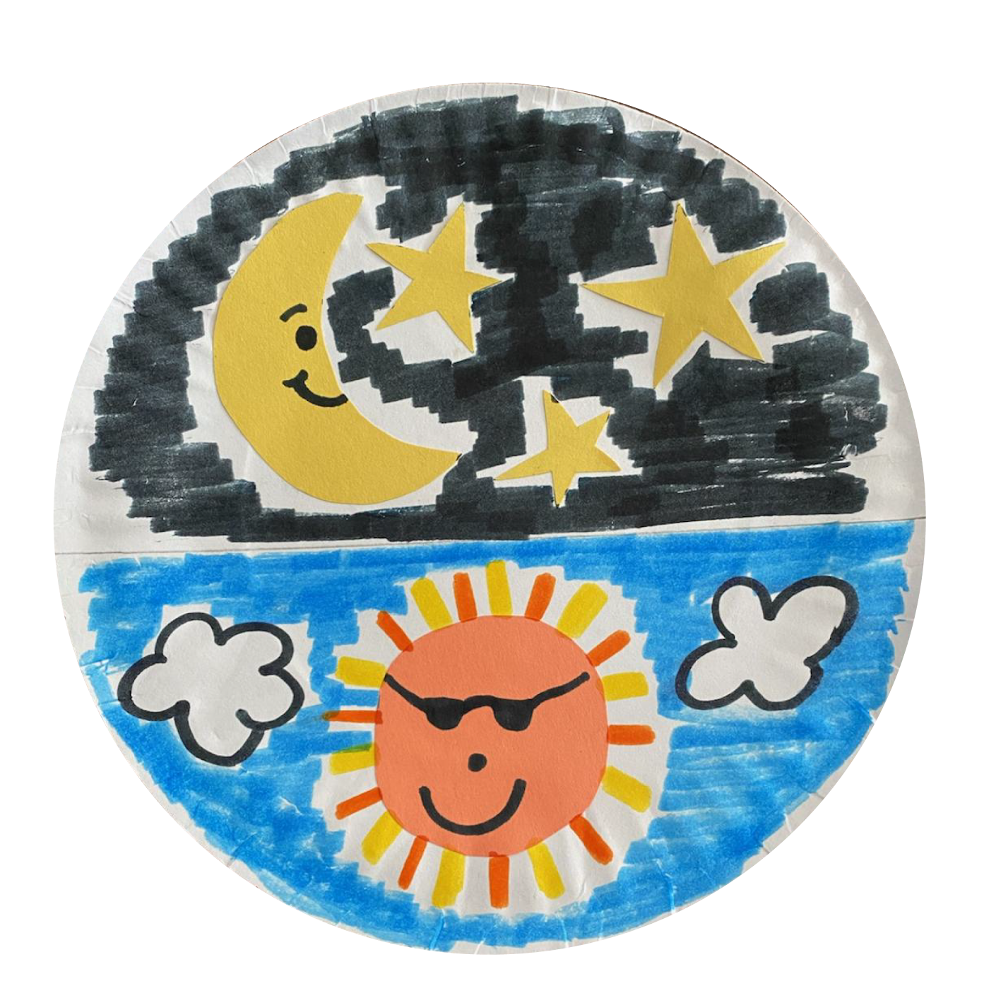
Make your own
Sun & Moon
Supplies:
Paper Plate OR Paper
Yellow, Orange, or White Paper
Markers
Scissors
Tape or Glue

Slide 16
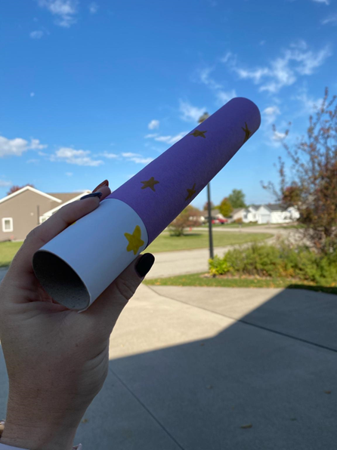
Learn and make your own
Telescope
Supplies:
Empty Toilet Paper or Paper Towel Tube
Markers
Paper
Stickers
Tape, Glue, or Rubber Bands

Slide 17

Learn & make your own Telescope

Slide 18
Ready for some more fun?
Do you know what a constellation is?
A constellation is a group of stars that create a recognizable pattern. Have you seen the Big Dipper in the night sky? That is a constellation.

Slide 19

Let’s make a constellation, the
Big Dipper
Supplies:
Toothpicks OR Pretzel Sticks
Mini Marshmallows

Slide 20

Awesome women in space

Slide 21
Let’s end with a game!
Girl Scouts love to play games and have fun together even when we cannot gather together! Let’s play a game of Girl Scout Says with a girl leading us!

Slide 22
WHOOHOO!
You have earned your Space Science Explorer Badge

