Slide 1

Daisy
Space Science Explorer
Girl Scouts of Central Illinois

Slide 2
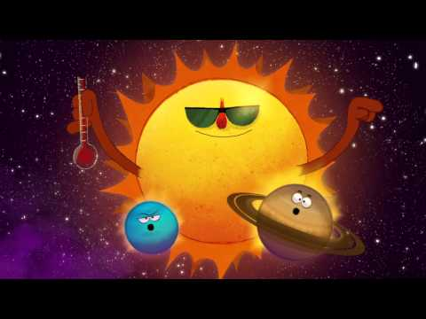
Step #1: Explore the Sun

Slide 3
Have you ever heard the words “sunrise” and “sunset”? That’s how we describe the Sun coming up in the morning (sunrise) and going down at night (sunset). But did you know that the Earth - the planet where we live- is actually spinning like a top on space? That’s why the Sun seems to move across the sky. On the part of the Earth facing the Sun, it’s day. On the part facing away, it’s night!

Slide 4
Make a day sky book
Go outside and look at the sky three times during the same day. You could do it after breakfast, after lunch, and neat dinnertime. Do not look directly at the Sun though! Just like a scientist, make a prediction (guess) for what the sky will look like each time you go outside. Then, see if your guesses were correct. Scientist check their predictions all the time- that’s how they learn.
Draw pictures of what you see at the different times of day. Does the sky look different each time you go outside? How? Did the colors or clouds change? Talk about the sky with your family after you have finished your three pictures.

Slide 5
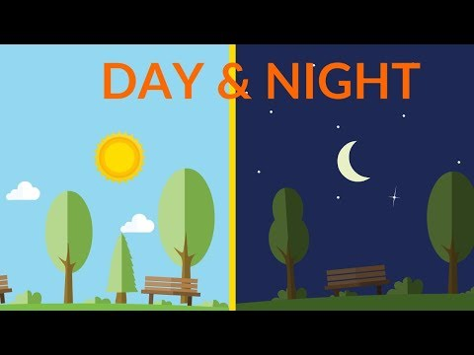
Day and Night

Slide 6
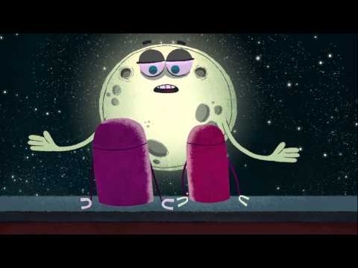
Step #2: Observe the Moon

Slide 7
Have you ever noticed the Moon in the daytime sky? Sometimes it’s there! It just doesn’t seem very bright compared to the blue sky or clouds. When it’s up at night it’s hard to miss, and some nights it’s brighter than others. Take a closer look at the Moon and see how it seems to change shape over time.

Slide 8
Make a Moon sky book
Let’s make a Moon book that is similar to our Sun book. For the Moon book you will be going outside at night at the same time for three days. Be sure to make a prediction for what you think the Moon will look like before going out. Then, go outside and draw what you see.
Were your predictions correct?
Using the next slide, write which moon phases your picture looks like most.
Share your Moon book with your family.

Slide 9
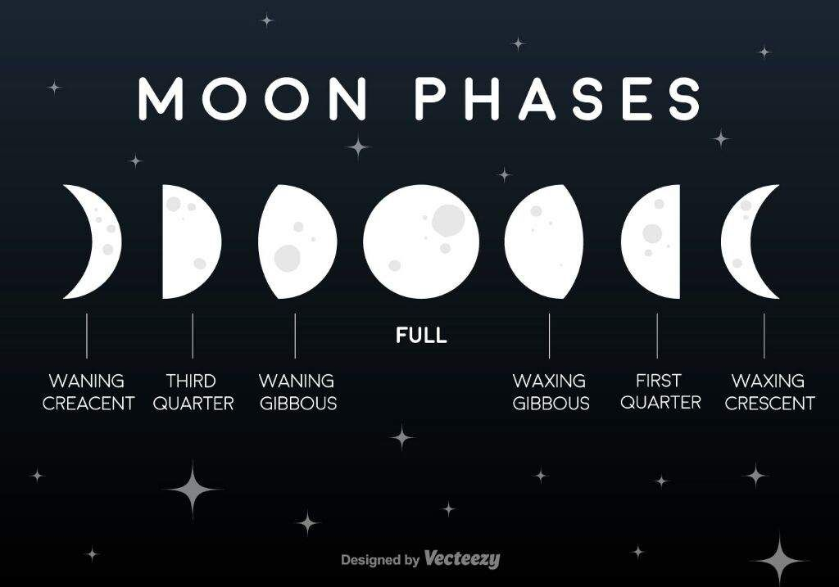

Slide 10
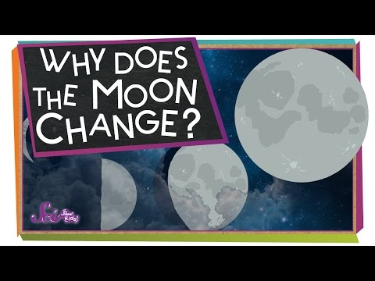
Why does the moon change?

Slide 11
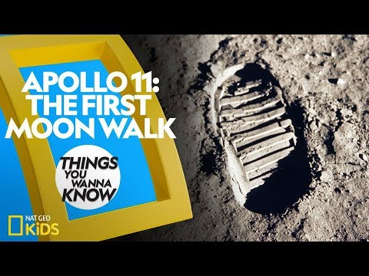
Apollo 11

Slide 12
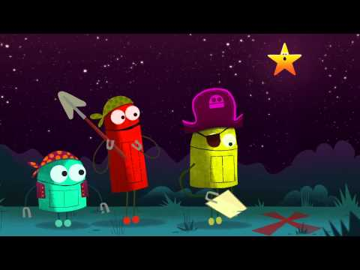
Step #3: Meet the Stars

Slide 13
Now that you’ve observed the Sun (our closest star) and the Moon, it’s time to see more stars!

Slide 14

What are Stars?

Slide 15
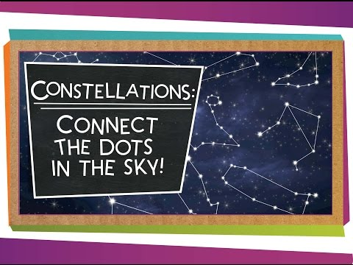
Constellations

Slide 16
Look to the sky!
Take a look at some constellations up close and the stars that form them:
https://www.dkfindout.com/us/space/constellations/
Check out some of the legends behind the constellations: http://www.tcoe.org/scicon/instructionalguide/constellations.pdf
Make a star wheel:
http://www.aosny.org/Starwheel.pdf

Slide 17
Now let's make your own constellation
Now that you have seen some of our constellations lets make up our own! Choose between these two options.
Option #1: I’m feeling crafty
Option #2: I’m feeling hungry

Slide 18
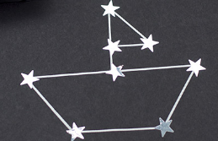
Option #1: I’m feeling crafty
Supplies: Paper, something to draw with, and small stickers if you have them
Think about what you want your constellation to look like: a person, animal, thing, ect.
Use stickers to represent stars or use a marker or crayon to make stars or dots that when connected will form the shape you have chosen.
Once you have your stars use a marker or crayon to connect the stars like you would a connect the dot puzzle.
Make up a story to go along with your new
constellation and share with your family or friends.

Slide 19
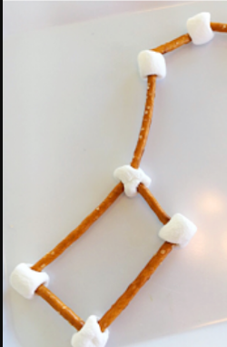
Option #2: I’m feeling hungry
Supplies: Mini marshmallows and pretzel sticks
Think about what you want your constellation to look like: a person, animal, thing, ect.
Now pretend that the marshmallows are the stars and the pretzel sticks are the lines connecting the stars.
Create your own constellation.
Make up a story to go along with your new constellation and share with your family or friends.
Eat your constellation!

Slide 20
We would love to hear from you! Please complete this quick 1-2 minute survey.
https://forms.gle/yFCNdKXXeymTUGFj8

Slide 21

Congrats! You completed your Space Explorer badge!
We would love to see your projects or hear about the fun things you did. Be sure to share with us!

