Slide 1
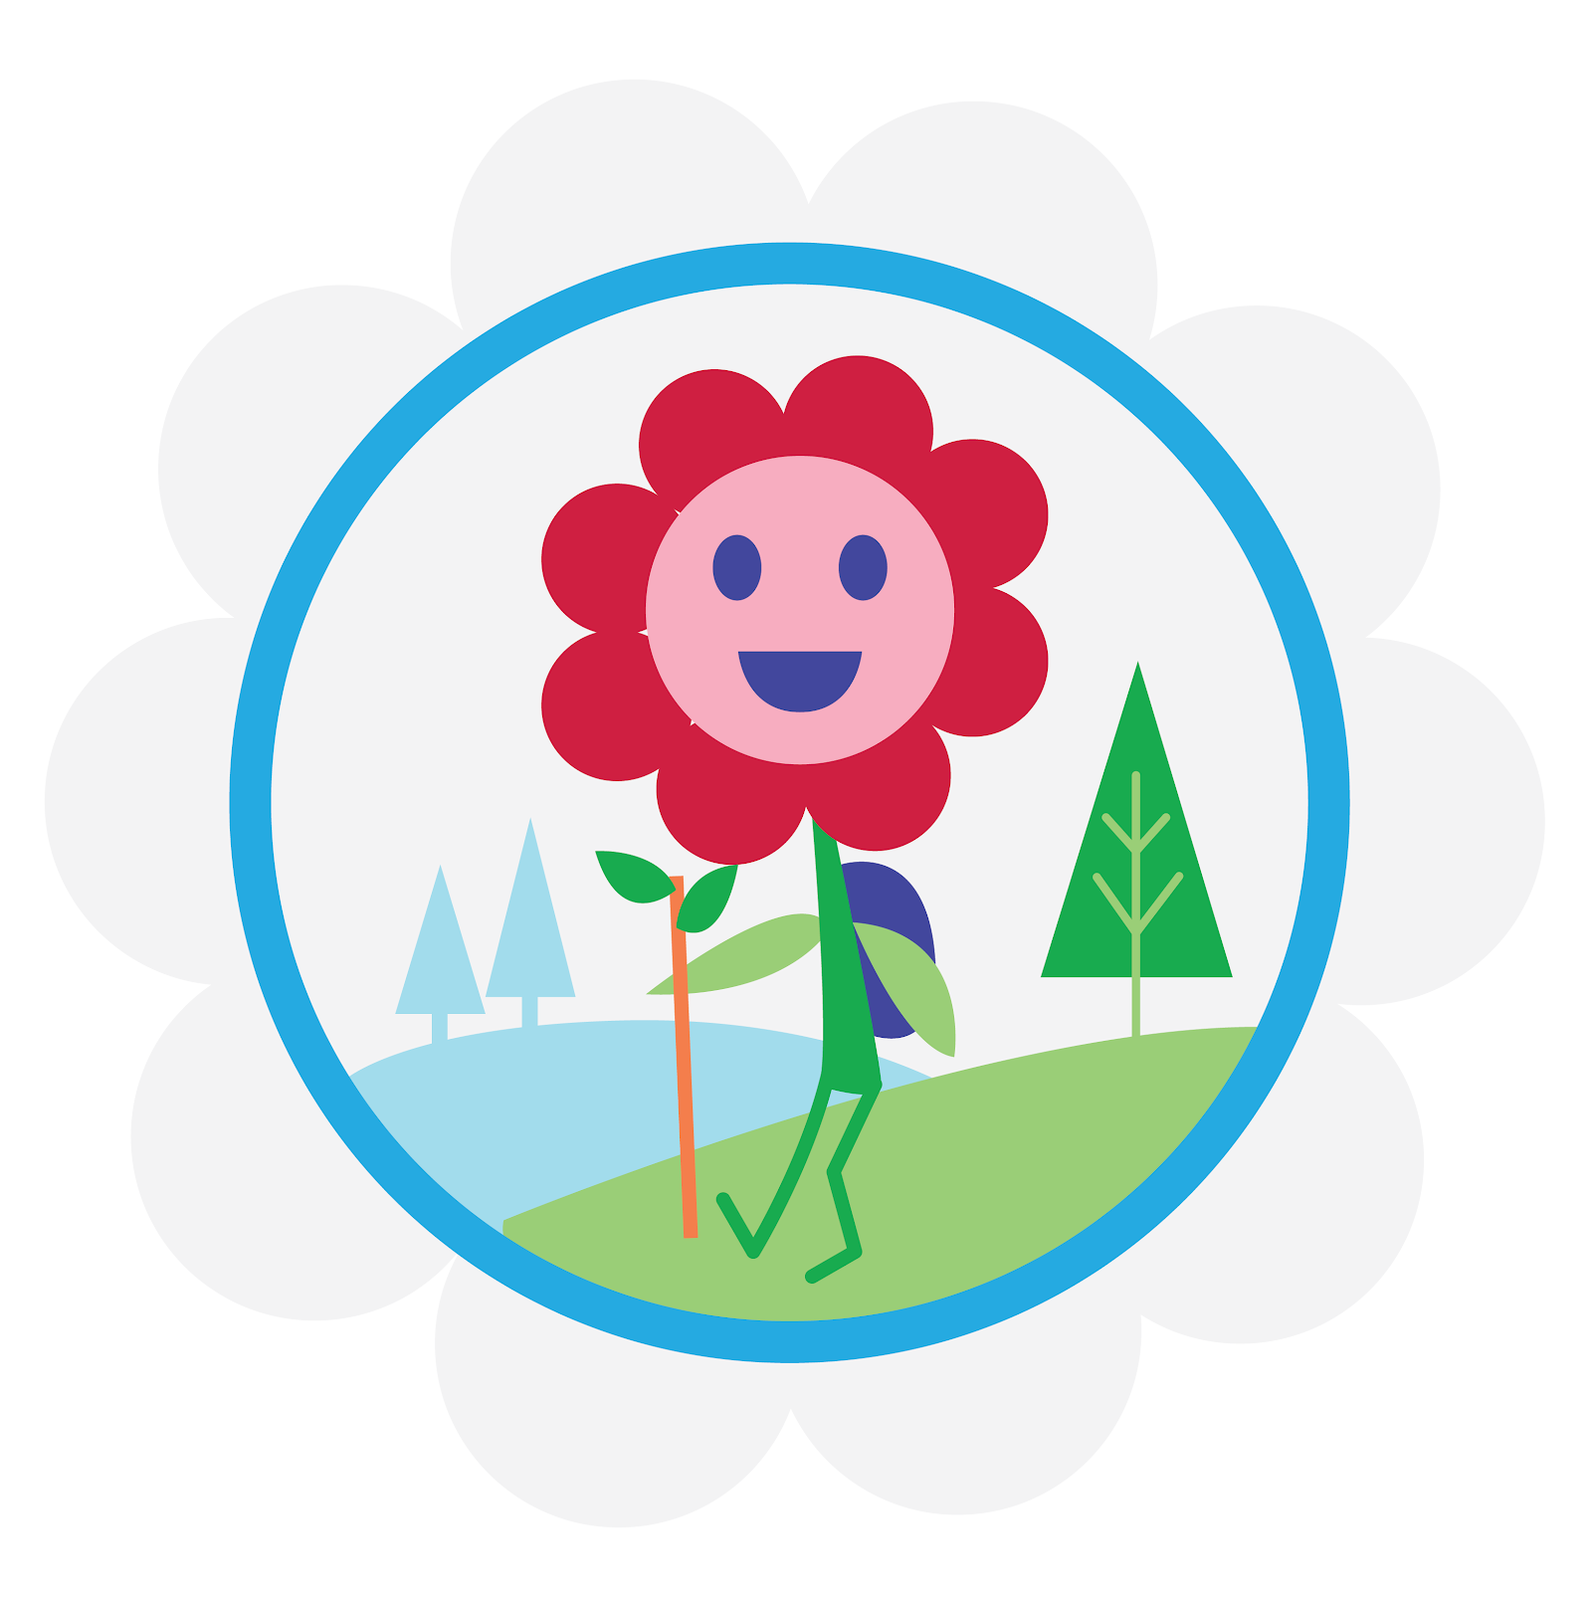

Leader Instructions & Meeting Prep:
Daisy Eco Learner Badge
The following slides will walk your troop through a virtual meeting to earn the Daisy Eco Learner Badge. When you share your screen during your meeting, be sure to click “Present” so girls see the full screen. Also, when you are sharing your screen in zoom, google meet, or another meeting app, please make sure you are sharing both picture and audio. For more information on using Zoom, visit gsnw.gl/VirtualMeetingHowTo
Many of the interactive activities included are shared through YouTube videos. Just click on the arrow in the center of the image to play the video, and the girls can see it too! You should try to review the slides before your meeting if possible, so you are familiar with the activities and any supplies needed.
This meeting will typically take approximately 60-90 minutes as written, depending on participation level and number of girls. As always, Girl Scouting is flexible, and troops may select the activities interest them most, add their own activities, or have girls do some of the steps afterward as “homework”.
When you send out your meeting invitation, be sure to let girls and parents know what supplies they should have on hand for the online troop meeting. They are things most girls likely have at home.

Slide 2



Daisy
Eco Learner
Badge
Brought to you by Girl Scouts of the Northwestern Great Lakes

Slide 3

Girl Scouts is so happy you’re here!
Let’s get started with the Girl Scout Promise!

Slide 4



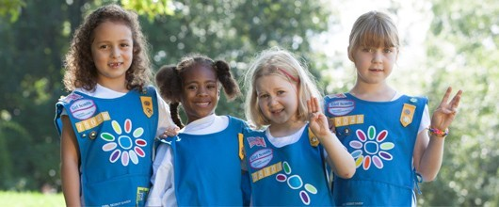

Slide 5


Let’s Say the Pledge

Slide 6
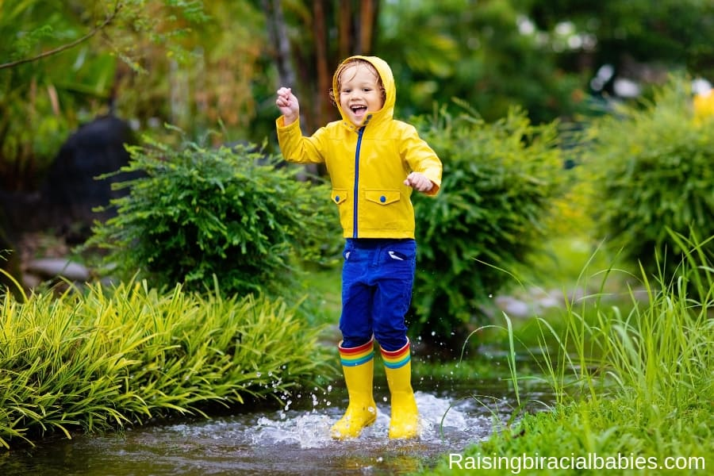
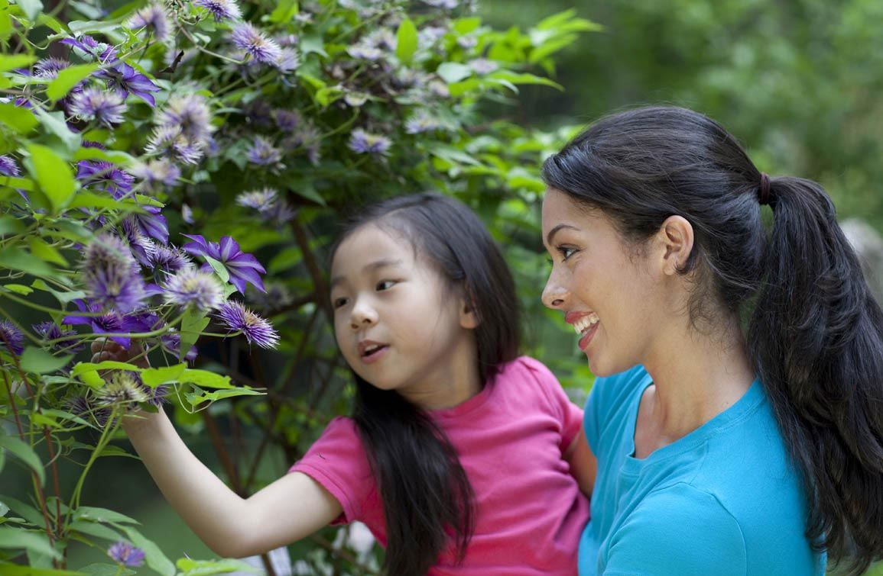
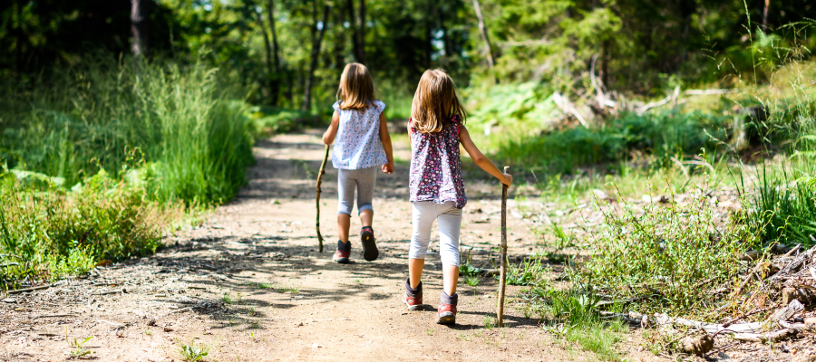
Are you ready to earn your Eco Learner Badge?
So that we know who is joining us today, when it’s your turn, please say your first name and your favorite thing to do outdoors in nature!

Slide 7
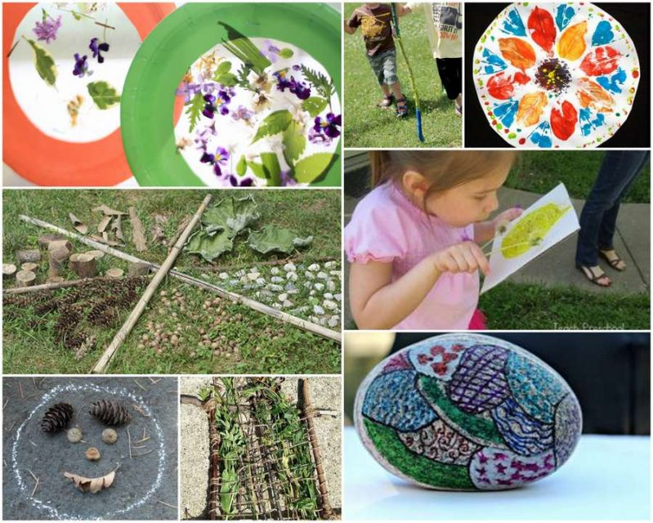

Those were all AWESOME outdoor activities! There is so much you can do in nature!

Slide 8
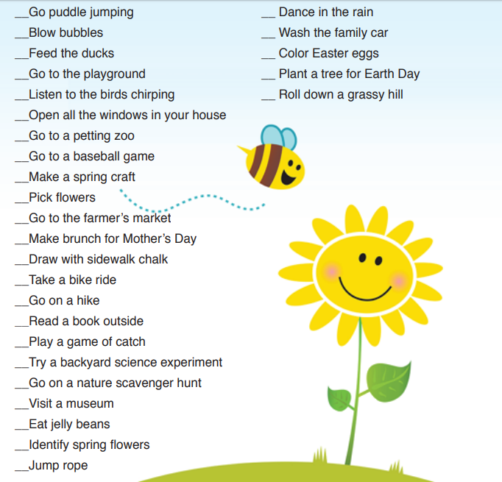


Did you know you can make a seasonal list of fun things to do in nature?
Let's find a few we like here!

Slide 9

For whatever you choose to do, it’s important to be prepared, just like a Girl Scout!
That’s Step #1 - Be prepared to protect nature before you go outdoors.
What does it mean to be prepared?

Slide 10


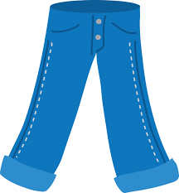
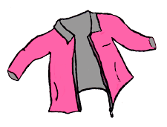
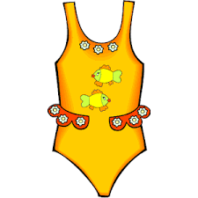
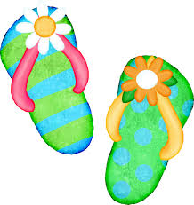
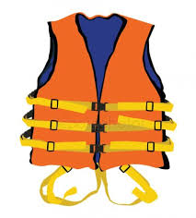
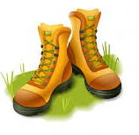


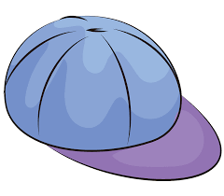
Being prepared means you know what to wear or bring with you in any occasion. What items would be needed for a spring hike?

Slide 11

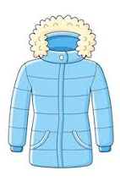


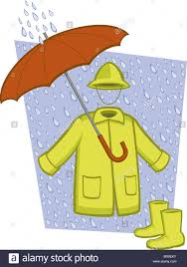
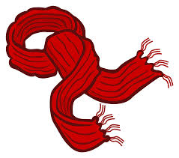

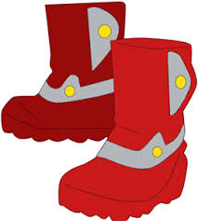
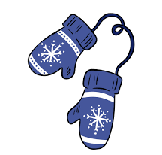
What about a winter hike?

Slide 12
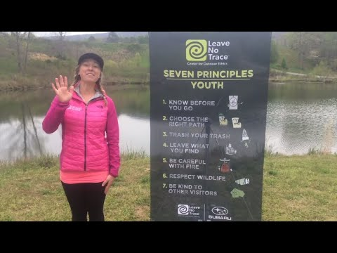

Now that we are dressed and ready to go, we also need to understand how to protect nature.
Leave No Trace

Slide 13

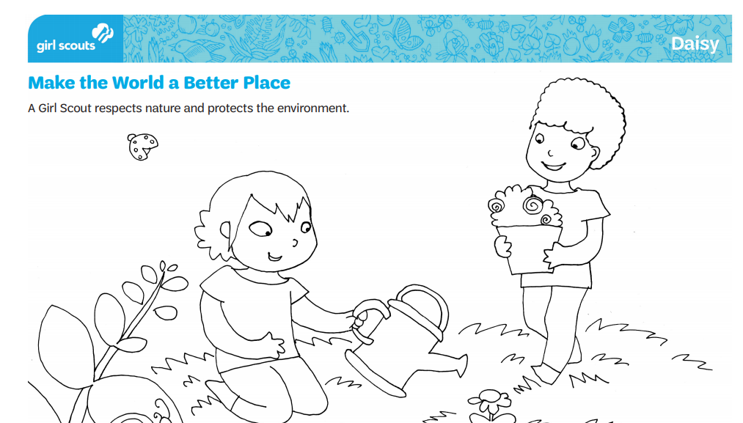

Step #2: Keep living things safe when you walk in nature.
Let’s brainstorm a list of living things that we can find in nature.
If you have the handout in front of you, you can add them to your picture.

Slide 14

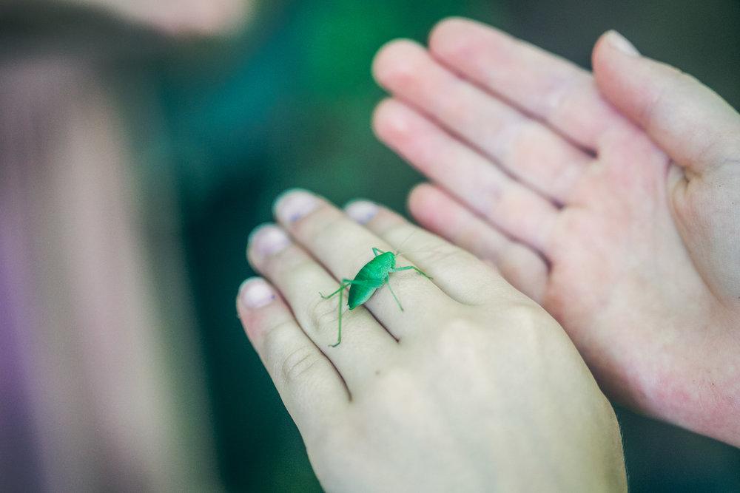
Always respect nature and the living things found in it!
Animals
Animals Homes
Plants
Insects
Flowers

Slide 15

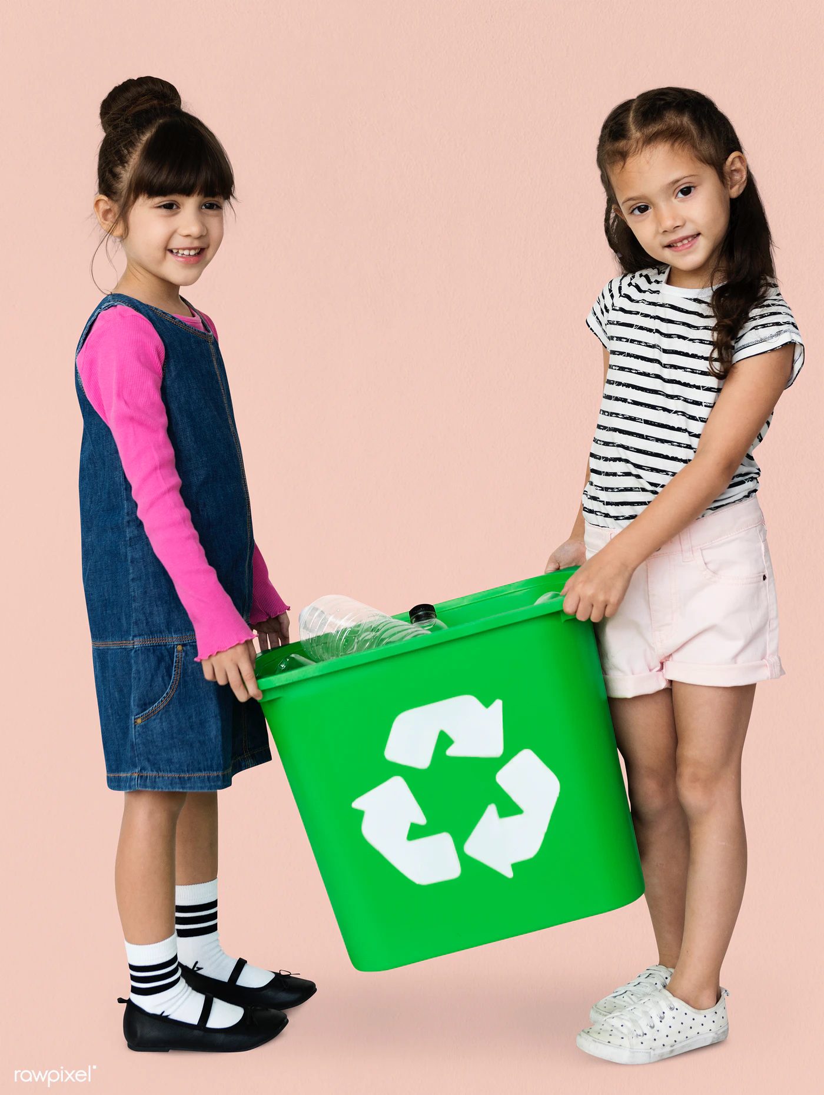
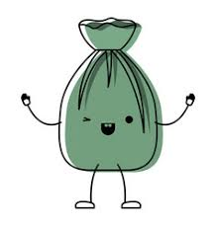

Step #3
Learn how to protect nature from trash.

Slide 16

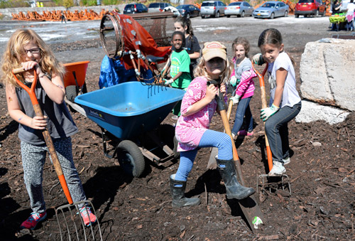




Girl Scouts ALWAYS leave a place better than they found it!
That means we pick up after ourselves every time. Does anyone have a good example of a time we’ve done that?
How about a time we could have done a better job?

Slide 17





Great Examples!!
When we talk and learn about picking up our garbage and recycling, we are making our planet, animals and nature all happy!
Girl Scouts make the world a better place!

Slide 18
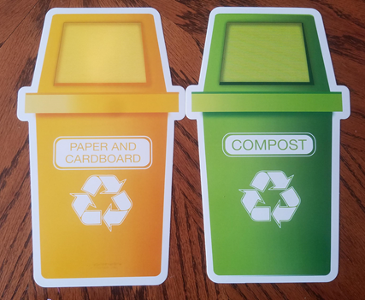
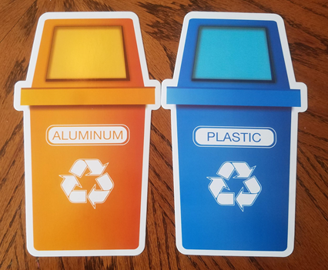

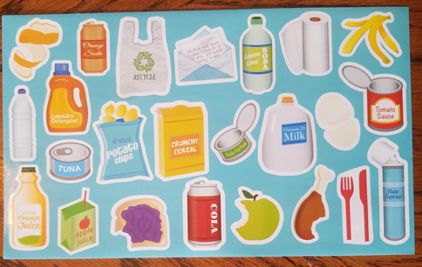
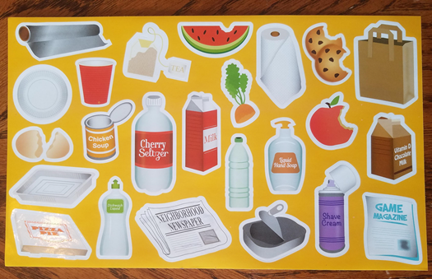
Can you sort the following items? Let’s pick 10 to do together.

Slide 19


Slide 20
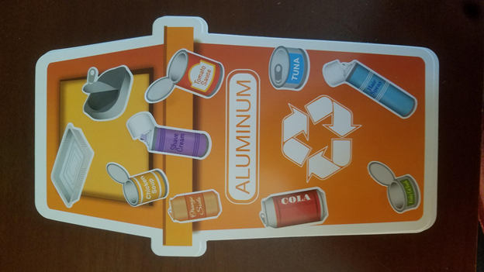
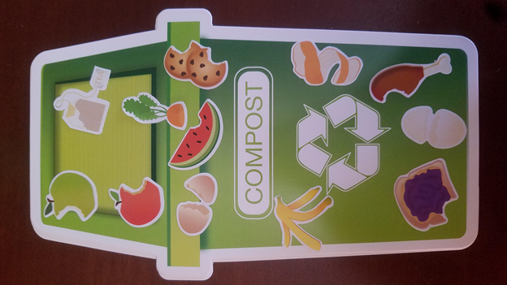


Slide 21
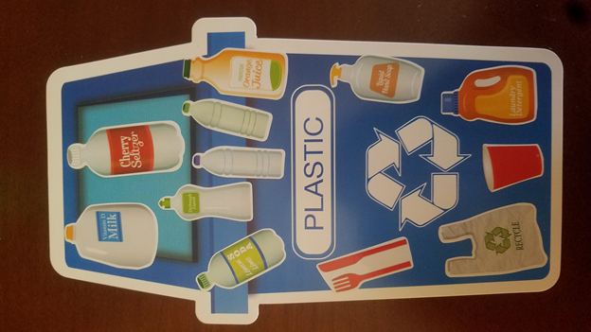
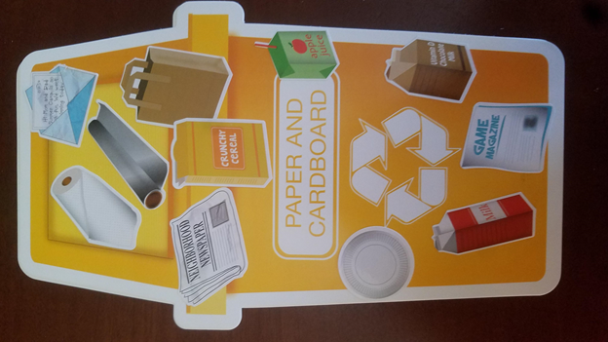

Slide 22

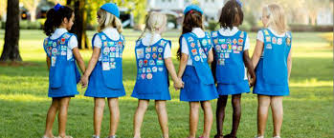
You’re ready for the outdoors!
We learned a lot
about NATURE!
  Be Prepared
  Keep Living Things Safe
  Learn How to Protect Nature from trash

Slide 23


Congratulations, you earned your badge!

Slide 24

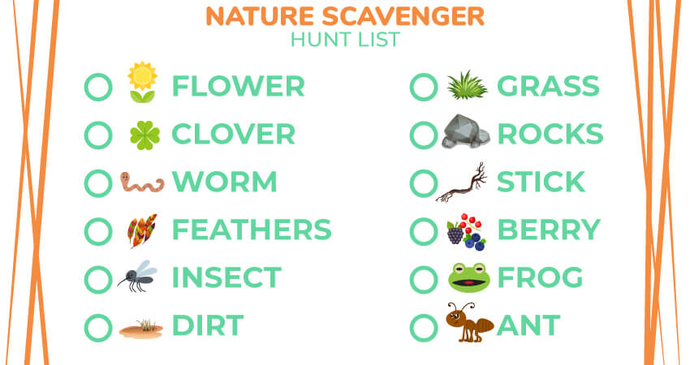
Continue the fun! Can you find the following the next time you take a hike?

Slide 25

See you next time Girl Scouts!

