Slide 1
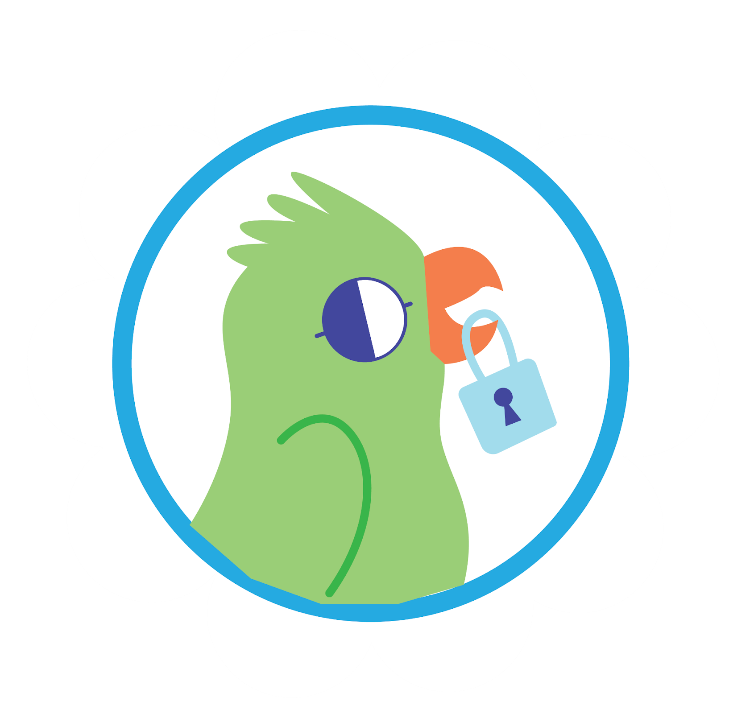

Leader Instructions & Prep
Daisy Cyber Security: Safeguards
Supply List:
Paper
Markers, crayons, or something to color with
The following slides will walk your troop through a virtual meeting to earn the Daisy Cyber Security: Safeguards Badge. When you share your screen during your meeting, be sure to click “Present” so girls see the full screen. Also, when you are sharing your screen in zoom, google meet, or another meeting app, please make sure you are sharing both picture and audio. For more information on using Zoom, visit gsnw.gl/VirtualMeetingHowTo
Many of the interactive activities included are shared through YouTube videos. Just click on the arrow in the center of the image to play the video, and the girls can see it too! You should try to review the slides before your meeting if possible, so you are familiar with the activities and any supplies needed.
This meeting will typically take approximately 60-90 minutes as written, depending on participation level and number of girls. As always, Girl Scouting is flexible, and troops may select the activities interest them most, add their own activities, or have girls do some of the steps afterward as “homework”.
When you send out your meeting invitation, be sure to let girls and parents know what supplies they should have on hand for the online troop meeting. They are things most girls likely have at home.

Slide 2


Daisy Cybersecurity: Safeguards Badge
Brought to you by Girl Scouts of the Northwestern Great Lakes

Slide 3
Girl Scout Promise
On my honor, I will try:
to serve god* and my country,
to help people at all times,
and to live by the girl scout law.

Slide 4


Let’s say the pledge

Slide 5
Daisy Cybersecurity: Safeguards
Badge Details:
Find out how to stay safe when you go online.
Discover what makes you different from others
Find out what information is private
Discover who is in your trust circle
When you've earned this badge, you will know what privacy is and how to protect my identity.

Slide 6


Slide 7
How can you be safe on the internet?

Slide 8
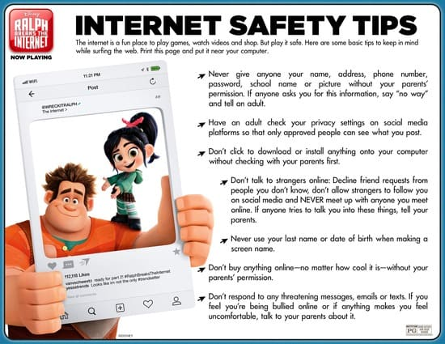

Slide 9

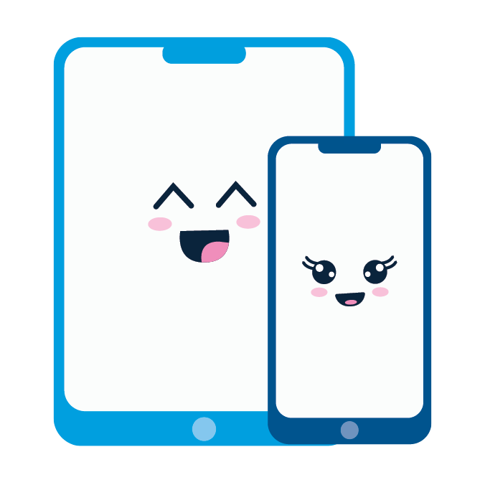
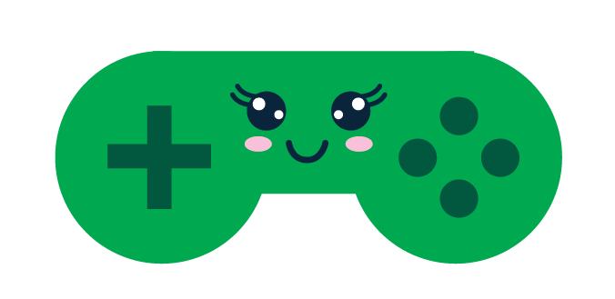
Where can you access the internet or talk to other people?
Computers | Laptops
You are connected! You can spend time with and talk to your family and friends every day using any of these items!
Just like us, computers are connected too. A group of computers is called a network. Our computer allows us to connect with other networks:
Example: You video call Grandma and Grandpa who live in a different city- they have a different unit and network from you!
Tablets | Smartphones
Videogame Player

Slide 10
Creating your own avatar and password

Slide 11

What is a password?
Imagine you have been given a magical pebble. Only you and your parents know about this pebble. If others find out about it, they may try to take it from you. The pebble gives you access to many things!
You can protect that pebble or password by:
Writing the password on a piece of paper
Not sharing the password with anyone
Keeping the paper in a safe place so others cannot find it – make sure you remember where it is!

Slide 12

Let’s create our own avatar and password.
Create a password that is easy for you to remember but hard for other people to guess.
  Example: I am going to use the first letter from each word in this sentence: I am a Girl Scout Daisy in 2020!
  My Password would be: IaaGSDi2020!
Take a few minutes to draw your own virtual avatar or character out and make your OWN special password that only YOU and YOUR caregiver know
We will then show our avatars but keep our passwords secret ☺
Supplies:
Paper
Something to write/color with

Slide 13
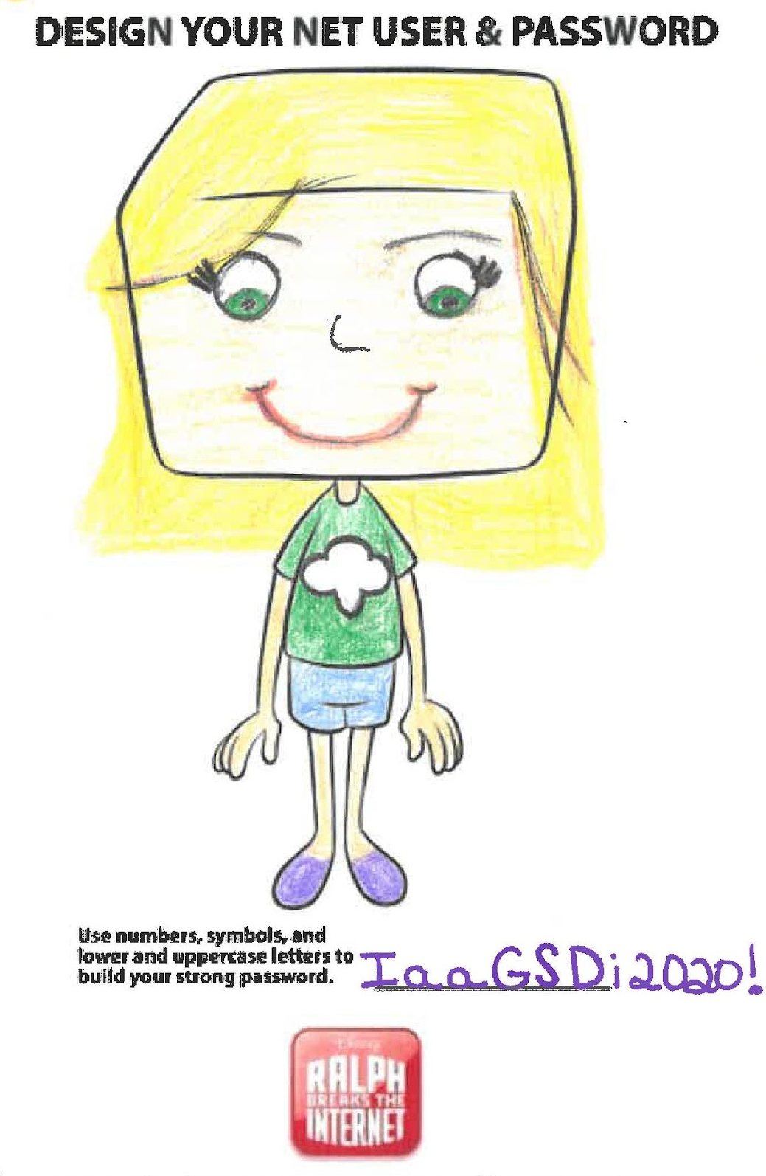
Example:
To show us your drawing- fold up the bottom over the password you wrote so that it remains a secret!
Your password is very special, but don’t share it with anyone! I am only showing mine as an example and won’t use this password.

Slide 14
What information is private?

Slide 15

Everyone has some information about them that is private. Here are some items we wouldn’t want to share with a stranger:
Your first and last name
Your birthday
Where you live
Your phone number
Where you go to school
Your family’s names

Slide 16
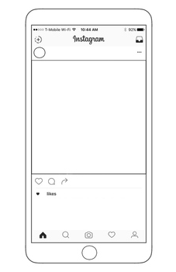
There are places on the Internet where we can put our own photos and videos (mom or dad might even have a place they post photos).
While posting photos on the internet can be fun, we need to make sure we are being safe.
Never post anything that describes where you are, where you’re going or giving out personal information.
We are going to play a game to determine which photo is safe vs unsafe.

Slide 17
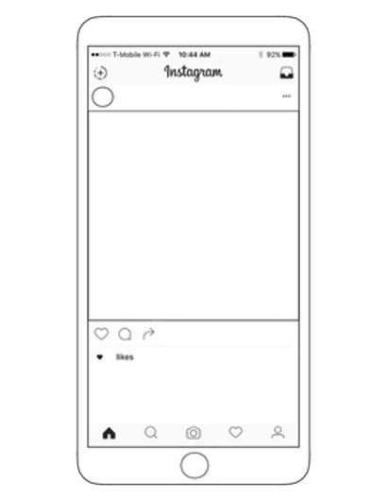

Which photo & text would be safe to post?
A or B
Veneloppe is here! Call us at 555.987.1234
Just hanging with the girls!

Slide 18
The answer is:
B
We do not want to post A because we gave out our personal number. In B, no personal information is provided.
Just hanging with the girls!

Slide 19
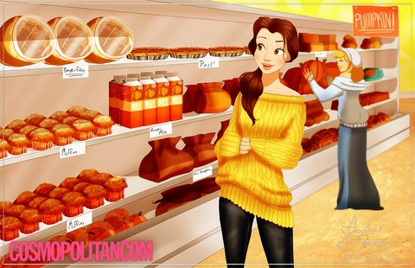
Which photo & text would be safe to post?
A or B
Pretty excited for the winter weather. I get to wear my new sweater!
Its cold! I get to wear my new sweater while I’m shopping at Pick N’ Save in Appleton, WI!

Slide 20
The answer is:
A
We would not want to post B because we gave out our exact location in that one. In A, we are not giving out any specific information.
Pretty excited for the winter weather. I get to wear my new sweater!

Slide 21

Which photo & text would be safe to post?
A or B
Headed into the Enchanted Forest today with Anna, Kristoff, and Sven- meet us there, 7 PM
Taking an adventure!

Slide 22
The answer is:
B
We would not want to post A because we would be extending an invitation to people we may not know and telling strangers where we are and when we will be somewhere.
Taking an adventure!

Slide 23
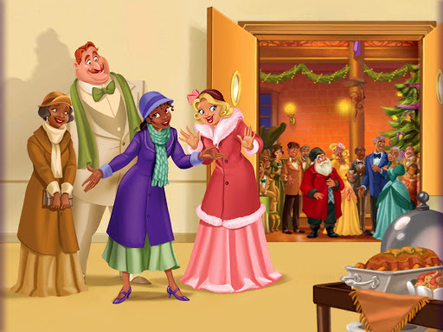
Which photo & text would be safe to post?
A or B
Holiday celebrations have begun!
I’m at 1234 N Frog Lane! Come hang out!

Slide 24
The answer is:
A
Again, we never want to post our exact location on the internet.
Holiday celebrations have begun!

Slide 25
Let’s discover our trust circle

Slide 26
Who can you trust?
When you trust someone, you believe that they want to help you and keep you safe!
You know it’s OK to share private information with them
You trust people you know very well like your parents, but what about the people you don’t know well? Or at all?
In real life, you probably wouldn’t walk up to a stranger and start talking to them if you were alone!
But if you’re lost and see a police officer, you might ask for help!
When you’re online, you have to be careful the same way you are in real life. You have to be careful with the people you don’t know.
For this activity, please grab a piece of paper and at least five different colored markers or crayons.

Slide 27
How do we know who to trust?
Everyone grab a piece of paper and draw circles just like this. (Feel free to use colors for this)
Purple – Your Inner Circle: These are the people who know you best and you spend a lot of time with them – you usually live with them and you trust them the most.
Blue – Your Circle of Friendship: These people are also close to you, but you do not live with them or depend on them. But you do share your dreams and good news with them!
Green – The Circle of Participation: These people are students in your classes, afterschool program, or daycare. You see them often, but they may not be a close friend.
Yellow – The Circle for Community Helper: These are people who help you out in the world, but you do not know them. This may be your doctor, hairdresser, or your teacher. It is okay to give personal information to them in an emergency
Red – The Stranger Circle: These are people you do not know and should not trust with personal information. These would be people walking down the street you do not know.

Slide 28
How do we know who to trust?
Knowing who we can trust with private information is tricky and is something we all have to be aware of!
Your parents or caretakers are a great place to start and can help you figure this out when you are unsure!
Remember everyone has different relationships, so although your friend might be super close and trust their 7th cousin once removed, that does not mean you should tell your 7th cousin once removed all of your private information

Slide 29
Now that we know how to be safe on the internet…
Let’s do a quick course
Let’s look up the item and take special note that all these topics are very broad. This means we are likely to get a lot of results.
  Cats
  Unicorns
  Disney
  Girl Scouts

Slide 30
On your own with your caregivers help
Choose a topic and do your own search on the internet.
We would love to see what topics you looked up and what you learned about that topic! Ask your caregivers to take photos of you doing your research and being safe on the internet!

Slide 31
Congratulations, you have earned the
Daisy Cybersecurity: Safeguards Badge!

