Slide 1


Leader Instructions & Prep
Cadette Trees Badge
Supply List:
Paper
Something to write with
Coloring utensils (colored pencils, markers, crayons, or anything else)
The following slides will walk your troop through a virtual meeting to earn the Cadette Trees Badge. When you share your screen during your meeting, be sure to click “Present” so girls see the full screen. Also, when you are sharing your screen in zoom, google meet, or another meeting app, please make sure you are sharing both picture and audio. For more information on using Zoom, visit gsnw.gl/VirtualMeetingHowTo
Many of the interactive activities included are shared through YouTube videos. Just click on the arrow in the center of the image to play the video, and the girls can see it too! You should try to review the slides before your meeting if possible, so you are familiar with the activities and any supplies needed.
This meeting will typically take approximately 60-90 minutes as written, depending on participation level and number of girls. As always, Girl Scouting is flexible, and troops may select the activities interest them most, add their own activities, or have girls do some of the steps afterward as “homework”.
When you send out your meeting invitation, be sure to let girls and parents know what supplies they should have on hand for the online troop meeting. They are things most girls likely have at home.

Slide 2

Cadette Trees Badge
Brought to you by Girl Scouts of the Northwestern Great Lakes

Slide 3
Girl Scout Promise
On my honor, I will try:
to serve god* and my country,
to help people at all times,
and to live by the girl scout law.

Slide 4


Let’s say the pledge

Slide 5

Ice Breaker
What is your favorite outdoor destination? The beach? A nature preserve? The local park?

Slide 6
Cadette Trees Badge
Badge Details:
Find out all about trees: from the shade to the science, the fruit to the forest, and the legends to the lumber.
Try some tree fun
Dig into the amazing science of trees
Make a creative project starring trees
Explore the connection between people and trees
Help trees thrive
When you’ve earned this badge, you’ll have gone to the root of what trees are all about and branched out as a naturalist

Slide 7
Step 1: Try some tree fun

Slide 8
Let’s design a treehouse!
What do you see when you imagine a treehouse? What are the details of a tree house like?
Have you ever been in a treehouse? If not, answer imagining what a tree house would feel and look like.
How was it designed? How does it feel? Smell?
What color was the wood? Was it painted? What was its texture?

Slide 9
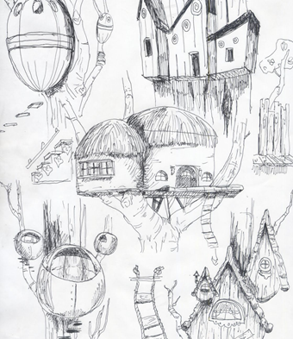
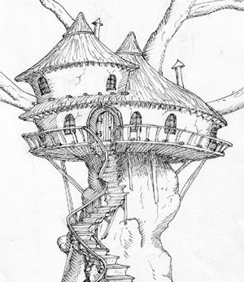
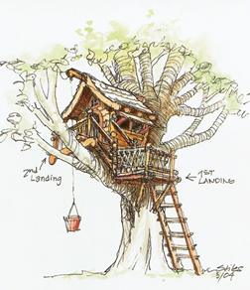
Let your creative juices flow & draft your dream treehouse
Be as creative as you’d like! You can make it a realistic tree house, or a dream treehouse that use state of the art architectural design! Try not to get too caught up in perfection, and remember to add the tree’s natural characteristics (branches, leaves, limbs) in your design!

Slide 10

On your own time - make apple pie!
In addition to providing oxygen, shade, and shelter, trees are also a great source of food! Apples, pears, lemons, oranges, and so much more come from trees! Let’s make a tree ingredient pie!

Slide 11
Instructions
Preheat oven to 425 F. Melt butter in a saucepan. Stir in flour to form a paste.
Add white & brown sugar, and bring to a boil. Reduce temperature and let simmer
Place bottom crust in your pan. Will with apples, cover with other crust (cut holes or make a weaved pattern)
Gently pour sugar and butter liquid over crust (slowly!)
Bake 15 minutes, reduce oven temp to 350 F, then bake for another 35-45 minutes, or until apples are soft.
Ingredients
9 in double crust pie
½ cup unsalted butter
3 TBS all-purpose flour
¼ Cup Water
½ cup white sugar
½ cup packed brown sugar
8 Granny Smith Apples – peeled, cored, and sliced

Slide 12
Step 2: Dig into the
amazing science of trees

Slide 13
Be a Naturalist! We’re going to play a bit of tree trivia!
I will ask you questions about what trees do and also show pictures of different trees common in Wisconsin and the UP!
It’s your job to try to answer the questions to the best of your ability. It’s okay if you do not know the answer, this badge is all about learning!

Slide 14
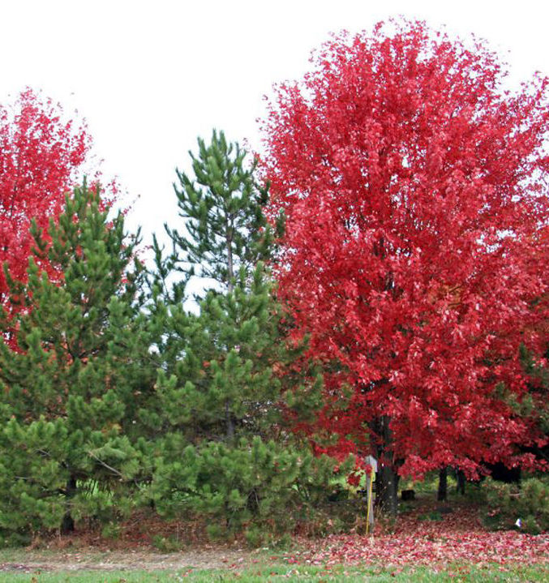
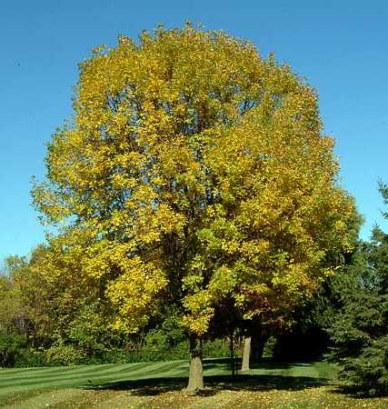
What do trees do for the earth?

Slide 15
Trees give us oxygen, provide habitats to critters big and small, and stabilize and improve soil quality.

Slide 16
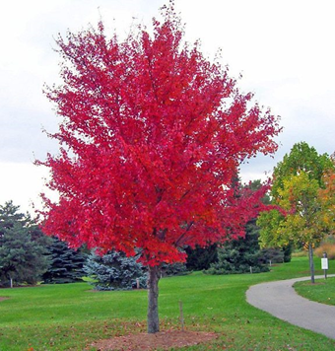
Do you know what kind of tree is this?

Slide 17
It’s a Red Maple

Slide 18
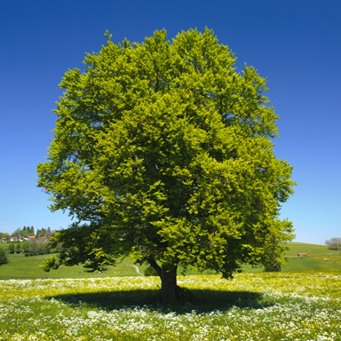
Do you know what kind of tree is this?

Slide 19
It’s an American Beech Tree

Slide 20
How can you tell how long a tree has been on Earth?

Slide 21
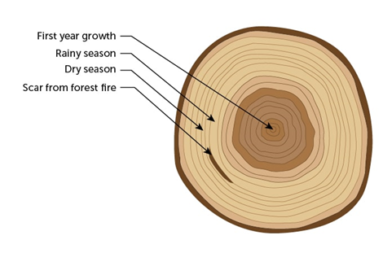
By counting its rings. This is called Dendrochronology. Simply start in the middle of wood and count the dark rings going outward!

Slide 22
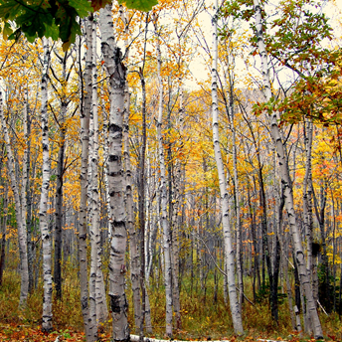
Do you know what kind of tree is this?

Slide 23
It’s a Birch Tree

Slide 24
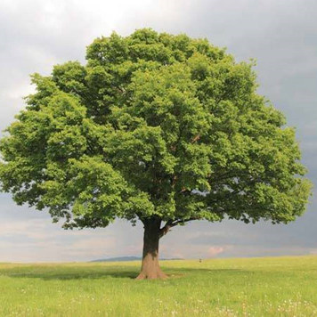
Do you know what kind of tree is this?

Slide 25
It’s an Oak Tree

Slide 26
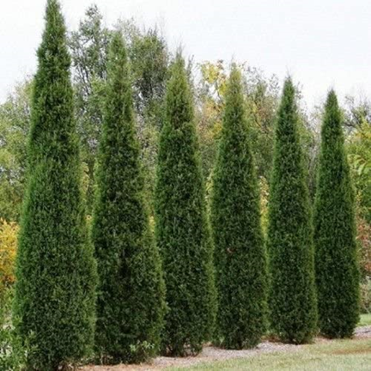
Do you know what kind of tree is this?

Slide 27
It’s a
Red Cedar Tree

Slide 28
Great job girls!

Slide 29
Step 3: Make a creative project starring trees

Slide 30
Let’s create our own tree legend
Did you know that trees are often deemed sacred and are significant in many of the world’s religions and mythologies?
On the next slide, we’ll watch a video by Crash Course that gives numerous tree mythologies!
Then, you’re going to create your own! Create a mythology, in honor of trees, that is fascinating, reflective, creative, and meaningful.

Slide 31

Let’s learn about tree mythologies!

Slide 32
Create your own mythology
Thinking of the mythologies we just learned about, let’s take some time to create your own!
You could make a comic book, a short story, or a short skit!
When we’re done and if we have time, a few girls should share their mythology!

Slide 33
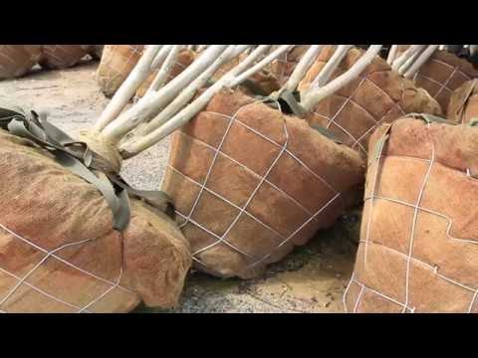
Let’s hear from a tree nursery expert
We’re going to hear from Robert Polomski who talks about tree production and tree nursery
He also talks about the maintenance that needs to be done while owning a tree!

Slide 34

Girl Scout Tree Promise
Let’s plant a tree!
Join our mission to protect the planet from the effects of climate change by planting a tree! You’ll earn an additional patch!
Let’s plant a tree in our neighborhood!
See the GSUSA site for more info.
https://www.girlscouts.org/en/girl-scouts-at-home/activities-for-girls/for-every-girl/tree-promise.html

Slide 35
Way to go, you have earned the Cadette Trees Badge!

