Slide 1


Leader Instructions & Meeting Prep:
Cadette Special Agent Badge
Special Leader Notes::
This Badge will likely take about 1.5 to 2 hours to complete. If this is too long for your troop, you could separate into 2 meetings, or give the girls some steps to do later as homework.
For Badge Step 2: If possible, Consider inviting a local Police Detective, Crime Scene Analyst, or Private Detective as a guest speaker. There is an alternate activity included if this is not convenient.
For Badge Step 5: Bring a picture of a celebrity the girls would know, to use as your “suspect” in the sketch artist activity. Do not show it to the girls, and keep their identity secret until the end.
Cadette Special Agent: :Badge:meeting plan: :supply list::
Pencils
Scotch Tape
Unlined Paper
Photo featuring several people. (Could be a family photo, magazine photo, whatever.)
Large cup (ideally about 16 oz)
Coffee filters
Black Marker
Rubbing Alcohol
Water
Ruler
Scissors
The following slides will walk your troop through a virtual meeting to earn the Cadette Special Agent Badge. When you share your screen during your meeting, be sure to click “Present” so girls see the full screen. Also, when you are sharing your screen in zoom, google meet, or another meeting app, please make sure you are sharing both picture and audio. For more information on using Zoom, visit gsnw.gl/VirtualMeetingHowTo
Many of the interactive activities included are shared through YouTube videos. Just click on the arrow in the center of the image to play the video, and the girls can see it too! You should try to review the slides before your meeting if possible, so you are familiar with the activities and any supplies needed.
This meeting will typically take approximately 60-90 minutes as written, depending on participation level and number of girls. As always, Girl Scouting is flexible, and troops may select the activities interest them most, add their own activities, or have girls do some of the steps afterward as “homework”.
When you send out your meeting invitation, be sure to let girls and parents know what supplies they should have on hand for the online troop meeting. They are things most girls likely have at home.

Slide 2

SPECIAL AGENT
Cadette .
Brought to you by Girl Scouts of the Northwestern Great Lakes

Slide 3


Let’s start with the
Girl Scout Promise

Slide 4

Icebreaker: .
What is your favorite crime or mystery related TV show, movie or book?

Slide 5

Step 1: Investigate Investigation
Every person on earth has unique fingerprint patterns. This means fingerprint evidence can be used to solve crimes! Take your own fingerprints, using this simple method.

Slide 6
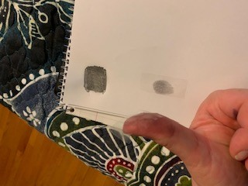
Fingerprint Yourself! .
Draw a small square on a piece of paper, and color it in with a pencil, as dark as you can.
Press your finger down on it, as though you were being fingerprinted.
Put a piece of clear tape on the end of your finger, covering the print.
Gently remove the tape, and attach it to the paper so you can see your print clearly.
Repeat for each finger.

Slide 7
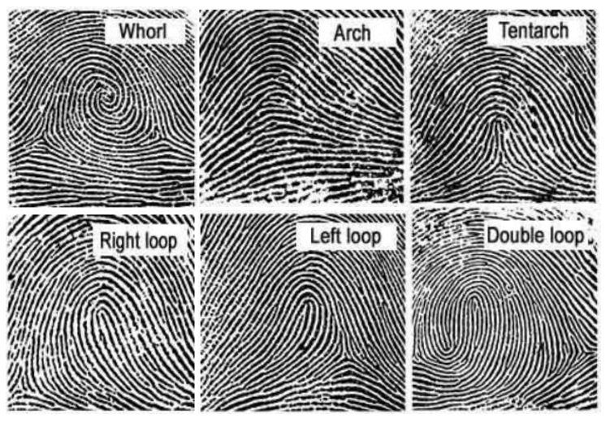
How many of each pattern type do you have?
Which types are most common in our troop?

Slide 8
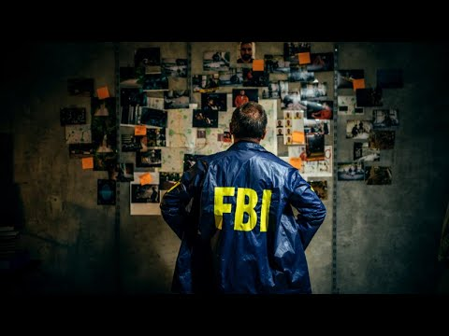
Step 2: :
Reveal Reality.
What does it take to be an FBI agent?

Slide 9
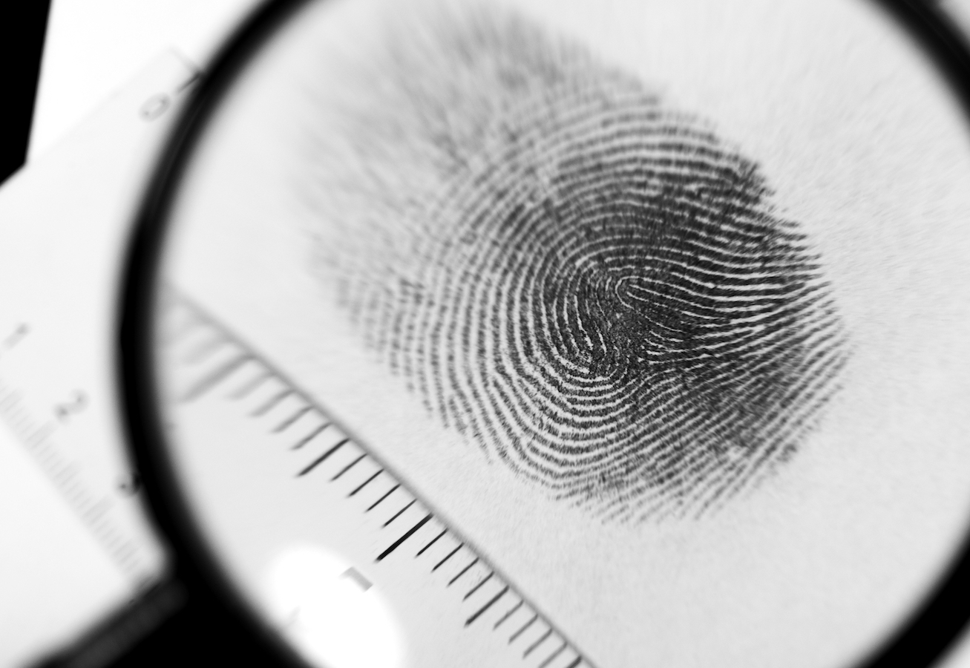
Do you have what it takes?
Do you think you would like to be an FBI agent?
What qualities that he mentioned do you think would be a good fit for you?
What parts of the job do you think you would like?
What would parts would you dislike?

Slide 10
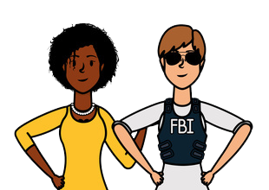
Ask an Expert... .
You may not have FBI special agents in your community, but you may have police detectives or private investigators.
Let’s work together to create a list of questions we would like to ask an actual investigator about their job.
Maybe they can even join our meeting as a special guest! If not, we can send our questions in an email or letter, and hopefully read their responses at our next meeting!

Slide 11

Step 3: Try the Science
Forensic Scientists use chemistry to help solve crimes. They use a process called chromatography to separate parts of a mixture, so they can detect things like poisons, drugs, or traces of explosives. Let’s try our own forensic chemistry experiment using chromatography!

Slide 12
Procedure:
Cut coffee filters into strips that are about 1 ½ inches wide and the same height as the paper cup.
About ¼ inch from the bottom of the coffee filter strip, use a ruler to draw a horizontal line in a pencil all the way across. Draw a dot on the center of the line using the black marker.
Mix equal portions of water and rubbing alcohol and put enough of the mixture in the cup so that it coats the bottom—it should be less than ¼ inch deep.
Hold the pencil horizontally and tape the top of the coffee filter strip to the pencil. Position the pencil horizontally across the top of the paper cup so that the strip hangs into the liquid. Make sure that the very bottom of the filter paper is touching the liquid but that the liquid is still below the ink dot on the filter paper.
Wait 15-20 minutes fir the ink to travel up the filter paper. How many colors do you see?
Try different black markers and pens around your house to see how many colors they separate into!
Coffee filter Chromatography
Materials:
Paper cup (16 oz.)
Coffee filters
Black marker
Pencil
Tape
Rubbing alcohol (99% works best)
Water
Ruler

Slide 13

Step 4: :
Key into Body
Language.
Special Agents often use body language to help understand situations. Here’s some simple tips!

Slide 14

Let’s try it! .
Let’s each show the photo you brought. Based on what we learned in the video, is there anything you can interpret about the body language of the people in your photo?

Slide 15
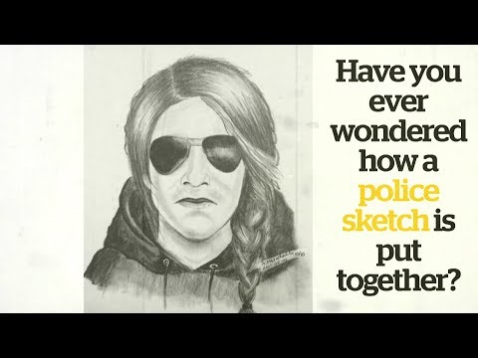
Step 5: :
Practice the
Art of
Detection
Detection.
Sketch Artists draw portraits of suspects, based on eyewitness descriptions.

Slide 16
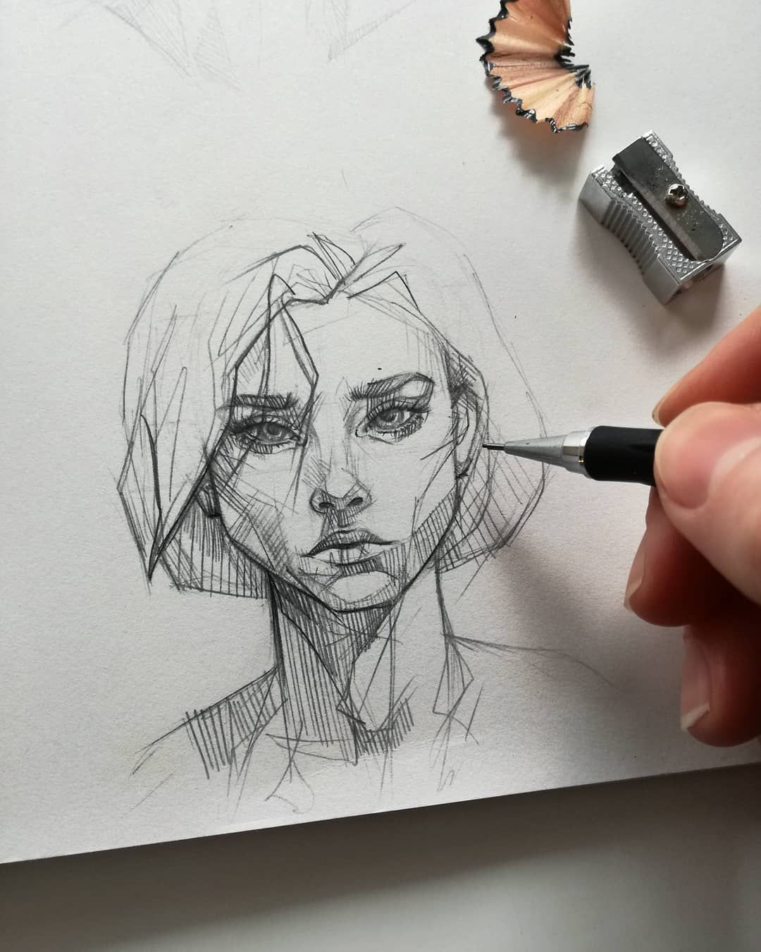
Now, Let’s give it a try!
You are the Sketch Artist!
Your troop leader is going to describe someone in detail. You can ask as many questions as you want.
How did your sketches turn out? How close were they to the actual person she was describing?

Slide 17
Great job,.
GIRL SCOUTS!
You have earned the
SPECIAL AGENT Badge

