Slide 1


Space Science Researcher
Cadette
www.GetYourGirlPower.org

Slide 2

Scientists have used the observation and exploration
of light to make discoveries that deepen their
understanding of the Sun, stars, and other objects in space. You’ll re-create some of these scientific experiments, observe the night sky with your own eyes, and explore the possibility of seeing light in new ways.

Slide 3

Step 1: What more can you see?
A Newton disc is a disc with seven segments in rainbow colors. When the disc is rotated, the colors fade to white; in this way Isaac Newton demonstrated that white light is a combination of the seven different colors found in a rainbow. This is due to the phenomenon called persistence of vision. It was an important discovery as it proves that light is not colorless, but has colors in it which together converge to give a faded white color which we consider colorless. This property is based on the principles of dispersion of light.

Slide 4

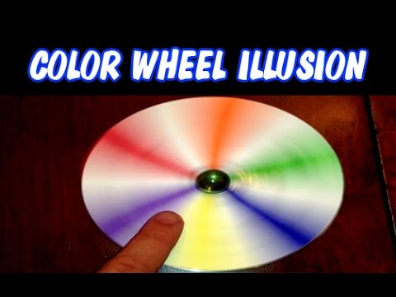
Create Newton’s Disk

Slide 5

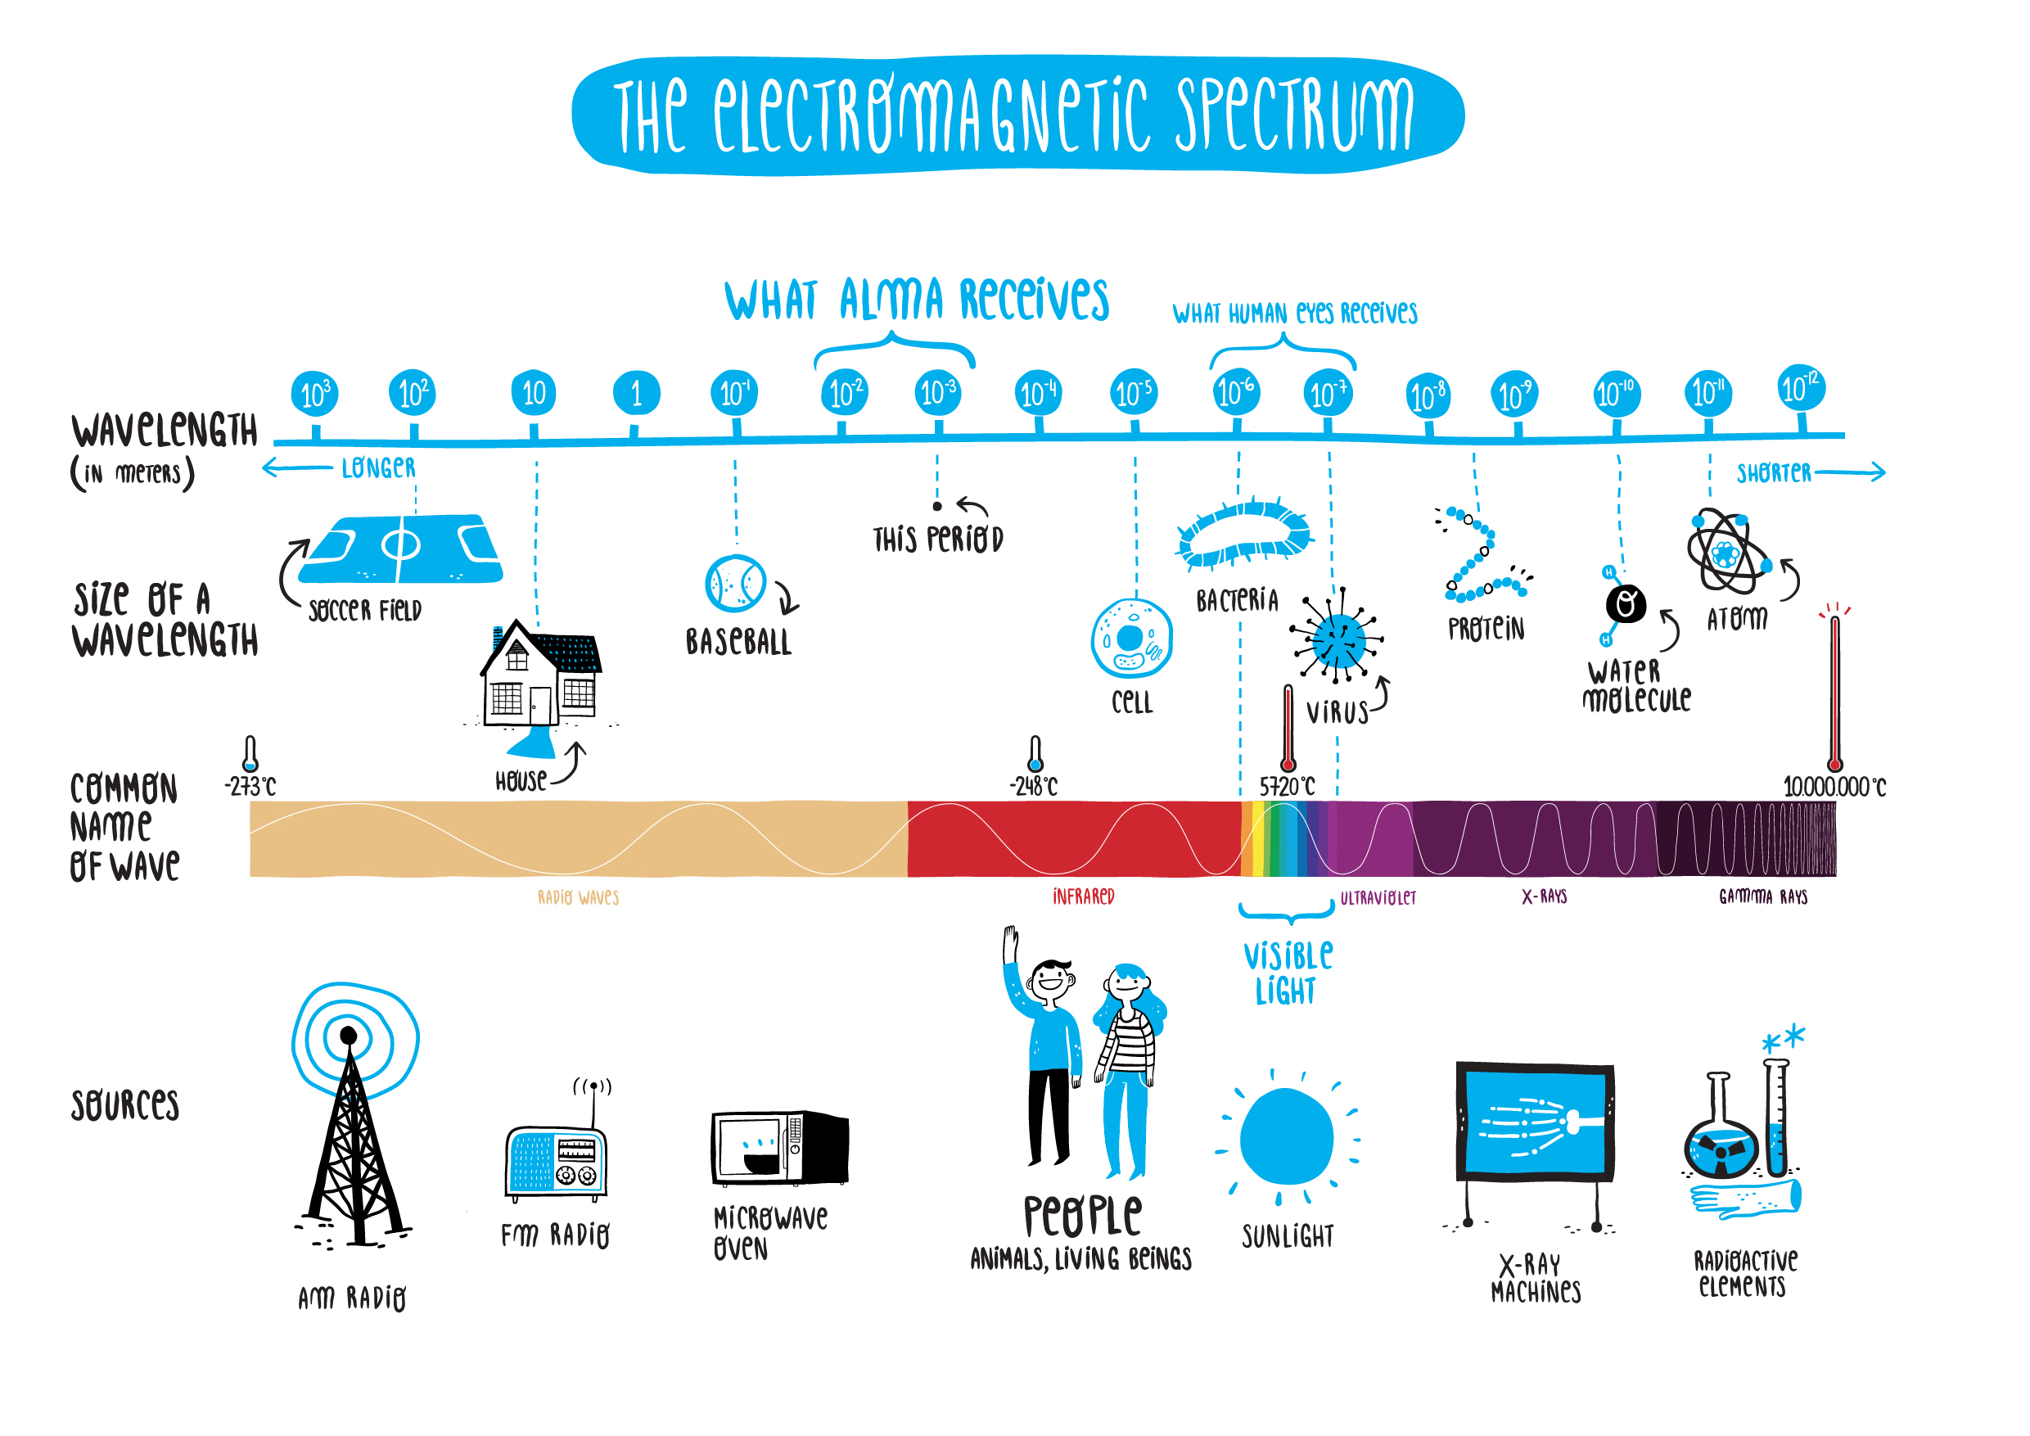
Step 2: Explore “invisible”light
The light we can see with our eyes, called visible light, is just a small part of all the light around us. Some types of light have more energy than visible light: UV, X-rays and gamma rays. Some types have less: infrared, microwaves and radio waves. We call all of these different types of light The Electromagnetic Spectrum-even the light we cannot see is still light!

Slide 6

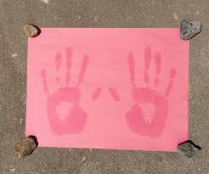
Step 2: Create a Sunprint
Click on the image to create a sunprint.
Things to think about
What do you see?
Why did this happen?
Test different types of sunscreen to see if you get different results.
Draw what you see in your notebook.

Slide 7

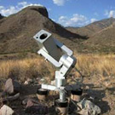
Step 3: Observe with NASA
Click Here to capture your own astronomical images from the ground-based MicroObservatory—a real robotic telescope that you can direct. Space science researchers control some of the world’s most sophisticated space probes and orbiting telescopes. This equipment provides amazing images of objects in space.
Compare multiple photos and draw or record your observations in a notebook. What are some things you notice? Which images turned out best? Why? Capture another image using what you know now.

Slide 8

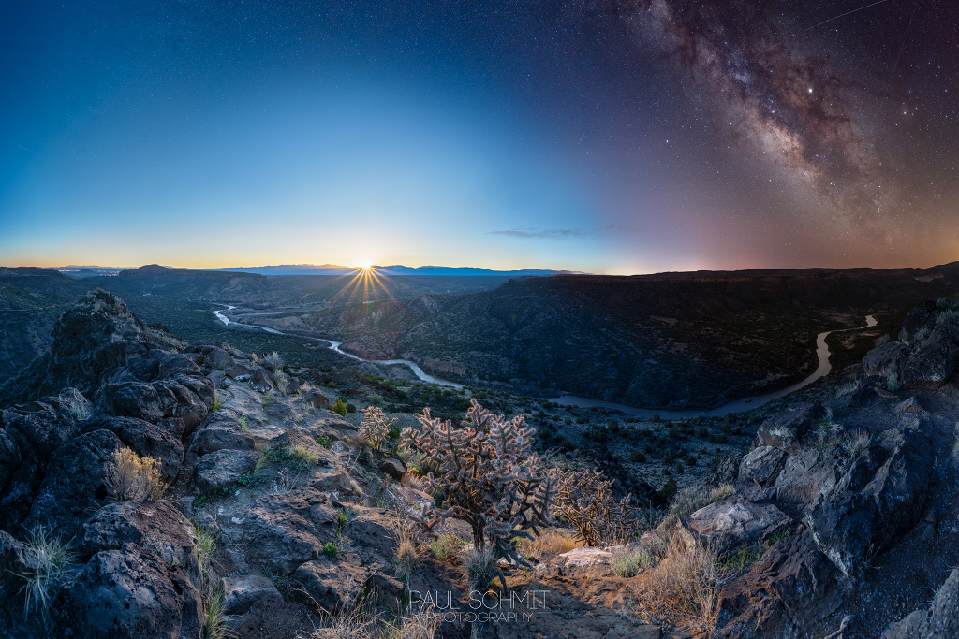
For More: Check out Astronomy Picture of the Day. A different image of our Universe every day with a brief explanation.

Slide 9
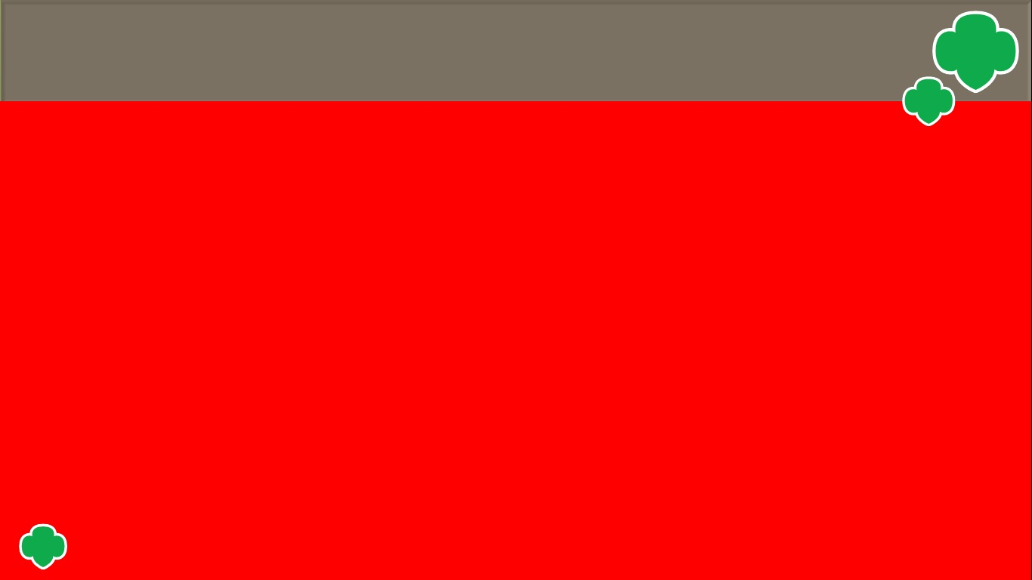
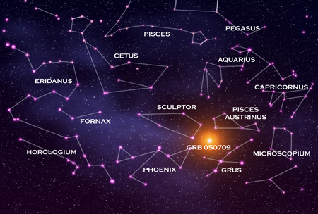
Step 4: Expand Your Vision
When stargazing, it's important to let your eyes adjust to the darkness. It can take up to a half hour for your eyes to fully adjust, and every time you use a normal white-light flashlight it can reset the adjusting process. But sometimes you need just enough light to read a star chart, adjust your telescope, or find your way down the path on a night hike; this is where a night vision flashlight comes in.
A night-vision-safe flashlight produces only red light, the spectrum of light that will allow you to see your surroundings without sacrificing your natural night vision.

Slide 10

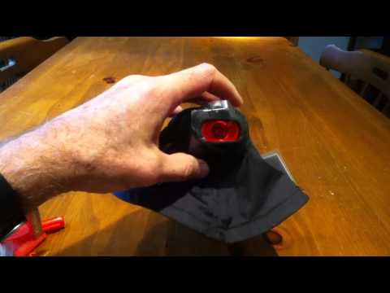
Make a Night Vision Flashlight

Slide 11
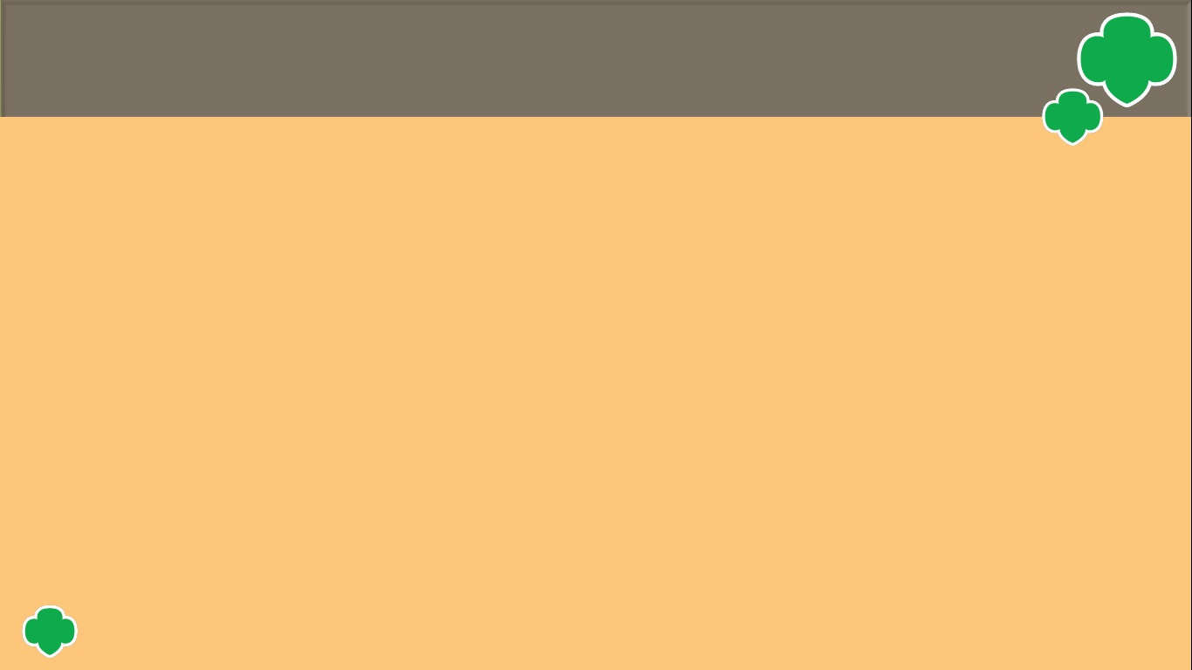
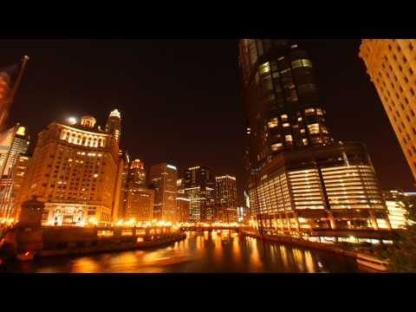
Step 5: Conserve The Night Sky

Slide 12


Light Pollution Pledge
On my honor, I pledge to do my share To reduce light pollution.
I promise to turn off the lights when I leave my house and to help properly shield all outdoor lights. I promise to close my blinds or curtains to keep light inside.
I also pledge to remind my family and friends. That we are the solution to light pollution.

Slide 13

Congratulations you earned Space Science Researcher Badge
www.GetYourGirlPower.org

