Slide 1


Leader Instructions & Meeting Prep:
Cadette Science of Happiness Badge
Cadette Science of Happiness: :Badge meeting plan supply list::
Journal or blank sketch pad or a personal device to store pictures/video/notes
Pencil/Pens
Notebook
Also give them this prep work to do: Write down one short and silly joke to share with the troop. Let parents know that we will offer the option to do a journal on a device if the girl prefers - they may need to investigate and download one of the following apps that will work best for their girl (top 2 are paid apps and private/no ads):
http://www.diaryzapp.com/
https://apps.apple.com/us/app/five-minute-journal/id1062945251 OR https://play.google.com/store/apps/details?id=com.intelligentchange.fiveminutejournal&hl=en_US
https://apps.apple.com/us/app/reminisce-journal/id1057091646?mt=12
The following slides will walk your troop through a virtual meeting to earn the Cadette Science of Happiness Badge. When you share your screen during your meeting, be sure to click “Present” so girls see the full screen. Also, when you are sharing your screen in zoom, google meet, or another meeting app, please make sure you are sharing both picture and audio. For more information on using Zoom, visit gsnw.gl/VirtualMeetingHowTo
Many of the interactive activities included are shared through YouTube videos. Just click on the arrow in the center of the image to play the video, and the girls can see it too! You should try to review the slides before your meeting if possible, so you are familiar with the activities and any supplies needed.
This meeting will typically take approximately 60-90 minutes as written, depending on participation level and number of girls. As always, Girl Scouting is flexible, and troops may select the activities interest them most, add their own activities, or have girls do some of the steps afterward as “homework”.
When you send out your meeting invitation, be sure to let girls and parents know what supplies they should have on hand for the online troop meeting. They are things most girls likely have at home.

Slide 2

Science of Happiness
Cadette
Brought to you by Girl Scouts of the Northwestern Great Lakes

Slide 3


Let’s start with the
Girl Scout Promise
On my honor, I will try,
To serve God and my Country.
To help people at all times,
And to live by the Girl Scout Law.

Slide 4


Let’s Say the Pledge

Slide 5


Science of Happiness Badgework
Icebreaker - Hopefully you all came prepared with a quick joke to share...make us laugh until we snort!

Slide 6

Science of Happiness Badgework
To earn our Science of Happiness Badge, today we will:
Make yourself happier
Think differently for happiness
Get happy through others
Do a helpful happiness experiment
Create a happiness action plan
Let’s get started... and just a warning, we can’t get happy in an hour, so there will be a little homework so you can reflect and build upon your happiness for the next few weeks.
“Maybe the truth is, there's a little bit of loser in all of us. Being happy isn't having everything in your life be perfect. Maybe it's about stringing together all the little things.”
― Ann Brashares, The Sisterhood of the Traveling Pants

Slide 7
Make Yourself Happier
According to scientists, there are actually 3 things that will make people the most happy.
Pleasure - doing things you enjoy
Engagement - feeling interested in your activities and being connected to others
Meaning - feeling like what you do matters.
    We spend most of our time on #1 Pleasure...but in reality that joy is short lived. Concentrate more on doing activities related to engagement and meaning!
Quick quiz...shout out the things in your life that make you happy:
leader click in 15 seconds
Did you say any of these?
Puppies Kitties Animals
Vacation Sunshine Money Iphone Friends Family My Room Books Cool Clothes School Sports Art Hobbies Sleeping Ice Cream
Any food! Laughing Music Outside Yoga Meditation Helping Others

Slide 8
Make Yourself Happier
Sure all those things keep you happy for a little while, but their effects are not long term! According to scientists, we can work toward making our own self happier, by having more engagement and meaning in the things that we do.
So this step requires a little homework over the next two weeks...but I would love if this was something you simply kept doing indefinitely. You will find it changes your mindset and helps you to focus on the positive things that bring you joy...those little things :)
Right now, take out your journal, sketch pad, or even your device and start a written or picture journal. Each day for at least 2 weeks, date your page then write down, draw, or photograph/video 3 things that made you happy or went well for you.

Slide 9
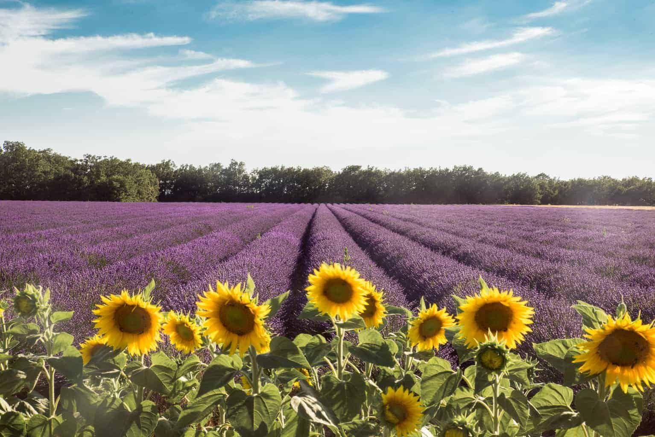
Make Yourself Happier!
Jot down notes to remember all the things that happened that day...hopefully you can see your negatives as a positive.
Perhaps you were overwhelmed with homework but you were able to chat with a friend you hadn’t seen in awhile to ask for their help.
Or maybe you were feeling sad, when your dog came over instinctively and put his head in your lap and made you smile.
Then your sibling stole something from your room, but later you had a fantastic time playing Just Dance with him, and beat the pants off of him!

Slide 10
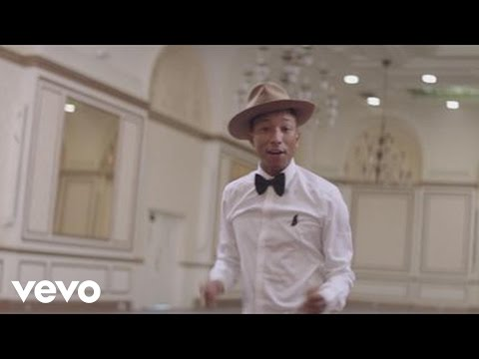
Make Yourself Happier
Let’s take 5-10 minutes and simply start that journal. Feel free to decorate the cover and make it yours while listening to a little music to make us happy!
If you are planning to do this on a device please ask your parent if you can download the paid app DIARYZAPP ($4.99) which allows you to document your day like a scrapbook, or the 5 MINUTE JOURNAL app also ($4.99) if you prefer photographs and happiness prompts! If you prefer a free app, try Reminisce Journal.

Slide 11
Make Yourself Happier!
When you are done, remember, you don’t need to share any personal reflections with the group - but share what you plan to do: write, draw, document on your device.

Slide 12

Think Differently for Happiness
We all have signature strengths...things that we are good at...maybe even better than our friends.
Let’s play a little game of “would you rather”, and find out your strengths!

Slide 13


Think Differently for Happiness
Would you rather paint a canvas of a unicorn or go to an escape room with a unicorn?
If you chose paint, your strength is creativity.
If you chose the escape room, your strength is curiosity.

Slide 14

Think Differently for Happiness
Would you rather fight a 3 headed dragon with a bow and arrow or climb a climb to the top of Mount Everest?
If you chose dragon, your strength is bravery.
If you chose the mountain, your strength is perseverance.

Slide 15
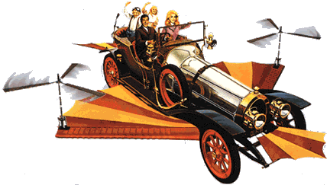

Think Differently for Happiness
Would you rather be the class president at your school or be part of the ensemble cast of Chitty Chitty Bang Bang?
If you chose president, your strength is leadership.
If you chose the school play, your strength is teamwork.

Slide 16



Think Differently for Happiness
When things get tough or scary would you rather lighten the mood with a funny movie or go to church and pray?
If you chose movie, your strength is humor.
If you chose church, your strength is spirituality.

Slide 17

Think Differently for Happiness
If I gave you 5 dollars would you rather buy a box of Girl Scout cookies for someone you love or donate it to charity?
If you chose someone you love, your strength is kindness.
If you chose the charity, your strength is humility.

Slide 18
Think Differently for Happiness
So there are no right or wrong answers to any of these, a strength is just one more characteristic you have that makes you...well YOU!

Slide 19
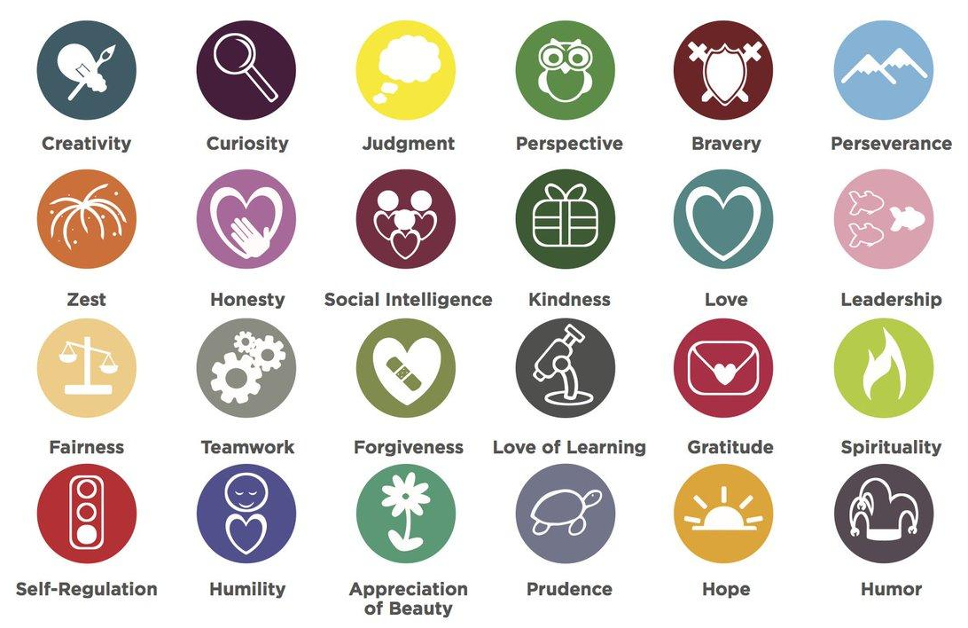
These are the 24 signature strengths recognized by psychologists. Write down 5-10 of them in your notebook or journal as a reference.
Then in the next few weeks, reflect back on these whenever you face a tough situation or are feeling overwhelmed and think about how one of these strengths can get you through!
Does anyone want to share their strengths?
I will share a few of mine and how I use them to cope!

Slide 20
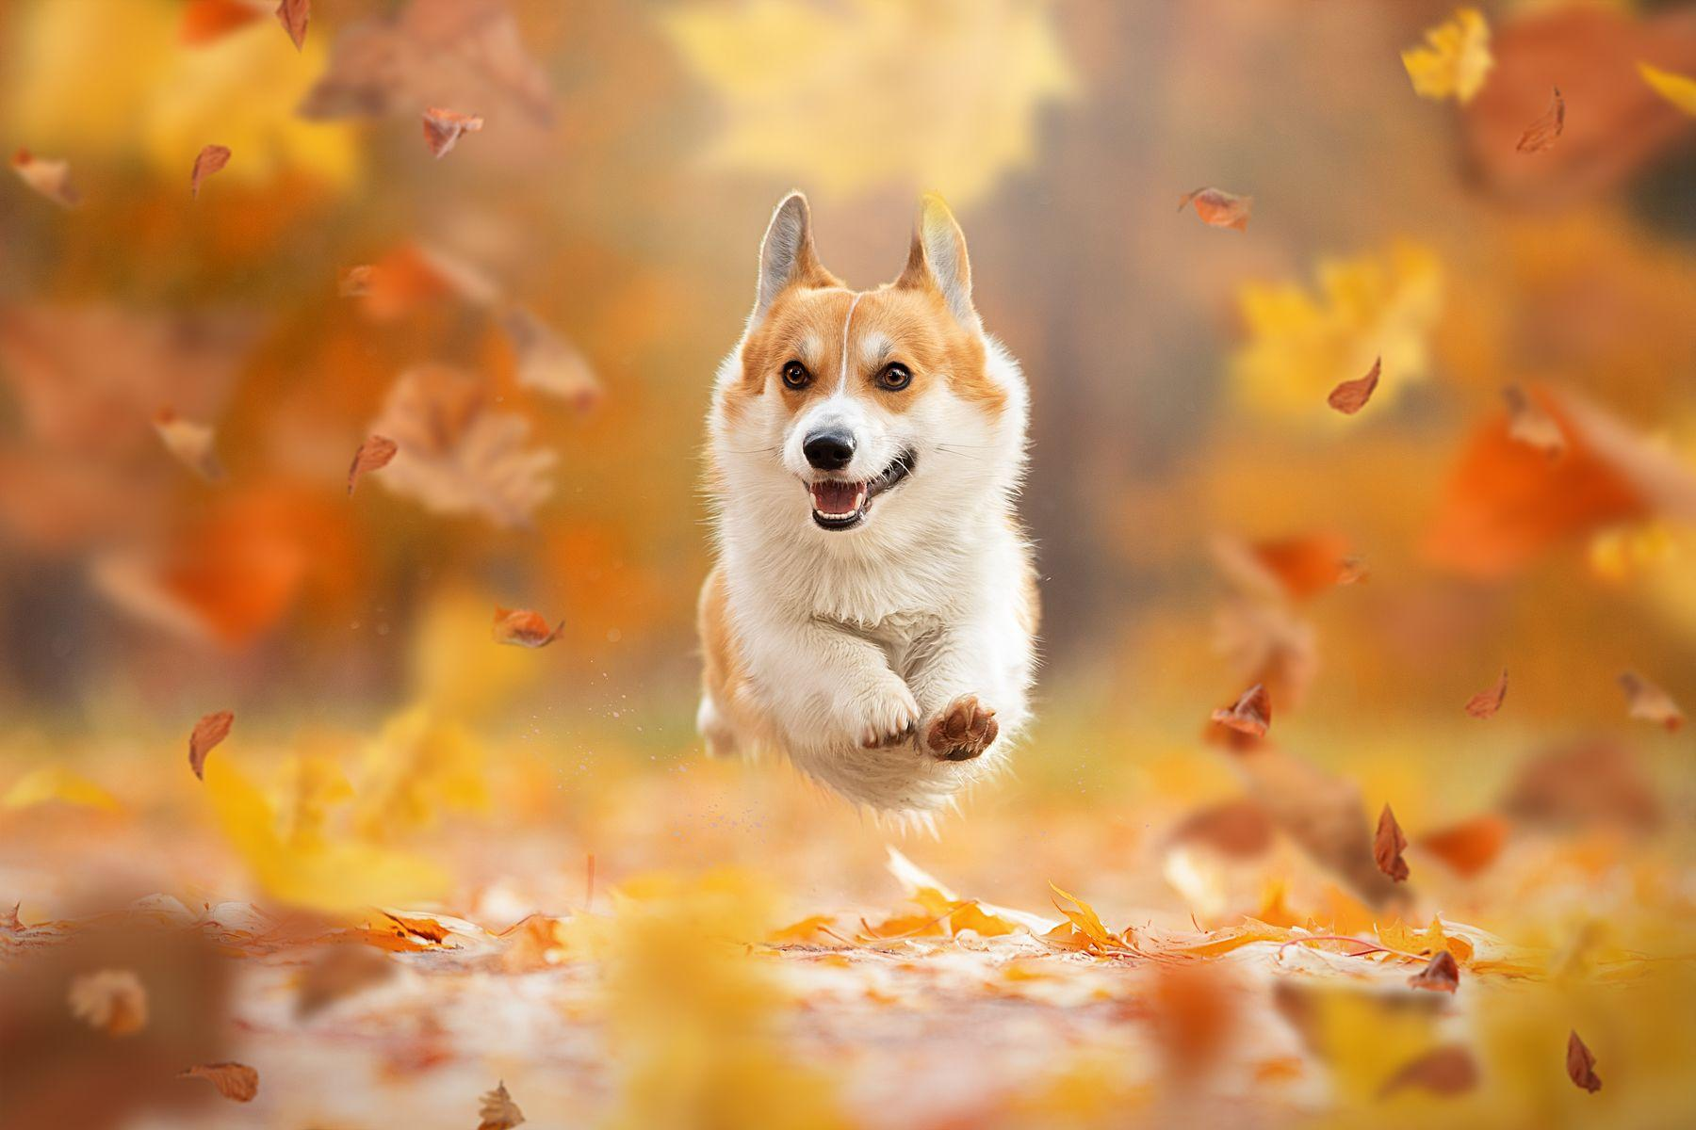
Get Happy Through Others
Admit it...this picture made you smile! This little corgi exudes happiness with every bound! Come on, he looks like he’s flying to meet you, because dogs are like that, so happy to see their owners and friends!
We need to take a lesson from our 4 legged friends and understand that our happiness is often passed to us through our interactions with others.

Slide 21
Get Happy Through Others
Now, more than ever, we can take some time to reflect on those who have really helped us
along our journey. Someone like a family member, teacher, coach, mentor, or maybe even a friend
or someone you don’t even know yet like a nurse, doctor, or first responder. Let’s think of some creative ways to reach out to them right now and thank them. It’s never too late to say “Thank You”.

Slide 22
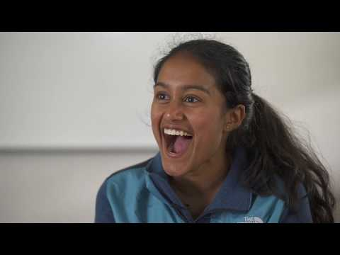
Get Happy Through Others
Let’s watch this quick video to see how this works. These students were given the challenge to write a letter to someone they wanted to thank. They didn’t know they were going to be reading these letters to them...let’s watch their reactions.
How did they feel after telling them what came from their heart?

Slide 23
Get Happy Through Others
Text them a poem you wrote.
Create a video telling them how much you appreciate them.
Create a digital collage of photos of you two together and email it.
Write up a list of 10 things you like about them and email it or share it on social media for the world to see.
Use an app to tell them Thank You in another language.
If you learned something special from them, promise them that you will teach a younger sibling or Girl Scout how to learn that skill as well.
Facetime them if you haven’t seen their face in a while.
Your homework challenge - this week come up with 3 people to thank creatively, and then do it! Use the ideas listed above...jot the ways down you think you’d like to try.

Slide 24

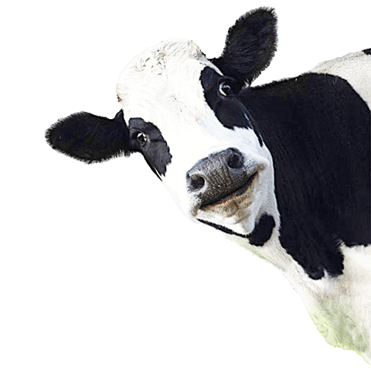
Do a Helpful
Happiness Experiment
Did you know that staying happy keeps your spirit strong, just like exercising keeps your body strong.
So LIFE gave you LEMONS, huh? Well it’s time to make lemonade! We have all heard this saying...but do we live it?

Slide 25
Do a Helpful Happiness Experiment
It’s time too MOOOOtivate!
Instead of thinking negative thoughts or complaining...for the next 24 hours flip everything to a positive!
Doing dishes sucks, but it means you have food to eat!
Cleaning your room is awful, but it means you have a safe place to live!
This house is noisy, you have an amazing family!
The internet is slow, you have a way to connect with friends!
See how easy it is? I hope you can focus on positivity over the next 24 hours.

Slide 26
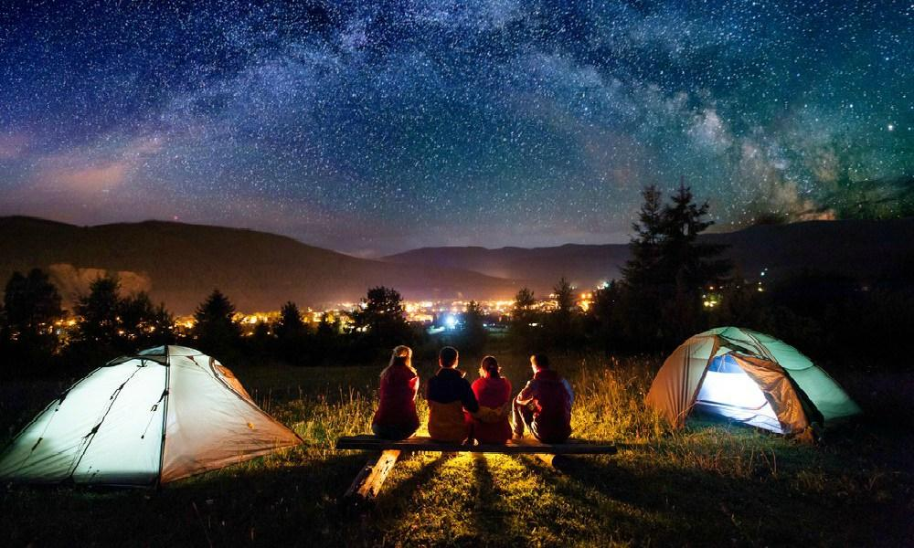
Create a Happiness Plan
Now that you’re becoming an expert in what makes YOU happy, let’s put together an action plan for you.
Your journal can be your guide, but determine something you will want to do to LIVE HAPPY.

Slide 27
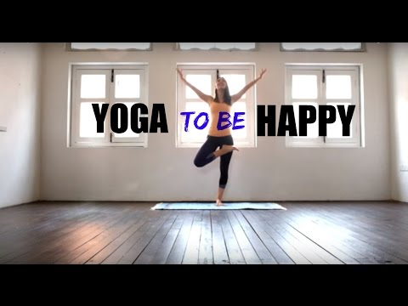
Create a Happiness Plan
Let’s watch this quick video of some ideas to put into action!

Slide 28
Create a
Happiness Plan
So here are a few things you could do to boost your mood, and a little more homework - pick one or more of these to try indefinitely:
Daily meditations (check out youtube for GoNoodle Meditations and try them in the morning light or before bed).
Gratitude Journal - keep journaling, don’t stop!!!
Paying it Forward - paint some kindness rocks to put out, positive messages on sidewalks, or find another way to help out a neighbor or a stranger.
Practice Yoga - check out YouTube for Teen or Middle School Yoga and practice once a day.

Slide 29
Science of Happiness
“Happiness is not ready made, it comes from your own actions.” ― Dalai Lama
So remember, there are so many things that are out of our control, but we can control our own happiness. I hope that you all put this badge into practice daily. If you take care of your own mental health, you will have the energy and presence to also help others.
Here’s some badgework you can do at home:
Write in your journal (whichever format you chose, every day for at least two weeks).
Do 24 hours of positive thinking...you can do it!
Think of 3 people you want to thank...and thank them using 1 or a few of these ways.
Text them a poem you wrote.
Create a video telling them how much you appreciate them.
Create a digital collage of photos of you two together and email it.
Write up a list of 10 things you like about them and email it or share it on social media for the world to see.
Use an app to tell them Thank You in another language.
If you learned something special from them, promise them that you will teach a younger sibling or Girl Scout how to learn that skill as well.
Facetime them if you haven’t seen their face in a while.

Slide 30

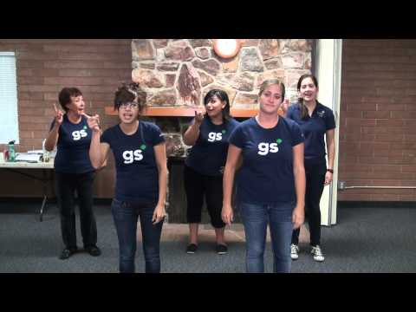
Science of Happiness
Let’s end our meeting with a great camp Girl Scout song that will make us all smile!
Be prepared to repeat after me!

Slide 31
Thank You!
Does anyone have any questions or want to tell us what they are going to be doing with what they learned today?
Any suggestions for next meetings or things you would like to share virtually (cooking, craft, or outdoor skills demos, etc.)?

