Slide 1

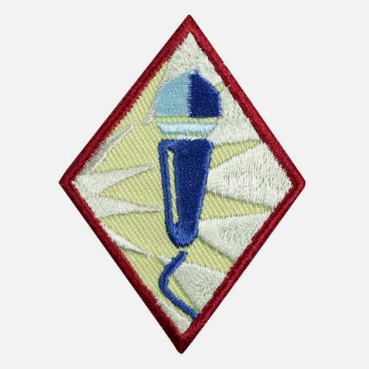
Public Speaker
Cadette
www.GetYourGirlPower.org

Slide 2

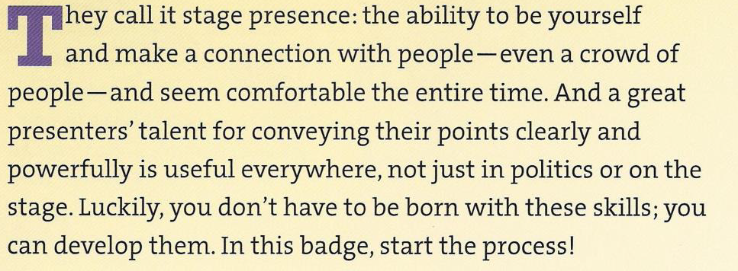

Slide 3

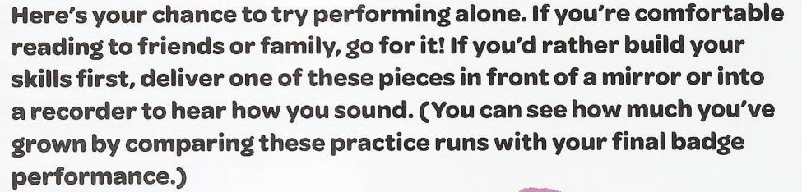
Step 1: Get a feel for performing solo

Slide 4
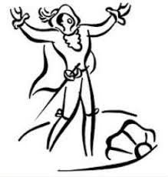
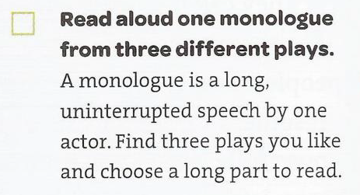
Step 1: Get a feel for performing solo
Need some ideas?
Check out these

Slide 5

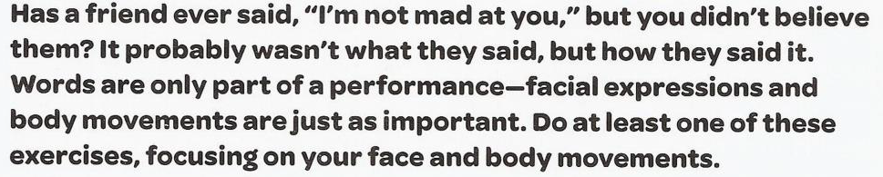
Step 2: Focus on body language

Slide 6
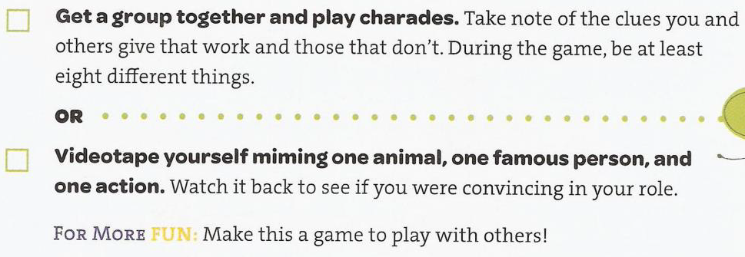
Step 2: Focus on body language
Play these games with your family or with friends in a virtual hang out!

Slide 7

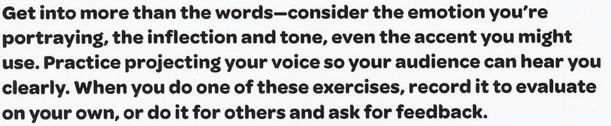
Step 3: Find your voice

Slide 8
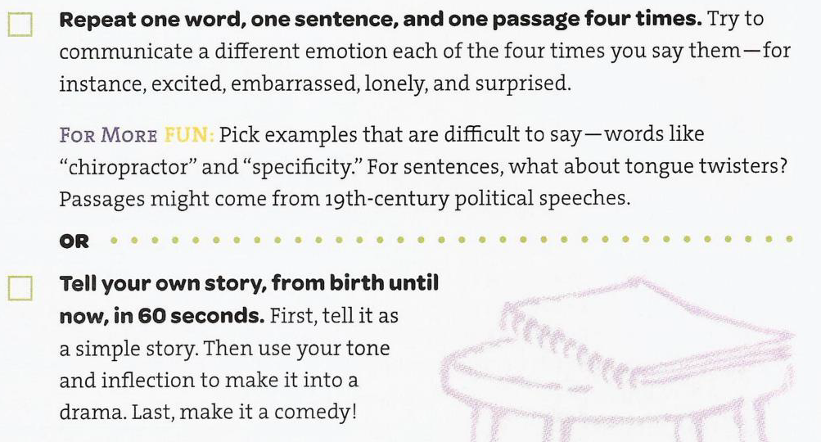
Step 3: Find your voice

Slide 9


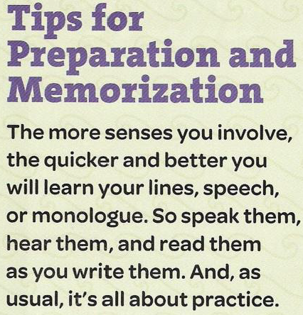
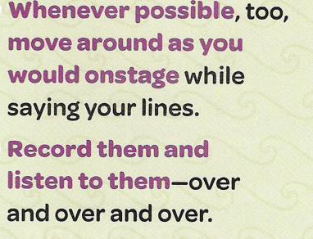
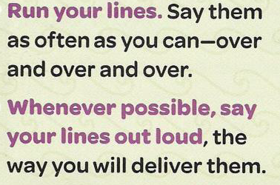
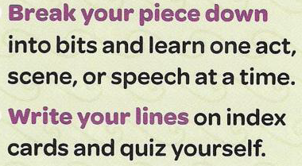
Step 4: Choose or create a piece to perform
Tips for preparation and memorization:

Slide 10
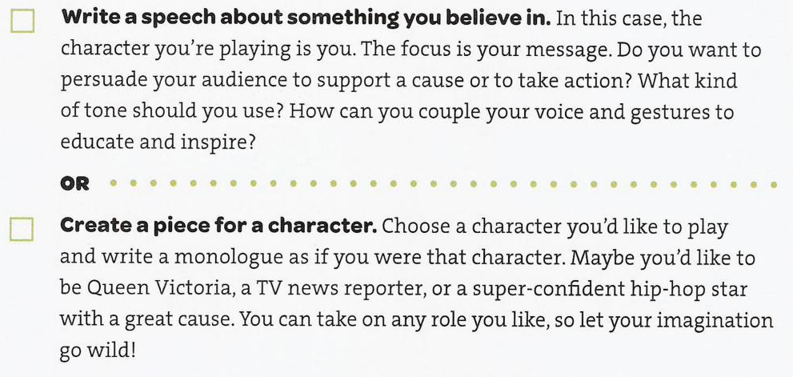
Step 4: Choose or create a piece to perform

Slide 11

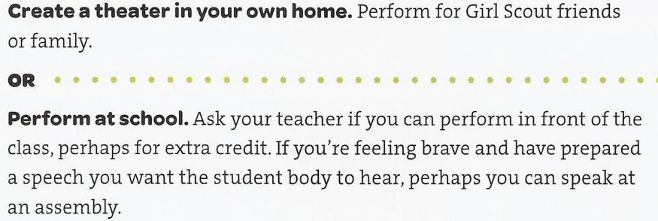
Step 5: Get onstage!
Since you can’t get out and about right now, record yourself giving your performance and share it digtially with friends and family!

Slide 12

Congratulations!
You have earned your Public Speaker badge!
www.GetYourGirlPower.org

