Slide 1
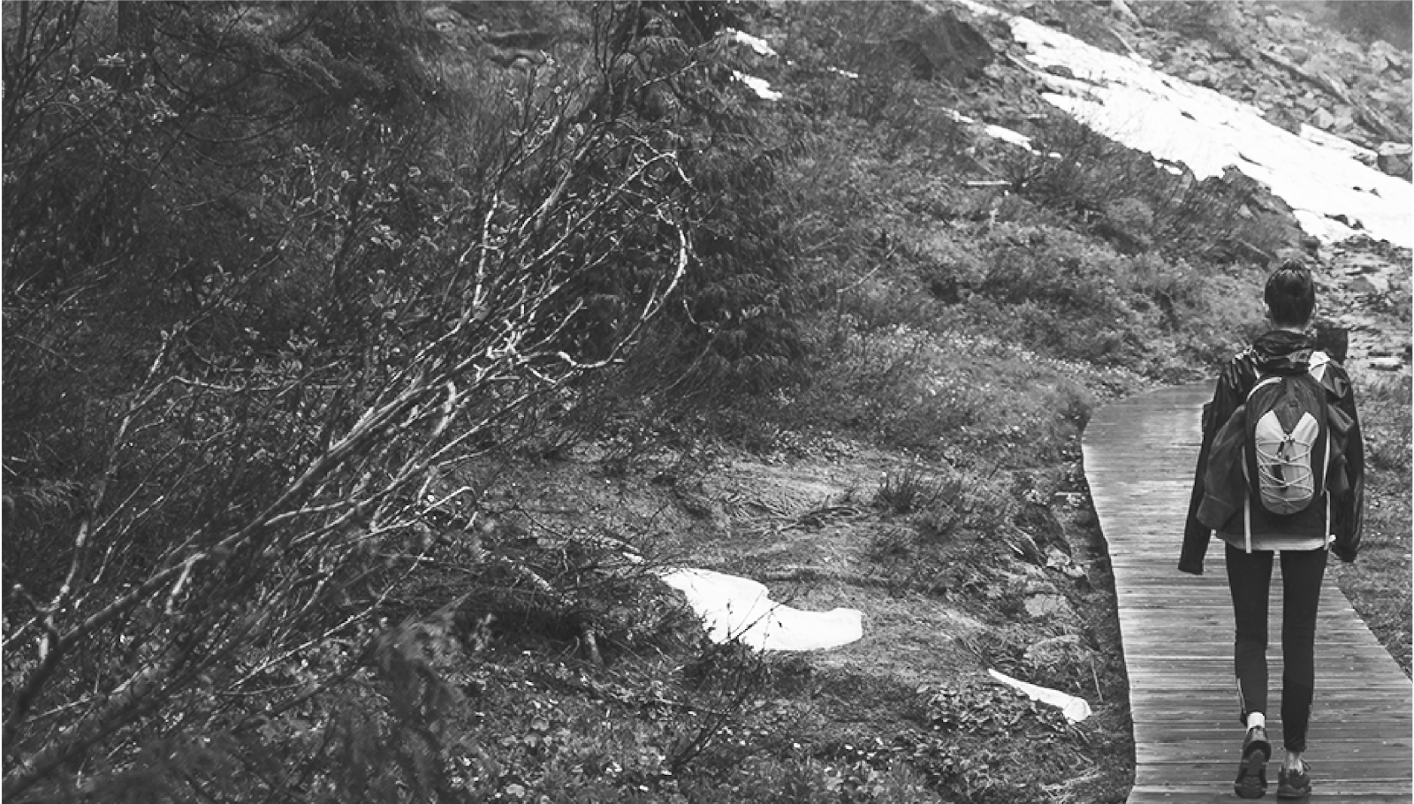
Primitive-Adventure-Survival
Cadette-Senior-Ambassador Camper Badges
Girl Scouts of Central Illinois

Slide 2
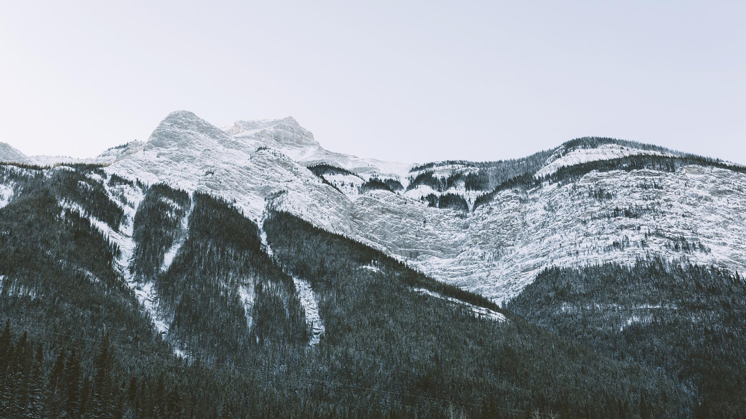
INTRODUCTION
By doing the activities in these slides, plus participating in the three virtual meetings with GSCI staff, you will complete steps 1-4 of your camper badge at the Cadette, Senior or Ambassador Level.
The final step is to actually go camping! By participating fully in these activities, you will be prepared to do so in the future!

Slide 3
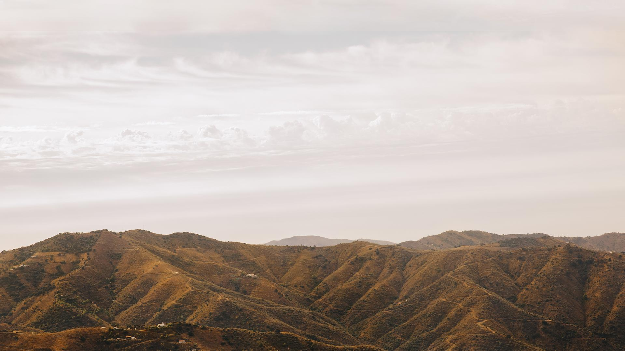
01
03
Plan Your Trip
Plan Your Trip Meals
02
04
Gather Your Gear
Learn a camp skill
05
Go on your trip!

Slide 4
—Gretel Ehrlich
““Everything in nature invites us constantly to be what we are.”

Slide 5
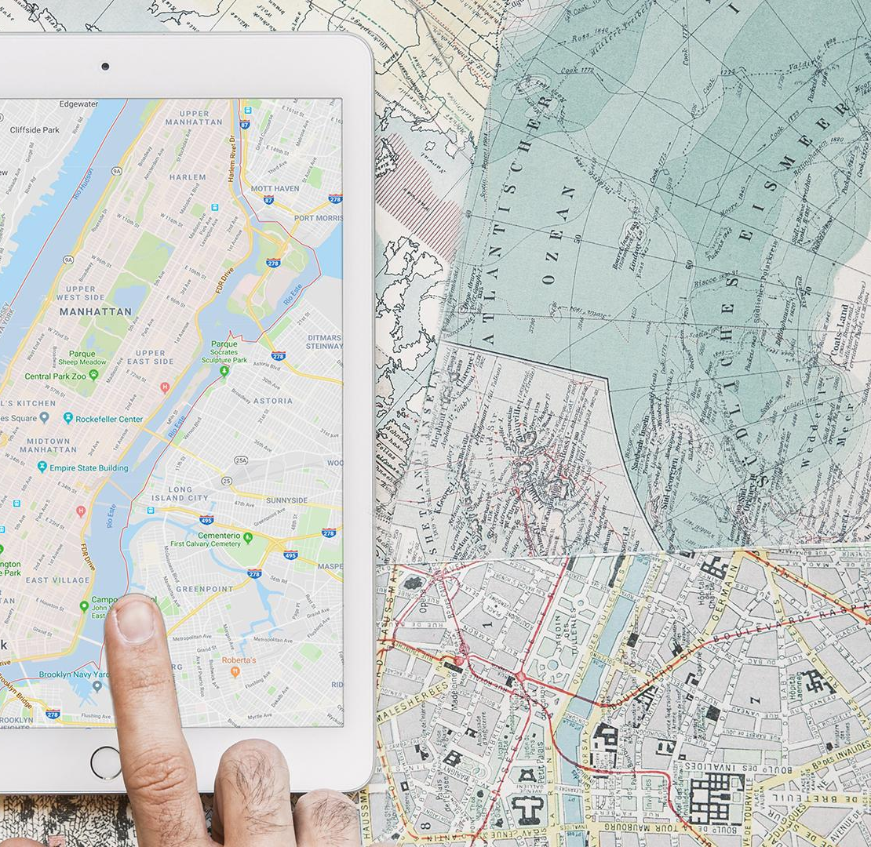
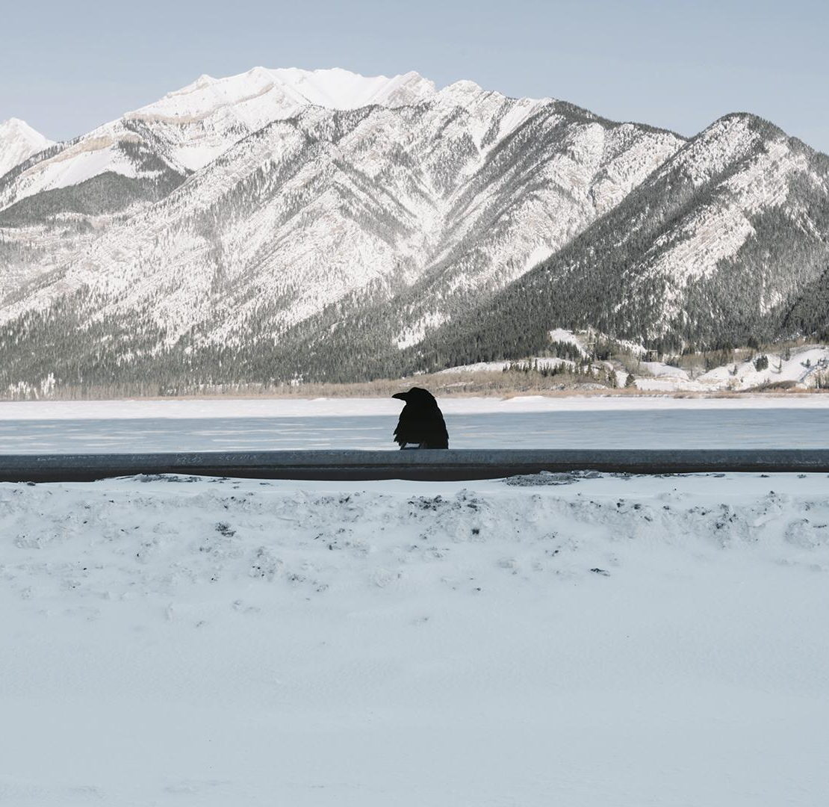
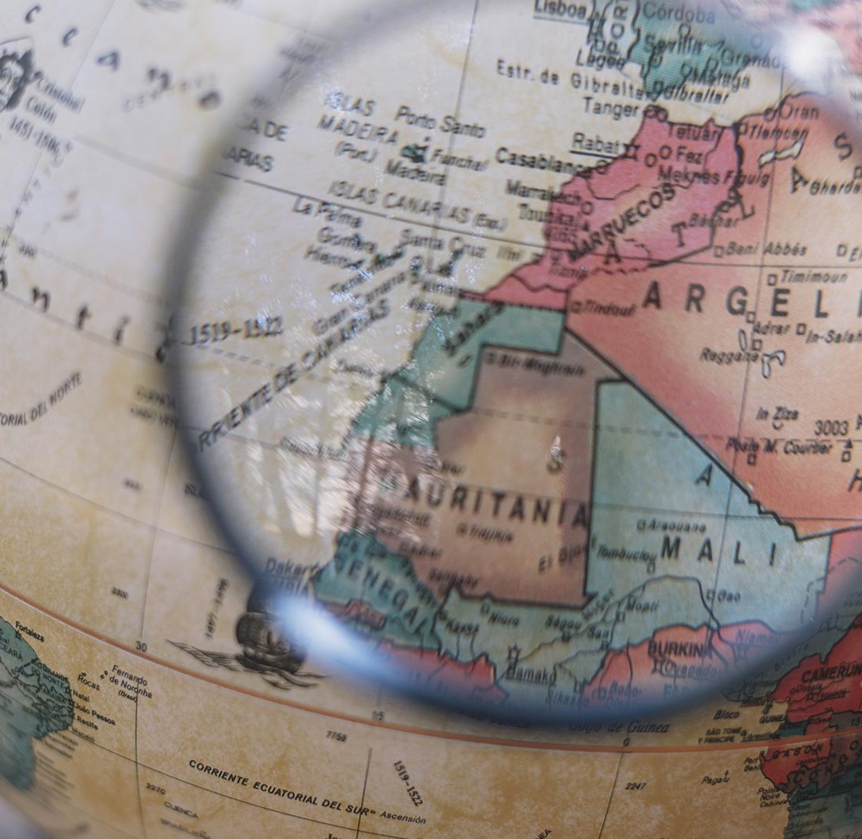
Primitive
Adventure
Survival
Let’s get started…
First, you need to figure out what type of camping trip you’re interested in...
Camping
Backpacking
Canoeing
Kayaking
Something Else?
Backpacking
Mountain Biking
Whitewater Rafting
Sea Kayaking
Mountaineering
Something else?
National Park
Girl Scout Camp
National Forest
State Park
Somewhere else?
C
S
A

Slide 6
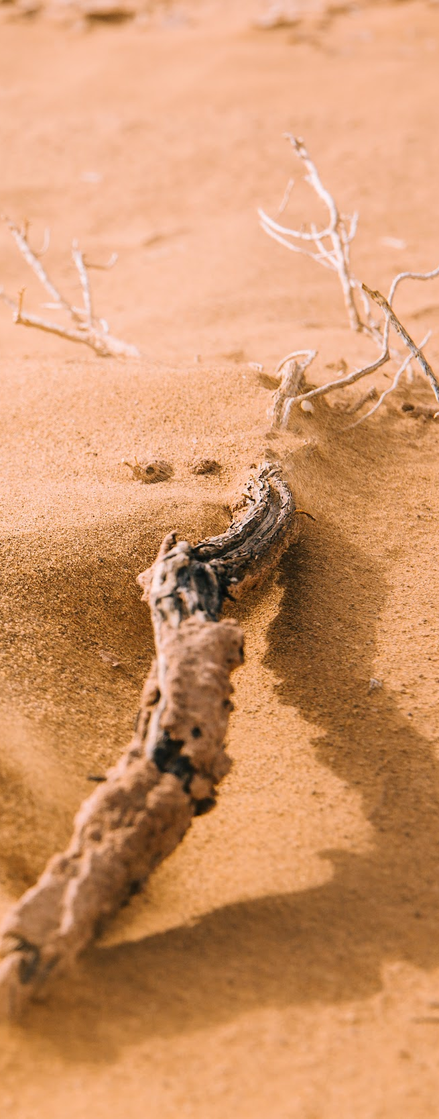
WHAT DOES IT TAKE TO DO THIS?
When planning a more intensive camping trip, no matter what type you chose, there are many factors to consider to ensure a successful trip. When planning your trip you will want to plan for all of these factors. Look into what you will need for your trip before our first zoom meeting.

Slide 7
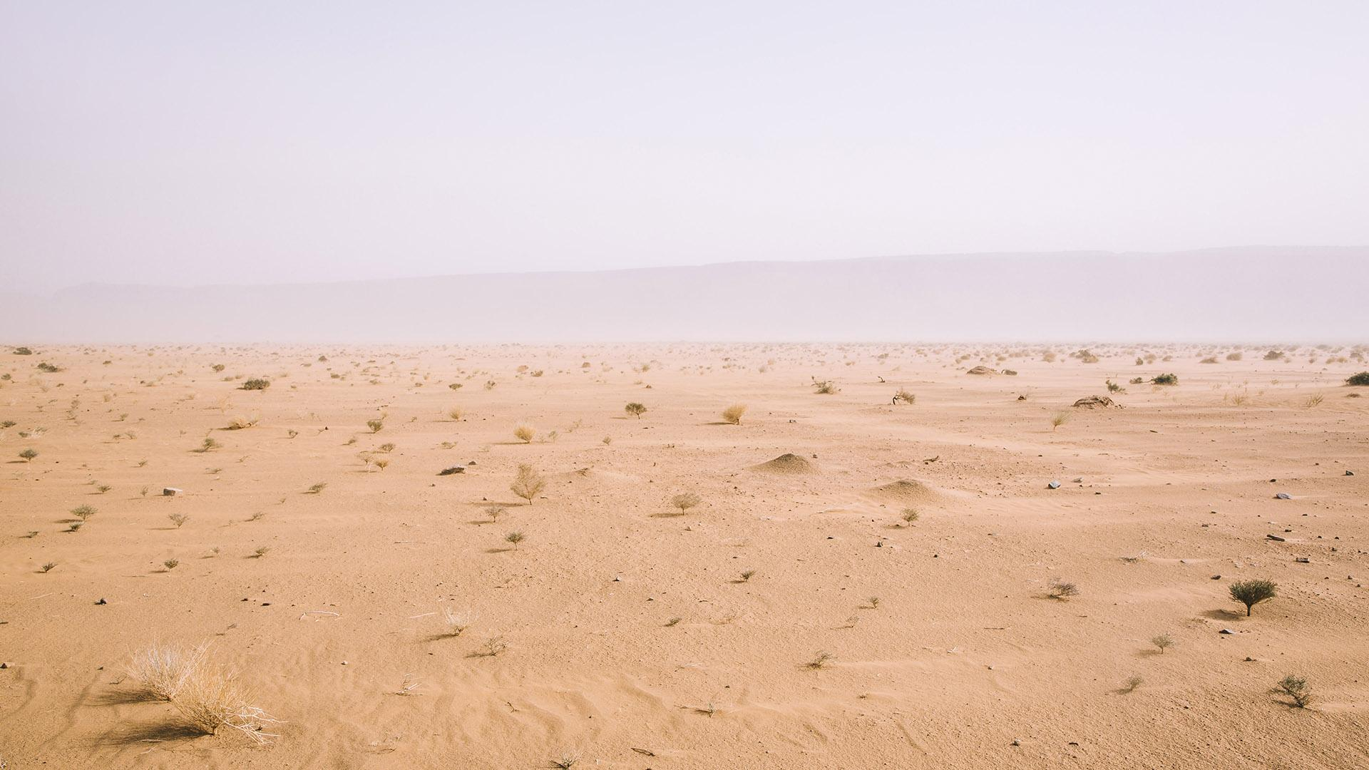
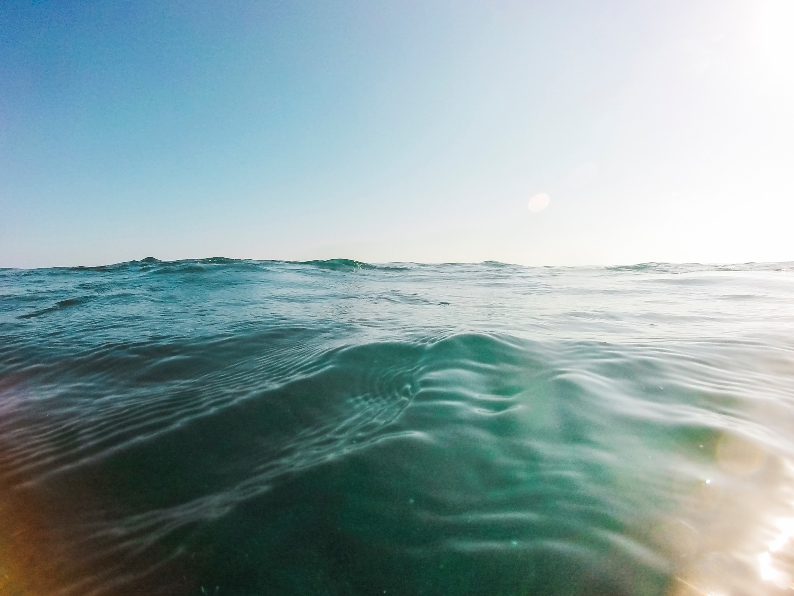
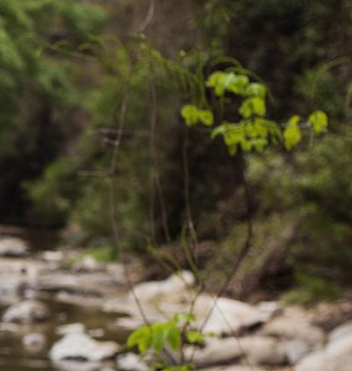

BUDGET
PERMITS
SPECIAL GEAR
EMERGENCIES
HERE ARE SOME OF THE FACTORS YOU WILL NEED TO THINK OF
How do you plan on paying for your trip and how much money do you have for it?
Do you need special permits or training to go there or do the activities you want to?
Do you need to purchase or rent special gear or equipment and do you know how to use them?
Do you have a plan and someone trained to handle emergencies on your trip?

Slide 8

Leave No Trace
And Your Trip
A large part of taking part in the outdoors and ensuring that it remains pristine for other campers is using the principles of Leave No Trace
When planning your trip it is important to keep these 7 principles in mind to make sure you are camping responsibly

Slide 9
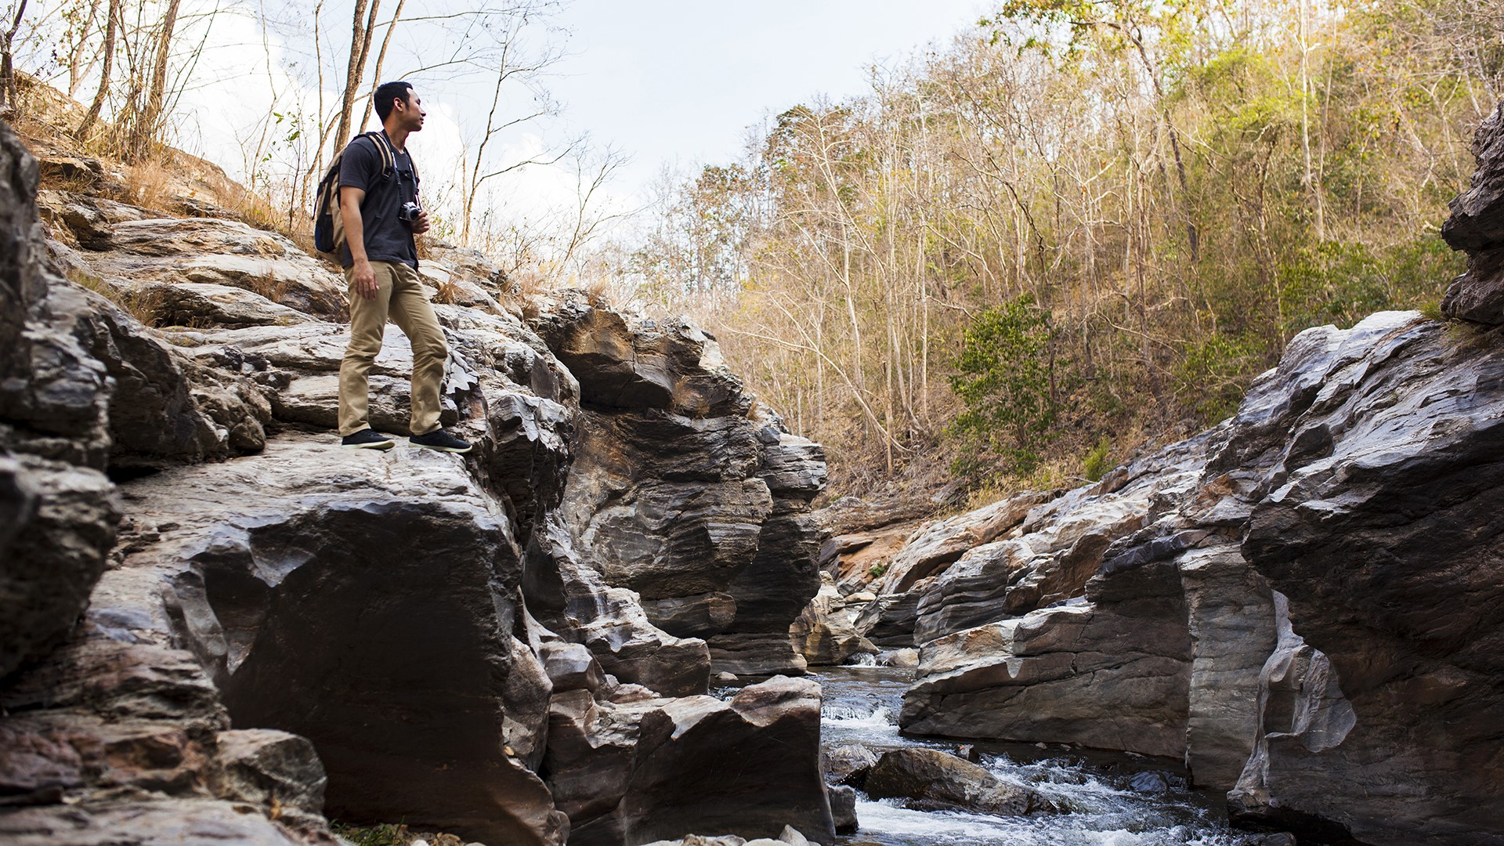
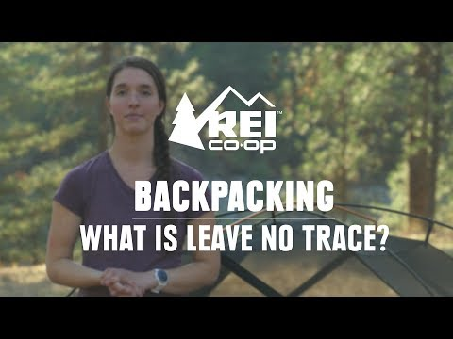
Watch this video for an overview of what the Leave No Trace principles are.

Slide 10
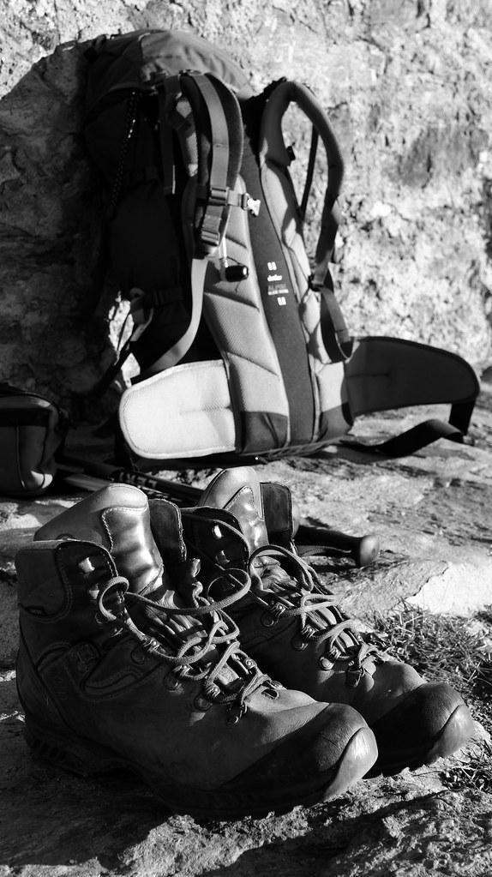
Before our first video meeting, look at the questions on the document linked below. Make notes so you will be prepared to share what you’ve learned and ask questions!
Click here to get started planning

Slide 11
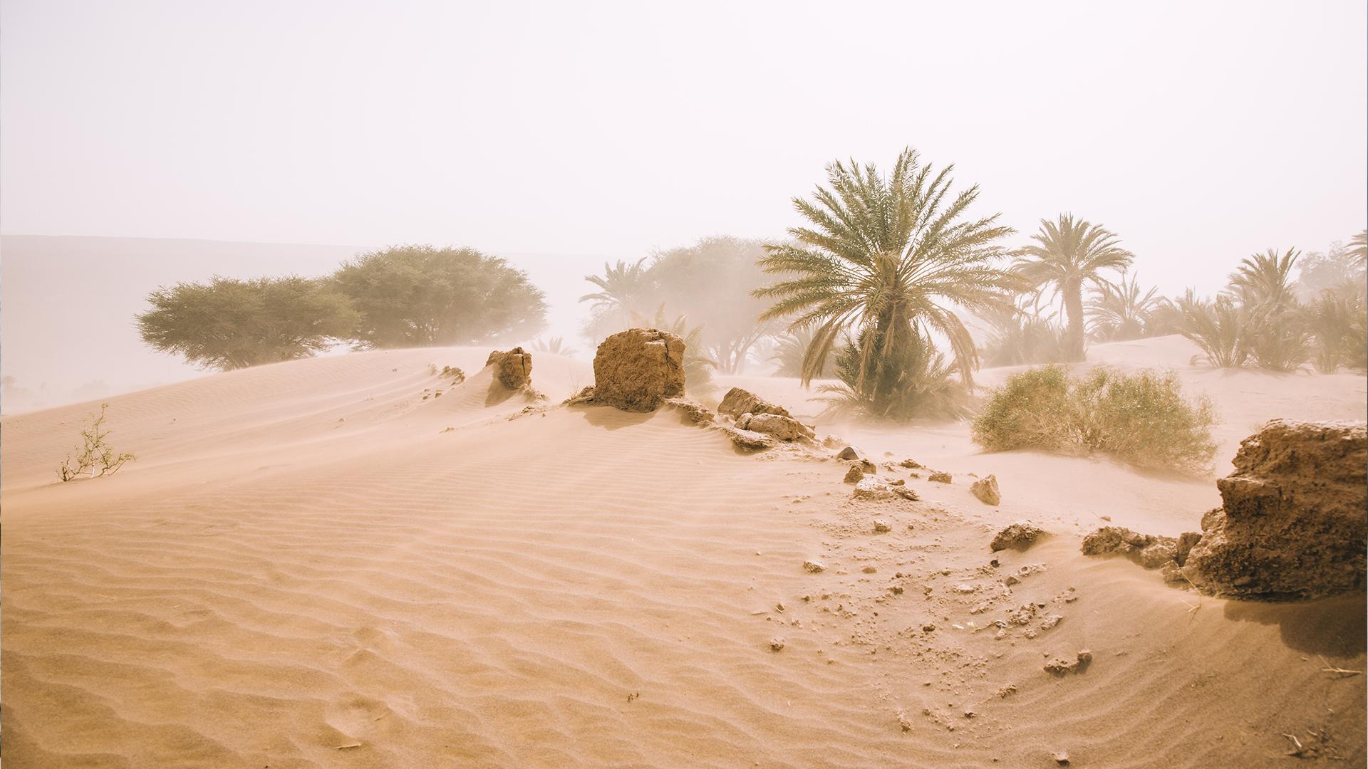
First Video Call
Wednesday, May 13th
4:30 pm
Join us on a GoToMeeting call to discuss your work so far and ask questions to an expert.
https://global.gotomeeting.com/join/401368869
Access Code: 401-368-869

Slide 12
MENU PLANNING
Before your trip, you will need to plan what you will eat and drink on your trip by considering your nutritional needs, any food allergies in your group, the weight and bulk of the food, and your budget. There are many different ways you might prepare your food while camping.
Things to consider when planning your menu
Number of Meals
Weight of Cooking Gear
Weight of Food
Amount of time for cooking
Budget
Any campsite restrictions, such as burn restrictions

Slide 13
DEHYDRATED
Doesn’t go bad easily, but needs to be prepared beforehand
NO COOK
SOLAR COOKED
Quick and great for hikes, but not as many options
Good alternative for not having a fire, but relies on the sun which is not always reliable
Types of Food Preparation
CAMPFIRE
BOX OVEN
Can cook almost anything, but are more time consuming and not always allowed.
Lightweight way to bake, but not always allowed on campsite. Instructions: here.
PORTABLE STOVE
BUDDY BURNER
There are multiple kinds, but many are made to be taken backpacking
A cheap, homemade portable stove, but not the best for longer trips. Instructions: here

Slide 14
Food Storage and Safety
Reduce weight and waste by leaving as much packaging at home as possible. You may want to repackage some foods into sealed plastic bags. If possible, try to group foods together by meal and day of trip. You can also print or write out cooking instructions to keep with your meals.
Protect food (and anything else with a smell,
like toiletries) from animals. Unless you are
carrying food for a hike, never keep any food in
your backpack, tent, duffel bags, or elsewhere near your sleeping area. If you’re staying at a campsite, store food in a designated rodent-proof area. If this is not available, check to see if food should be hung in trees or stored in a vehicle.

Slide 15
Food Storage and Safety
If you’re base camping, use three buckets or deep pans for dishwashing. The first is for hot, soapy water; the second holds clean water for rinsing; the third is either for boiling water or cool water with a health department-approved sanitizing solution. Sanitize dishes by placing them in a net bag and immersing in boiling water for one minute, or according to the directions of the sanitizing solution. Hang the net bags to air dry. Dirty dishwater should be filtered to remove food particles once the water has cooled. If you’re staying at a campsite, follow their rules for disposal of your dishwater, or practice the Leave No Trace method of scattering strained dishwater instead of pouring it into the ground.
If you’re backpacking or doing another activity where you may have limited ability to bring equipment or limited access to water, you may have to get creative. Dr. Bronner’s soap is often used to clean dishes in the backcountry, as it is biodegradable, non-toxic, and highly concentrated. Boiling is often the best way to sanitize in the backcountry. Do some research or come up with some questions on how to safely keep your dishes clean in the backcountry.

Slide 16
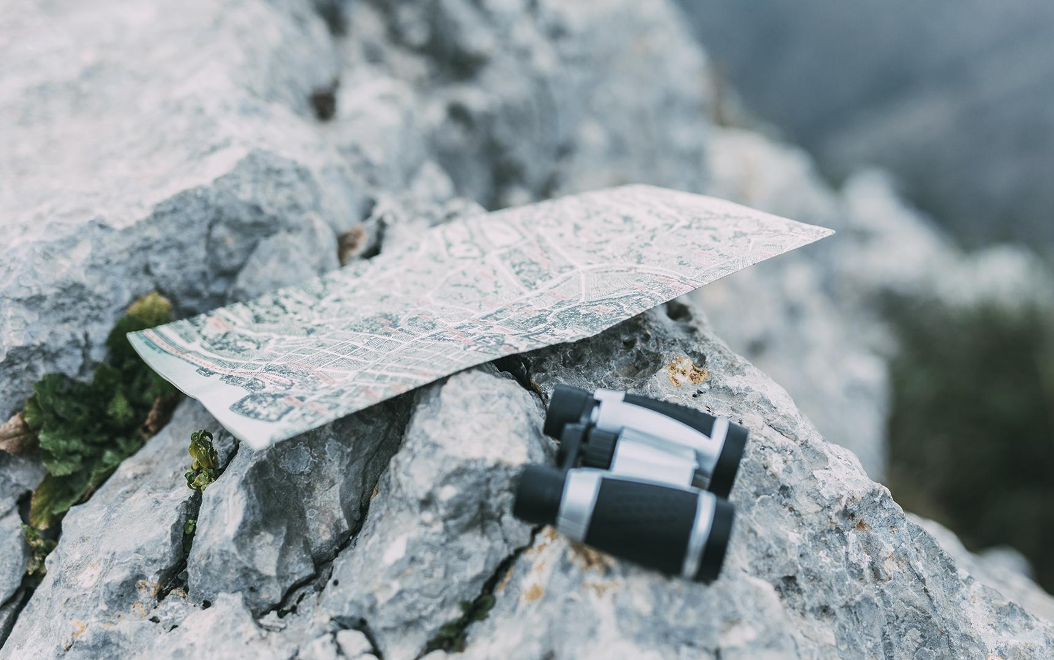
Packing
Pack Smart. You don’t want to be carrying a bunch of extra stuff. A loaded backpacking pack should not weigh more than about 20 percent of your body weight. (If you weigh 150 pounds, your pack should not exceed 30 pounds for backpacking.)
Weatherproof your gear. You can protect the gear inside your pack with a waterproof stuff sack or store your backpack inside a trash compactor bag. Fire-starting materials can be kept in zipped sandwich bags. Be sure to bring a repair kit for your sleeping pad, tent, or backpack. Think about anything you’re bringing that could be affected by high winds, rain, or snow. How will you protect these items and keep them in place?
Plan gear for a side trip. If you’re kayaking and want to take an afternoon hike, or on a biking trip and decide to do some rock climbing, what additional equipment will you need? Will you need a lightweight backpack to hold your water, snacks, and rock climbing gear? Add any additional items to your packing lists.

Slide 17
No matter what type of
camping you do, you’ll want
to bring these items along.
Talk to your family before
you go, to make sure you’re
not missing anything!
Water in a reusable bottle, water purification gear
Flashlight with extra batteries
Long-sleeved jacket
Poncho or raincoat
Sun protection: hat with a
brim, sunscreen, lip balm,
and sunglasses
First aid kit
Any medications you may
need (inhaler, EpiPen)
Pocket knife (be sure to practice your knife skills before your trip)
Emergency food (such as trail mix or granola bars)
Trowel, plastic bags that zip, and toilet paper(to make a portable toilet,if needed)
Whistle
Appropriate shoes
Matches in a waterproof container
Bug spray
Map of area and compass
Make note of any gear questions you have for the next video call.

Slide 18
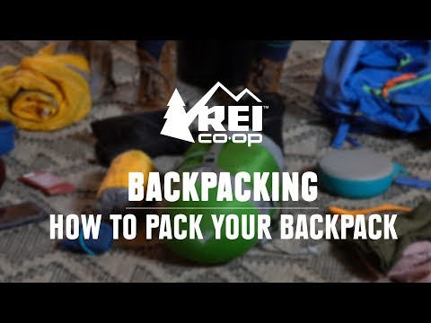
In addition to what you bring, how you bring it is important. Watch this video on how to pack your backpack.

Slide 19
Second Video Call
Wednesday, May 20th
4:30 PM
Come prepared with a more complete gear list and at least one trail meal recipe to share.
https://global.gotomeeting.com/join/658141717
Meeting ID: 658-141-171

Slide 20
For this last section we will be looking at different things to consider when planning a camping trip as well as different camp or survival skills that are good to know. These slides are not exhaustive, so you will want to research specifics for your trip and what you have planned. Then, in our last video call you can learn some knot tying skills.

Slide 21
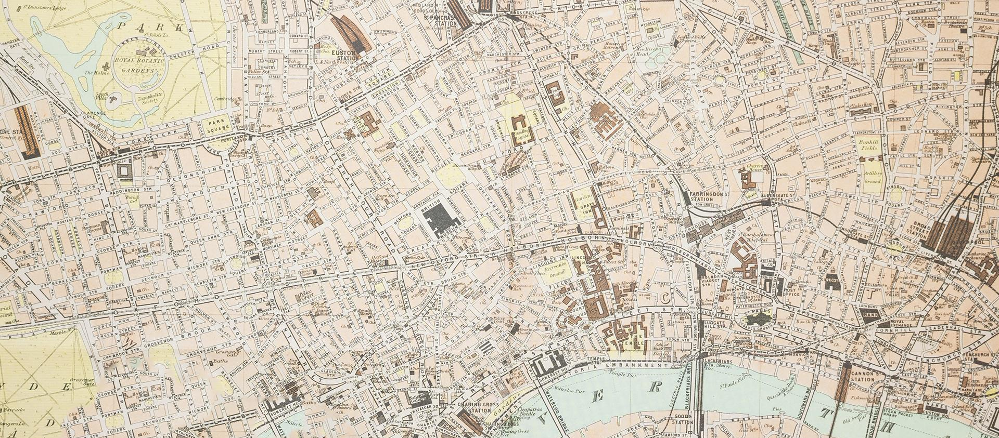
Investigate your camping area.
Investigate your camping area. Look for signs of flash flooding, ant mounds, animal tracks, and dead or dying trees.
Safety at Camp
Don’t assume you’ll have cell service.
Know where to go for help
If you’re far out in the wilderness, cell service may be unreliable. Look into cell service in the area where you’ll be camping. (Some cell providers may have better service than others.) If service is spotty, make sure you can easily get to a place where you can make a call. Have emergency contact numbers with you at all times. Think about how you will charge your battery.
Find out about park administrators or rangers who can help in an emergency. Be sure to check in with park staff or campground hosts before you go on your trip—or on any side hikes—so people know where you’ll be in case of an emergency.

Slide 22
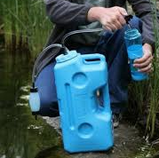

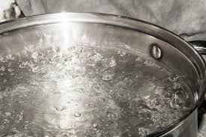
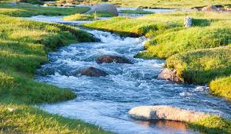
Portable water filters
Chemical tablets
Boiling water
Water Purification
The water at campgrounds is not always safe to drink. Even a sparkling-clear water source can be contaminated with bacteria, chemicals, and viruses. So it’s important to use one of these three methods to purify your water:
Pump water from the source into a container with a filter. The filter’s built-in system cleans the water.
These tablets use chemicals, like iodine, to purify water. They don’t always taste so great, though!
Bring your water to a boil, pour it into a container, and let it cool.

Slide 23
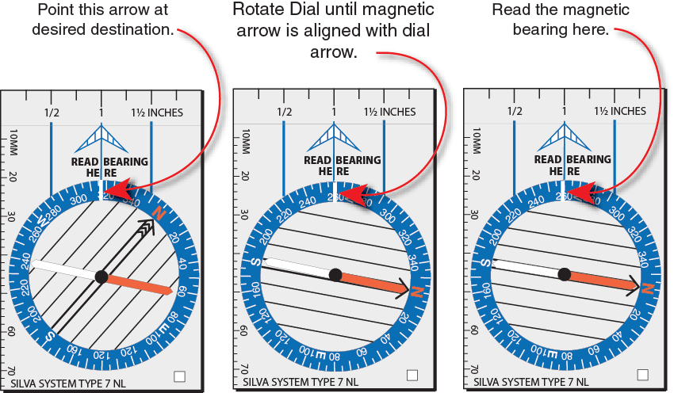
How to Read a Compass
You can reverse this process if you know the direction, by turning the dial and then turning yourself until North lines up.
It is important to hold your compass flat in the palm of your hand so it is parallel to the ground.

Slide 24
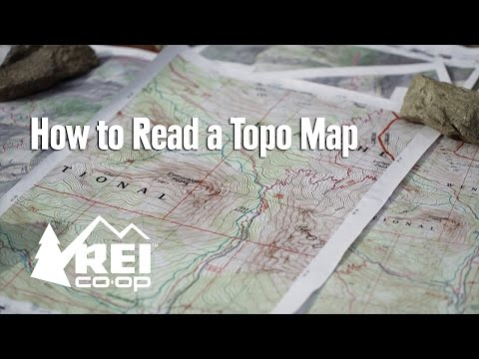
Maps
When talking about safety, we discussed not being able to rely on cell service. So, it is important to both have a map and know how to use it. You can combine these skills with the compass ones on the previous slide.

Slide 25
Final Video Call
Wednesday, May 27th
4:30 pm
Join us for one final video call to learn a new and useful camp skill to use on your camping trip and discuss any final trip details! You will need a rope for knot tying.
https://global.gotomeeting.com/join/249124389
Access Code: 249-124-389

Slide 26


