Slide 1

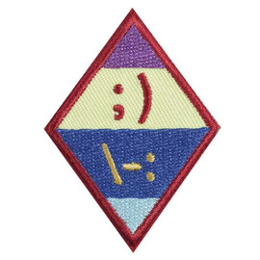
Netiquette
Cadette
www.GetYourGirlPower.org

Slide 2

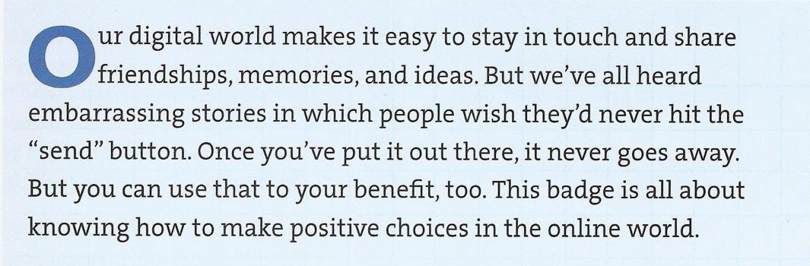

Slide 3

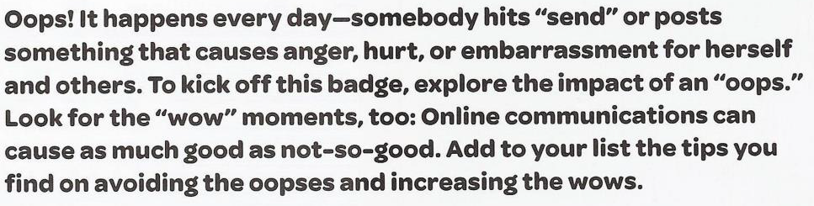
Step 1: Explore “Oops” and “Wow” Moments

Slide 4
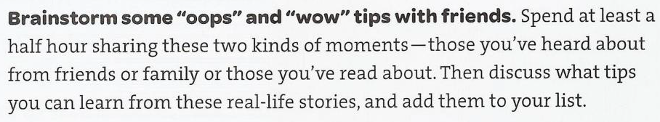



Step 1: Explore “Oops” and “Wow” Moments
Call up some friends or video chat with them to do the following:

Slide 5

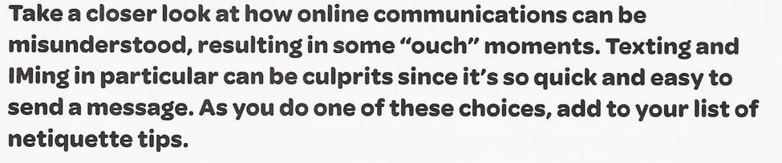
Step 2: Dig into some “ouch” moments

Slide 6
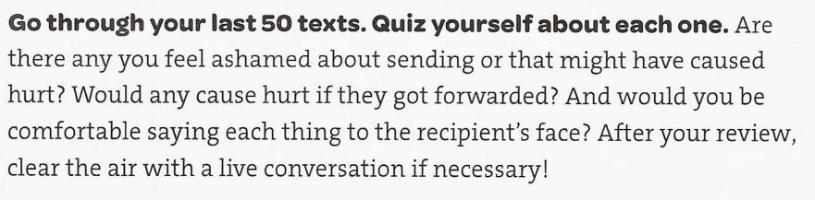

Step 2: Dig into some “ouch” moments
Feeling brave?
Show your text messages to a parent and
ask for their honest opinion as well!

Slide 7

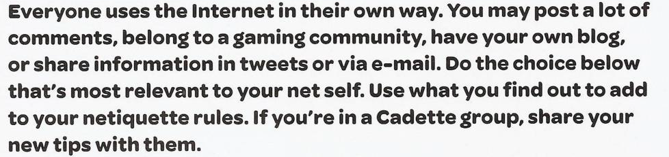
Step 3: Look at e-mail, commenting, & blogging

Slide 8
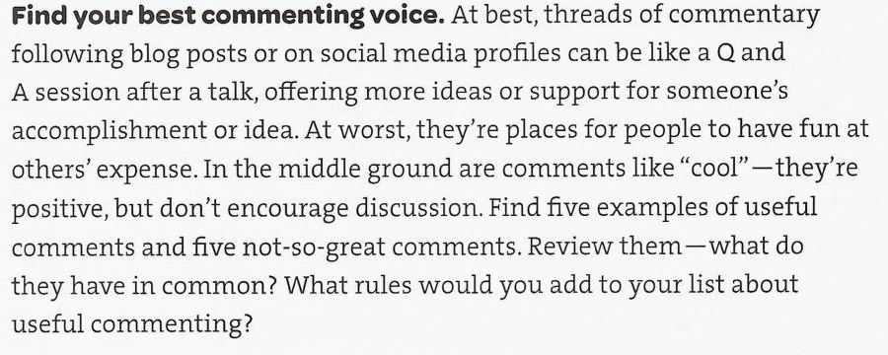

Step 3: Look at commenting

Slide 9
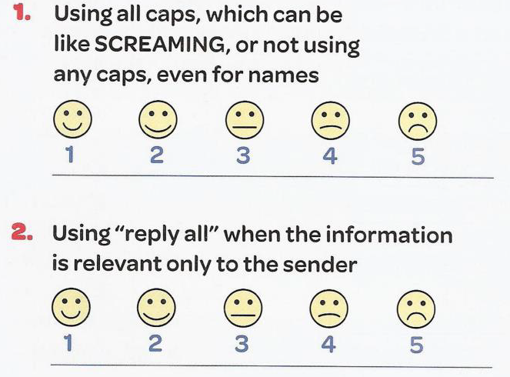
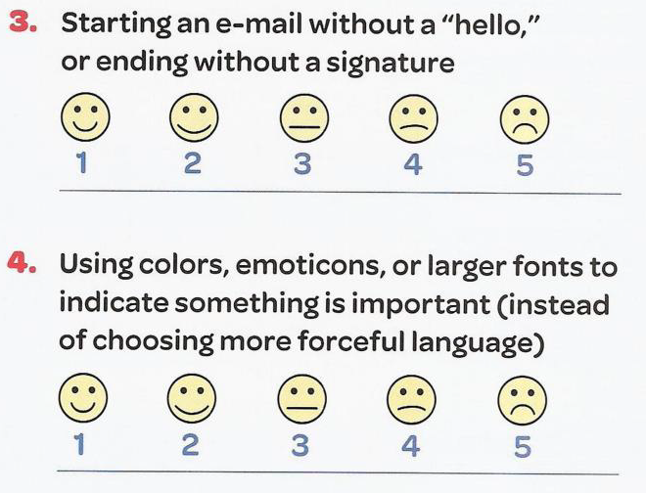
Step 3: E-mail Etiquette Quiz

Slide 10
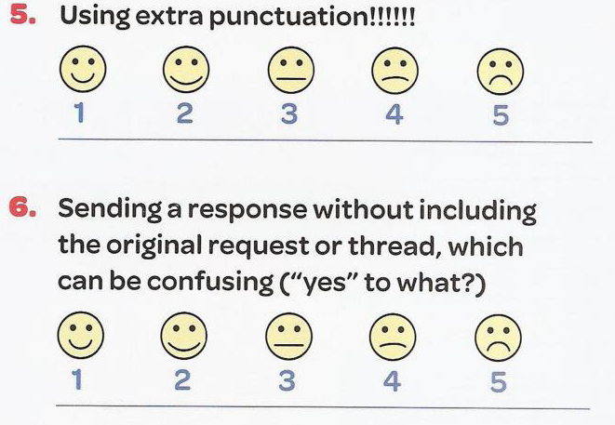
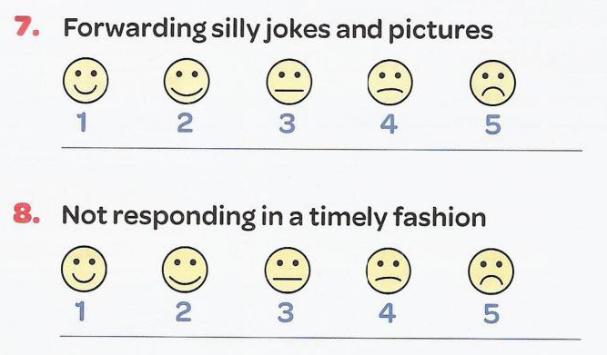
Step 3: E-mail Etiquette Quiz

Slide 11
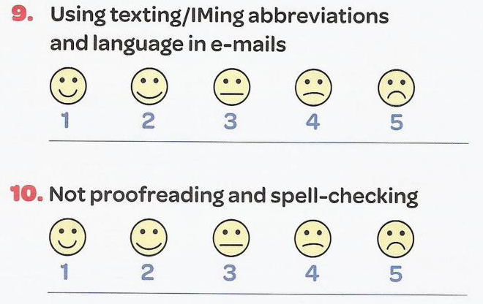
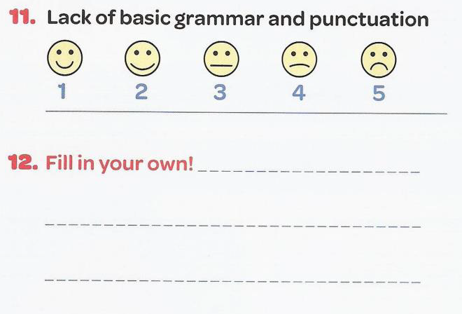
Step 3: E-mail Etiquette Quiz

Slide 12

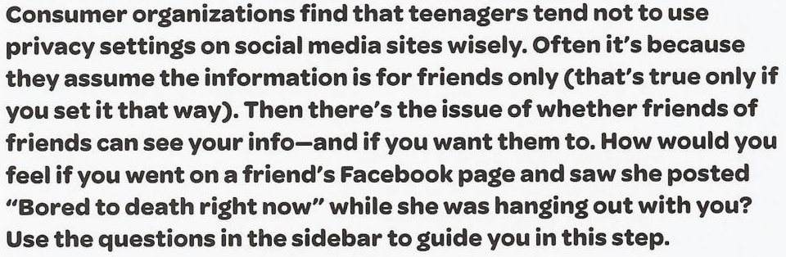
Step 4: Decide What Makes a Great Social Media Profile
Tips for preparation and memorization:

Slide 13
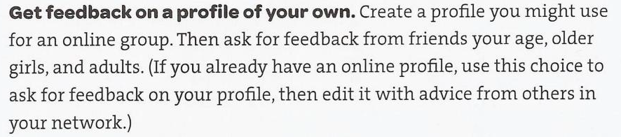

Step 4: Decide What Makes a Great Social Media Profile

Slide 14


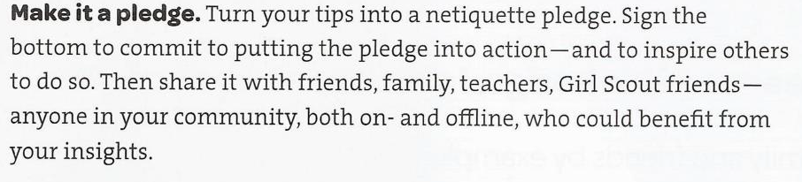
Step 5: Spread Better Practices

Slide 15
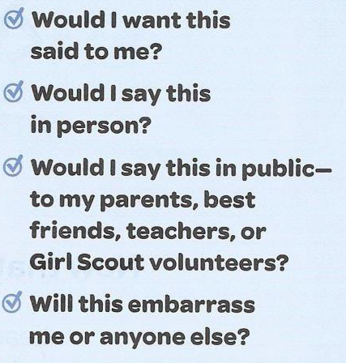
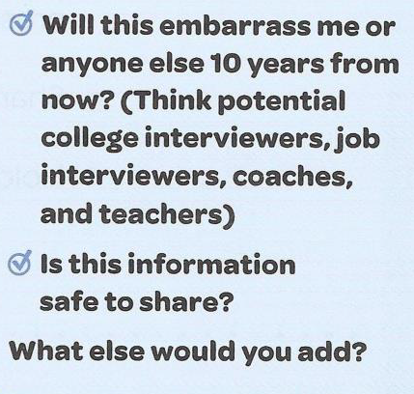
Step 5: Before I Post Checklist

Slide 16

Congratulations!
You have earned your Netiquette badge!
Please take a moment to answer a few questions about this virtual badge.
www.GetYourGirlPower.org

