Slide 1
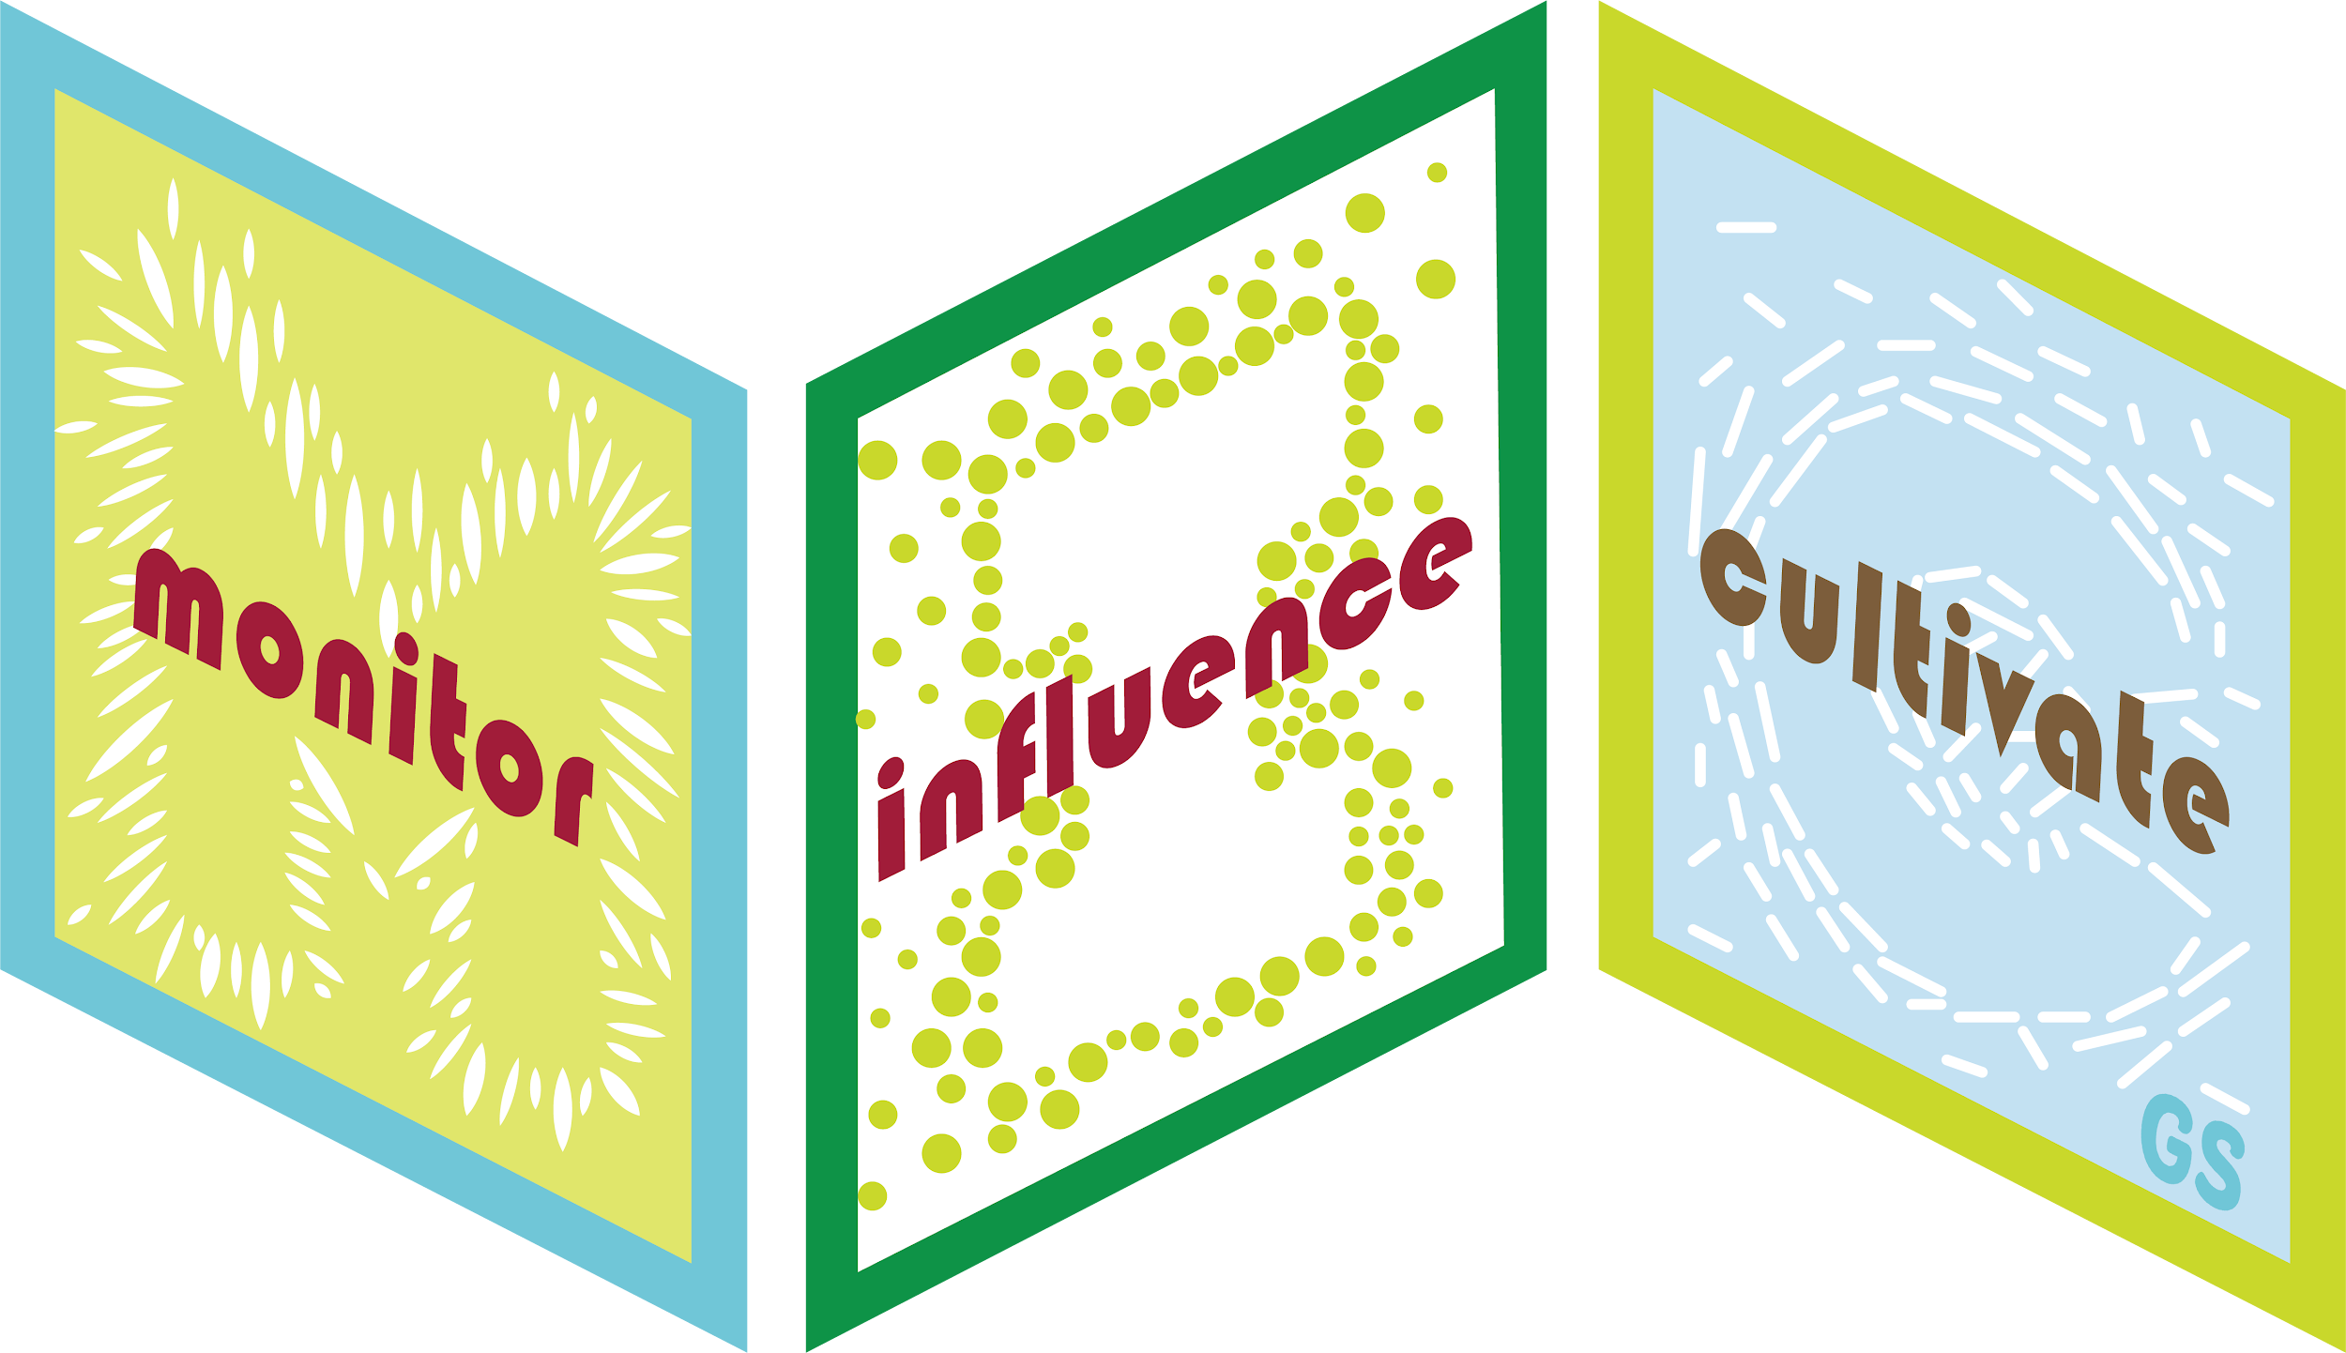
Leader Instructions & Prep
Cadette MEdia Journey
Supply List:
The following slides will walk your troop through a virtual meeting to earn the Cadette MEdia Journey. When you share your screen during your meeting, be sure to click “Present” using “Presenter View” so girls see the full screen and you can read the speaker notes.. Also, when you are sharing your screen in zoom, google meet, or another meeting app, please make sure you are sharing both picture and audio. For more information on using Zoom, visit gsnw.gl/VirtualMeetingHowTo
Many of the interactive activities included are shared through YouTube videos. Just click on the arrow in the center of the image to play the video, and the girls can see it too! You should try to review the slides before your meeting if possible, so you are familiar with the activities and any supplies needed.
This meeting will typically take approximately 60-90 minutes as written, depending on participation level and number of girls. As always, Girl Scouting is flexible, and troops may select the activities interest them most, add their own activities, or have girls do some of the steps afterward as “homework”.
When you send out your meeting invitation, be sure to let girls and parents know what supplies they should have on hand for the online troop meeting. They are things most girls likely have at home.
Leader facilitation supplies needed: (Just the leader would need to gather these, not girls). Leader may want to gather some magazines or food products to show advertisements and stereotype examples.
Supplies girls should have on hand: General supplies: Pencils, paper, markers, colored pencils, etc.
Girls may also need access to a device for researching their Take Action project. If they are already using a computer or tablet for the virtual meeting, maybe having a phone or another device handy for some quick research may be necessary.

Slide 2
Type your answers in the chat.
Gratitude Game
Name a person you are thankful for.
Name a place you are thankful for.
Name a food you are thankful for.
Name a thing you are thankful for.
Name anything of your choice.

Slide 3

Cadette MEdia Journey
Brought to you by Girl Scouts of the Northwestern Great Lakes

Slide 4
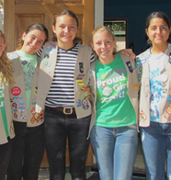
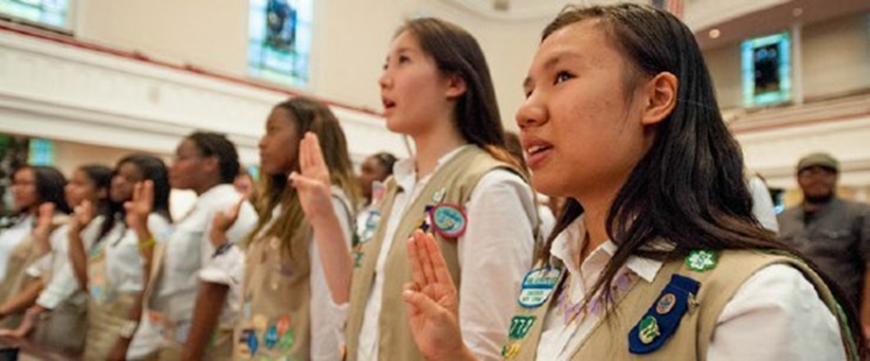
Girl Scout Promise
On my honor, I will try:
to serve god* and my country,
to help people at all times,
and to live by the girl scout law.

Slide 5


Let’s say the pledge

Slide 6
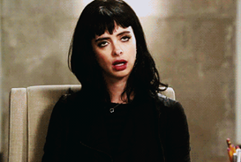
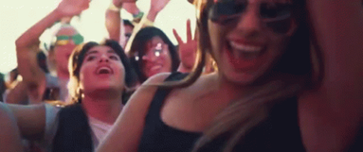
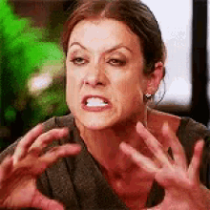
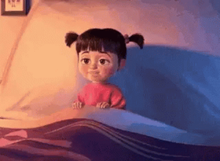

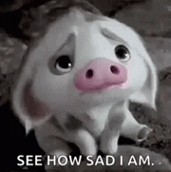

Which best describes you today?
B
A
C
E
F
D

Slide 7
There are 3 components to this journey
Monitor Hone in on the role media plays in your life and the lives of those around you and in your community.
Influence Influence people in positive ways by teaming up as a troop to change media for the better with a MEdia remake!
Cultivate Challenge yourself to make a positive change in the way you use media in your life...become an inspiration to others!
Together these components give you a way to broadcast – to amplify – your own story!

Slide 8
Let’s put the ME back in media.

Slide 9
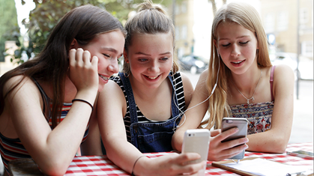
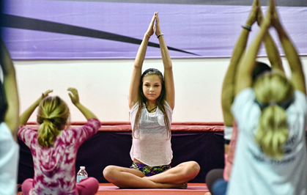
So who are you currently? Put it in the chat!
Gadget Girl:
Loves social media...it’s your fun zone
and my link to a gazillion people
OR
Lily Tranquility:
Media is so confusing and it’s such a time suck! I’d rather do something active or read a book.
Let’s put the ME back in media.

Slide 10

Let’s put the ME back in media.
Media is everywhere in our lives today. However, this means we might live in someone else’s reality rather than your own
This journey is all about bringing the focus back on ME and understanding how all forms of media can skew your reality
Beyond the internet, media is also billboards, magazine, popup ads, and ads during videos
...

Slide 11

In a recent poll by Pew Research center, 64% of Americans say that social media has a mostly negative impact on the U.S. today.
About 30% of these individuals(~20% of whole study) cite misinformation as social media’s wrongdoing.
Only 10% of individuals believe that social media has a mostly positive impact on the way things are going today.
About 25% of these individuals (2.5% of the whole study) believe that social media’s positive impact is keeping individuals informed and aware.
Click here for the whole study: https://www.pewresearch.org/fact-tank/2020/10/15/64-of-americans-say-social-media-have-a-mostly-negative-effect-on-the-way-things-are-going-in-the-u-s-today/

Slide 12
So, what is media?
Type in the chat or annotate any and all forms of media you can think of!

Slide 13
Let’s slice your media pie.
We all love to analyze data using pie charts - so let’s do an experiment!
On a piece of paper draw your own rough sketch of a pie and list next to it all those ways we have media influencing us on a daily basis. Then slice up and label the pieces of your pie with how much time represents your daily intake.
On the next slide is an example!
This is not what you should have, but represents how someone’s life might be consumed by media.

Slide 14

News
Other Social Media
Facebook
Music/Radio
Emails
TV

Slide 15
Do you think you spend more, less, or the same amount as your peers?
How could spending a lot of time on media affect you?
Now go to your pie chart and next to each item write a good and/or bad way that affects you. The next slide has examples of good and bad ways these types of media can influence you.
Good are in green Bad are in red

Slide 16
Real world info.
Can be hard to tell what is fact & what is opinion.
Entertainment.
News
Time suck.
Trying to keep up with everyone else.
Other Social Media
Connection to friends & family.
Able to share life events.
Facebook
Negativity & division.
Music/
Radio
Mood booster.
Radio is filled with ads.
Some music has negative messages.
Emails
Entertainment.
TV
Time suck.
Connection to friends & family.
Spam.

Slide 17
The next slide is a 2020 lifespan chart, created by the World Health Organization of a person that has an average lifespan of 72 years and how long they spend doing certain activities
Look at how much time we spend on social media and watching TV (We spend nearly 12% of our life watching TV!)
So, how much
is too much?
Many of us might hear or feel that we are on our devices too much. How long do you spend on your devices?

Slide 18
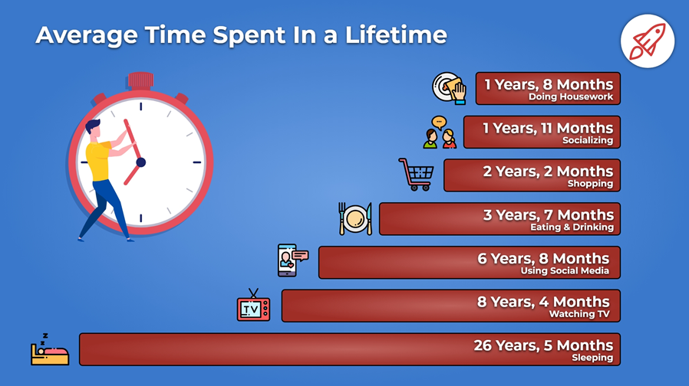

Slide 19
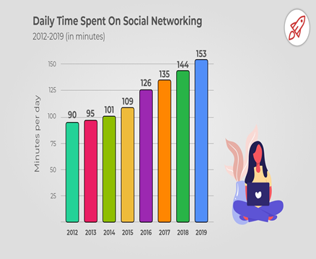
How much
is too much?
Look at how quickly our usage per day has increased over the years. Do you think the numbers will go up or down as the years go on?

Slide 20
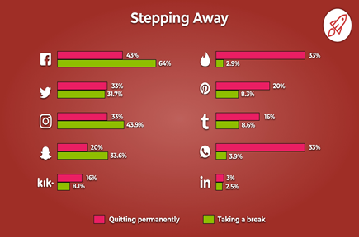
In 2019, a study found that much of Gen Z either took a break or quit social media all together. This research suggests that the increased time on social media may not continue much further into the future.
Everything from Facebook to Tinder was affected. But why?
Why do you think?
See the next slide for what the study found.

Slide 21
The majority stepped away because they felt they were spending too much time on social media.
Content negativity and privacy concerns also played a huge role.
This needs to change! If we are going to use social media platforms to communicate, we need to control the content and make it a safer place.

Slide 22
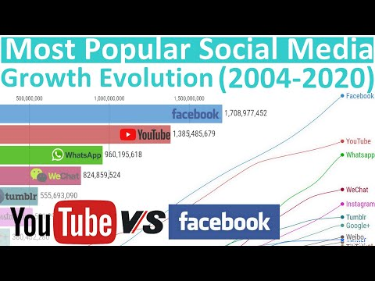
How has social media evolved?
This video shows the ranking of the most popular social media and its growth.
It’s 8 minutes long, we’ll start at the beginning, fast forward to the year you were born, and then to around 2015 until the end.
Notice how in 2019, we were headed into an election year and Twitter surged?
Then in 2020 being in quarantine for Covid, people looked to Pinterest for cleaning and redecorating tips
Then Tiktok blew up as well.
Social media is always changing and will continue to especially during virtual life.

Slide 23
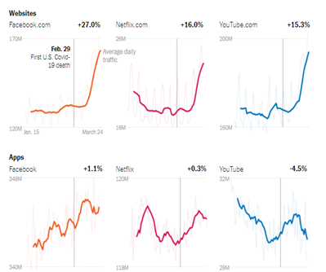
How has social media evolved?
Because of quarantine, there was a drastic increase entertainment sites and social media like Facebook, Netflix, and YouTube.
Many of us needed new ways to keep entertained or stay connected.

Slide 24
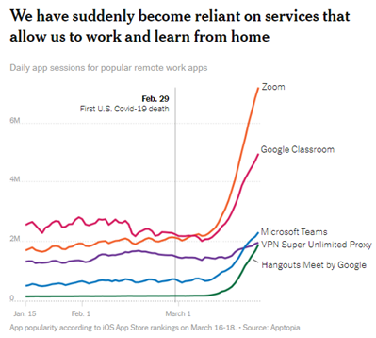
How has social media evolved?
We also have become reliant on services that allow us to work from home. Many of us used or still use Zoom, Google Classroom, and others to stay connected with friends and family.
How do you think this might change the future of the work and school environment?
Of social gatherings?

Slide 25
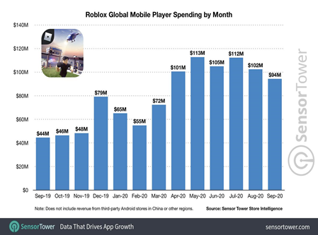
What is the real reason you keep playing Roblox?
Look at how may millions of dollars Roblox generates in a month from its users!
Game developers keep the game interesting by developing new games, features, and now it has been developed so that educators can incorporate it in their teaching!

Slide 26
How much is too much?
We’re going to see how much you are engaging with the media around you!
Take out a scratch piece of paper and write down
your answers to the questions on the next few slides!

Slide 27
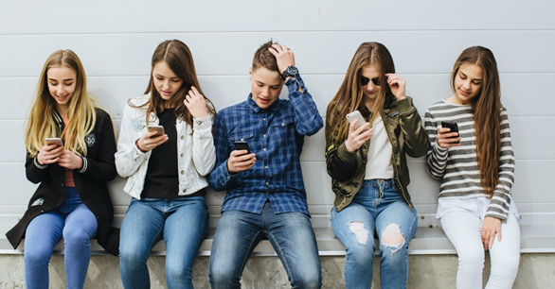
Someone asks you how many text messages you received today. You answer:
I don’t text people often or at all.
Let me go check…
A ton!

Slide 28
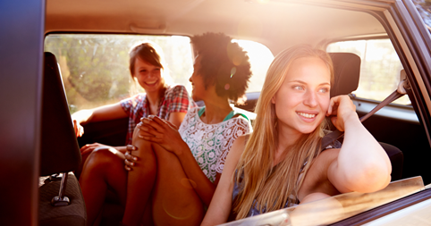
When you take a trip, you:
Chatting with your friends or family you’re on the trip with.
Put your cell phone on “vibrate” and take a book along for the ride.
Watching movies, playing games, or texting others while on the trip.

Slide 29
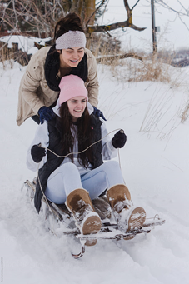
School is canceled because of snow, you:
Pile on winter clothes and spend the day sledding, skiing, snowboarding, or ice-skating.
Catch a movie with your best pals or Netflix with family.
Chat and game with your friends.

Slide 30
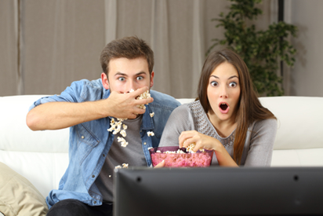
How much TV do you watch on a typical Saturday?
A.Very little.
B.Depends what’s on.
C.Impossible to say. The TV is on all the time in the background.

Slide 31
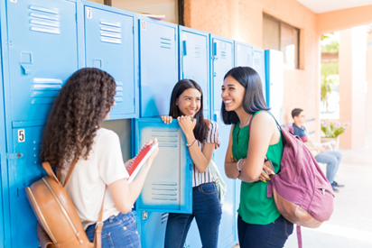
When you go to school on a Monday, how much do you already know about what your friends did over the weekend?
Nothing or very little!
I’m on a need-to-know basis with my friends. If it’s important they’ll call.
I know everything there is to know, and more. That’s why social media was invented, right?

Slide 32
How much is too much?
Now...count your answers. Give every A answer 1 point, B - 2 points, and C - 3 points.

Slide 33
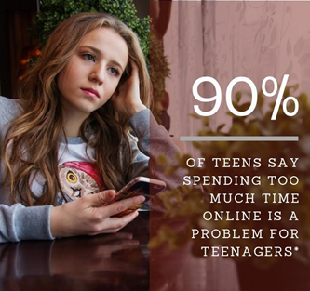
Between 5 and 7 points:
You spend very little time on technology! Tell us how you keep up with what is going on with your friends.
Between 8 and 12:
You live and breathe the motto “Everything in moderation”. Still, make sure your habits stay healthy by balancing what you expose yourself to. For every 15 minutes online socially, spend 15 minutes reading the news or watching a documentary, or researching a project.
Between 13 and 15:
Experiencing FOMO? You may be dangerously close to developing a condition known as Gadget-Girl-Itis. It may be time to take a break.

Slide 34
It’s really hard to figure out how much media time is too much!
Sometimes you have to spend a lot of time on the internet researching for school or for Girl Scout Take Action Plans. But these are considered good uses of media.
When people talk about media, they often only talk about the bad parts. However, media can enrich and deepen your knowledge and heighten your creativity!
Truthfully, only you can be the judge of how much is too much. But really think if the time you are spending in intentional and having a positive influence or if you are simply passing time because there is nothing else to do or FOMO!

Slide 35
Consider the source.

Slide 36
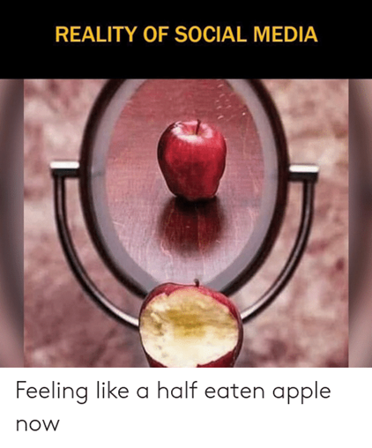
Part of media’s job is to throw images at you to get you to react...your friends have learned to do this as well.

Slide 37
Consider the source.
We’re going to dive a little deeper into what we see and take in from our media outlets.
An image on social media will never be the true picture – filters, happiest of times, and photoshop help portray a world we all want to live in.
Behind the scenes things might not be all that they seem – we need to take back our true images!
It’s our job to screen what we see – to separate the positive from the negative, fact from fiction, and to weed out the harmful.

Slide 38
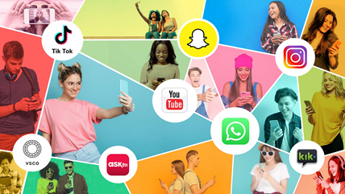
We tend to believe what we see or hear, and if it’s on the internet, it must be true right?
We can’t assume that the expensive or trendy beauty product is going to cure your acne overnight.
Or that the new trendy and expensive pair of leggings is going to raise you into the “cool group”
Ads are full of words and images that overemphasize the facts and make things appear better than they actually are.

Slide 39
How many of you have fallen for these 2020 challenges?

Slide 40
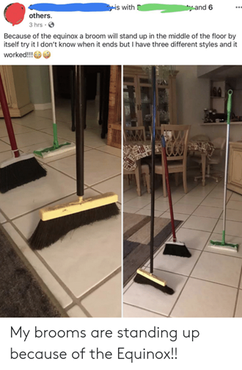
The standing broom that would only stand on a certain day of the year because of the equinox or something?
We gotta try it! Pretty harmless, right?
But guess what, a broom will stand any day of the year! If you have patience and the right broom, it’s simple physics.

Slide 41
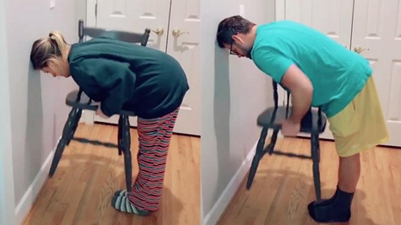
This is another science challenge!
This one is based on men’s versus women’s center of gravity.
How many of you tried to challenge a boy to see if you could pick up a chair to your chest, but they couldn’t?

Slide 42
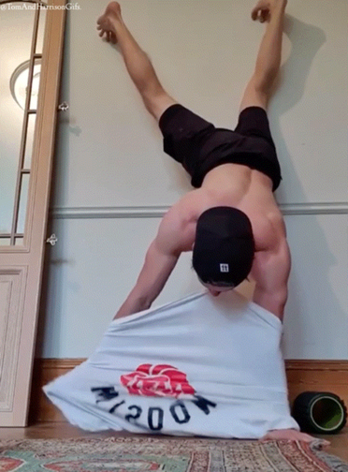
How about this one?
This challenge just takes pure strength! Go for it, give it a try.
It took Simon Biles, Olympic gymnast to take off her sweatpants while doing a handstand to show these boys what talent really looks like!

Slide 43
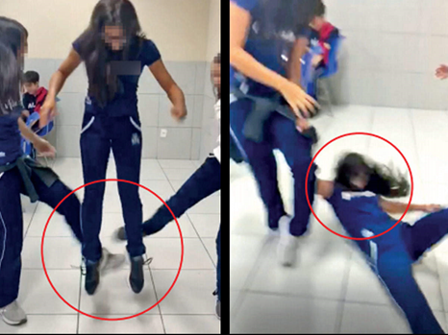
You would ask to film a cool viral video with a “friend” jumping, but then sweep their legs right from out below them causing them or fall to the ground!
So many kids where injured it became known as the skull breaker challenge and removed from TikTok.
The leg sweet challenge.
Don’t try this at home or anywhere else! This was less of a challenge and more of a bullying tactic.

Slide 44




Consider the source - we need to fact check!
So how do we fact-check the internet?
We use the internet!
There are many sites you can trust or whose sole purpose is to fact check or tell the real story behind something!
There are websites like MediaMatters.org, Fact Check, and PolitiFact that will help you to research media misinformation
There are also websites that will tell you how often websites spew fact, fiction, or both!
Chances are, if something is too good to be true, it probably is!

Slide 45
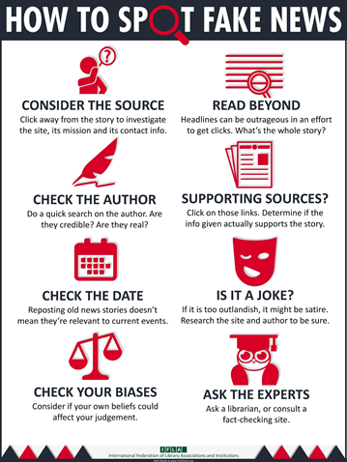
Let’s read off the 8 easy ways to spot fake news!
For the Take Action Project, let’s be sure to use a fact checker!

Slide 46
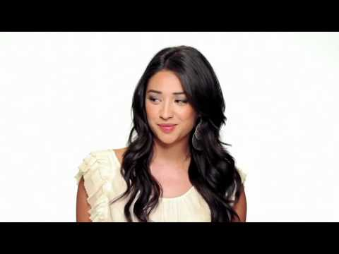
Watch what you WATCH
Let’s watch this short video that reminds us to watch what we watch and really understand what we are seeing and believing.

Slide 47

The Social Dilemma.
For further understanding of how social media draws you in, you can watch The Social Dilemma on Netflix.
It’s rated PG-13 so you will want your parents’ permission, or you could watch it together!
It’s eye-opening and a great way for your family to start a discussion about social media, manipulation, advertising, and programming.

Slide 48
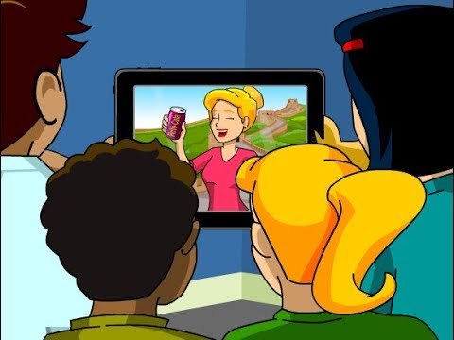
My day of message overload.
For one day, track all the ad messages you see, from when you wake up to when you go to sleep. What are all these messages trying to sell you or say to you?
How do you feel about what the ads show? Would your feelings change if the models looked more like you (an average teen with acne, messy hair, not perfect) or were not white, had a different sexual identity, or had differing body types?

Slide 49
Hey! I can’t hear or see me!
Have you ever felt that looking through a magazine or watching a movie there is NO one like YOU?
It’s time to dial into stereotypes and unconscious biases!

Slide 50
First - All of us!
Can you identify which characteristics are being stereotyped in the following statements?

Slide 51
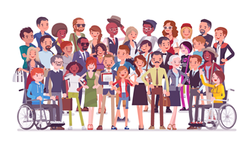
He’s too old to do that job.

Slide 52
He’s too old to do that job.
The answer is: Age

Slide 53
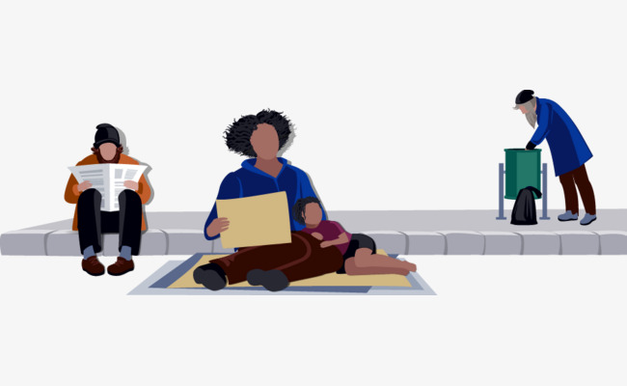
Poor people don’t try hard enough.

Slide 54
Poor people don’t try hard enough.
The answer is: Socioeconomic Status

Slide 55
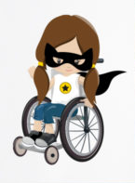
We should feel sorry for her because she is in a wheelchair.

Slide 56
We should feel sorry for her because she is in a wheelchair.
The answer is: Physical Ability

Slide 57
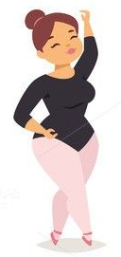
If she’d just stop eating so much, she could be thin.

Slide 58
If she’d just stop eating so much, she could be thin.
The answer is: Weight

Slide 59
Great job girls!
Unfortunately, there’s a lot of stereotyping in the world, especially in media.
Stereotyping is another thing we have to work hard to combat.

Slide 60

Second - Just girls!
Which of these statements are stereotypes about girls?

Slide 61
Girls love pink.
D. Girls believe that having a significant other is more important than having friends.
B. Girls love to shop.
E. Math and science are too hard for girls, or they just don’t like those subjects.
C. Girls think makeovers can fix all their problems.
F. Girls only use the computer to chat with friends.

Slide 62
All of them!
I bet you can name even more.
How do you fight stereotypes?

Slide 63
Second - Just girls!
Let’s delve a little deeper by finding out how much alike or different we all are.
I’m going to stop sharing my screen now, and everyone should switch to gallery view and turn on your camera if you can and feel comfortable, so you can see everyone on your screen for a quick activity.
You will be read and presented a series of questions and if the statement applies to you, you will either raise your hand, raise a sheet of paper with the word “Me” written on it, or with the Zoom reactions.

Slide 64

Raise your hand if:
You have enjoyed our session so far.
You play a sport.
You like hanging out with your friends.
You love your parents...but don’t always like them.
You want to be successful in your future.
You don’t like school most days.
You have felt left out before.
You are worried about how you look more than you’d like.
You have a friend who has said something mean to you and hurt your feelings.
You feel lonely sometimes.
You have been called a geek or nerd or something else hurtful that you felt didn’t really describe you.
You have someone you can trust.

Slide 65

Just girls!
We all face stereotypes. I hope through this exercise you saw that you are more alike than different. Especially during teenage years, you have insecurities, and some days are going to be worse than others.
Remember that your friends and family love you and your Girl Scout sisters care about you and will always be here to support you.
Did anyone learn something they would like to share?

Slide 66

Stereotypes: that’s so fetch!

Slide 67
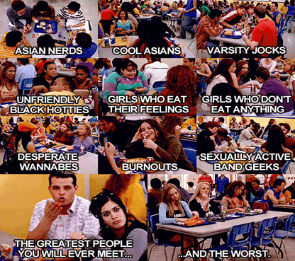
People stereotype because it’s an easy way to assume they have a “handle” on how certain groups of people believe or behave. Advertisers do the same and target their messages!
Has an ad ever convinced you that you “belong” to a certain group of people and therefore you should want to do or buy something because of it?
We have to be careful to view ourselves as individuals and put stereotypes aside to take control of our own story!

Slide 68
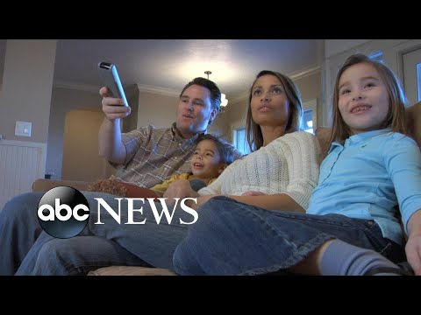
Stereotypes: How do they impact you?
Even as a child, we are being fed stereotypes in advertisements, movies, and cartoons! For example, cleaning ads focusing on women.
Or in cartoons women doing most of the housework while men work to support the family or enjoys sports
Do you think it can have an impact on how we see our world? What do you want to see in advertisements?

Slide 69
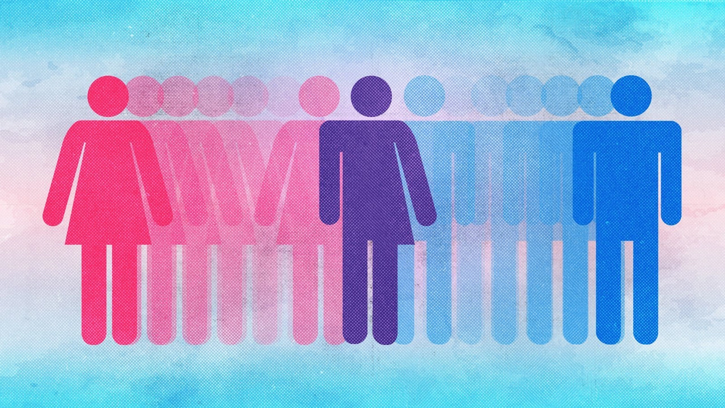
Stereotypes: Gender Inequality
So how do stereotypes influence advertisements?
We are going to look at two ads for very similar products.

Slide 70

Stereotypes: Gender Inequality
What do you think of this ad?
What does this slide suggest about women?
What stereotypes does this ad use?
Why was this product chosen for this presentation?

Slide 71
What do you think makes someone successful?
What does this ad mean by successful?
What judgement in this ad is being made about “successful women”
About their cooking ability?
Their ability to be a mom?
Why do you think a brand called “Lean Cuisine” is marketing directly to one gender?
Let’s look at one that stereotypes men.

Slide 72

Stereotypes: Gender Inequality
Take some time again to discuss what you think of this ad
What does it suggest?
What doesn’t it suggest?

Slide 73
What does this ad suggest about men? Women?
How does this ad differ from the last ad?
Do men really only cook one day out of the year?
Do you think a brand would be called Hungry Woman?

Slide 74


Stereotypes: Gender Inequality
What do you notice about these ads?
How do they differ or are similar to the last two ads?

Slide 75
Stereotypes: Gender Inequality
What does the ad assume women want? What about men?
Which are the outcomes the ads focus on?
Do you think this type of targeting in ads is common?

Slide 76
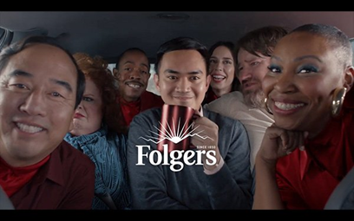

Stereotypes: Social Class Inequality
What do you notice about these ads?
The types of people in the ads vs the types of products?

Slide 77
Stereotypes: Social Class Inequality
What ads target the everyday you or adults versus the aspirational you or aspirational adult.
Everyday items like coffee and Snickers represent the everyday person.
Luxury items like perfume and alcohol use celebrities living their best lives to appeal to a life many people typically want.

Slide 78
Racial Inequalities
Racial stereotypes are everywhere in advertising! We have been working hard to pressure companies to end these stereotypes, but the work needs to continue. We need to hold companies and people accountable when they do things that are not acceptable! We can write letters, email the corporation, and educate our community!
These depictions are not okay because most of them come from White people who used caricatures of Black or Indigenous people to form the images. For example, Aunt Jemima was not a real person, she was inspired by a minstrel show, or a form of entertainment that White people participated in Blackface to demean Black individuals. Let’s watch the video on the next slide for more information.

Slide 79
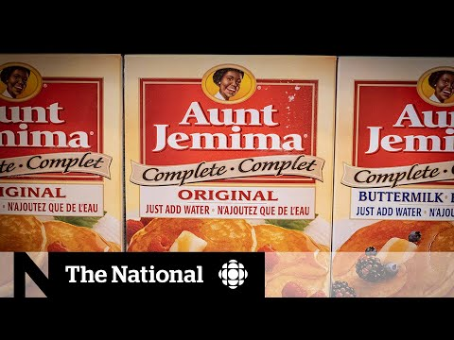

Slide 80
Stereotypes: Photoshop Beauty Fails
Filters and photoshop are used by celebrities and advertisers alike!
From covering a zit to emphasizing background colors, to dramatic physical appearance changes.
These images make it so that every day we judge our own image we see in the mirror and wonder why we aren’t that beautiful or healthy.
It’s always important to be mindful of the photos you see and if you alter photos.

Slide 81

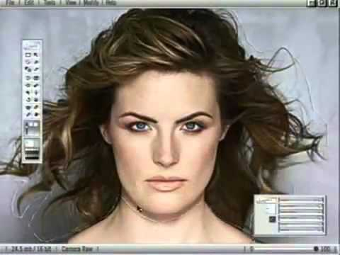
Stereotypes: The power of editing.
Since the inception of video and photo editing arrived, individuals and companies have greatly edited people’s features and bodies.
Let’s take a look at this video to see just how much someone can edit them.

Slide 82

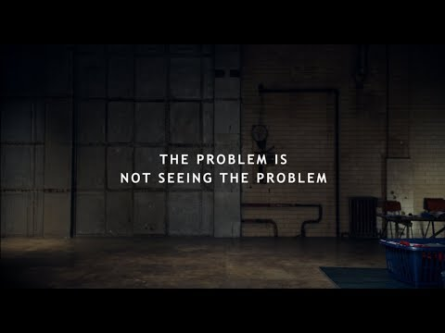
Stereotypes: Let’s destroy them!
To understand that stereotypes even exist in advertising and TV, we must realize and see the problem!
We need to see how these roles are type-casted and fed to us on a daily basis! Let’s check out this video on typecasting in ads and the film industry!

Slide 83




Stereotypes: Let’s destroy them!
Your homework...pay attention to advertising on TV and in magazines and try to find 3-4 examples of stereotypes.

Slide 84
You have earned your Monitor award!
To complete this journey...you need to use what you learned to Influence others and Cultivate Change!

Slide 85
Cadette Media Journey - Meeting 2
Brought to you by Girl Scouts of the Northwestern Great Lakes

Slide 86
Girl Scout Promise
On my honor, I will try:
to serve god* and my country,
to help people at all times,
and to live by the girl scout law.

Slide 87
Let’s say the pledge

Slide 88
Time for the Influence award!
To complete this journey...you need to use what you learned to Influence others and Cultivate Change! The good news is that the Influence Award is a built in Take Action project for this journey!

Slide 89

What is a Take Action project?
A Take Action project is different than a community service project, because Take Action projects address the root cause of an issue and provide a sustainable solution. Girl Scouts of the USA suggests three ways to make a project sustainable:
Make your solution permanent.
Educate and inspire others to be part of the change.
Change a rule, regulation, or law.

Slide 90
Let's brainstorm.
What are some ways that we can address what we have learned and educate others during this time?
Could we . . . .
Do videos to share with our friends, school, and on social media?
Write letters to our legislatures to make a change?
Make posters in our school?
Put on a virtual event for younger Girl Scouts?
Remember to keep it Girl Led, but don’t over think it. The harder you make it to be accessible, the harder it will be to get your point across to many people.

Slide 91
So, how can we influence others?
Let’s really take a deep dive into what bothers you on TV, in magazines, or online. What gets you fired up, angry, or depressed?
Let’s take a couple of minutes on the next slide to talk about this and to brainstorm ideas. Then, we’ll turn that frustration into a desire to make a change!!

Slide 92
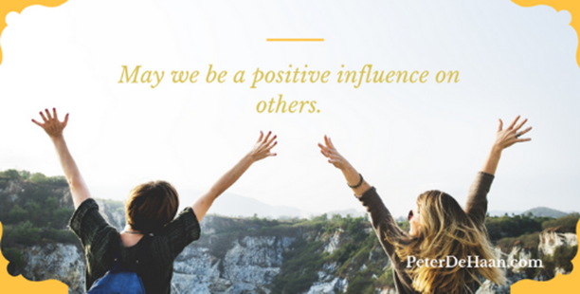
How can we influence others?
Do images in advertising affect your feelings and your behavior...or your friends?
Do they make you want to be impossibly thin, impossibly rich, or impossibly self-confident?
Do girls in your favorite shows always wear revealing clothes or extra-skinny jeans?
Do games or advertising suck you into the abyss of endless hours online?
Are we sick of stereotypes and bullying when we don’t fit the mold?
What bothers you?

Slide 93
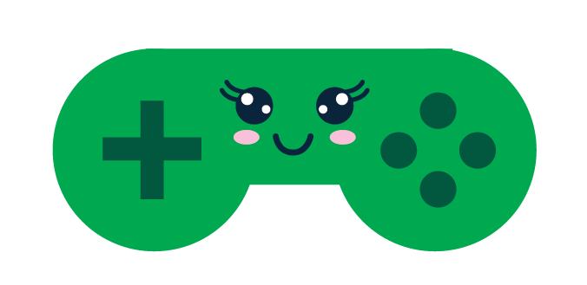
Can games change the world?
Let’s look at this example of how a group saw a need in society to create a safe place to game.
Maybe even to use games for good to tackle big issues like poverty, human rights, and climate change
Video games are often violent or simply endless hours of time suck right? Do they all need to be? NO!

Slide 94
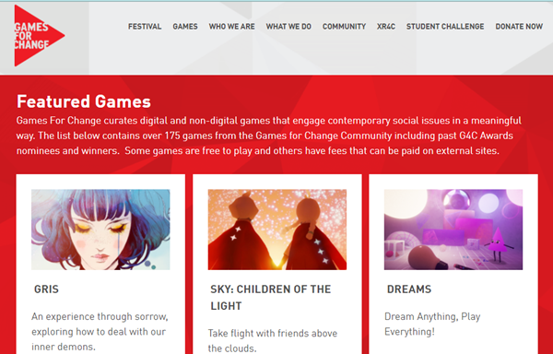
Can games change the world.
Founded in 2004, this female driven online platform, Games for Change is home to 100s of games created by students and game developers aimed at tackling big issues.
Check them out on gamesforchange.org. Many are free online!

Slide 95
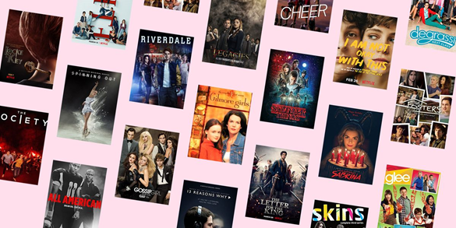

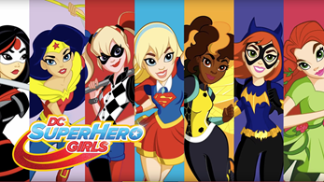
Let’s do a media remake! Maybe you want to ban stereotypes in a popular prime-time TV Show!
You could make a storyboard or script your own episode and share it with your language arts classes. You could even try sending it to the original producers!

Slide 96

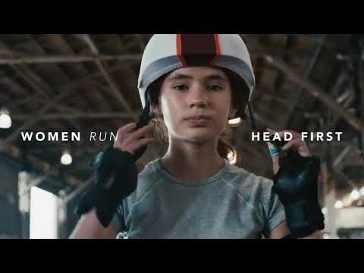
Let’s do a media remake!
Maybe you want to stop fashion spreads of unrealistic models or TV ads that show men as the stronger gender.
You could recreate your own real-life magazine spread or marketing campaign using real-life models, and share it with younger Girl Scouts.
You could send them to the magazine editors or name brand manufacturers to let them know you see a need for change in their marketing!
Let’s check out this ad for women changing the future!

Slide 97


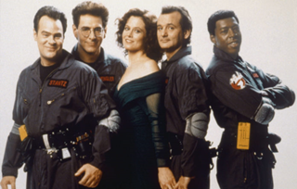

Let’s do a media remake!
Maybe a blockbuster movie is way too violent or sexist, or just doesn’t show women in real-life ways.
You could use iMovie and remake the storyline and post it online for others to see.

Slide 98





Let’s do a media remake!
Maybe you want to change an ad campaign to debunk unhealthy body image myths,
expose false claims and useless products, or address harmful advertising aimed at teens.
You could use apps to download images of existing advertisements and recreate them
using yourself and fellow Girl Scouts.

Slide 99


Let’s do a media remake!
Women are certainly sick of being objectified
It’s our time to take over the air with something positive!
Maybe you want to rewrite a popular song that’s loaded with negative or anti-women lyrics.
Or maybe you want to create a new soundtrack for an existing movie, TV show, or commercial because you think the original sends the wrong message.

Slide 100

Let’s do a media remake!
Let’s look at what one troop did for their remake.

Slide 101

Here are some examples of what other troops have done.

Slide 102

Here are some examples of what other troops have done.

Slide 103
Now, let’s do something!
Through this journey, we have done lots of discussing and exploring the role media plays in our life and how we can reclaim media! Now, let’s put what we have learned into action! On the next slide, we are going to vote to do one of two actions for our Take Action Project!

Slide 104



So, how can we influence others?
Let’s make this Girl Led!
You decide which activity you want to do as a troop to move forward and earn the Influence award.
Let’s create a survey in Survey Monkey or Google Forms that we can share with all our friends asking them questions about media. We will then compile the results and find a creative way to share them in a video or flyer that can be shared with our peers.
Or together let’s pick a type of media and do a makeover of it! Remaking ads using real girls or a movie trailer with an all female cast, etc.
Notes:
Which did the girls choose?
If they chose to do the Media Survey, please use slides 105-107
If they chose to do the Media Remake, ignore slides 105-107, but use slides 108-109

Slide 105


You picked the Media Survey! Awesome, let’s do the get a media survey of your peers.
Is there anyone who is really good or interested at creating surveys?
One or two girls can create the survey using Google Forms or Survey Monkey, just have an adult check over it before publishing it.
The next 3 slides are for the Media survey, please skip ahead if you picked the Media Remake.

Slide 106
Let’s create our Media Survey!
Let’s create a Media Survey!
Let’s use annotations or the chat to suggest some questions for the survey!
Questions shouldn’t be open ended but simple answers (multiple choice or T/F)
Here are some example questions:
Do you own a phone or other device?
Does being on social media make you feel better or worse about yourself?
How much time do you spend on social media? Gaming? Watching TV/Netflix, etc.?
What social media platform do you spend the most time on?

Slide 107
Who do we want to send this survey to?
Only peers or also include parents?
After this meeting, we will create the survey, then share it with at least 10 friends asking them to complete it in the next few days.
Then, I (the leader) will compile the results and share them at the start of our next Journey meeting.
Then we will decide how we will share the results with others.

Slide 108



You picked the Media Remake! Let’s do it!
Let’s take some time to either split into Zoom Breakout Rooms or in the large group to discuss something you have seen in the media and how would you remake it?
If possible, please share your screens as needed!
Let’s try to get everyone to say something before moving on.

Slide 109
Let’s do our Media Remake: Homework
You can choose to work together in teams, with a parent helper, and/or as individuals.
What are you going to remake? How are you going to remake it?
Here are some ideas:
Create an iMovie trailer.
Take an existing ad and edit it to be more positive or inclusive.
Write a skit that you will perform a role in a new movie rewrite.
This homework must be done before our next meeting. In the next meet we will decide where we can share it (with parents’ permission)

Slide 110
Time to say goodnight, until next time!

Slide 111
Cadette Media Journey - Meeting 3
Brought to you by Girl Scouts of the Northwestern Great Lakes

Slide 112
Girl Scout Promise
On my honor, I will try:
to serve god* and my country,
to help people at all times,
and to live by the girl scout law.

Slide 113
Let’s say the pledge

Slide 114
Time for the Influence award!
To complete this journey...you need to use what you learned to Influence others and Cultivate Change! The good news is that the Influence Award is a built in Take Action project for this journey!

Slide 115
What is a Take Action project?
A Take Action project is different than a community service project, because Take Action projects address the root cause of an issue and provide a sustainable solution. Girl Scouts of the USA suggests three ways to make a project sustainable:
Make your solution permanent.
Educate and inspire others to be part of the change.
Change a rule, regulation, or law.

Slide 116
Cadette Media Journey - Meeting 4
Brought to you by Girl Scouts of the Northwestern Great Lakes

Slide 117
Girl Scout Promise
On my honor, I will try:
to serve god* and my country,
to help people at all times,
and to live by the girl scout law.

Slide 118
Let’s say the pledge

Slide 119
Use annotation text or the chat to key in your favorites below:
Favorite subject in school:
Favorite food:
Favorite movie or TV show:
Favorite place:
Favorite activity:
Favorite time of day:

Slide 120
So, how can we influence others?
Let’s take a moment to look at our progress so far on our project! Once it is completely done, where can we post it with parents’ permission if necessary?
How can we use what we created to influence others? To share what we learned in this journey thus far?
Can we...
Post it online? Share it with friends and family?
Share the results with others?
Use it as inspiration to write letters to media gurus to change the way things are presented?
Use it to inspire individuals to follow body positivity influencers rather than weight loss influencers?

Slide 121
Work time.
Let’s also take time to continue working on our project and to
really brainstorm and come up with a plan to share our product.

Slide 122
You have earned your Influence award!
To complete this journey...you need to make a promise to Cultivate Change!

Slide 123
A commitment to Cultivate. Now, it’s time to challenge yourself to cultivate better use of media in YOUR OWN life.

Slide 124






Slide 125
A commitment to Cultivate!
What are some ideas people have of how to cultivate this commitment to putting the me back in media in your daily life?
You could commit to saying no to the TV stereotypes.
You could reinvent yourself as a positive only role model on social media or a “real” role model who portrays her real life and not the perfect picture image.
You can make a commitment to reduce your time online.

Slide 126

A commitment to Cultivate!
Take out a piece of paper and write what appears on the screen on the right. Now...how do you fill in that blank?
Once you have written your commitment following these directions, it would be wonderful for some or all of you to share what you plan to do!

Slide 127
You have earned your Cultivate award!

Slide 128
Congratulations, you have earned the MEdia Journey!

