Slide 1


Leader Instructions & Meeting Prep:
Cadette Eating for You Badge
Cadette Eating for You:Badge meeting plan supply list::
Leader facilitation supplies needed: (Just the leader would need to gather these, not girls). Gather about 12 pre-packaged food products, things like canned soups, macaroni and cheese, condiments, cereals, granola bars, cookies, crackers, chips. These won’t be used, but just evaluated in the sugar busters activity.
Supplies girls should have on hand: General supplies: Pencils, paper, markers, colored pencils, etc.
The following slides will walk your troop through a virtual meeting to earn the Cadette Eating for You Badge. When you share your screen during your meeting, be sure to click “Present” so girls see the full screen. Also, when you are sharing your screen in zoom, google meet, or another meeting app, please make sure you are sharing both picture and audio. For more information on using Zoom, visit gsnw.gl/VirtualMeetingHowTo
Many of the interactive activities included are shared through YouTube videos. Just click on the arrow in the center of the image to play the video, and the girls can see it too! You should try to review the slides before your meeting if possible, so you are familiar with the activities and any supplies needed.
This meeting will typically take approximately 60-90 minutes as written, depending on participation level and number of girls. As always, Girl Scouting is flexible, and troops may select the activities interest them most, add their own activities, or have girls do some of the steps afterward as “homework”.
When you send out your meeting invitation, be sure to let girls and parents know what supplies they should have on hand for the online troop meeting. They are things most girls likely have at home.
For Spa water Activity:
Large container with lid, such as Mason jar or large wide-mouthed water bottles
Water and Ice
Choice of things to add to water: fresh or frozen fruit, fresh herbs, cucumbers, cinnamon sticks, etc.
Knife/cutting board to cut fruit/veg with, if not pre-cut.
For Energy Bites:
Mixing bowl and spoon
Standard Tablespoon
Pan
Wax paper (optional)
1 ripe banana (1/3 cup mashed)
1/4 cup honey
1/4 cup peanut butter (or, any nut butter you prefer)
1 3/4 cups oatmeal (not instant)
1/2 cup chocolate chips (miniatures work best. Raisins could be substituted)

Slide 2

Eating for YOU
Cadette
Brought to you by Girl Scouts of the Northwestern Great Lakes

Slide 3

Let’s start with the
Girl Scout Promise
On my honor, I will try,
To serve God and my Country.
To help people at all times,
And to live by the Girl Scout Law.

Slide 4


Let’s say the
Pledge

Slide 5
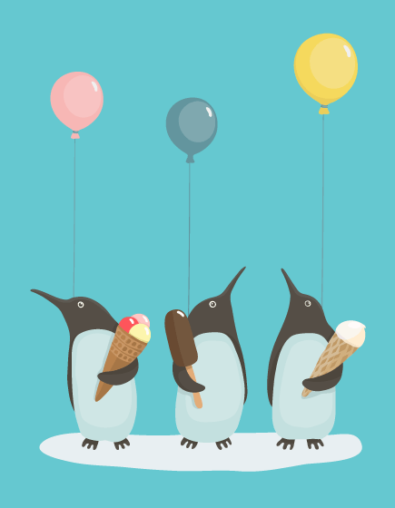
Icebreaker
If you were stranded on an island and could only eat one food for the rest of your life, what would it be? (Do you think you could survive on that type of food?)

Slide 6
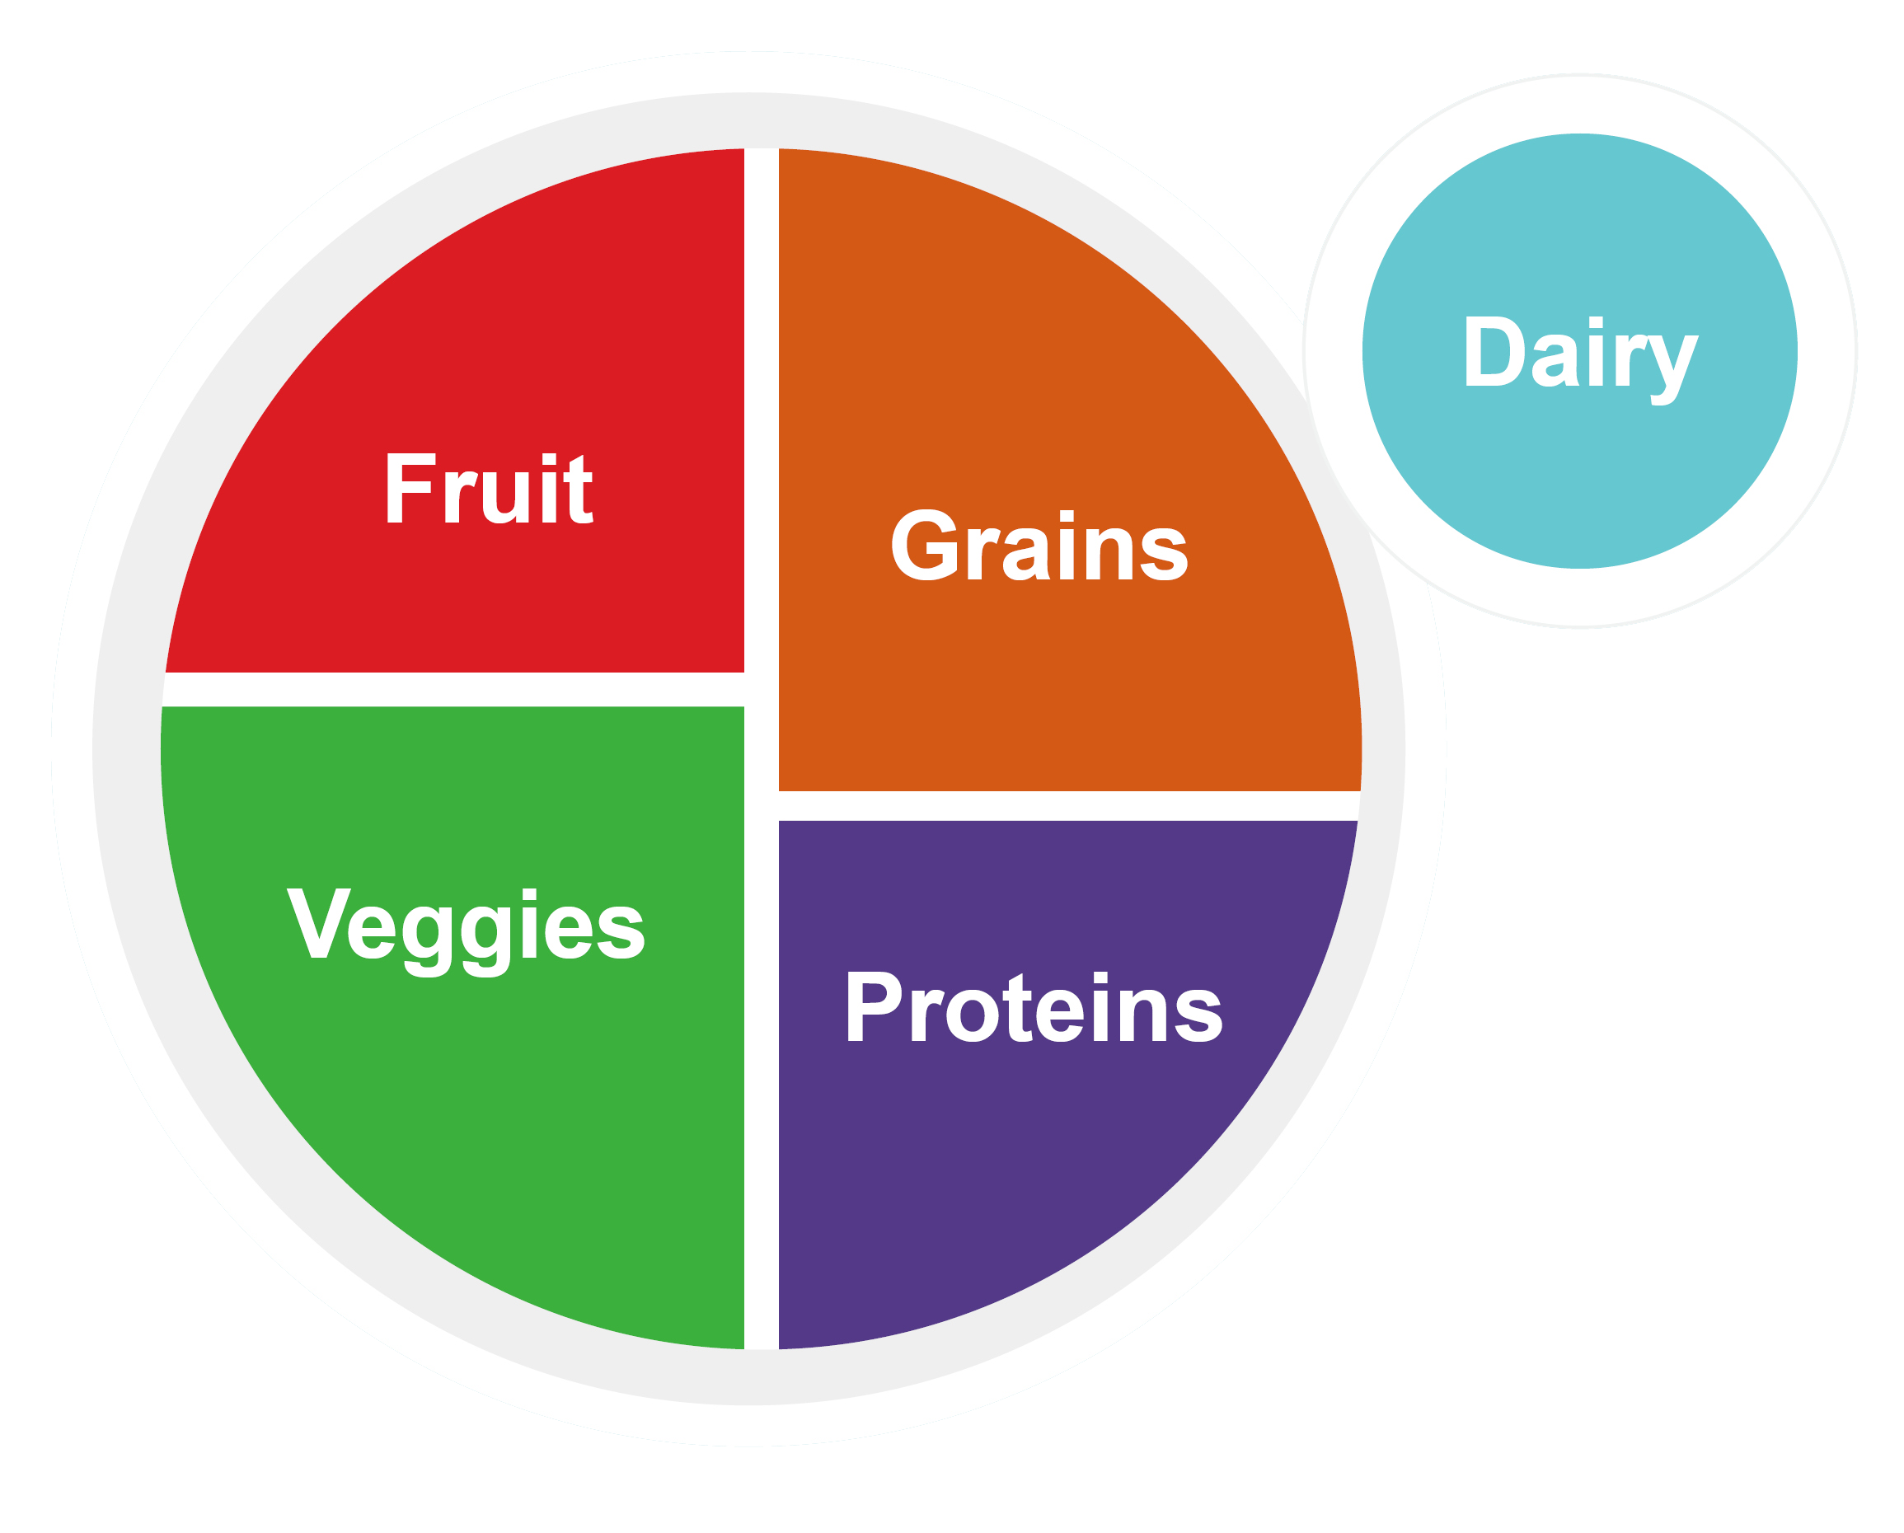
Step 1: Know how
nutrition helps your
body stay healthy!
Now, the government has changed from the food pyramid to using a my plate model to show food groups and portions! The Myplate graphic shows how everyone’s diet should be divided by food groups.

Slide 7
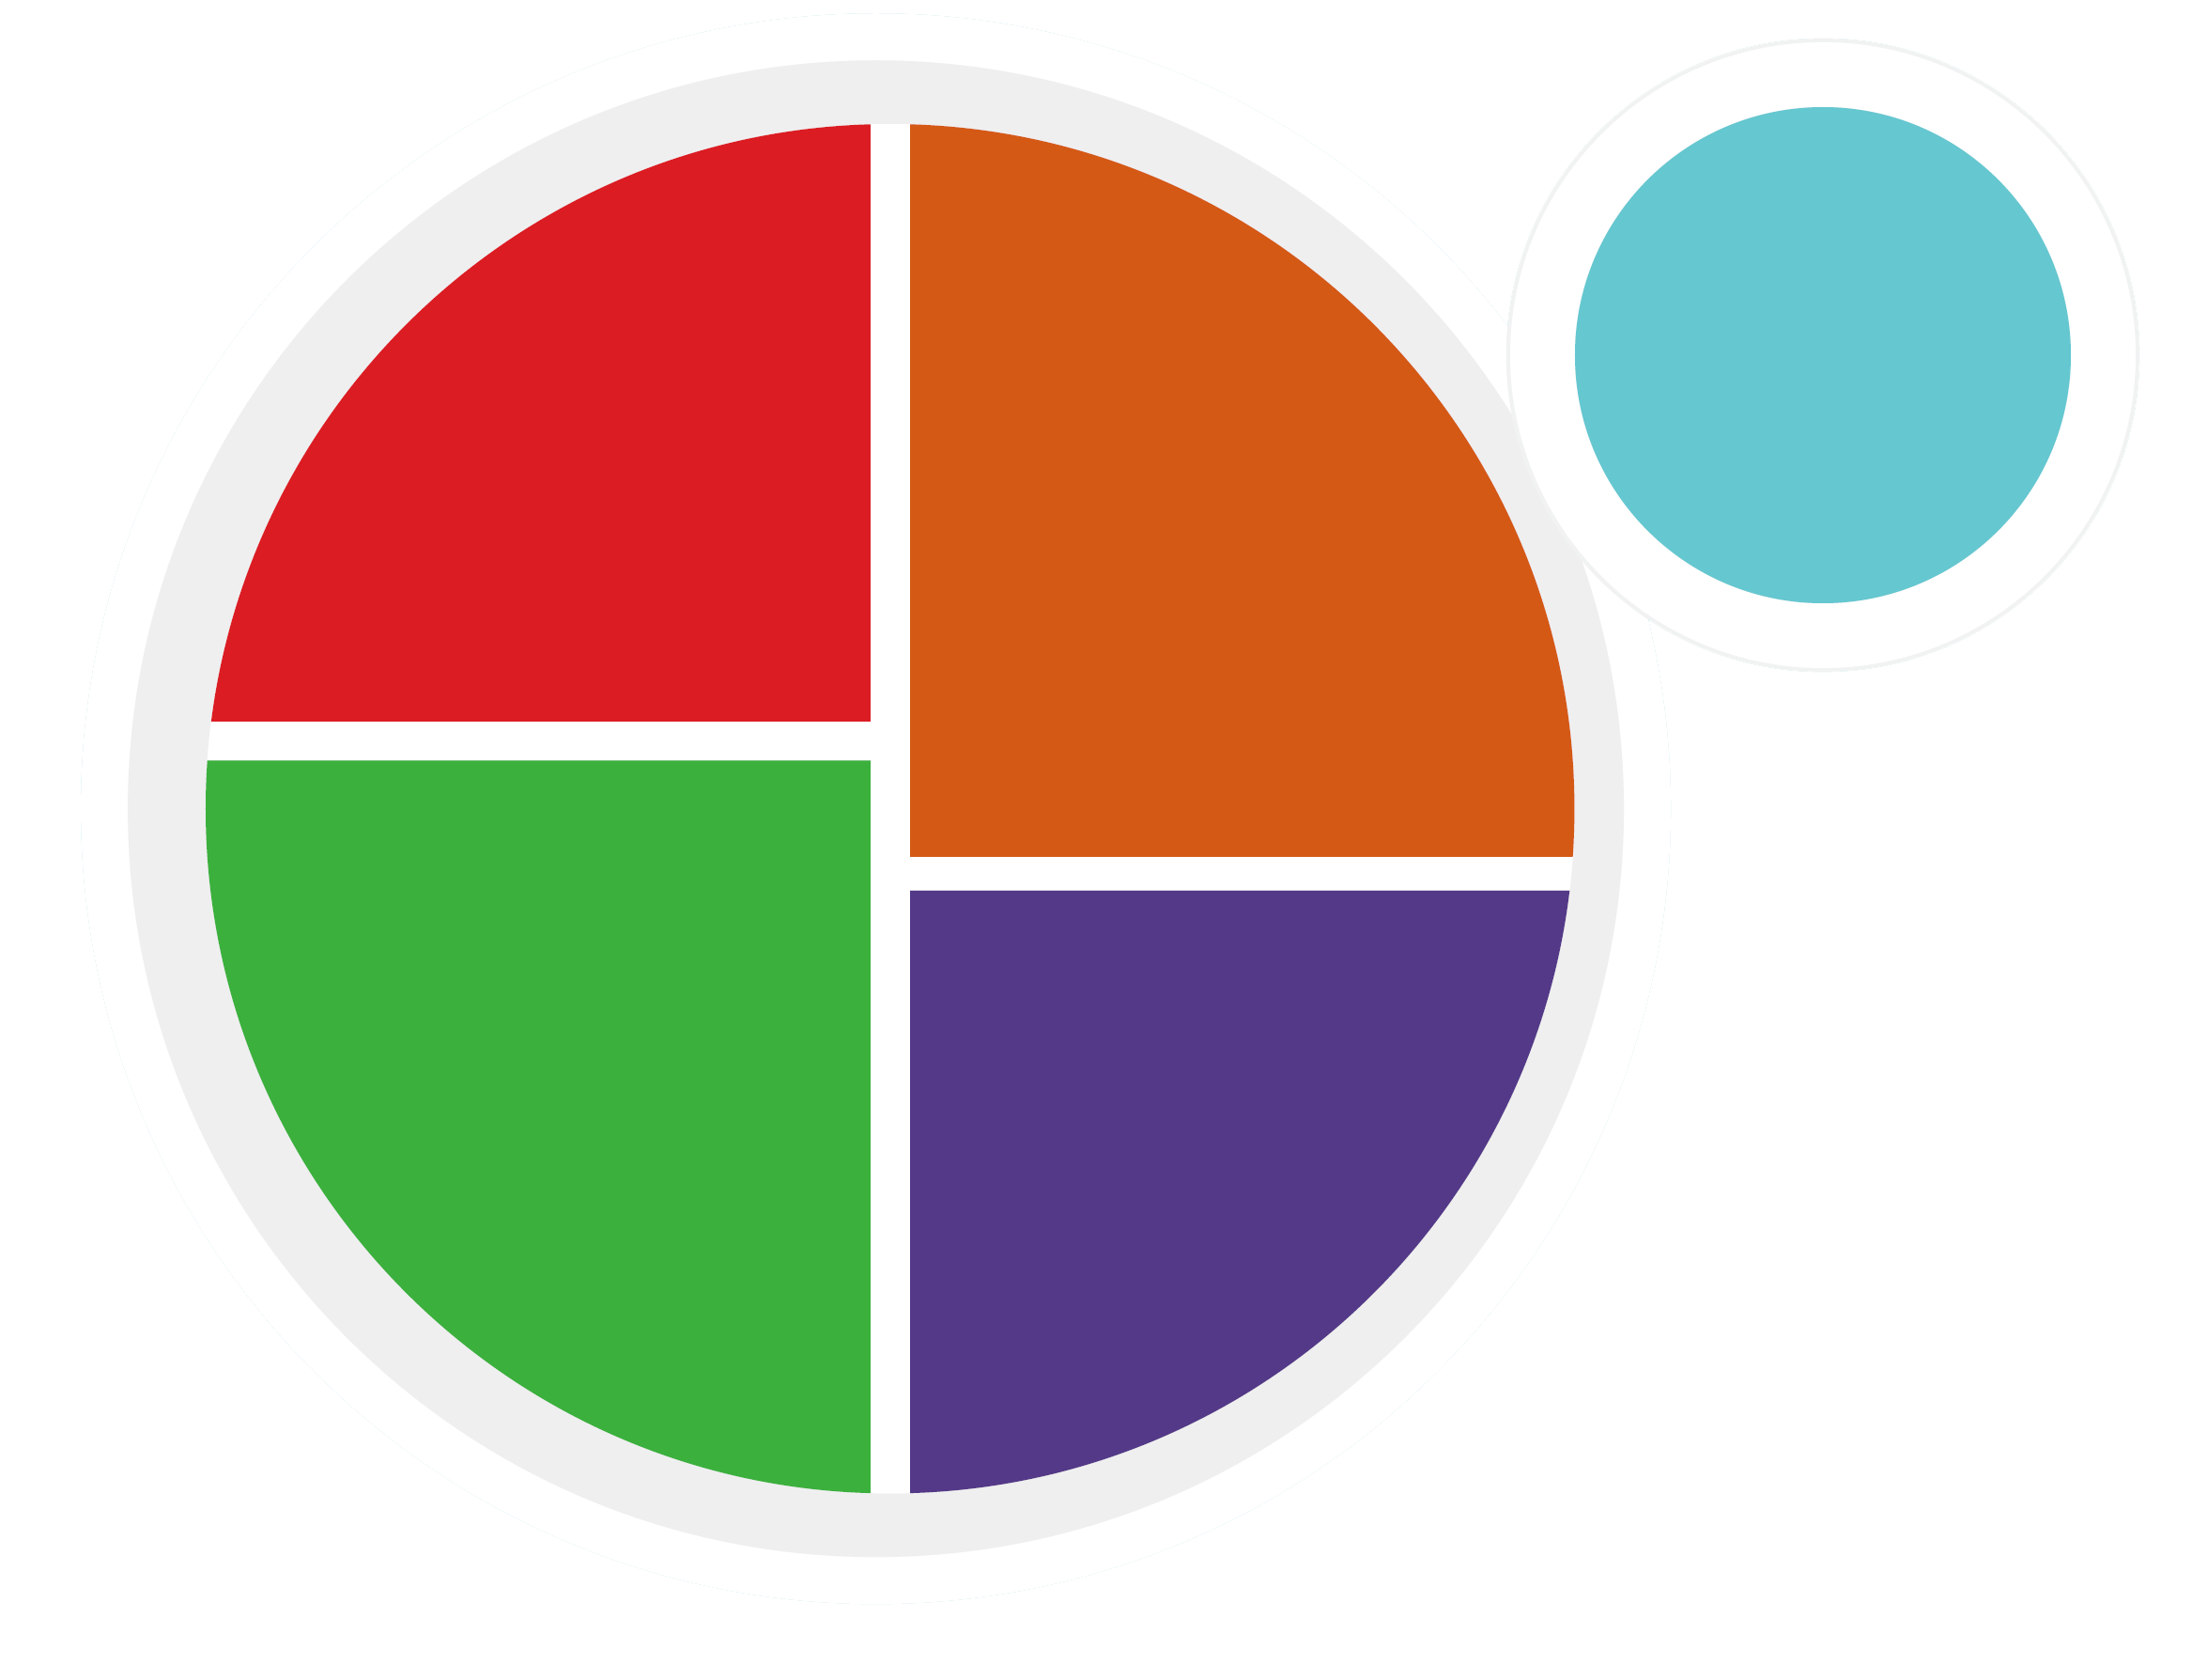
Draw your own MyPlate, and draw everything you ate yesterday in that section of the plate.

Slide 8
How much do we know about recommended daily nutrition? Write your best guesses down on a piece of paper.
How many cups of vegetables do you think are recommended each day?
How many cups of fruit?
How many ounces of grains?
(at least ½ should be whole grain!)
How many ounces of protein?
How many cups of dairy?
How many teaspoons of oil?

Slide 9
Check your answers! How close were you?
How many cups of vegetables do you think are recommended each day? 2.5
How many cups of fruit? 1.5
How many ounces of grains? 5 to 6
How many ounces of protein? 5
How many cups of dairy? 3
How many teaspoons of oil? 5
These are approximate, everyone is different! Talk to your doctor about specific recommendations for you!

Slide 10
Now - in looking at your own My Plate Drawing, how close was yesterday’s menu to the recommended healthy daily plate?

Slide 11


Step 2: Find out how what you eat can impacts your health.
Let’s Discuss...
Why do you think water is important for health?
How much water do you think you need a day?
How do you think a lack of water could impact your skin?
What percent of your body is water?

Slide 12
The facts...
Why do you think that water is important for health?
It helps in almost everything, like circulation, digestion, absorbing nutrients, excreting toxins, and more!
How much water do you think you need a day?
6 to 8 cups. How much do you drink?
How do you think a lack of water could impact your skin?
It would get dry, flaky, or chapped!
What percent of your body is water?
About 60%. Your brain and heart are over 70% water!

Slide 13

Now - let’s make our water more exciting!

Slide 14
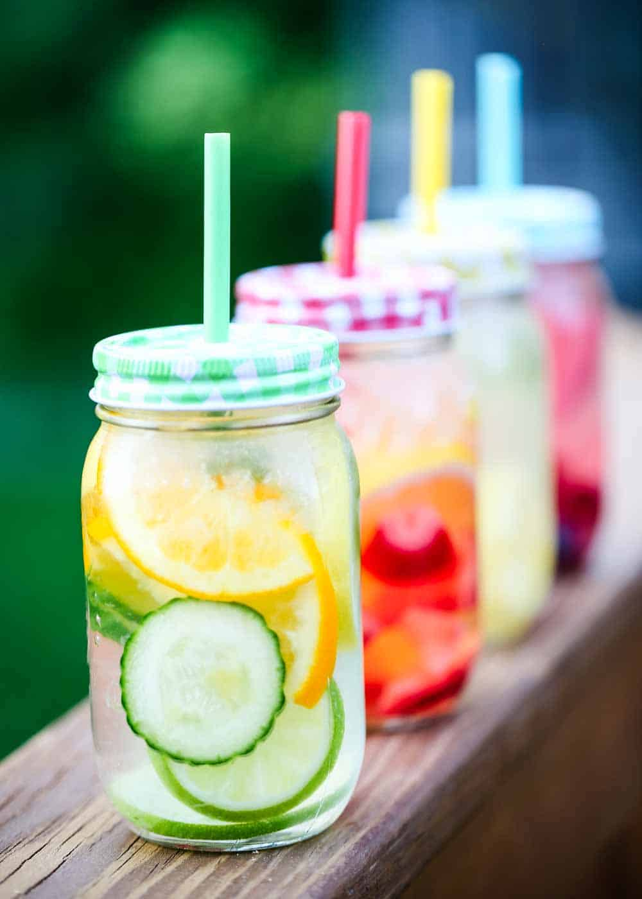
Master Chef… water edition!
Fill your container with some ice, and your your choice of the ingredients you brought. Now, fill it with water and seal it. What was your recipe? Let it seep for a while. In about 15 minutes, you can open it up and sample. What do you think? Could this convince you to drink more water?

Slide 15
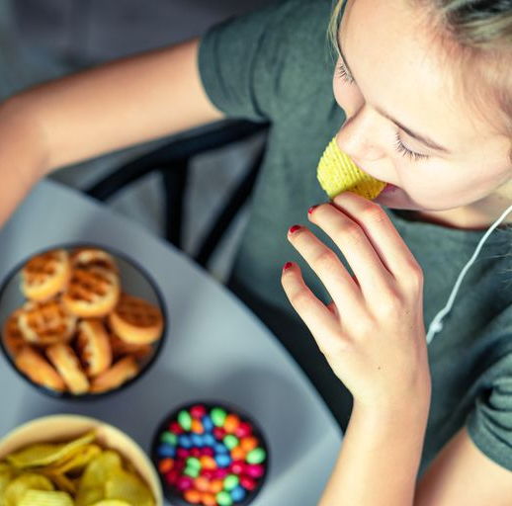
Step 3: Learn how diet impacts your stress level.
When you feel stressed out, what are the foods you eat most?

Slide 16
It’s a vicious cycle!
Did you know that sugar and caffeine increase stress levels?
And, when your stress level goes up, the hormone cortisol goes up, and makes you crave sugar and caffeine! Sometimes, it is hard to identify what foods have a lot of sugar so you know what to avoid.

Slide 17

Let’s play
Your troop leader will hold up groups of 4 packaged food items. Let’s try to put them in order from least sugar to most.
How did your troop do? What were the biggest surprises?

Slide 18

Step 4: Investigate how what you eat affects your sleep.
Do you usually have a bedtime snack before bed? What are your favorites?
Have you ever noticed that what you ate before bed impacted your sleep?
Do you think that food can cause bad dreams?

Slide 19
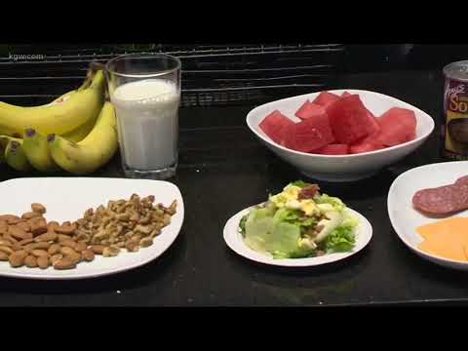

Slide 20
Let’s make a list of foods that you like to eat that would make good night time snacks, and wouldn’t interrupt your sleep.
How many can we come up with?

Slide 21

Step 5: Think about how food impacts your energy levels. Snacks with protein and nutrients will make you feel more energized!
Let’s make a high-energy, no bake treat!
Notes:
*Is your troop running short on time? Go through the recipe, and have the girls make these for their family after the meeting!

Slide 22
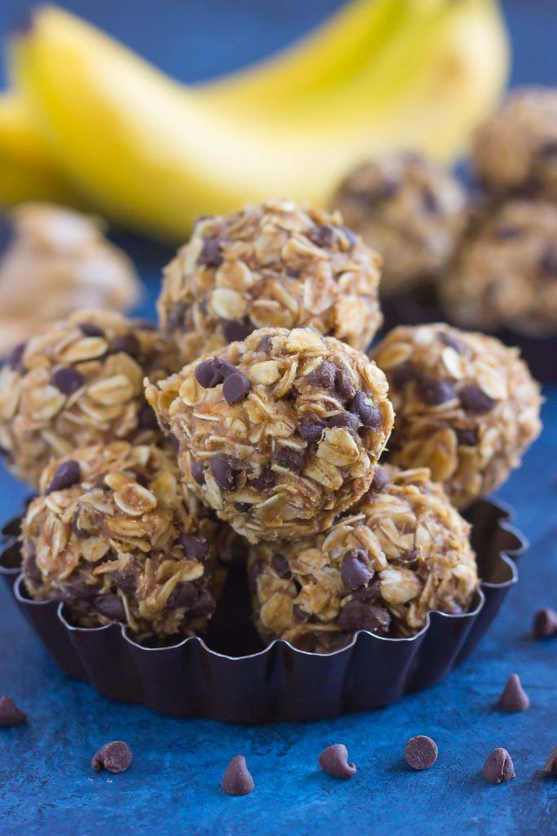
Peanut Butter and Banana Energy Bites
Ingredients
1 ripe banana (1/3 cup mashed)
1/4 cup honey
1/4 cup peanut butter (or, any nut butter you prefer)
1 3/4 cups oatmeal (not instant)
1/2 cup chocolate chips (miniatures work best. Raisins could be substituted)
Steps:
Peel banana and mash it until it is smooth.
Mix in honey,peanut butter, oatmeal and chocolate chips to the banana and stir everything together.
Refrigerate the mixture for about for 30 minutes.
Roll the dough into bite size balls
Refrigerate any energy bites that won’t be eaten right away.

Slide 23
Congrats!
You have earned the Eating for You Badge!
Eat healthier to feel better, sleep better, and have lots of energy!

