Slide 1
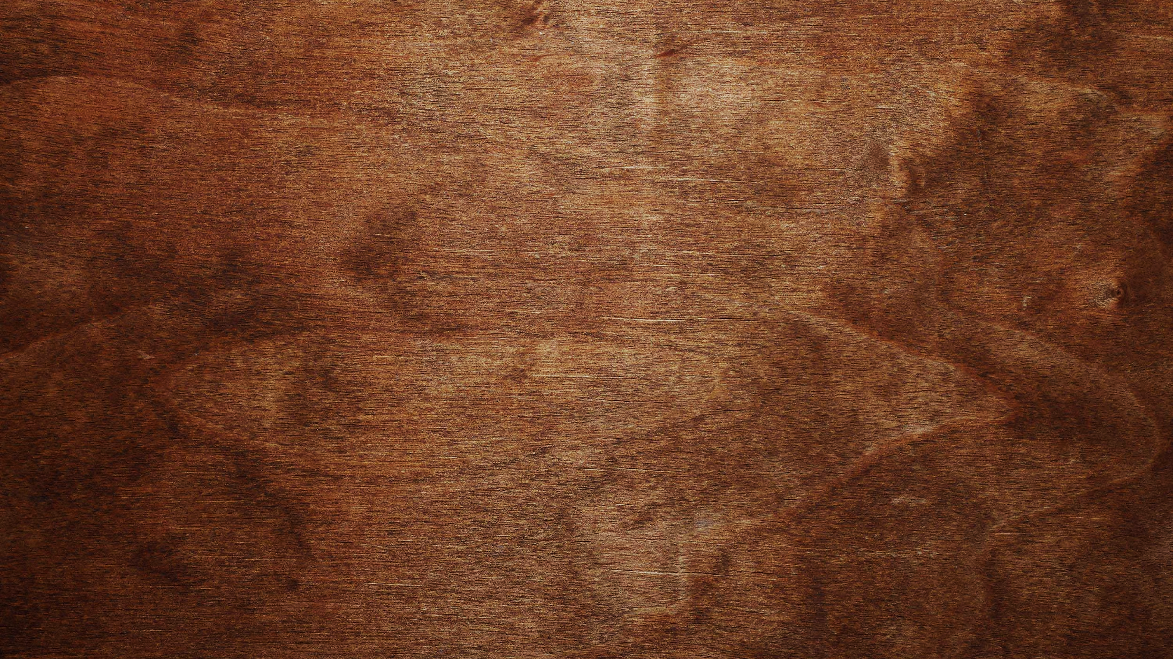

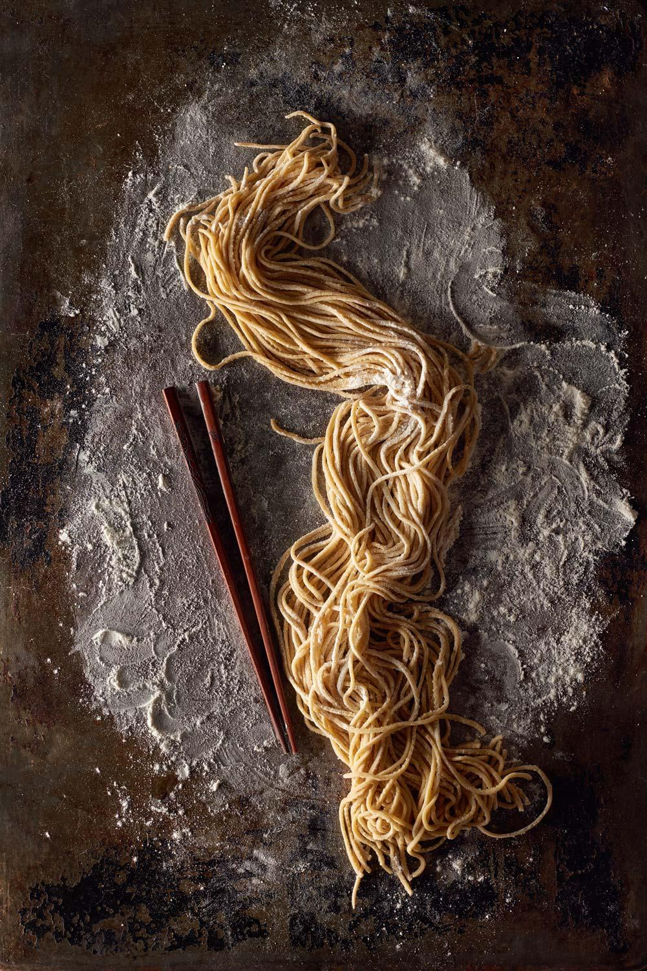
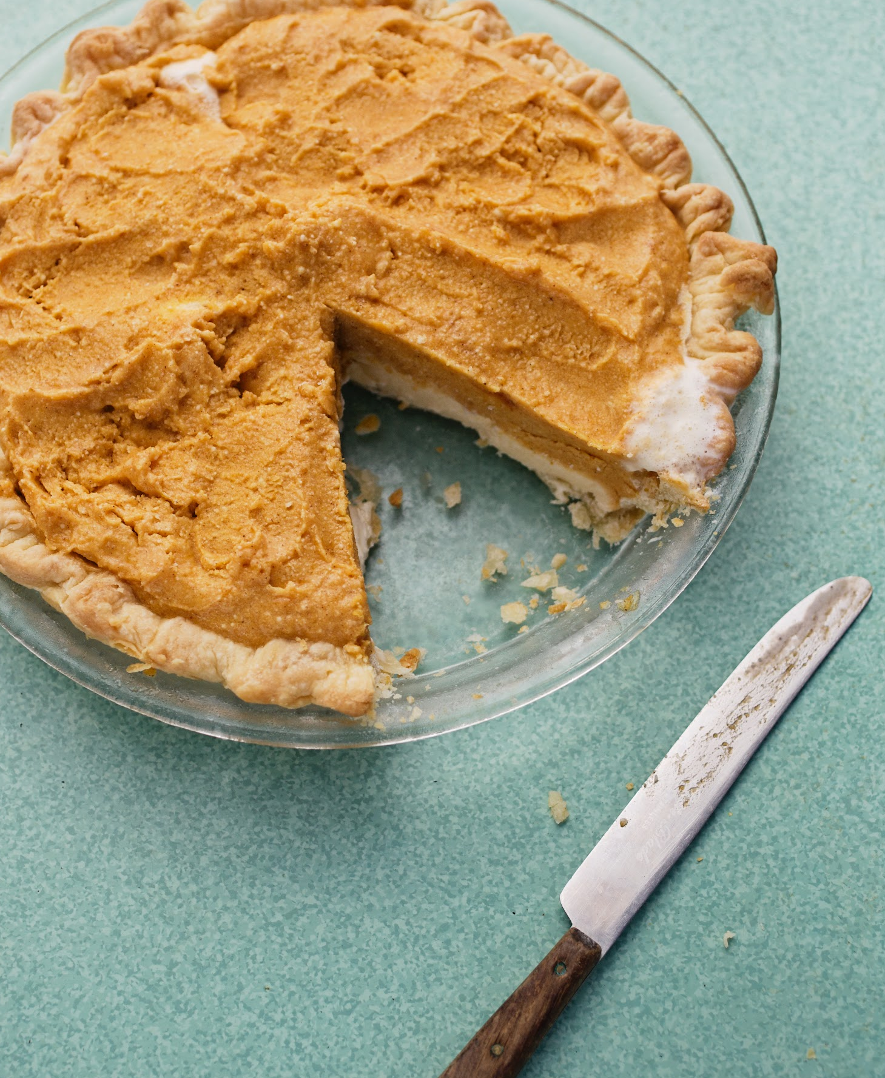
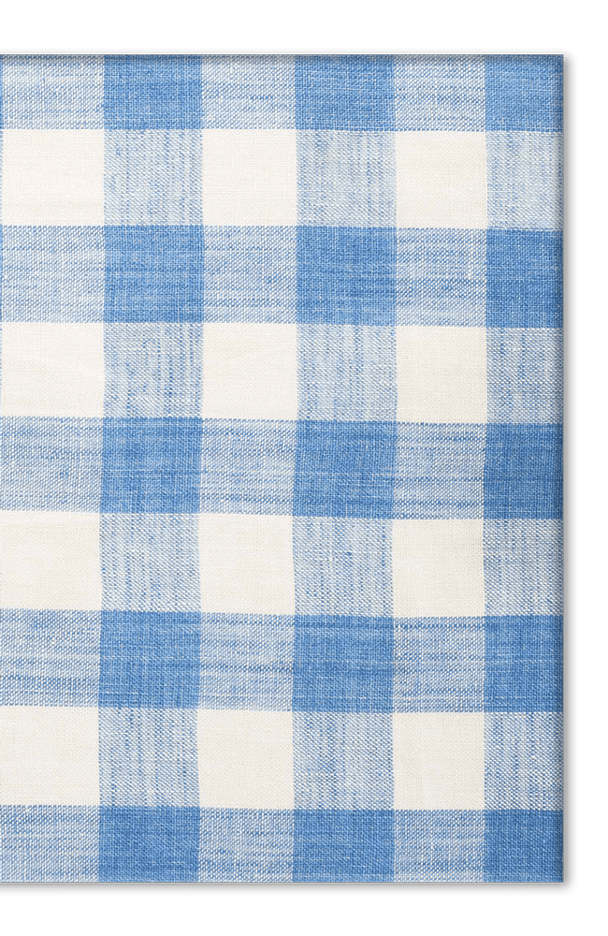
Eating for You
Girl Scouts
of Central Illinois

Slide 2
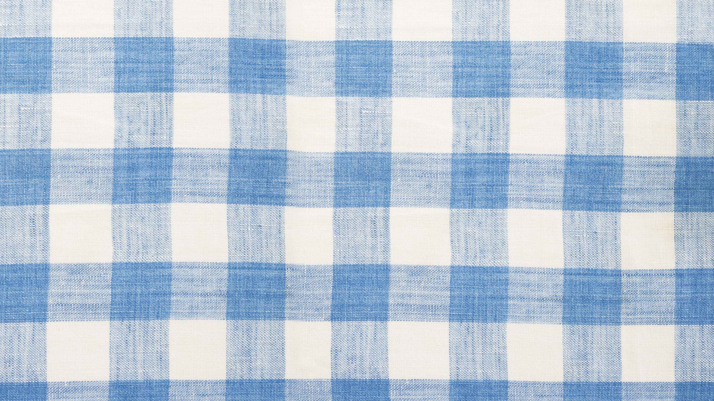
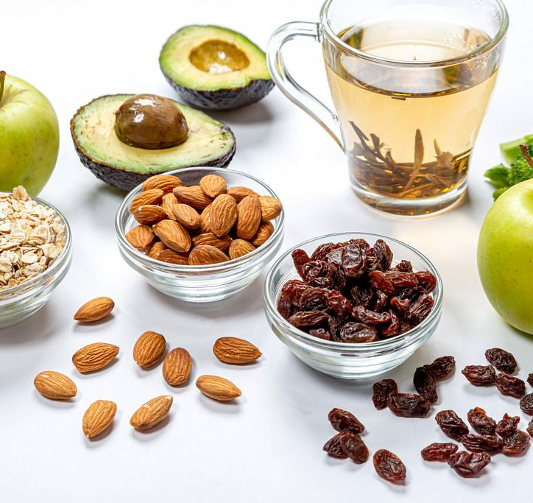

Nutrition isn’t just about maintaining a healthy weight. Eating well helps your body inside and out. Choosing the right foods can help you sleep better, stress less, get smooth skin, shiny hair, and strong nails.
In this badge, you will find out how to eat to keep your skin glowing, your mind focused, and your energy flowing.

Slide 3
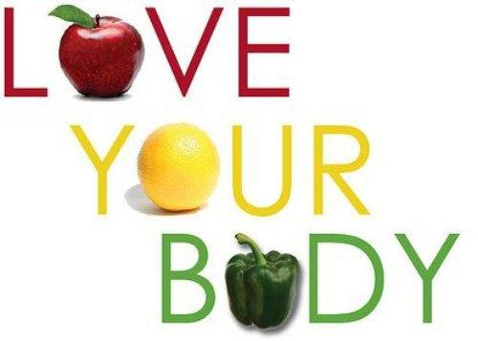
Step One:
Know how good nutrition helps your body stay healthy

Slide 4
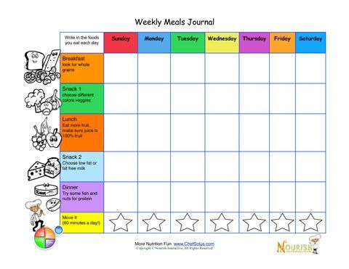
Step One:
Using a meal journal, track your meals and snacks for one week. Then, evaluate how many foods in each color/category you consumed.
Click on this link to play interactive games and conduct further research!
https://www.nal.usda.gov/fnic/interactive-playground

Slide 5
Step Two:
Find out how what you eat affects your skin

Slide 6
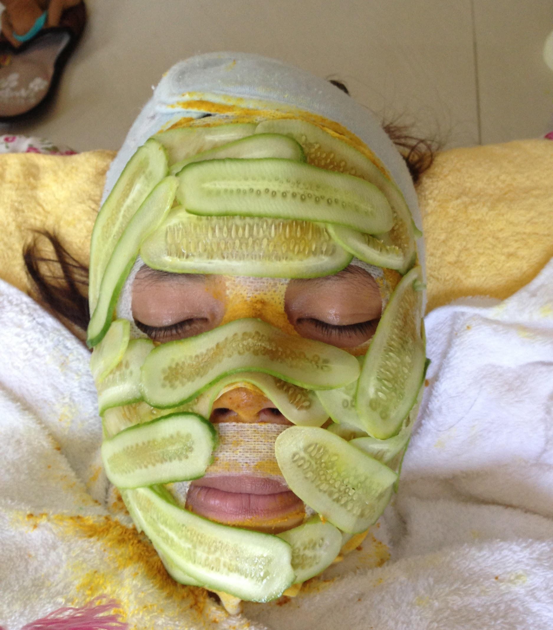
Step Two:
Create a DIY daily intake water bottle to track how much water you drink!
Click to the next slide for two helpful videos!

Slide 7

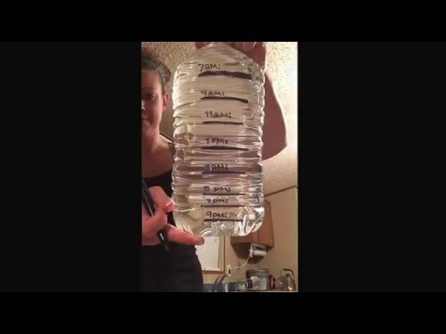

Check out this tutorial and testimonial!

Slide 8
Step Three:
Explore how your diet affects your stress level

Slide 9

Step Three:
Research the food additives and chemicals that can cause stress and anxiety.
Then, check out the labels on the food in your kitchen and see if you find any matches. Educate your family on your findings!
www.today.com/health/what-causes-anxiety

Slide 10
Step Four:
Investigate how what you eat affects your sleep

Slide 11

Watch and learn how food relates to your sleep!

Slide 12
Step Five:
Look at how your diet affects your energy

Slide 13

Step Five:
Take a poll of friends and family. Ask them five questions about when they feel most energetic and how it seems to relate to what and when they've eaten. Now ask yourself the same questions. What conclusions or advice can you draw?

Slide 14

Congratulations!
You’ve earned the Eating for You Badge!

