Slide 1


Leader Instructions & Meeting Prep:
Cadette Comparison Shopping Badge
Cadette Comparison Shopping: :Badge meeting plan supply list::
With a parent or guardian review the Girl Scout Internet Safety Pledge: https://www.girlscouts.org/en/help/help/internet-safety-pledge.html
Notebook or paper
Pencil
Calculator (if you want)
The following slides will walk your troop through a virtual meeting to earn the Cadette Comparison Shopping Badge. When you share your screen during your meeting, be sure to click “Present” so girls see the full screen. Also, when you are sharing your screen in zoom, google meet, or another meeting app, please make sure you are sharing both picture and audio. For more information on using Zoom, visit gsnw.gl/VirtualMeetingHowTo
Many of the interactive activities included are shared through YouTube videos. Just click on the arrow in the center of the image to play the video, and the girls can see it too! You should try to review the slides before your meeting if possible, so you are familiar with the activities and any supplies needed.
This meeting will typically take approximately 60-90 minutes as written, depending on participation level and number of girls. As always, Girl Scouting is flexible, and troops may select the activities interest them most, add their own activities, or have girls do some of the steps afterward as “homework”.
When you send out your meeting invitation, be sure to let girls and parents know what supplies they should have on hand for the online troop meeting. They are things most girls likely have at home.

Slide 2


COMPARISON
SHOPPING
Cadette .
Brought to you by Girl Scouts of the Northwestern Great Lakes

Slide 3

Let’s start with the Girl Scout Promise

Slide 4

Icebreaker: .
You have just won the big million dollar jackpot lottery!!! Congratulations!
What is one thing you would do with that money?
(FYI, your leader would like a little something!)

Slide 5
Comparison Shopping Badgework
Learn to comparison shop
Find out how to use online reviews
Check out the fine print
Investigate how to avoid online fraud
Know how to manage your online shopping
You can buy just about anything online today. Even if you end up buying an item in a physical store, you might take to the internet to comparison shop anyway. Today you will learn how to find a fair price, quality item, and not fall victim to fraud.

Slide 6

Comparison Shopping Badgework
Before we begin, did you and your parent or guardian
go through the criteria of the Girl Scout Internet Safety Pledge?
https://www.girlscouts.org/en/help/help/internet-safety-pledge.html
It is important when surfing the net for your latest treasures that you ensure your safety online!

Slide 7
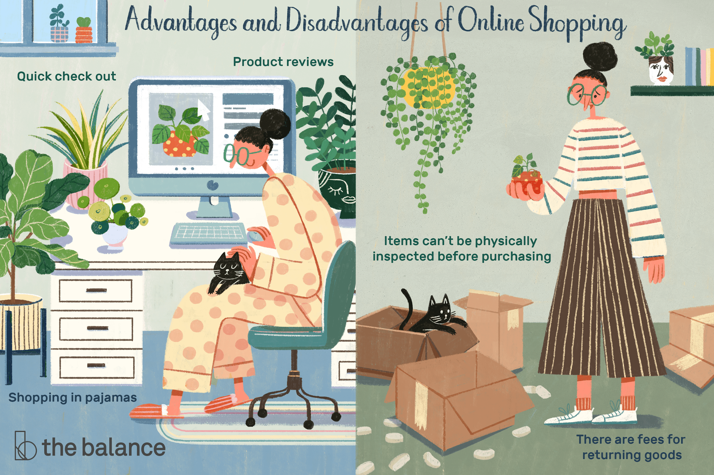
Learn to Comparison Shop
The possibilities are endless when shopping online today! It is essentially the world’s mall. You can find just about anything you need or desire online at store fronts like Amazon, Walmart, Target, Ebay, and even Etsy to name just a handful. But is it better to shop online?

Slide 8

Learn to Comparison Shop:
Do you have any online horror stories to share? Did you or a parent buy you some clothing that arrived looking like it might fit your infant sister? Or perhaps you saved up to buy the latest Airpods and a friend found them for less at a local store?
Did you list any of these?
Variety
Better Prices/Price Comparison
No Crowds
Easy to Find Anything
No Annoying Salesperson
Easy to Send as Gifts
Did you list any of these?
Too much Packaging
Wait for Shipping
Fraud
Hard to Return
Too Much Time Online
Unsure of Store Owner (Preference to shop local)
No Sales Assistance
Not Sure of Quality or Fit
List some Advantages of Shopping Online:
List some Disadvantages of Shopping Online:

Slide 9

Learn to Comparison Shop
Alright...who’s ready
for a game of...

Slide 10
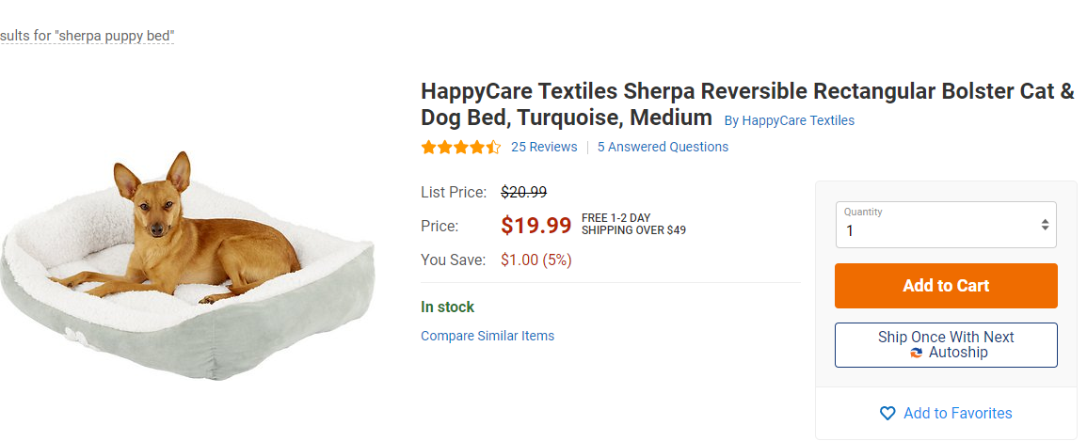

Learn to Comparison Shop .
Let’s pretend we just got a new puppy, and we need to purchase all the supplies for little Bowser. We have $90 to spend...so choose wisely!
First, he will need somewhere to sleep, and I know my puppies like their sherpa beds, so I did a Google search to find a few suppliers:

Slide 11

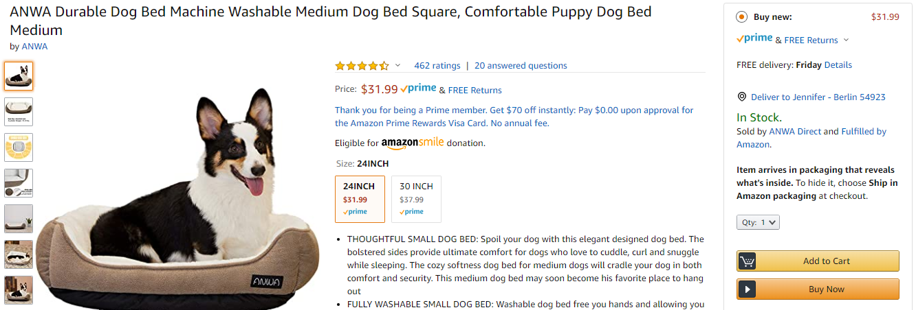
Learn to Comparison Shop .
Let’s pretend we just got a new puppy, and we need to purchase all the supplies for little Bowser. We have $90 to spend...so choose wisely!
First, he will need somewhere to sleep, and I know my puppies like their sherpa beds, so I did a Google search to find a few suppliers:

Slide 12

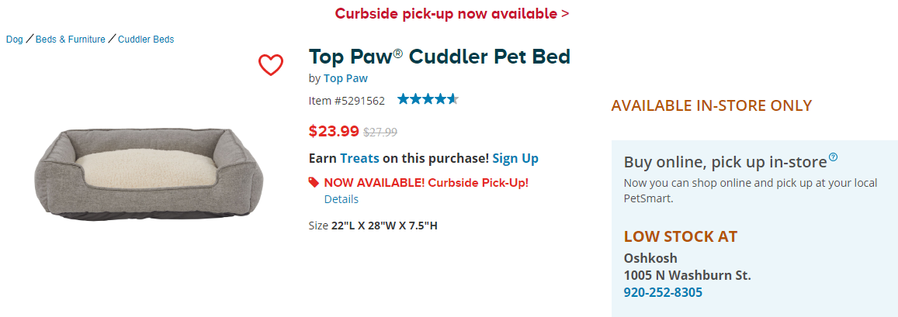
Learn to Comparison Shop .
Let’s pretend we just got a new puppy, and we need to purchase all the supplies for little Bowser. We have $90 to spend...so choose wisely!
First, he will need somewhere to sleep, and I know my puppies like their sherpa beds, so I did a Google search to find a few suppliers:

Slide 13

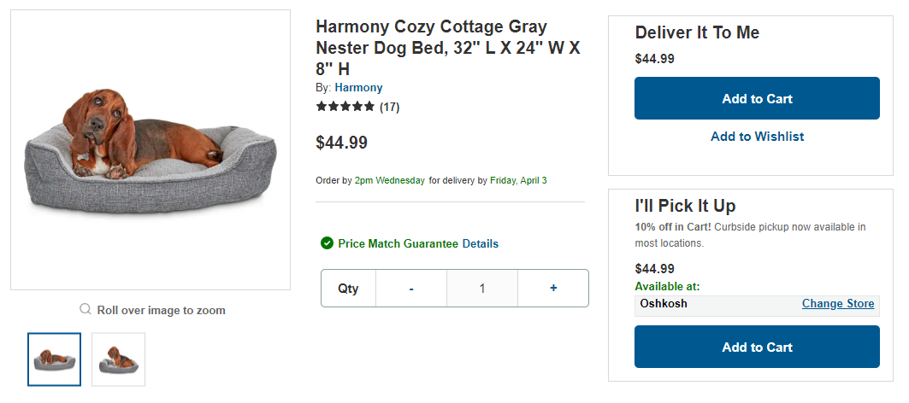
Learn to Comparison Shop .
Let’s pretend we just got a new puppy, and we need to purchase all the supplies for little Bowser. We have $90 to spend...so choose wisely!
First, he will need somewhere to sleep, and I know my puppies like their sherpa beds, so I did a Google search to find a few suppliers:

Slide 14

Learn to Comparison Shop .
Did you notice how most of those website offerings looked pretty similar. But there are differences that are important to notice when shopping online.
Here is our comparison of important criteria we should look at when comparing products online: price, shipping charge, size, user reviews, features
$19.99 | $31.99 | $23.99 | $44.99
+Shipping $4.95 | Free Shipping | Pick Up at Store | Free Shipping
25”x21”x4” | 24”x22”x6” | 28”x22”x7.5” | 32”x24”x8”
4 ½ stars (25 reviews) | 4 ½ stars (460 reviews) | 4 ½ stars (7 reviews) | 5 stars (17 reviews)
Machine Washable, Corduroy, Sherpa, Faux Suede | Machine Washable, Poly Sherpa | Machine Washable, Poly Sherpa | Machine Washable, Poly Sherpa
Which bed would you choose for Bowser? Write down your price (plus shipping) on your notepad.

Slide 15
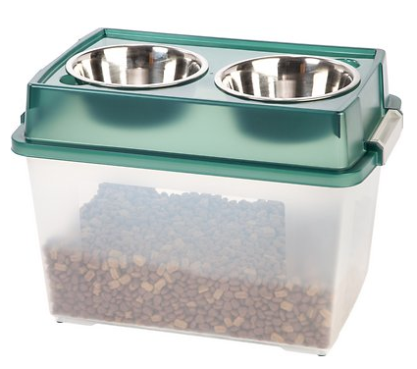
Learn to Comparison Shop .
Alright...Bowser is one hungry puppy, let’s talk about dog bowls.
I am going to select one that provides storage as well, just to make it practical.
$16.99 | $16.99 | $23.99 | $89.99
+Shipping $4.95 | Free Shipping | +Shipping $4.95 | Free Shipping
21”x14”x15” | 21”x14”x15” | 21”x14”x15” | 20”x14”x12”
4 ½ stars (215 reviews) | 4 ½ stars (2,832 reviews) | 4 ½ stars (8 reviews) | 2 stars (1 reviews)
Removable steel bowls | Removable steel bowls | Removable steel bowls | Removable steel bowls but this piece was wood
Which bowl would you choose for Bowser? Write down your price (plus shipping) on your notepad.

Slide 16
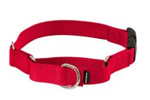
Learn to Comparison Shop .
Next up, little Bowser is going to need to go on a few walks. Let’s pick him out a leash and collar. To do a good comparison we will choose nylon 6 foot leashes and martingale collars.
$6.99 + $6.20 | $8.99 + 6.99 | $15.99 + $9.99 | $14.99 + $22.49
+Shipping $4.95 | Free Shipping | +Shipping $4.95 | Free Shipping
6ft and 1” wide | 6ft and 1” wide | 6ft and 1” wide | 6ft and 1” wide
4 ½ stars (728 reviews) | 4 stars (2,033 reviews) | 4 ¼ stars (6 reviews) | 5 stars (24 reviews)
Nylon, metal clip and plastic quick snap, multiple colors | Nylon, metal clip and plastic quick snap, multiple colors | Nylon, metal clip and plastic quick snap, multiple colors | Nylon, metal clip and plastic quick snap, multiple colors
Which leash and collar set would you choose for Bowser?
Write down your price (plus shipping) on your notepad.

Slide 17
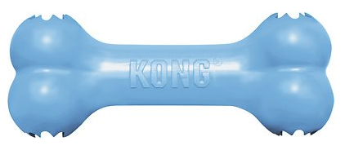
Learn to Comparison Shop .
Bowser is a chewer!!! UGH, we need to make him stop chewing on his new bed and our furniture, so we are going to get him an indestructible Kong dog bone.
$6.99 | $6.99 | $10.99 | $6.99
+Shipping $4.95 | Free Shipping | Pick Up at Store | Pick Up at Store
5” x 1.25” | 5” x 1.25” | 5” x 1.25” | 5” x 1.25”
4 stars (308 reviews) | 4 ½ stars (470 reviews) | 3 ½ stars (9 reviews) | 4 ½ stars (41 reviews)
Soft Rubber, Interactive-hides treats | Soft Rubber, Interactive-hides treats | Soft Rubber, Interactive-hides treats | Soft Rubber, Interactive-hides treats
Which toy would you choose for Bowser? Choose wisely...these are identical!
Write down your prices (plus shipping) on your notepad.

Slide 18

Learn to Comparison Shop .
High 5!
Alright...we have all the items that Bowser needed. This is how I fared...did you do as well? I chose the more expensive dog bed...but it was also bigger. Bowser is going to grow, so this will last longer. Most of the other items were simply based on price and shipping charges.
 | Bed | $44.99
 | Dishes | $16.99
 | Leash/Collar | $15.98
 | Toy | $6.99
 | Total | $84.95
I was below the $90 budget.
Give yourself a high 5 if you were too!

Slide 19

Learn to Comparison Shop .
So what did you learn? When we shop online we need to really pay attention to price, shipping, quality, even size and quantity will matter. Often times you might be purchasing something like a new perfume or your favorite body soap online, and when it ships the bottle is much smaller than it appears. Or even in the example I did here, the dog dishes I had selected, came in 3 different sizes, but on some of the sites I used, the Medium cost $4 more than the Large. So you just cannot be thorough enough! Do your research, put things in your cart for later, and check other sellers, read your reviews!
So...now for just a little homework on your own: Think of one thing you really would like that you could spend your own savings or allowance on: maybe some AirPods you have been wanting, a new bike, a DVD of a recent release, or something cute for your room like a fluffy bean bag. Now go online to 3-4 different websites and try to find the best value (not the best price...the best quality and price combined)!

Slide 20


Learn to Comparison Shop .
Take a few minutes to do your homework. Don’t actually buy anything!!!
You have about 5 minutes, just as long as these videos for background noise!

Slide 21
Anyone want to share the surprising deals they found?
Anyone find an amazing deal?

Slide 22
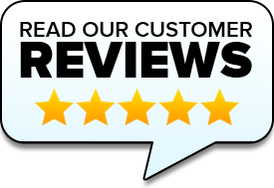
Find Out How to Use Online Reviews.
So, did anyone notice on the items we bought for Bowser, how the online reviews were sometimes super low?
Or sometimes there were thousands of reviews at one shop and at other shops there might have only been a handful of reviews?
Stores know that their consumer is their biggest advertisement for their product. Have you ever bought something and received that email to go back to the website and place a review? Those are important to drive up sales.
It is important to read and understand those reviews to assist you on your purchases.
On the next page we will look at some fun reviews that we found online.

Slide 23
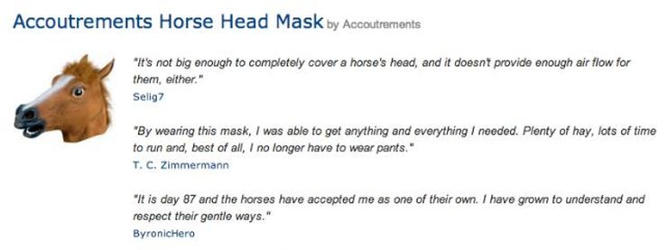
Find Out How to Use Online Reviews. .

Slide 24
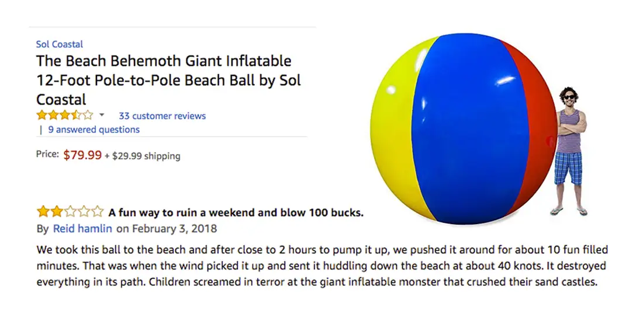
Find Out How to Use Online Reviews. .

Slide 25
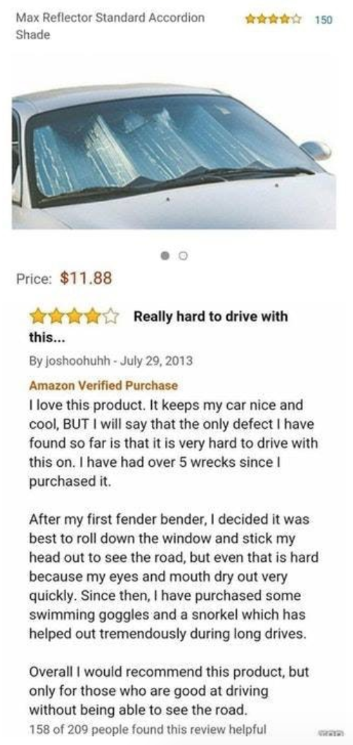
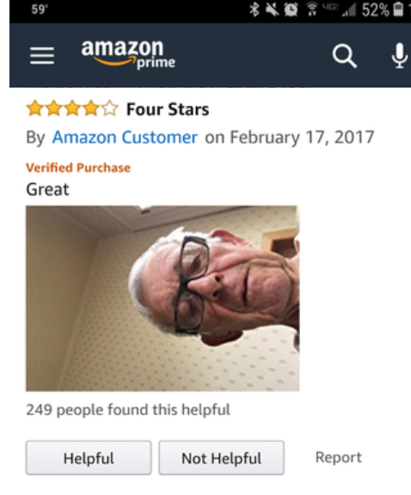
Find Out How to Use Online Reviews.

Slide 26
How many of these reviews were useful? None!
Sure they were funny, but it’s important to read the reviews.
If there are a lot, read the ones that give the product 5 stars and why, and read the ones that gave the product low stars. It’s also important to look at those dates and see if it might be an old problem that the manufacturer fixed. And sometimes the manufacturer or seller will also respond and let the customer know that they will offer a refund.
In short, the customer reviews will help you determine if a product is quality, what the fit might be like, and if it is worth the money..

Slide 27

Check Out the Fine Print!
We looked at a little bit of this online purchase fine print while doing our quick comparison shop on Bowser’s puppy items. The fine print online can often be a little less obvious when you are making a purchase. Often you have to get that item into your shopping cart, enter in your personal information, and almost be ready to click on Order Now before you realize shipping and handling costs have been added, there is sales tax on this item, and this company does not allow returns. So more than ever you need to weight out the benefits of online shopping versus picking up that item at the store.

Slide 28





Check Out the Fine Print
Another thing that you might not be aware of is how both in store and online, those stores are working to boost their sales without you even being aware! Let’s watch a couple of videos that clue us into things we might never have even considered when shopping.

Slide 29
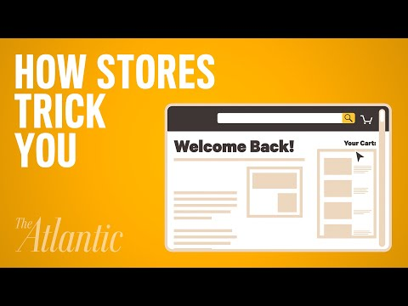
Check Out the Fine Print
So after watching these videos...what things have you fallen for?
Do you know any other tricks that retailers or online stores use?

Slide 30
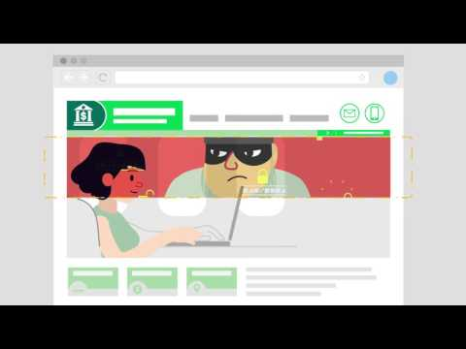
Investigation How to Avoid Online Fraud
Most online sites are safe and secure, and they need to ensure and maintain that to keep their shoppers trust and guarantee they will come back again and again. But how can you protect your own credit and be aware of potential scams?
Let’s watch a video that helps us be more aware of things to look for:

Slide 31

Investigation How to Avoid Online Fraud
Watch for the padlock on your browser bar, and the address should be legit. https (with S standing for secure is one clue!)
What are some ways to tell if a website it secure?

Slide 32
Investigation How to Avoid Online Fraud .
What personal information should you NEVER give out?
Phone #?
Full name?
Address?
Date of birth?
Social Security #?
Credit Card # info?
Bank Account info?

Slide 33
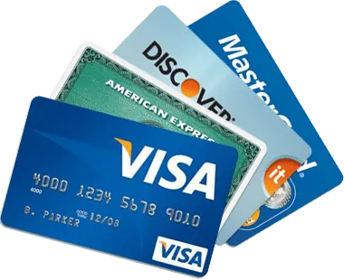




Investigation How to Avoid Online Fraud .
What are the safest ways to pay online?
Be sure you have secure Wifi and aren’t using a public Wifi when making purchases. A network Firewall is your protection.
Mal-Ware and Anti-Virus Software will also offer protection.
Use a Credit Card, Paypal, or even store gift card to make transactions. Most of those services will provide protection after purchases and be sure again that you are seeing the padlock at the top of your browser when entering those numbers.

Slide 34
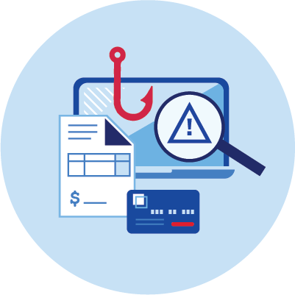
Investigation How to Avoid Online Fraud .
What can you do if you suspect online fraud?
If you believe an email isn’t legit (because the sender's address doesn’t look real, or the deal is too good to be true, or they are asking for personal information) don’t click on any links in it. Go directly to the website to check on it’s accuracy, and send that email to a junk folder.
Tell a parent or trusted adult immediately if you feel that you have fell victim to a scam. They can help you to ensure your identity remains secure and help you to process any claims with the seller or credit card companies.

Slide 35

Investigation How to Avoid Online Fraud
Another way that young people are targeted as well is through clickbait. Let’s watch a video to ensure you understand how to protect your computer...even when you really do want to find out about the “World’s Tiniest Horse”!

Slide 36
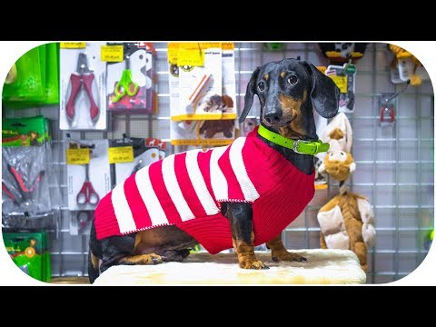
Knowing How to Manage YOUR Online Shopping
Since you don’t have to have actual dollar bills in your pocket to do online shopping, it can be a bit of a lure to buy more than you need, just to have the latest and coolest thing. So let’s watch this video and talk about how you can avoid the urge to spend!

Slide 37
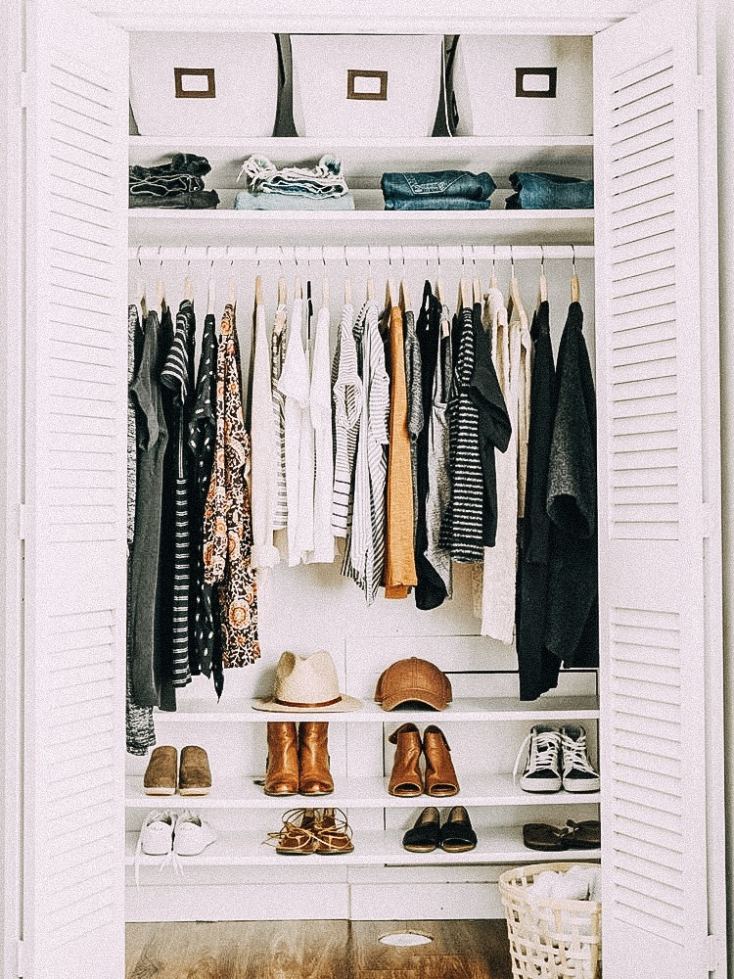
Knowing How to Manage YOUR Online Shopping
Can you think of any strategies to keep you from spending those dollars compulsively, and instead shopping more sensibly? Here are a few tips to help you out:
Take inventory of what you already own!
  For example if you already have 2 little black dresses or 3 pink sweaters, do you really need anymore?
  Or you already have a perfectly working Iphone, it might not be the most current model, but should you spend a lot of money when the one you has works for everything you need now?

Slide 38

Knowing How to Manage YOUR Online Shopping
Can you think of any strategies to keep you from spending those dollars compulsively, and instead shopping more sensibly? Here are a few tips to help you out:
Create a personal buy ban
  Set a time limit for yourself. If you have a purchase you are considering, walk away from it or put it in your cart, but don’t pull the trigger. Instead wait 30 days. In that time you can determine that you can truly live without that item or the fad is over. On the other hand you might have found that yes, that item really will make your life better.

Slide 39
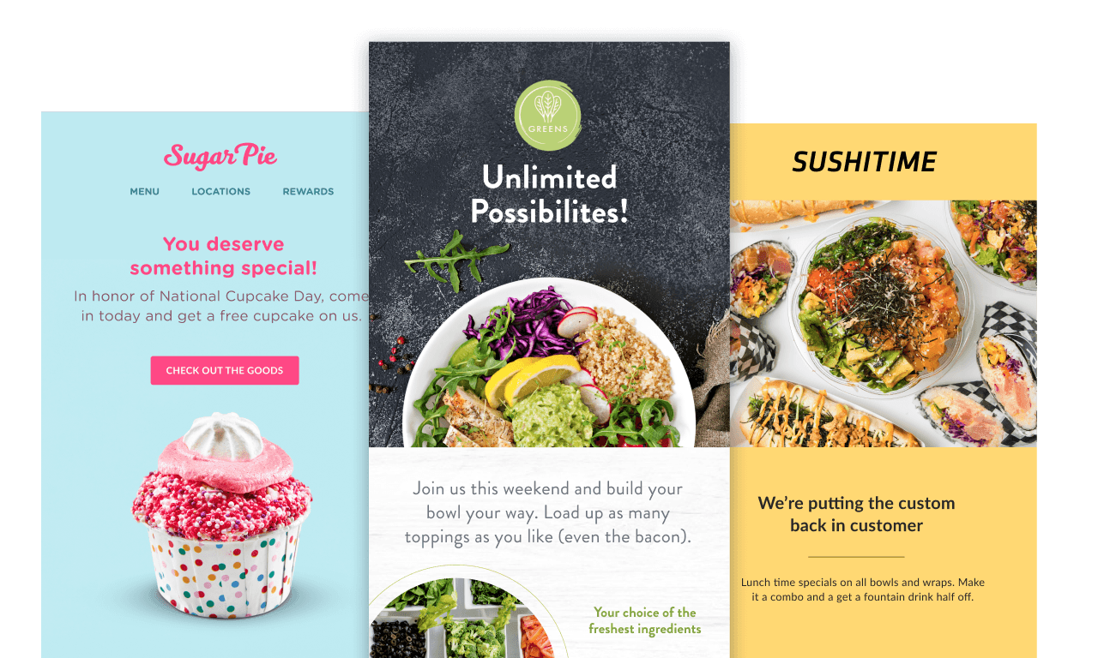
Knowing How to Manage YOUR Online Shopping
Can you think of any strategies to keep you from spending those dollars compulsively, and instead shopping more sensibly? Here are a few tips to help you out:
Unsubscribe from catalogs, magazines, emails, and newsletters.
  All of these contain advertisements and marketing ploys to get you to make a purchase every day. If you don’t see their sales or ads, you won’t be tempted to add that 4th pink sweater to your closet.

Slide 40

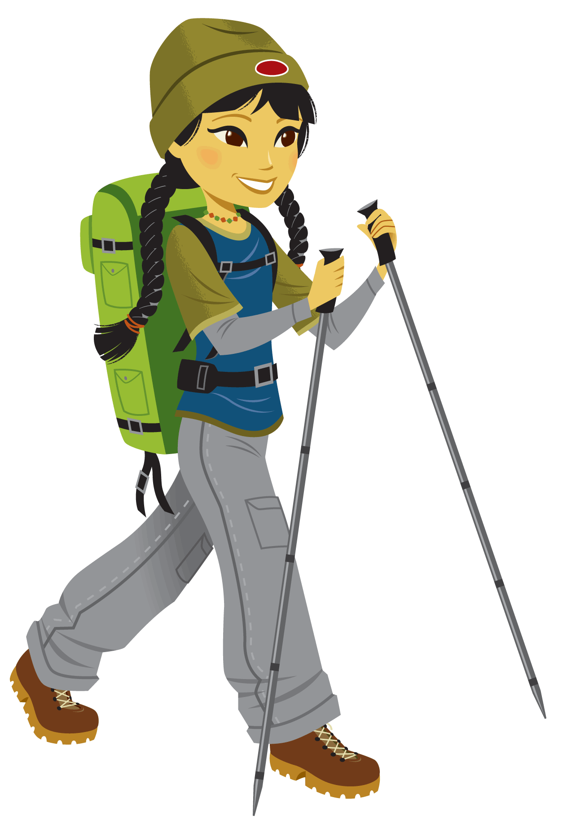
Knowing How to Manage YOUR Online Shopping
Can you think of any strategies to keep you from spending those dollars compulsively, and instead shopping more sensibly? Here are a few tips to help you out:
Socialize differently
  We all use eating and shopping as a way to spend time with friends...but why? Explore other ideas, for example next time a friend says “let’s get together” suggest going on a nature walk or trying out a new art or yoga class you wanted to check out.

Slide 41
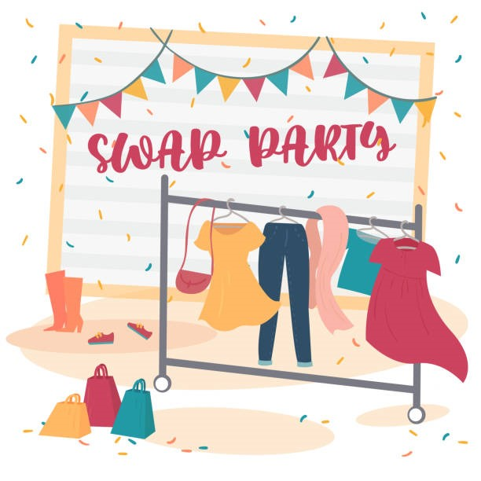
Knowing How to Manage YOUR Online Shopping
Can you think of any strategies to keep you from spending those dollars compulsively, and instead shopping more sensibly? Here are a few tips to help you out:
Set up a swap with friends
  You all want the latest trends, and how often do you see your friends wearing the same shirt or leggings you already have. So why not go through each other’s closets and trade a backpack for a leather jacket or a pair of boots you don’t wear often for a different pair of jeans or a book you wanted?

Slide 42

Knowing How to Manage YOUR Online Shopping
Can you think of any strategies to keep you from spending those dollars compulsively, and instead shopping more sensibly? Here are a few tips to help you out:
Finally, and most importantly, ignore sales!
  Use this tactic, even if you look at the sale price, imagine that the item wasn’t on sale. Would you pay full price for that item? Be sure to try it on or read the reviews! If the top doesn’t quite fit right, doesn’t look the best on you, the color isn’t quite right, and it were the full $50 price would you still buy it? If the answer is no, you REALLY DON’T NEED IT!

Slide 43
What’s your biggest takeaway from today’s meeting?
Are there things you might do differently or things you might change because of what you learned today?

Slide 44
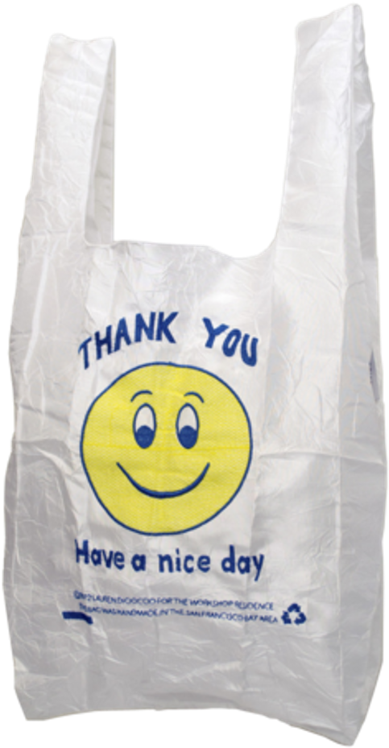
Thank You for shopping with us today!
Have a nice day!
Does anyone have any questions?
Do you want to share what you might need to shop for soon and use what you learned today?
Any suggestions for our next meeting?

