Slide 1


Leader Instructions & Meeting Prep:
Cadette Comic Artist Badge
Cadette Comic Artist Badge: :meeting plan supply list::
Paper - blank white
Notebook or sketch pad
Post It Notes
Pencil
Erasers
Fine Line Black Marker and Thicker one if you have them
Colored pencils or pastels or markers or even crayons
The following slides will walk your troop through a virtual meeting to earn the Cadette Comic Artist Badge. When you share your screen during your meeting, be sure to click “Present” so girls see the full screen. Also, when you are sharing your screen in zoom, google meet, or another meeting app, please make sure you are sharing both picture and audio. For more information on using Zoom, visit gsnw.gl/VirtualMeetingHowTo
Many of the interactive activities included are shared through YouTube videos. Just click on the arrow in the center of the image to play the video, and the girls can see it too! You should try to review the slides before your meeting if possible, so you are familiar with the activities and any supplies needed.
This meeting will typically take approximately 60-90 minutes as written, depending on participation level and number of girls. As always, Girl Scouting is flexible, and troops may select the activities interest them most, add their own activities, or have girls do some of the steps afterward as “homework”.
When you send out your meeting invitation, be sure to let girls and parents know what supplies they should have on hand for the online troop meeting. They are things most girls likely have at home.

Slide 2
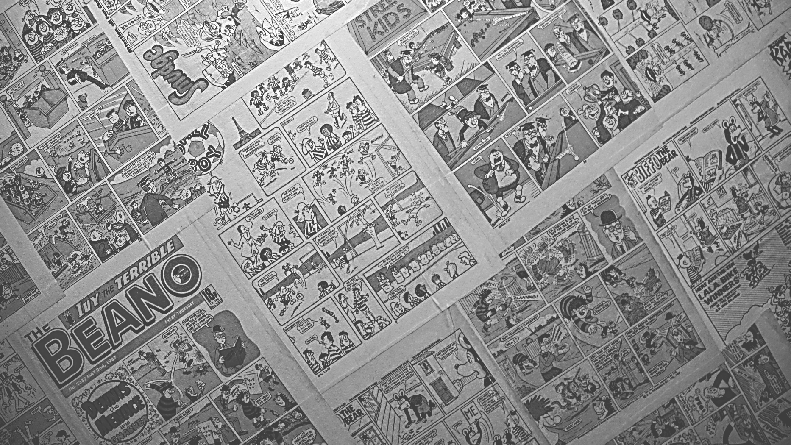




Comic
Artist
Cadette
Brought to you by Girl Scouts of the Northwestern Great Lakes

Slide 3
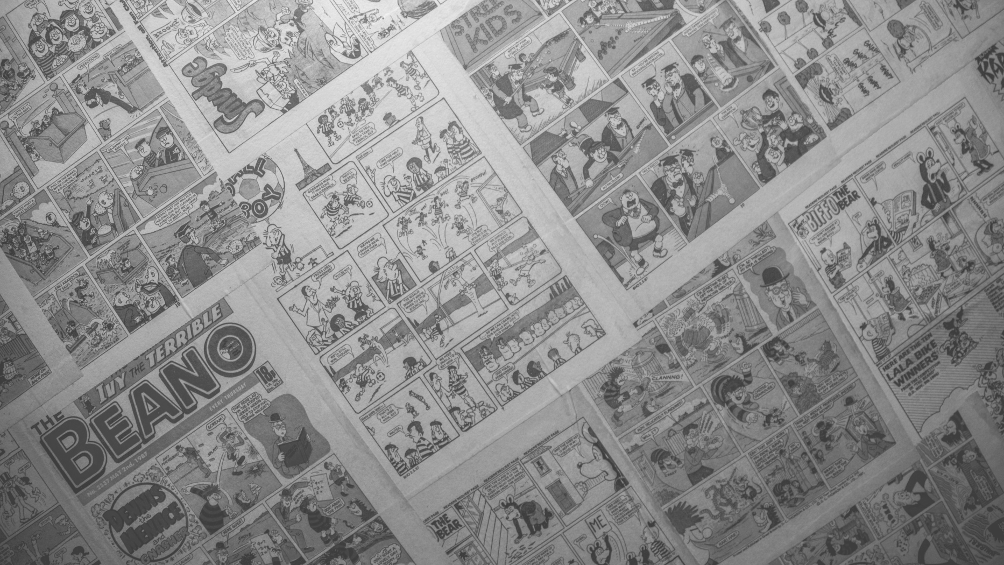


LET’S START WITH OUR PROMISE
AND LAW

Slide 4


Let’s Say the Pledge!

Slide 5

Comic Artist Badgework
Icebreaker - let’s do a quick roll call. Alphabetically by first name, tell us your favorite cartoon, graphic novel, comicbook, or even animated film.

Slide 6





Comic Artist Badgework
Newspaper cartoons, comic books, even graphic novels - comic artistry is broad and an ever growing field. The fastest growing book industry are those graphic novels geared toward 8-14 year olds! You know the ones.
CAN YOU LIST SOME MORE THAT YOU LOVE?

Slide 7
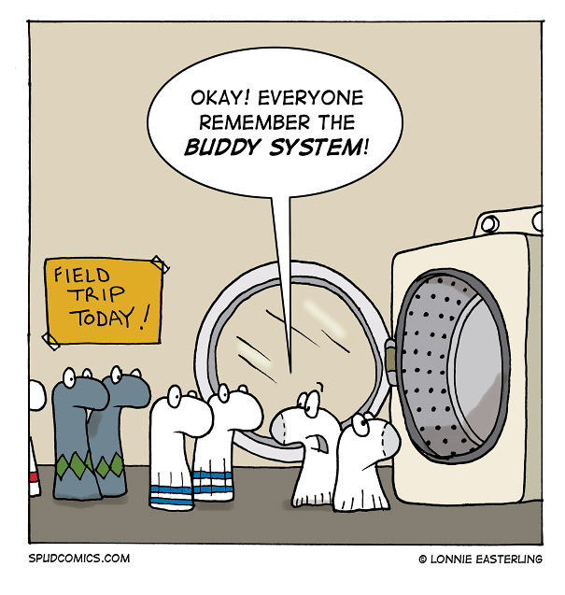
What’s a comic?
Comics are sometimes described as “sequential art”, spanning many panels. While some are only one panel. So what is a comic, exactly? It’s a visual story, however YOU would like to tell it! So let’s go for it!
To earn our Comic Artist Badge, today we will:
Delve into the world of comics
Choose a story to tell
Draw it out
Frame it in four panels
Add the words
Let’s get started...

Slide 8
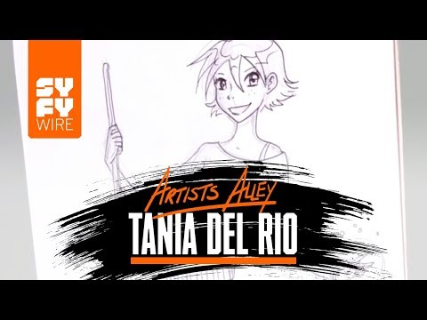
Delve into the world of comics
Let’s visit with a few comic artists and find out what that world is like.
Tania Del Rio -
Sabrina the Teenage Witch

Slide 9
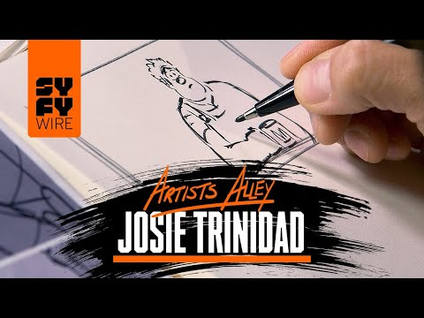
Delve into the world of comics
Let’s visit with a few comic artists and find out what that world is like.
Josie Trinidad -Disney artist

Slide 10

Delve into the world of comics
Let’s visit with a few comic artists and find out what that world is like.
Amanda Connor -
Harley quinn

Slide 11


Delve into the world of comics
So, you might already know, there are multiple jobs within this industry:
Artist
Video Game Artist
Police Sketch Artist
Colorist
Storywriter
Text artist-called an “Inker” (the look of the text in a comicstrip)
Editor
So many more!!!

Slide 12
Choose a story to tell
Comics are simply another method of storytelling. Think of characters or animals you already doodle or cartoons you love, and let those inspire your story! Your story should be short - remember you are making a comic strip - 4 panels long and usually that last panel is a punch line. So keep your story SUPER simple!
Think of a story from you life, something silly that happened to a friend or a memory from camp.
Think of a story from a book or a movie...could it be turned into a comic strip?
Make something up, let your creativity take over!

Slide 13
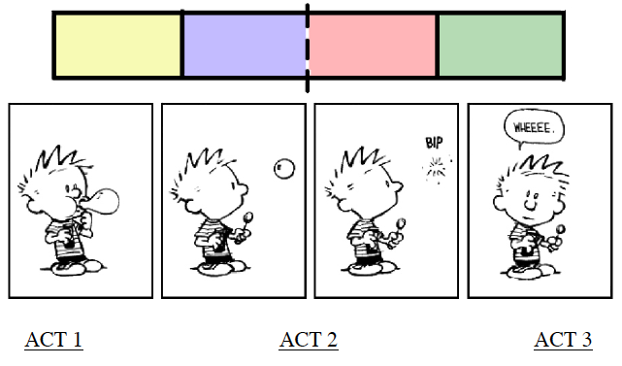
Choose a story to tell
Okay - who is ready to share their story?
Let’s hear ‘em!
Make sure you have a:
Situation
Location
1-3 Characters
Punch Line or Consequence

Slide 14

Draw it out
Take the characters in your story, start to think what they might look like and how they might act. This video of Rebecca Sugar might help you on character development:

Slide 15
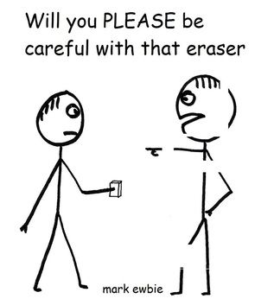
Draw it out
Now let’s start some rough sketching. Stick figures are just fine...you
saw how Josie Trinidad sketched quickly just to get her ideas going
for Wreckit Ralph!
Using some scrap paper, cardboard cookie boxes,
or your notebook - take 5 minutes and everyone
just sketch your characters, more than once to show
different emotions and show movement. Keep it
simple, just sketch with a pencil or fine black marker.

Slide 16

DRAW IT OUT
LET’S SEE THOSE SKETCHES.
Everyone show your sketches to us on screen.
Which one’s made you giggle?
Who are the best artists?
Who did the best to show emotion?

Slide 17
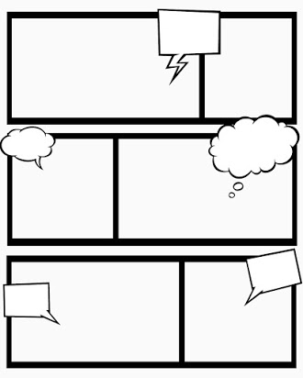
Frame it in Four Panels
Okay, let’s give those characters some action, that means framing them, those frames are called “panels”. An easy way to do this is to use sticky notes, or use a ruler and draw 4 boxes on your page.
Now, tell your story! Be sure to have your characters changing facial expressions and body postures to illustrate their feelings and movement.

Slide 18
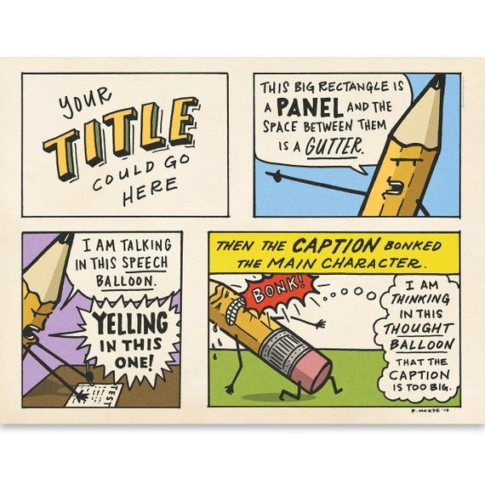
FRAME IT IN FOUR PANELS
While you are drawing, let’s look at the parts of a comic strip with this funny illustration...this is what you will need to know before adding text.

Slide 19



ADD THE WORDS
Sure, some comics convey their message without words, but for most the art of combining words and pictures is what captures the audience. So now we will add words by either adding simple dialogue in speech bubbles, or maybe just convey what someone is thinking in a thought bubble. Another method is writing as a narrator in dialogue boxes at the bottom of each panel.

Slide 20

Add the words
So take some time...lets add our text...and listen to a song. When the song is done, be prepared to SHARE!

Slide 21
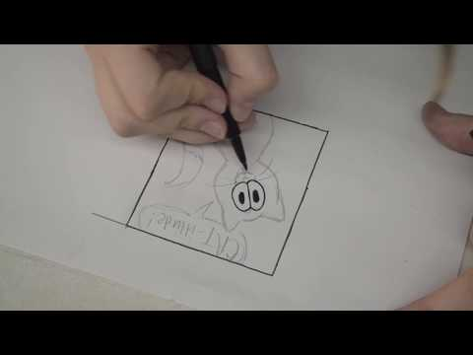
Tell the
whole story!
You should now have a completed comic strip in the rough form. I challenge you all to take it to the next level. Ink it in, clean it up, create multiple stories...even go so far to create a mini comic book, adding to it every day until our next meeting!
Here is a young artist, giving you the step by step of her own comic strip.

Slide 22



Tell the whole story!
Use what you learned today and give back!
Consider drawing an uplifting or inspirational comic to share with classmates or family members and share it on social media.
Create eye catching comic posters or booklets to educate the public and younger kids to wash their hands, recycle, or not to litter.
Draw a comic about a school or community issue and share it with a leader to maybe be the basis for a Silver Award project.

Slide 23


Tell the whole story!
Now...some things you might want to check out:
This website has some great ideas to keep you drawing (even a how to draw a unicorn tutorial): https://comicsclub.blog/comics-worksheets/
Free online comics to read: http://www.moosekidcomics.com/
Download the free app: PIXTON to create your own stories
Clip2Comic is another great app that allows you to change your photos into illustrations.

Slide 24

Thank you
for joining
us today!
We hope you had a and continue to draw & create
Does anyone have any questions or want to tell us what they are going to be doing with what they learned today?
Any suggestions for next meetings or things you would like to share virtually (cooking, craft, or outdoor skills demos, etc.)?

