Slide 1


Leader Instructions & Meeting Prep:
Cadette Babysitter Badge
The following slides will walk your troop through a virtual meeting to earn the Cadette Animal Helper Badge. When you share your screen during your meeting, be sure to click “Present” so girls see the full screen. Also, when you are sharing your screen in zoom, google meet, or another meeting app, please make sure you are sharing both picture and audio. For more information on using Zoom, visit gsnw.gl/VirtualMeetingHowTo
Many of the interactive activities included are shared through YouTube videos. Just click on the arrow in the center of the image to play the video, and the girls can see it too! You should try to review the slides before your meeting if possible, so you are familiar with the activities and any supplies needed.
This meeting will typically take approximately 60-90 minutes as written, depending on participation level and number of girls. As always, Girl Scouting is flexible, and troops may select the activities interest them most, add their own activities, or have girls do some of the steps afterward as “homework”.
When you send out your meeting invitation, be sure to let girls and parents know what supplies they should have on hand for the online troop meeting. They are things most girls likely have at home.

Slide 2

Cadette
Babysitter
Badge
Brought to you by Girl Scouts of the Northwestern Great Lakes

Slide 3




Program Pillar: Life Skills
STEM
Outdoors
Entrepreneurship
Life Skills
Girls become better problem-solvers, critical thinkers, get better grades, and see STEM as the foundation for a meaningful and successful future.
Girls discover that they can better problems and overcome challenges, build social bonds, and become team players that care about protecting our environment.
Girls gain new skills, ​
build their confidence ​
and develop an entrepreneurial mindset over time.
Girls gain the skills and the inspiration to accept challenges, overcome obstacles, and take the lead.

Slide 4





5 Outcomes
Sense of Self Girls have confidence in themselves and their abilities and form positive identities.​
Positive Values Girls act ethically, honestly, and responsibly, and show concern for others.​
Challenge Seeking Girls take appropriate risks, try things even if they might fail, and learn from mistakes.​
Healthy Relationships Girls develop and maintain healthy relationships by communicating their feelings directly and resolving conflicts constructively.
Community Problem Solving Girls desire to contribute to the world in purposeful and meaningful ways, learn how to identify problems in the community, and create action plans to solve them.

Slide 5
5 Outcomes
Sense of Self Girls have confidence in themselves and their abilities and form positive identities.​
Positive Values Girls act ethically, honestly, and responsibly, and show concern for others.​
Challenge Seeking Girls take appropriate risks, try things even if they might fail, and learn from mistakes.​
Healthy Relationships Girls develop and maintain healthy relationships by communicating their feelings directly and resolving conflicts constructively.
Community Problem Solving Girls desire to contribute to the world in purposeful and meaningful ways, learn how to identify problems in the community, and create action plans to solve them.

Slide 6
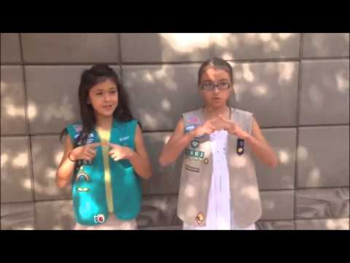

Girl Scout Promise
On my honor, I will try:
To serve God and my country,
To help people at all times,
And to live by the
Girl Scout Law.

Slide 7
Girl Scout Law
I will do my best to be honest and fair friendly and helpful, considerate and caring, courageous and strong, and responsible for what I say and do, and to respect myself and others, respect authority, use resources wisely, make the world a better place, and to be a sister to every Girl Scout.

Slide 8
Babysitter Badge
Prime age to get started babysitting is 12 years old
​
Most parents won’t allow anyone younger than 12 to babysit small kids ​
“Children are apt to live up to what you believe of them”​ - Lady Bird Johnson, former First Lady

Slide 9
Badge Requirements
Steps: ​
Get to know how kids develop ​
Prepare for challenges ​
Focus on play ​
Find potential employers​
Practice your babysitting skills ​
​
Purpose:
When I’ve earned this badge, I’ll be prepared to babysit and will have tried out my skills on the job.

Slide 10
Step 1: Get to know how kids develop
Age groups: newborns, infants, toddlers, preschoolers, young kids (age 5-7), and older kids (8-10). ​
Questions to keep in mind when observing kids in each age group: ​
What’s more important to know about different age group? ​
What do kids at this age like? ​
What do they act like? ​
How do they interact with others?

Slide 11

True or False
A baby can’t see or hear at birth.

Slide 12



The answer is…
False
While a baby’s vision is still very blurry at birth, a newborn can still see close up! They can only see about a foot in front of them so be very close to them. An infant’s sight fully develops at age 6 months.

Slide 13
True or False
A child is born right or left handed.

Slide 14

The answer is…
False
Most toddlers can use either right or left hand equally. They develop their dominant hand by age 2 or 3 years old. 90 percent of toddlers choose the right hand.

Slide 15

Fun Fact
When a 3 or 4-year-old covers their eyes, they think since they can’t see you, you can’t see them either! At this age, they think very literally and cannot process other points of view, only their own.

Slide 16
See kids in action!
Watch the one-year-old’s actions in the video. ​Pay attention to how the babysitter interacts with the child.
Let’s watch this video.
https://drive.google.com/file/d/1ptzJR0xl8C25WyzFui8FvVz-JK6EAby8/view?usp=sharing

Slide 17
Step 2: Prepare for Challenges
Number one rule of babysitting: keep the kids safe! ​
Babies and toddlers need to be fed and have their diaper changed​
Behavioral issues: temper tantrums, meltdowns, sibling rivalry, scrapes and tumbles – it’s all part of the experience!

Slide 18
Interview a mom and babysitter
Find out babysitting tips from those who know!
Let’s watch this video.
https://drive.google.com/file/d/12fPKjDEU70Qw1M5eZEKvHb7hwqL6FmSG/view?usp=sharing

Slide 19
Step 3: Focus on Play
Playtime is so important!
​
Learn which toys and games are popular for kids in each age group

Slide 20

Here’s some examples of safe toys for different ages.

Slide 21

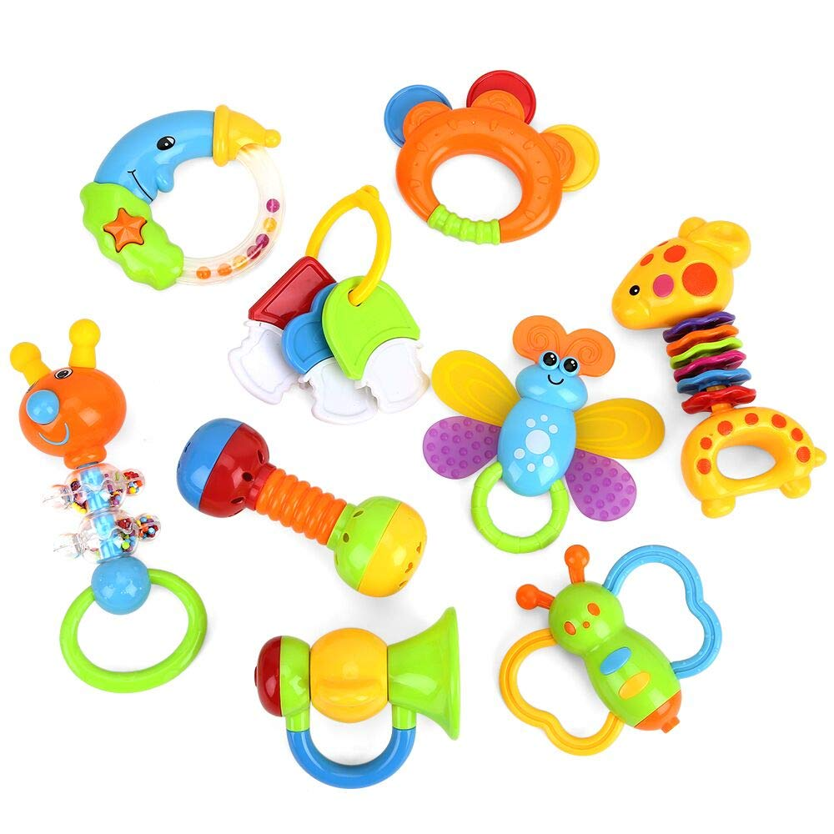
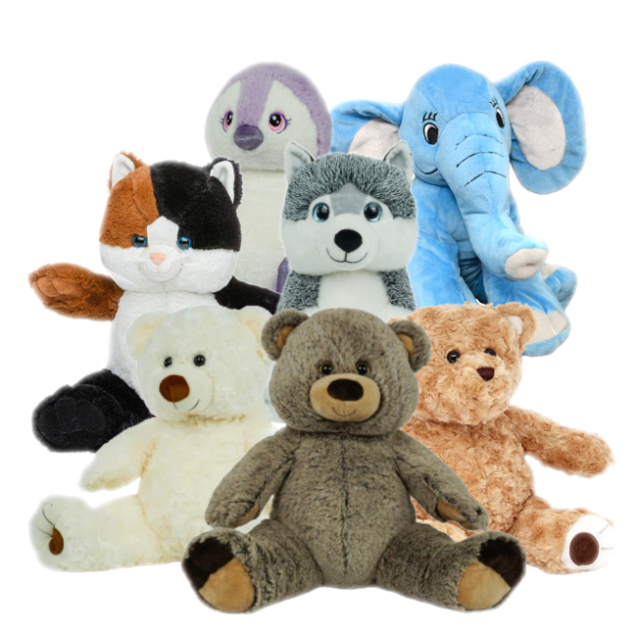
Safe toys for infants: Newborn - 6 months
Soft Mobiles
Rattles
Stuffed Animals

Slide 22
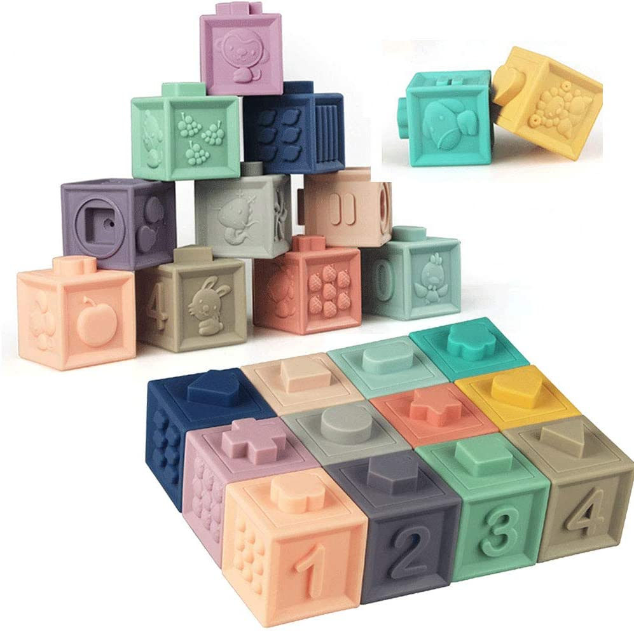
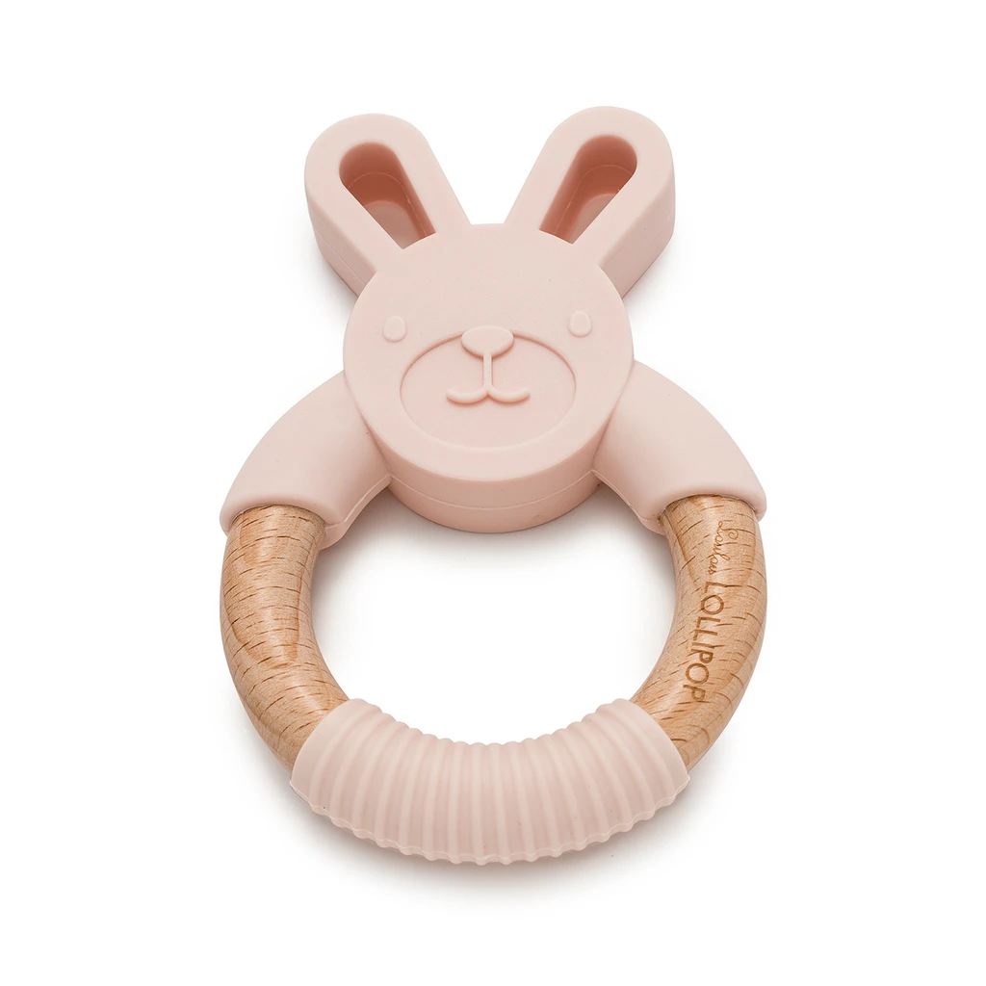

Safe toys for infants: 6 - 18 months
Teething Rings
Stackable Blocks
Stuffed Animals

Slide 23
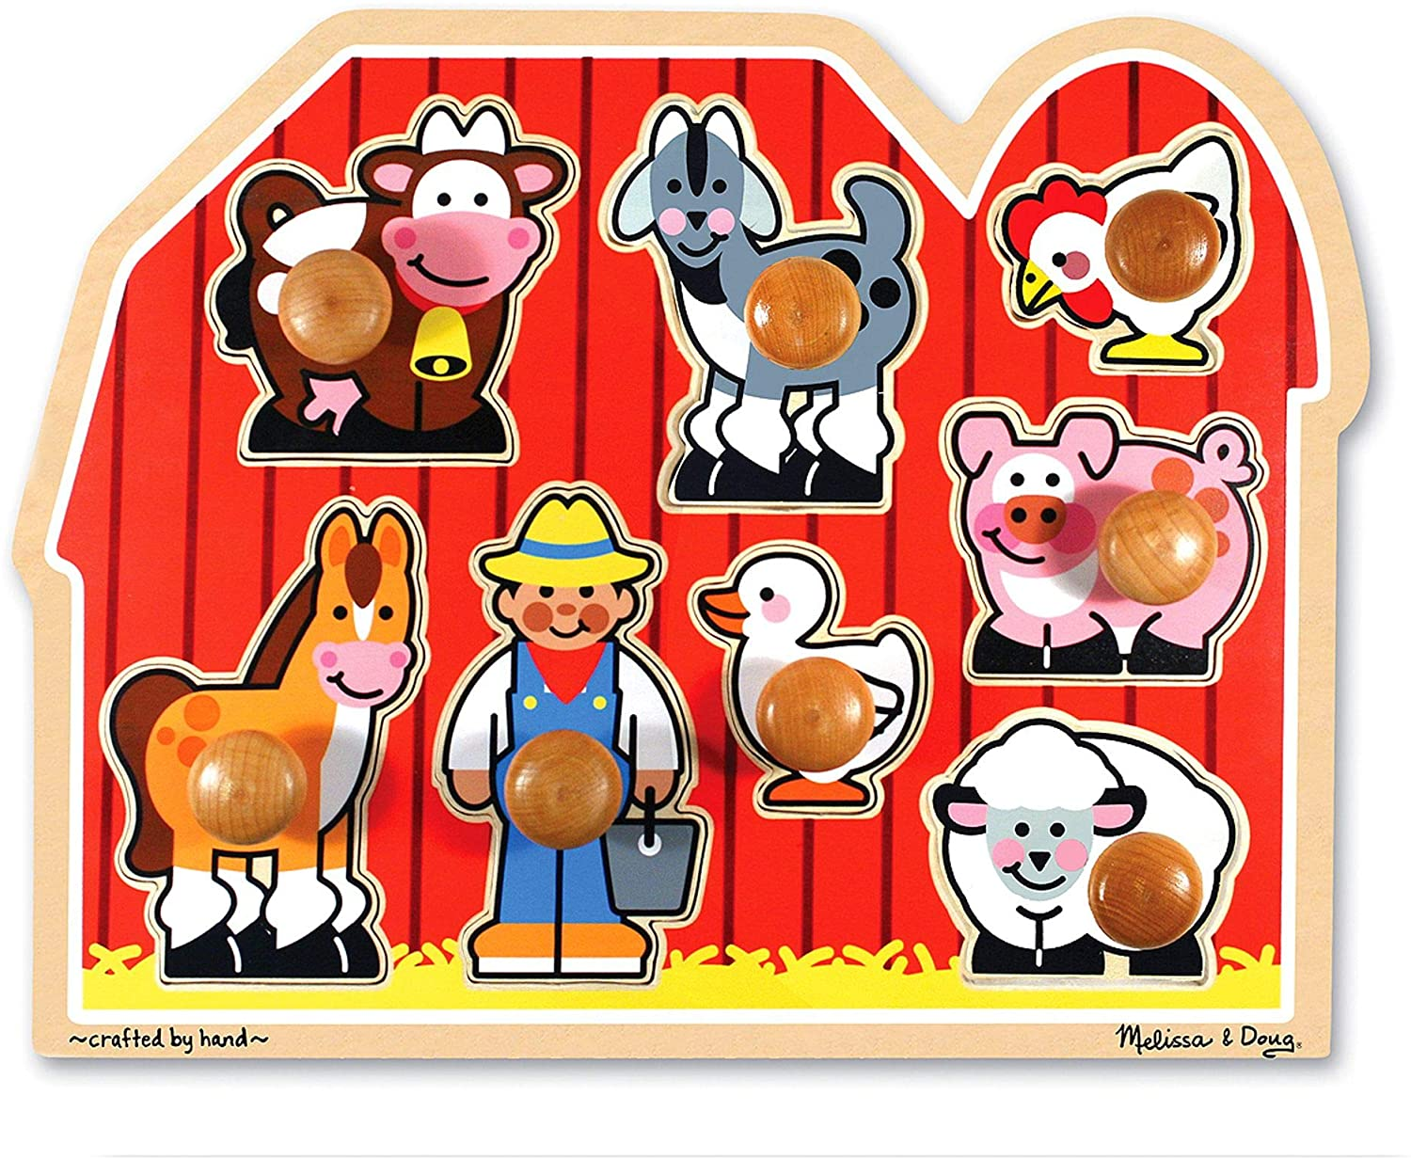
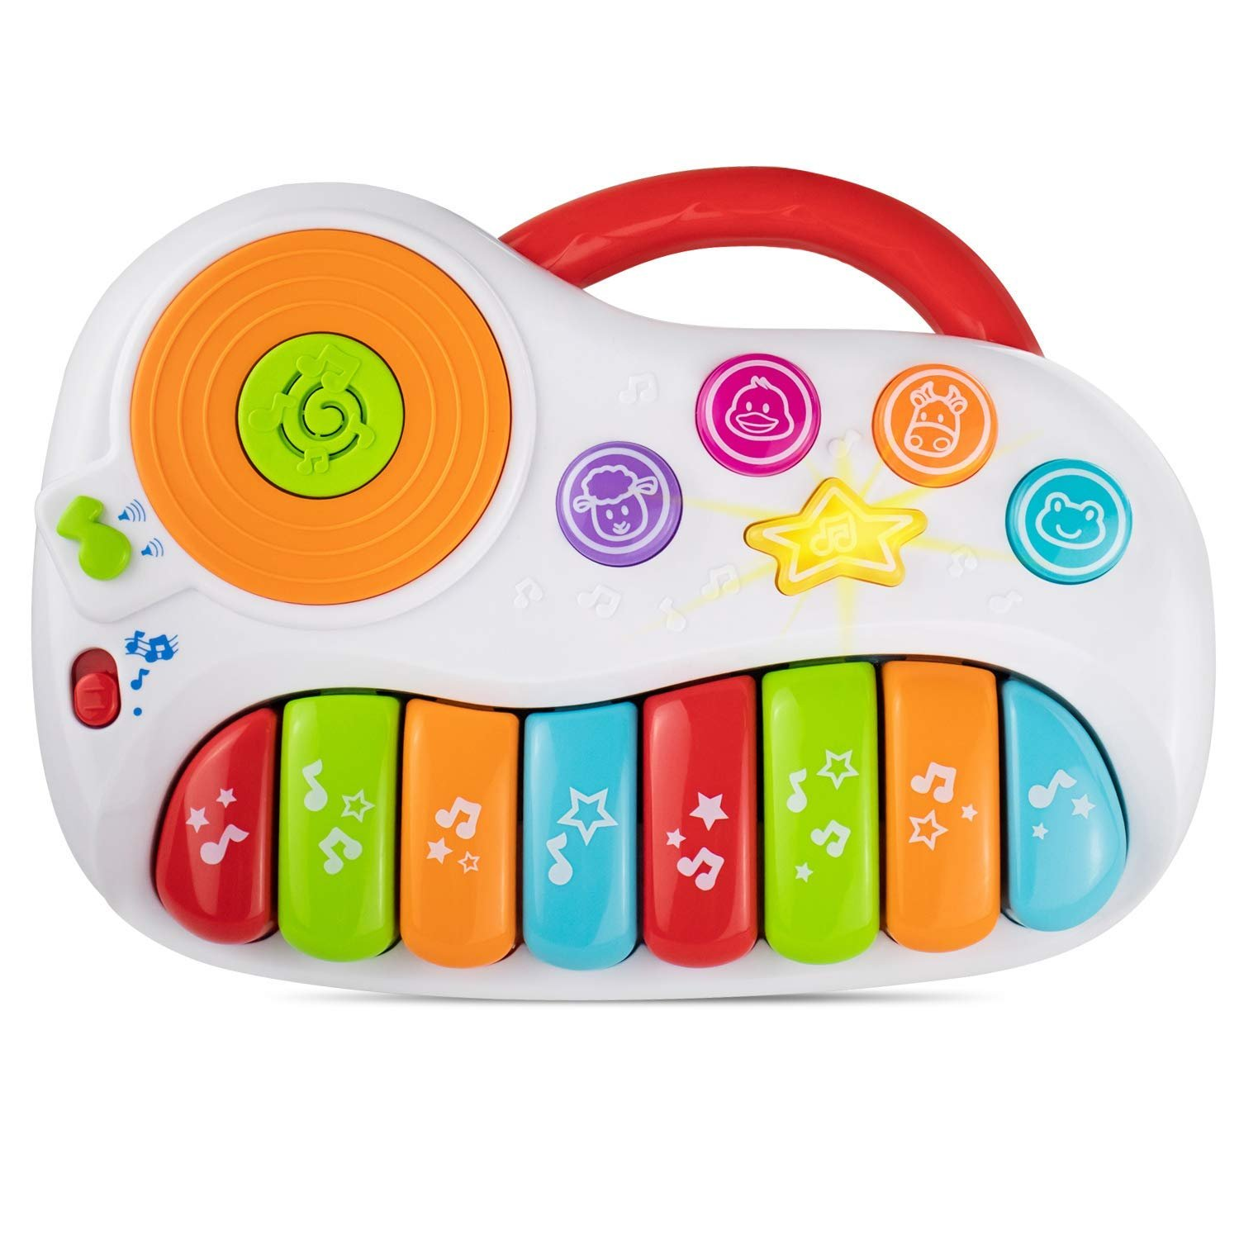
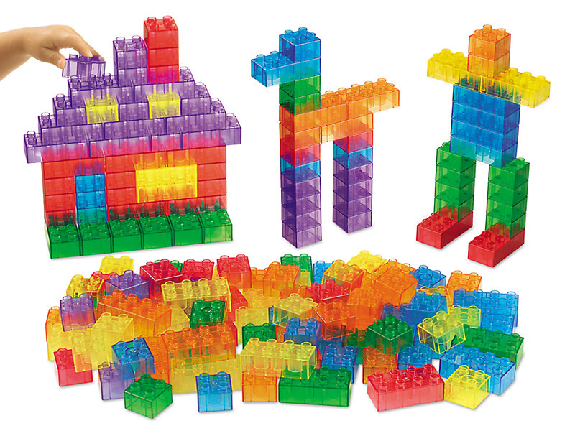
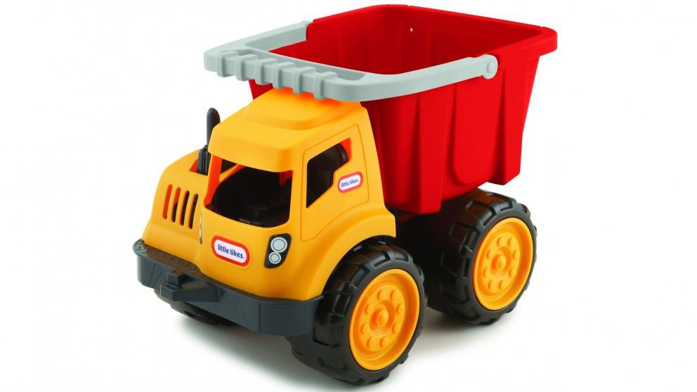
Safe
toys for toddlers: 1 - 2 year olds
Puzzles with Knobs
Musical Toys
Building Blocks
Large Plastic Toys

Slide 24
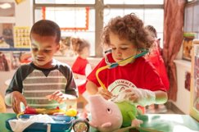



Safe
toys for Pre-K: 3 - 4 year olds
Larger Play Props
Pretend Play
Soft Balls
Story Books

Slide 25
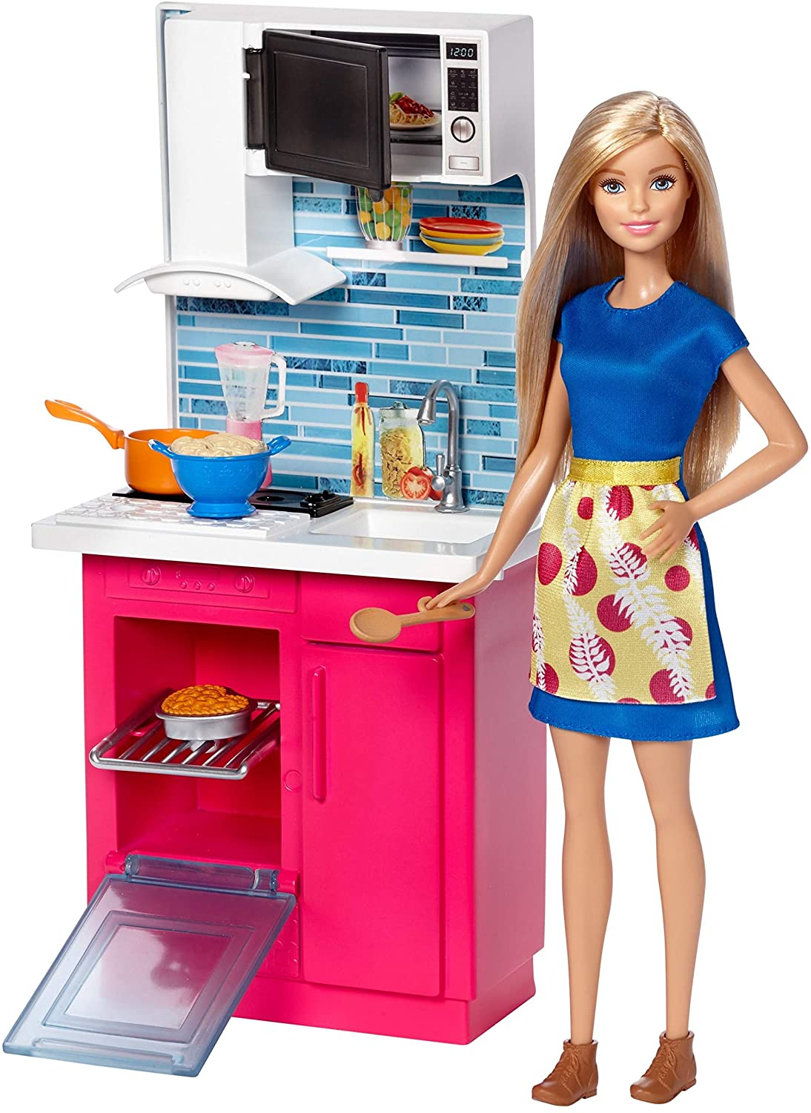
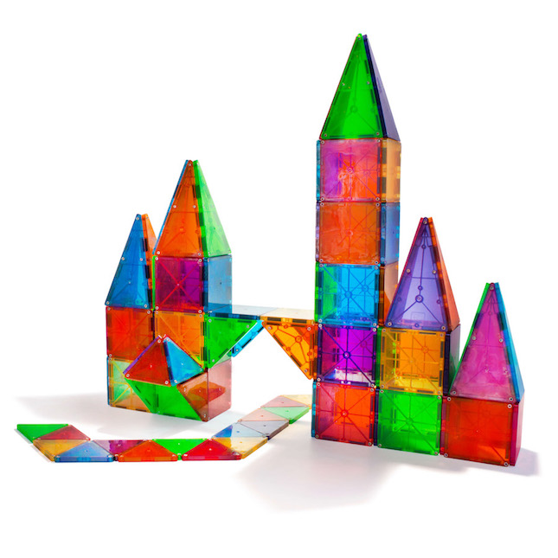
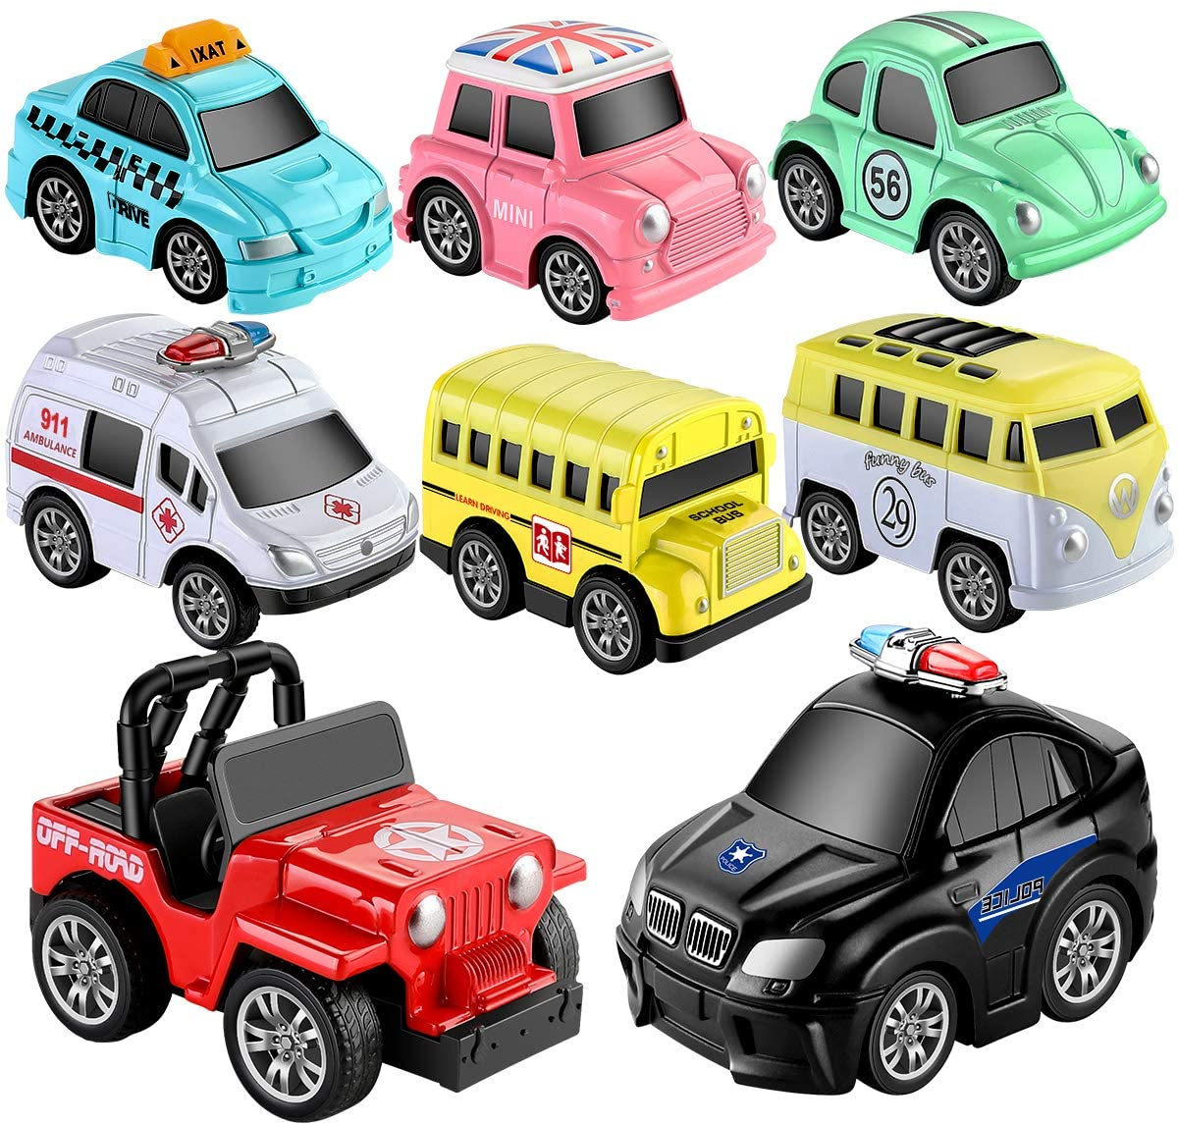
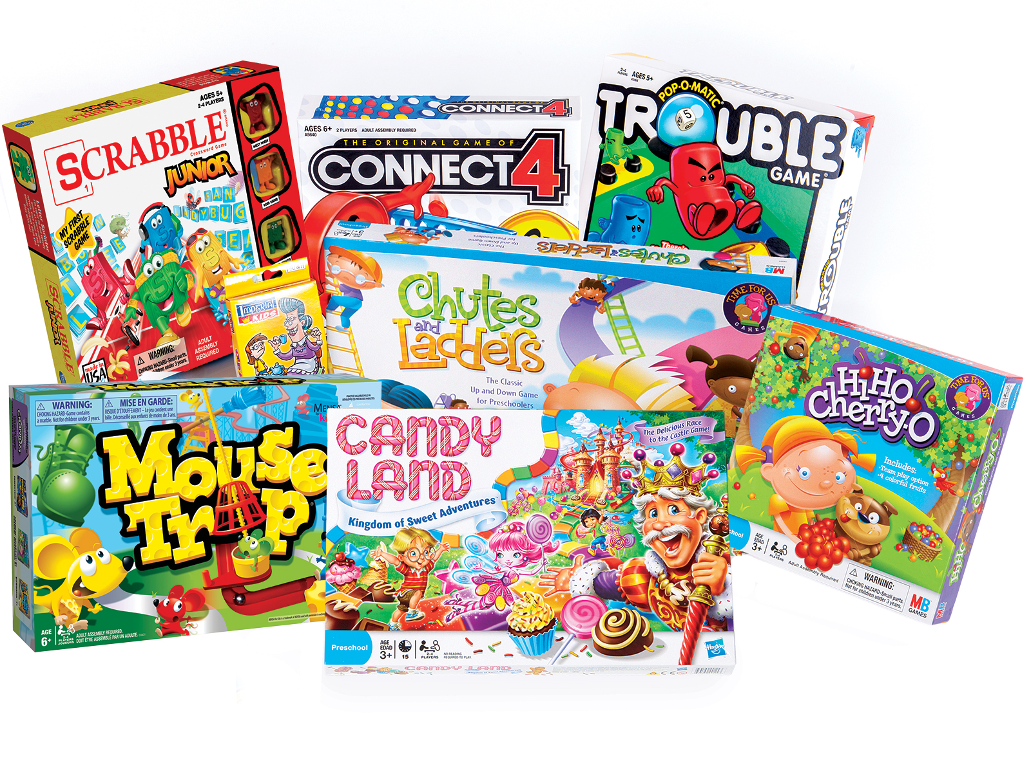
Safe
toys for young school age children: 5 - 7 year olds
Small Play Props
Magnetic Tiles
Toy Cars
Board Games

Slide 26

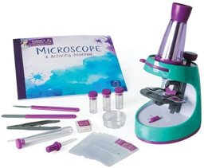
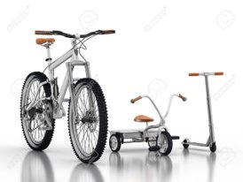
Safe toys for older school age children: 8 - 10 year olds
Sports Equipment
Scientific Toys
Bikes & Scooters

Slide 27
Let's do a fun craft that you can do with kids you may babysit!

Slide 28
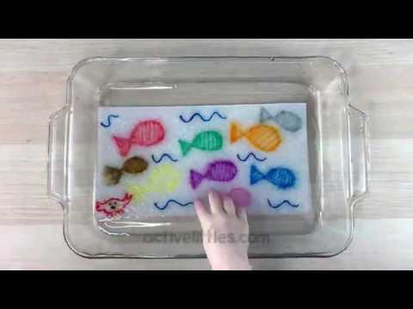
Magic Paper Towel Art
Supplies: ​
Paper towels ​
Markers ​
Water in a small tray​
Scissors

Slide 29
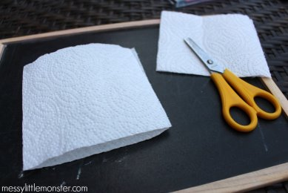
Step 1:
Fold a paper towel in half and cut it so that it looks like a square ​
There should be two squares when the paper towel is folded

Slide 30

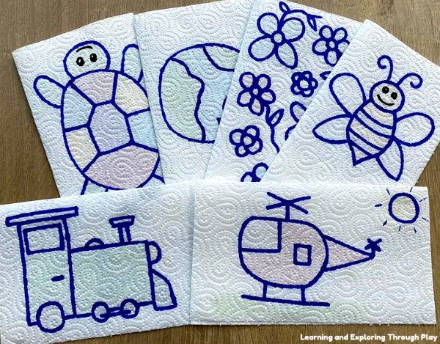
Step 2:
Draw a picture on the paper towel square.
​
It can be anything you want, it’s best if you use multiple colors.

Slide 31

Step 3:
When you lift the top layer, you will see the marker got on the bottom layer.
​
Now color in the bottom layer.

Slide 32
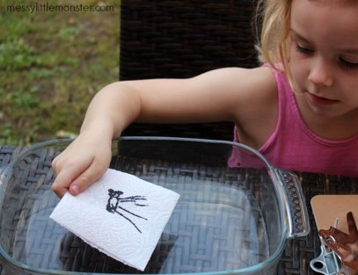
Step 4:
Put the top layer back on top of the bottom layer and put the paper towel in the water.

Slide 33
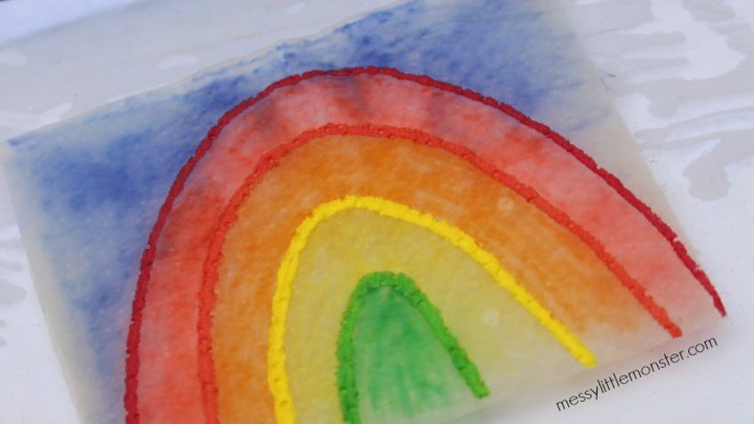
Watch the magic happen!

Slide 34
Step 4: Find potential employers
You’ve seen kids in action! ​
Now think of which age groups you want​
Review Market Prep ​
Find families needing babysitters

Slide 35
Market prep - things to think about.
How much do you want to be paid per hour?
  The minimum wage in Wisconsin is $7.25 per hour​
What do you want to be paid per child you watch? ​
  Usually up $1/hour per child ​
Ask current babysitters what they charge for babysitting ​
When are you available to babysit? ​
How are you going to get to where you need to babysit?

Slide 36
Now it’s time to market yourself.
Word of mouth is best advertisement!​
Write a speech about yourself
  Highlight babysitting skills ​
Prepare questions ​
Call around ​
Keep notes of potential families ​
If and when call you them back

Slide 37
Sample speech:
Hi! My name is______. I am ______ years old. I am fun loving and responsible. I love kids and I help my mom and dad take care of my ______ siblings. I have taken a babysitter certification course from ___________________ (organization name). I can work weekend evenings during the school year and sometimes during the day in the summer. My rate is ______. I would love this opportunity!

Slide 38

Safety tips
Do NOT post your name, address, or phone number on internet!​
Do NOT post flyers/business cards in public places!

Slide 39

Create a flyer for yourself
Put your name, qualifications, babysitting interest​, and how to contact you.

Slide 40
Questions to be prepared for:
What were the ages of the children you have watched in the past?
What is your favorite age to care for and why?
What activities do you like to do with kids? Art? Music? Field trips to the park, library, zoo, etc.?
Have you ever had a philosophical difference with a parent? What did you do?
If my child was upset or crying, what would you do?
If my child were to have a temper tantrum, what would you do?
If my child threw a toy at another child, what would you do?

Slide 41
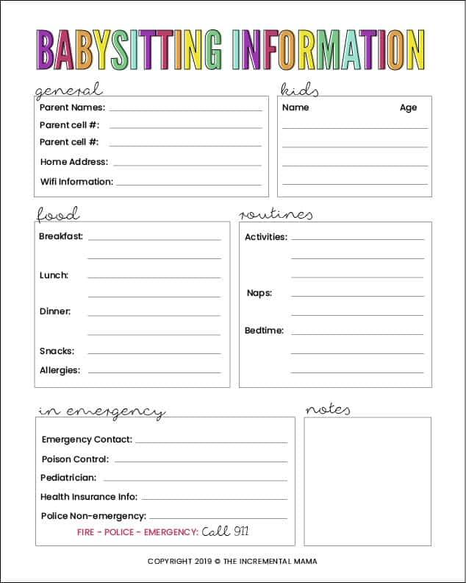
Sample babysitting questionnaire
This will help you get to know the family and have the information you need when you start babysitting.

Slide 42
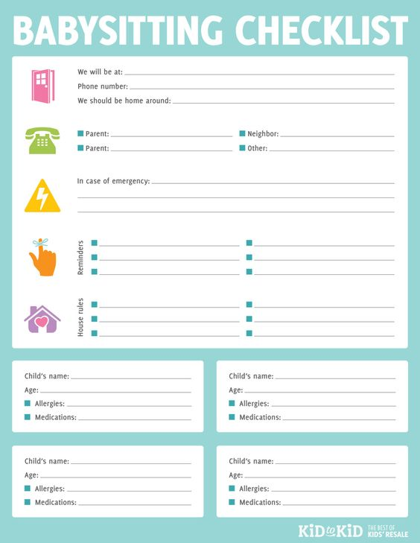
Create a parent form
Give this to the parent’s to fill out before they leave, this will let you know where they are and how to contact them in case of an emergeny.

Slide 43
Questions to include on your parent form
Address and phone number of workplace
House information: ​
Ask about answering the door ​
Do locks and alarms work? ​
Where are emergency supplies? ​
Special instructions? ​
Pet needs?
Kid information: ​
Meal and nutritional information
Allergies? ​
Medications? ​
Nap time? ​
Favorite toy? ​
Traditions?
Emergency numbers: ​
Fire ​
Police ​
Doctor ​
Neighbor ​
Family ​

Slide 44
Step 5: Practice makes perfect
Be your parent’s helper
Assist an older girl when she babysits
Co-sit with a friend

Slide 45
What is a parent helper?
Someone who helps parents while parents are home ​
Parents are busy with something else ​
Can go along with family to watch kids​
Great on-the-job training​
Essential to gain trust

Slide 46
Babysitting tip:
Are you watching more than one child? ​
Ask the parents about the kids’ schedule or​ ask if you can create your own schedule. ​If you create your own, be sure to talk it over with the parents.
Your schedule could include: ​
Play time ​
Nap time​
Homework ​
Meals ​
Bedtime

Slide 47
Babysitter Certification
Take a babysitter certification course
American Red Cross Babysitting Basics Course Online - $45 ​https://www.redcross.org/take-a-class/classes/babysitting-basics-online/a6R0V0000015FUP.html ​
KidProof Safety Babysitter Training Program Online - $45 ​
https://courses.kidproofsafety.com/product/babysitter-training-programs-teens/ ​
ExpertRating Babysitting Certification Online - $19.99 ​
https://www.expertrating.com/certifications/babysitting/babysittingcertification.asp ​
Intro to Safe Babysitting by Safe Sitter $12.50 (teamed up with Girl Scouts)​
https://safesitter.org/intro-safe-babysitting/

Slide 48
Congrats!
You have earned the Cadette Babysitter Badge!
Give service by: ​
Helping parents in watching their kids ​
Volunteer at daycare or afterschool programs ​
Create fun age-appropriate games and activities

