Slide 1


Leader Instructions & Meeting Prep:
Cadette Animal Helper Badge
Cadette Animal Helper:Badge: :meeting plan supply list::
Paper
Something to write with
Crayons, markers, or colored pencils
The following slides will walk your troop through a virtual meeting to earn the Cadette Animal Helper Badge. When you share your screen during your meeting, be sure to click “Present” so girls see the full screen. Also, when you are sharing your screen in zoom, google meet, or another meeting app, please make sure you are sharing both picture and audio. For more information on using Zoom, visit gsnw.gl/VirtualMeetingHowTo
Many of the interactive activities included are shared through YouTube videos. Just click on the arrow in the center of the image to play the video, and the girls can see it too! You should try to review the slides before your meeting if possible, so you are familiar with the activities and any supplies needed.
This meeting will typically take approximately 60-90 minutes as written, depending on participation level and number of girls. As always, Girl Scouting is flexible, and troops may select the activities interest them most, add their own activities, or have girls do some of the steps afterward as “homework”.
When you send out your meeting invitation, be sure to let girls and parents know what supplies they should have on hand for the online troop meeting. They are things most girls likely have at home.

Slide 2

Cadette
Animal Helper
Brought to you by Girl Scouts of the Northwestern Great Lakes

Slide 3
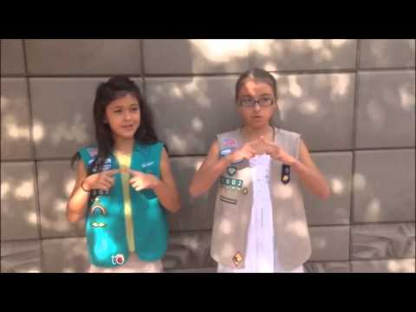

Girl Scout Promise
On my honor, I will try:
To serve God and my country,
To help people at all times,
And to live by the
Girl Scout Law.

Slide 4
Animal Helper Badge
Animals have always provided humans with food, clothing, and transportation, but today they’re also trained to help people with disabilities, find people who are lost, and event discover tumors. And, of course, animals offer us companionship, love, and sheer joy. Girls will learn about the many ways animals help humans.
Explore the connection between humans and animals
Find out how animals help keep people safe
Know how animals help people emotionally
Check out how animals help people with disabilities
Look at how animals might help us in the future

Slide 5

Icebreaker:
Do you own any pets?
If you could own any animal as a pet, what would it be and why?

Slide 6


How do you think dogs were domesticated?
Any guesses before watching the video?
Survival of the friendliest!
Friendlier dogs or wolves had an advantage, so they blended with humans!
May have been good at picking up human cues
Have learned to use humans to solve problems rather than to rely on each other
Now, if you and your dog gaze lovingly into each other’s eyes, your brains secrete oxytocin (hormone associated with maternal bonding and trust!)

Slide 7
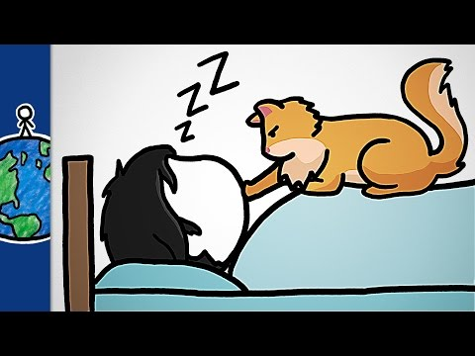
How do you think cats were domesticated?
Are you surprised by how cats were domesticated?
Does your cat wake you up at night? Here might be why!
Creature of routine
Knows when you are waking up or are in light sleep
Hungry in the morning
Nighttime might be the time of most activity

Slide 8
Let’s Compare
We’re going to compare the domestication of cats and dogs! A fact from one of the two videos is going to be read to you and then you will have to guess whether it applies to cats or dogs!
Let’s begin!

Slide 9
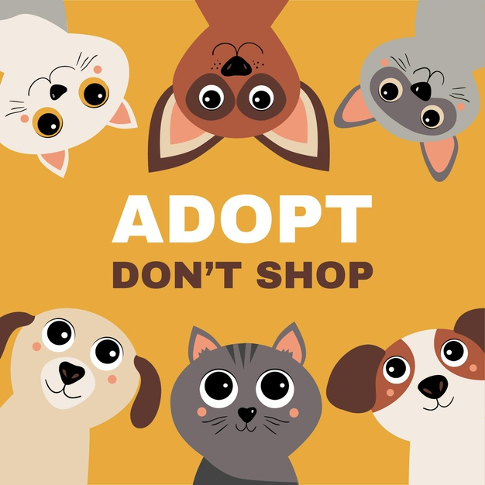
Question 1
Before being domesticated, I survived by myself. I did not live with packs of other animals.

Slide 10
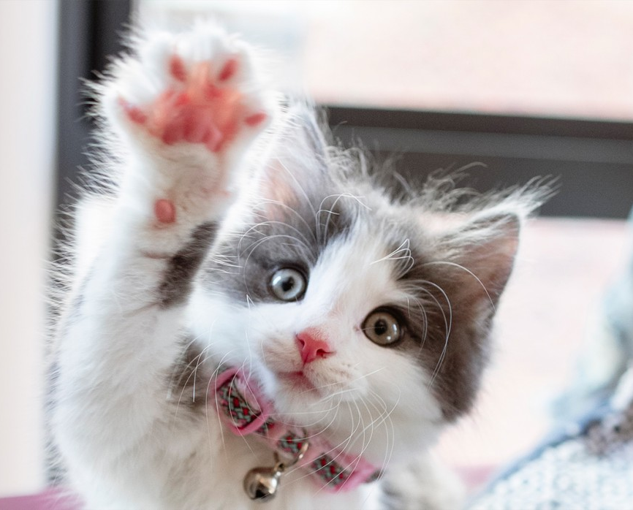
Who roamed the world by themselves?
Cats
Lone Ranger
Dogs
-

Slide 11
Question 2
Which animal worked in complex social groups?

Slide 12
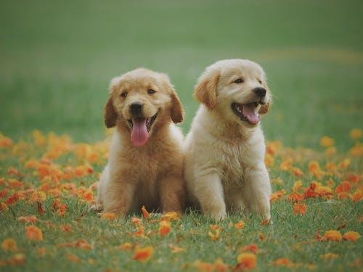
The answer is...
Cats
Lone Ranger
Dogs
Lived in complex social groups

Slide 13
Question 3
Who was domesticated because of
“survival of the friendliest”?

Slide 14
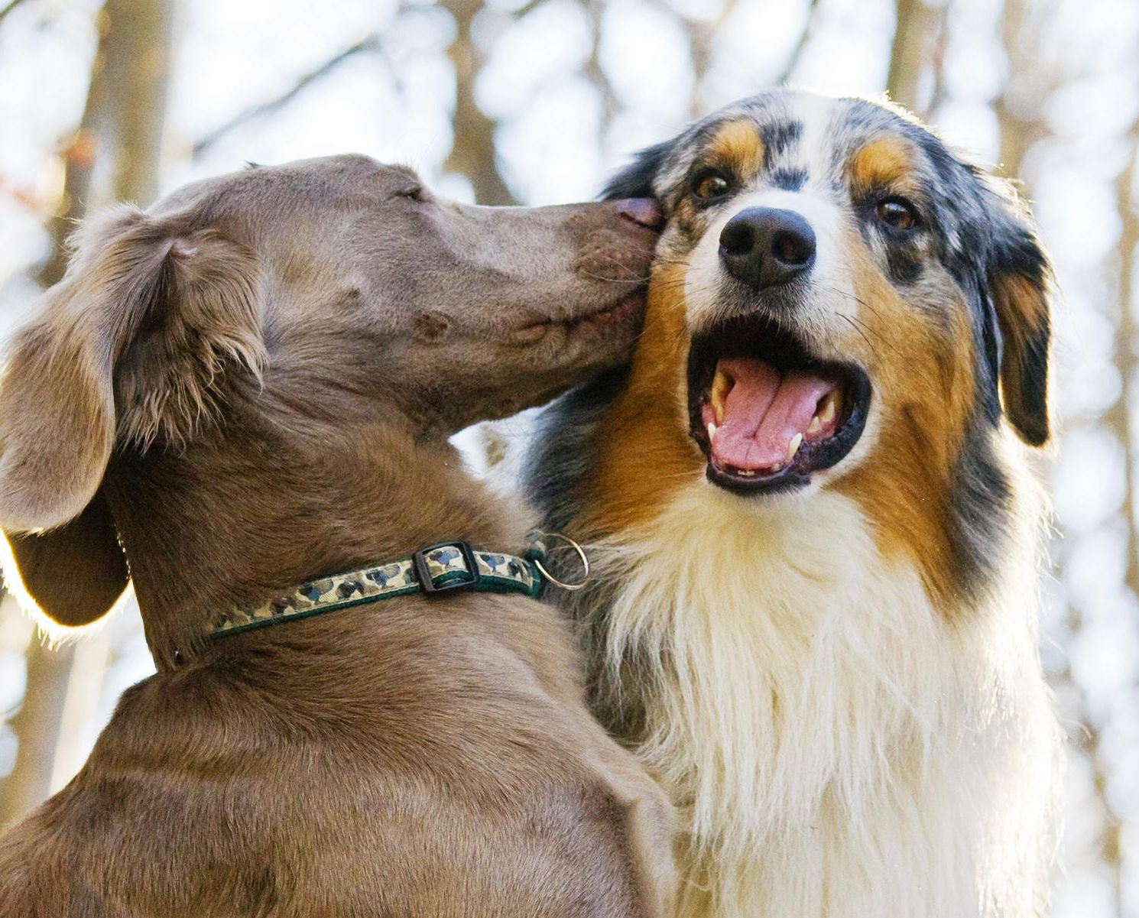
The answer is...
Cats
Lone Ranger
Dogs
Lived in complex
social groups
Survival of the
Friendliest

Slide 15
Question 4
Was it cats or dogs who depended on humans for survival?

Slide 16
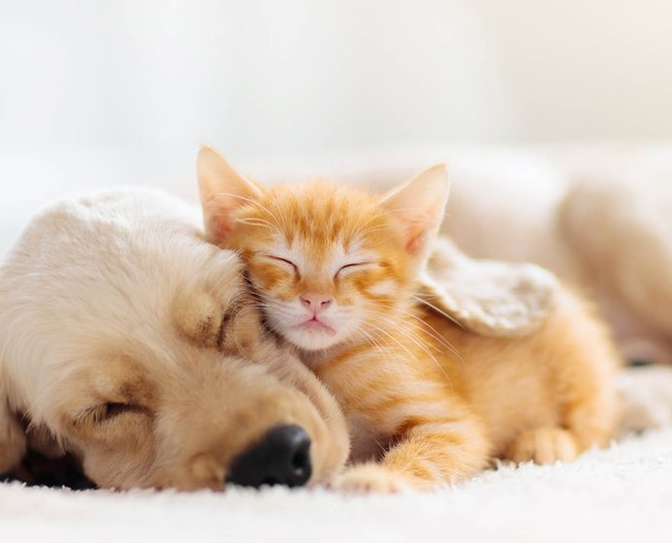
The answer is...
Both
Humans for survival
Cats
Lone Ranger
Dogs
Lived in complex
social groups
Survival of the
Friendliest

Slide 17
Question 3
Who came to human civilization
and served as pest control?

Slide 18
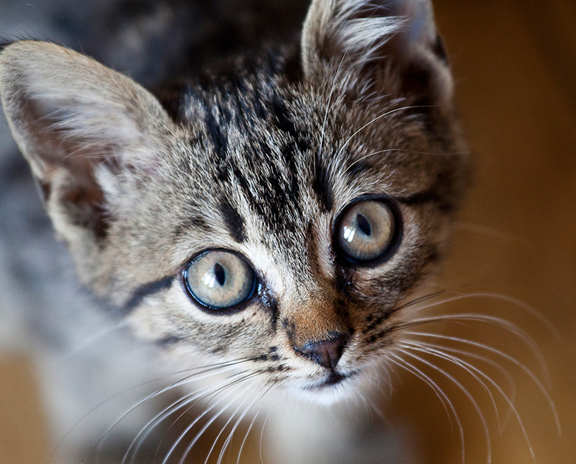
The answer is...
Both
Humans for survival
Cats
Lone Ranger
Pest Control
Dogs
Lived in complex
social groups
Survival of the
Friendliest

Slide 19
What else did you learn about the two?
Let’s add onto our own Venn diagram other facts we learned about the domestication of cats and dogs!
Is there anything you are curious about that you didn’t learn here?
Both
Humans for survival
Cats
Lone Ranger
Pest Control
Dogs
Lived in complex
social groups
Survival of the
Friendliest

Slide 20
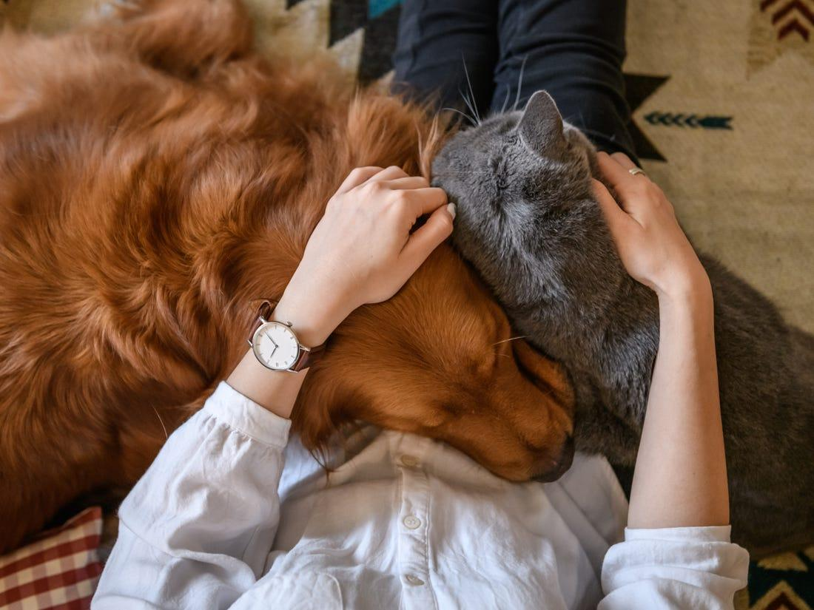
How do you think animals keep people safe?
Let’s imagine, draw, or write about a situation where we think animals help keep people safe before diving deeper!
Supplies
Paper
Something to write or color with!

Slide 21
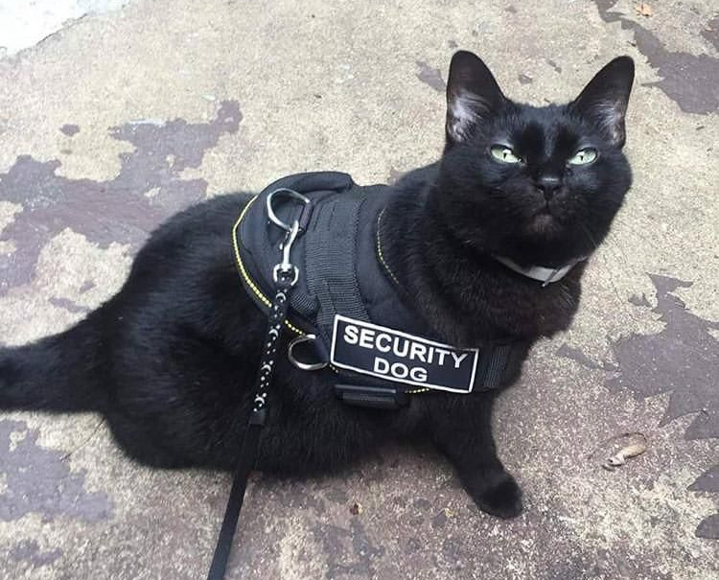
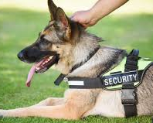
Animals Helping People
What did you come up with? Let’s share!

Slide 22
Police use animals for safety & security reasons.
Apprehension: trained to bite dangerous suspects and hold them hostage
Detection: Dogs have a great sense of smell (225 million scent receptors compared to humans’ 5 million)
  Can find dangerous substances and are used at airports, large events, and other places
Search and Rescue: Looking for lost victims – kidnapped, lost people, earthquake victims, and individuals trapped by an avalanche.

Slide 23
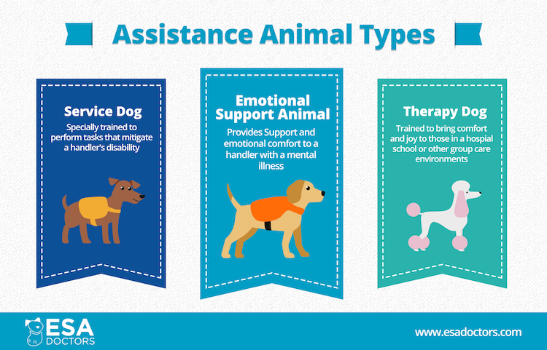
Helpful
Furry Friends
There are three main types of assistance animals
They all have very different purposes in helping people
While therapy dogs are brought places to bring happiness and relaxation to others, service dogs and emotional support animals (ESA) help their owners
What do you think the difference between ESAs and Service Animals are?

Slide 24
ESA vs Service Dog
ESA
May live with Owner even if “No Pets” policy in place
Provides emotional support through companionship
May be able to fly on airplanes with owner for little to no cost
Service Dog
ADA covered: Rights to bring animal into public establishments
Needs to tolerate wide variety of experiences, environments, and people
May live with owners even if “No Pets” policy in place
Specifically trained to assist just one person with very specific tasks

Slide 25
What are some ways service dogs help their owners?
Service dogs might serve as guide dogs and help blind or visually impaired individuals navigate the world around them.
They also might help someone with a severe mental illness and interrupt repetitive harmful behaviors done by their owner
An individual with diabetes may have a service dog to notify them when their blood sugar levels are low
Another common task service dogs are trained in is to smell out allergens in foods and other substances to protect their owner from a dangerous allergic reaction
Many service dogs wear a vest while on duty and it’s very important not to give them attention while they are working or it could severely hinder their performance and hurt their owner

Slide 26
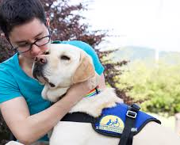
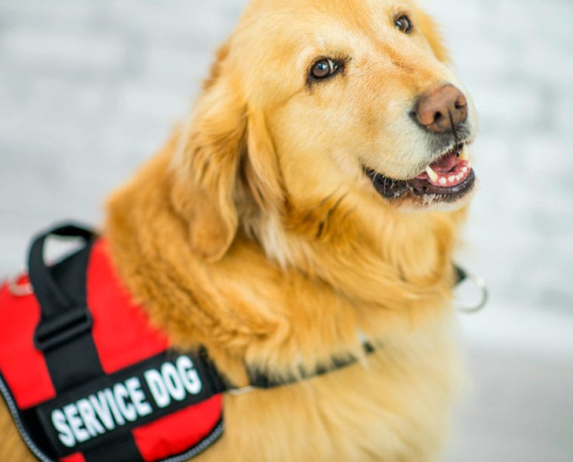
Who trains
service dogs?
Anyone can train a service dog, It takes a lot of patience and hard work!
Many service dog organizations, like Custom Canines in Wisconsin rely on volunteers and donations to obtain and train their dogs!
Check out their website if you have time or are curious: https://www.customcanines.org/
Individuals looking for a service dog can also train the dog themselves
Purchasing a guide dog can be very expensive (Think $30,000) which is why organizations like these are crucial to so many people!

Slide 27
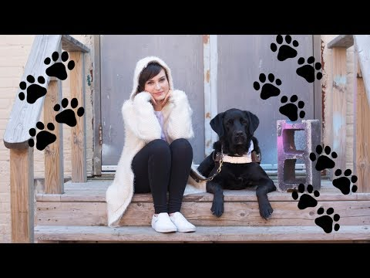
Are you curious about life with a Guide Dog?
To learn something best, it is important to learn from someone who experiences a situation you are trying to understand.
If you have time watch Molly Burke’s video here and check out many of her educational videos on her YouTube channel.
Molly Burke is a young YouTuber and motivational speaker that aims to educate individuals about living with a disability.

Slide 28
Take Action!
Possible Ideas:
  Make cards to local businesses
  Make posters for the community
  Make a mural in your community
After listening to Molly Burke’s story and hearing about struggles being denied access, what can you do to help people in your community?
Brainstorm some ideas that either educate others or advocate for access!

Slide 29
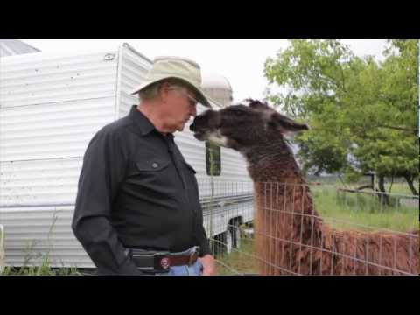
How might animals help us in the future?
Some European countries have been using dogs at airports to “sniff out” Covid-19!
  96% effective after just 2 weeks of training
Bees are powerful pollinators and help pollinate 30% of our crops and 90% of wildflowers
Beavers combat climate change
Llamas patrol farms!

Slide 30
Congrats!
You have earned the Cadette Animal Helpers Badge!

