Slide 1
CSA CITIZEN SCIENTIST JOURNEY- WEEK 2
GIRL SCOUTS OF CENTRAL ILLINOIS

Slide 2
REVIEW
Citizen science—a way for everyday people to participate in and help scientists advance research. Typically, this collaboration involves volunteers who aren’t professional scientists. Citizen scientists follow guidelines (or “protocols”) to collect data, share observations, or analyze data for scientists and others to answer questions about the world.

Slide 3
THIS WEEK WE ARE PRACTICING THE SCIENTIFIC METHOD TO PREPARE FOR DOING OUR CITIZEN SCIENTIST PROJECT
SCIENTIFIC QUESTION
DATA COLLECTION
01
02
03
04
05
OBSERVING
HYPOTHESIS
CONCLUSION

Slide 4
01
Observation
Observation - watching and noticing something using all of your senses, especially sight, to get information. Observation helps you better understand a situation or environment.
Read through the quotes from scientists: here and create an observation tip sheet to help you throughout this journey

Slide 5
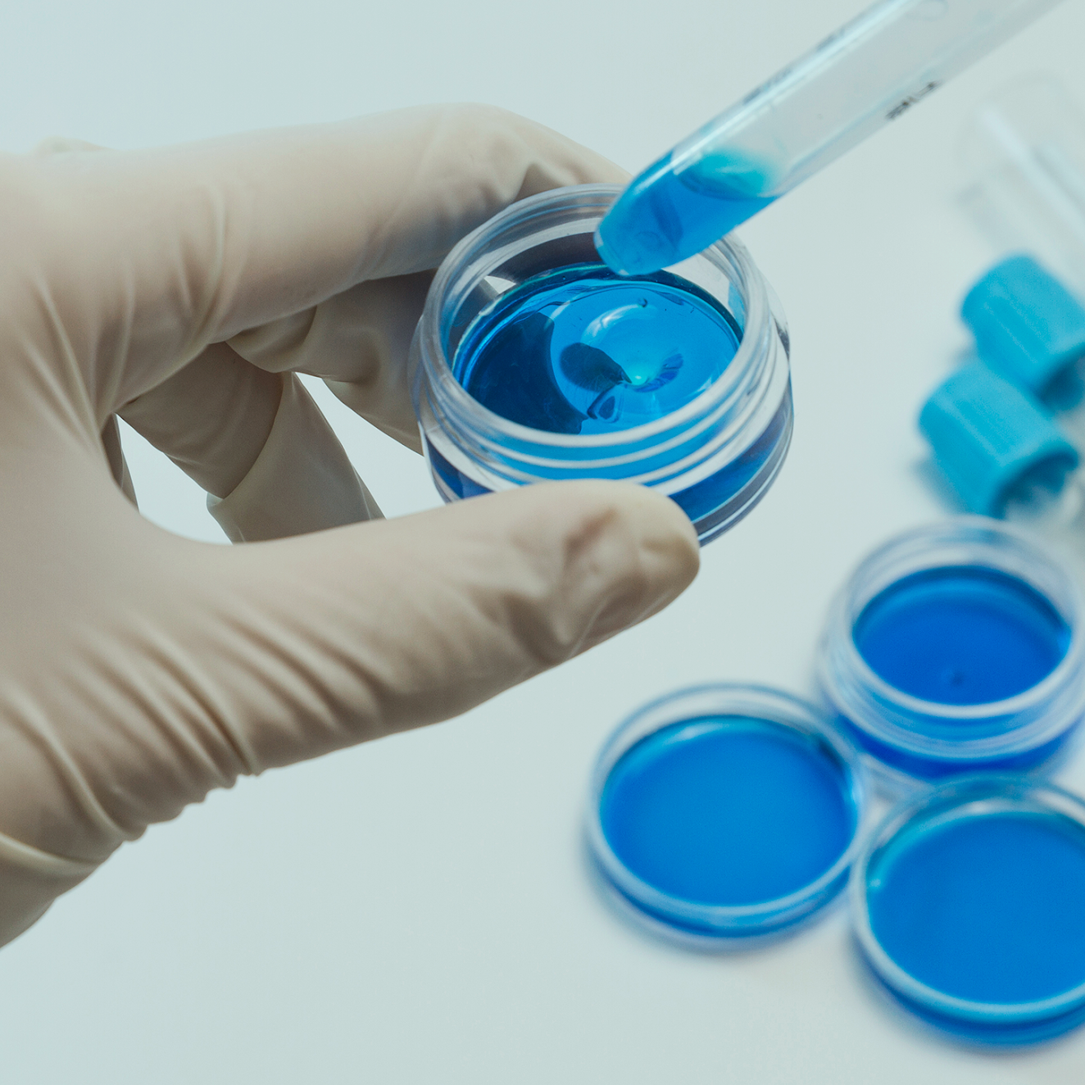
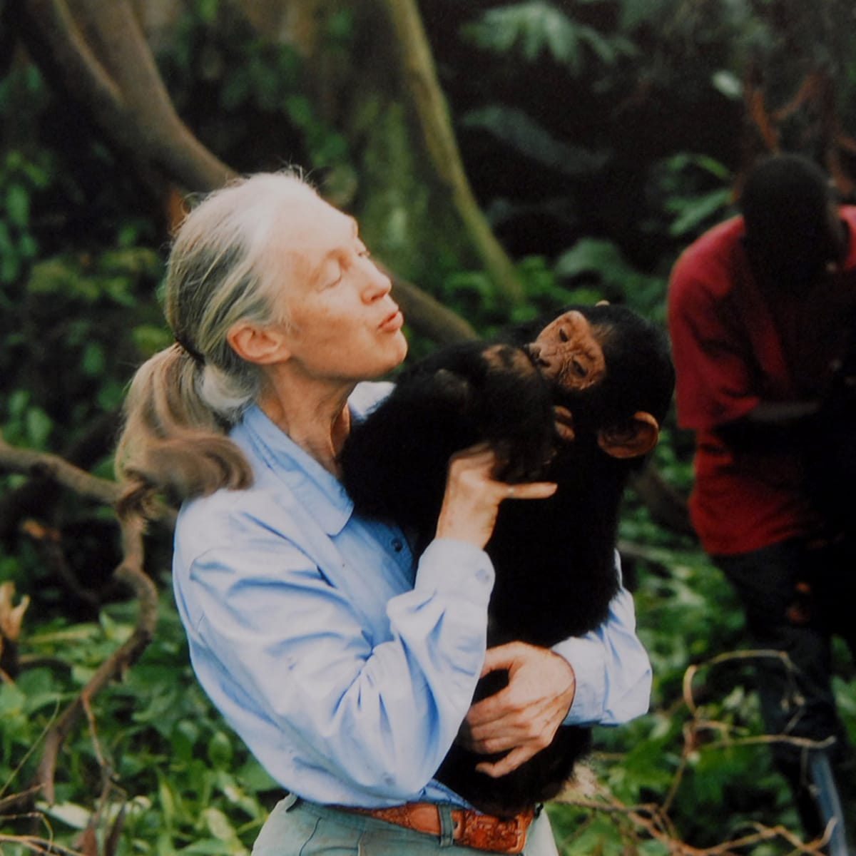
Observation isn't just looking at things around you. You also need to think about what you see. This is something all scientists do.
For example, Jane Goodall has observed groups of chimpanzees closely and over a long period of time. While observing them, she noticed that chimps would use grass and twigs to reach food. They'd dip the grass into termite mounds, attracting loads of termites and bringing them towards the surface of the mound. The chimps also broke the leaves off twigs, adapting them to be a tool. - Before Jane began researching chimpanzees, the scientific community believed that only humans could build and use tools, but her observations became a new discovery that disproved the past scientific theory.

Slide 6
Do Your Own Observations?
Now, what do you think you can learn by observing the world around you?
If you are outside,
If you are inside,
Take some paper and pen/pencil and start to observe the world around you,. If you have questions about what your observing, write them down too!
observe natural objects like trees, rocks, dirt, animals, etc.
observe people, objects, and how the two interact.

Slide 7
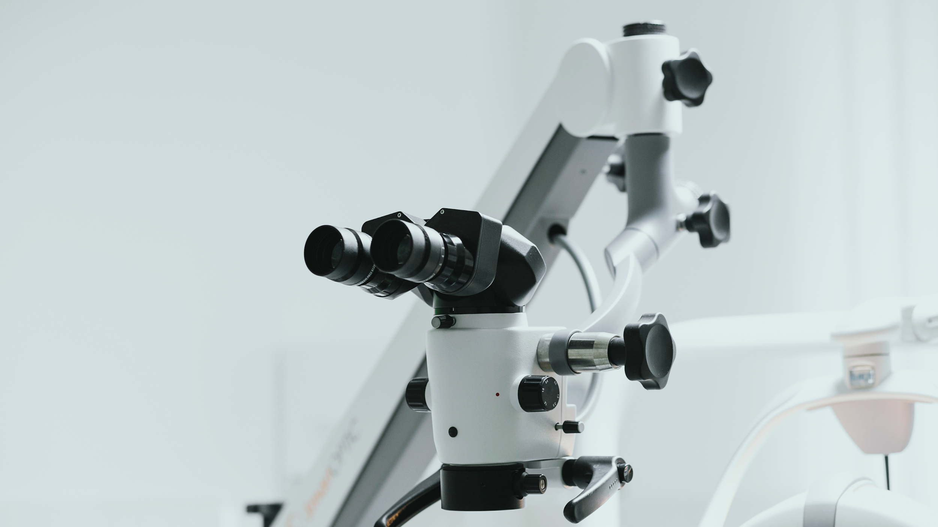
It is important to practice close observation
When working on citizen science, scientists are relying on everyday people to collect as accurate data as possible for them to use for their project. We want to make sure that we are putting our best data forward with our project

Slide 8
SCIENTIFIC QUESTIONS
Next, you are going to choose your most interesting observations from the last step and form scientific questions from it.
REMINDER
A scientific question can be answered with a hypothesis and confirmed or denied by investigating with an experiment (testable).

Slide 9
IS THE QUESTION SCIENTIFIC?
01
03
02
IS THIS TESTABLE?
WHAT EXPERIMENT OR TEST COULD I CONDUCT
HOW COULD I FIND AN ANSWER?
IF YOU CAN ANSWER ALL THREE, IT IS A SCIENTIFIC QUESTION.

Slide 10
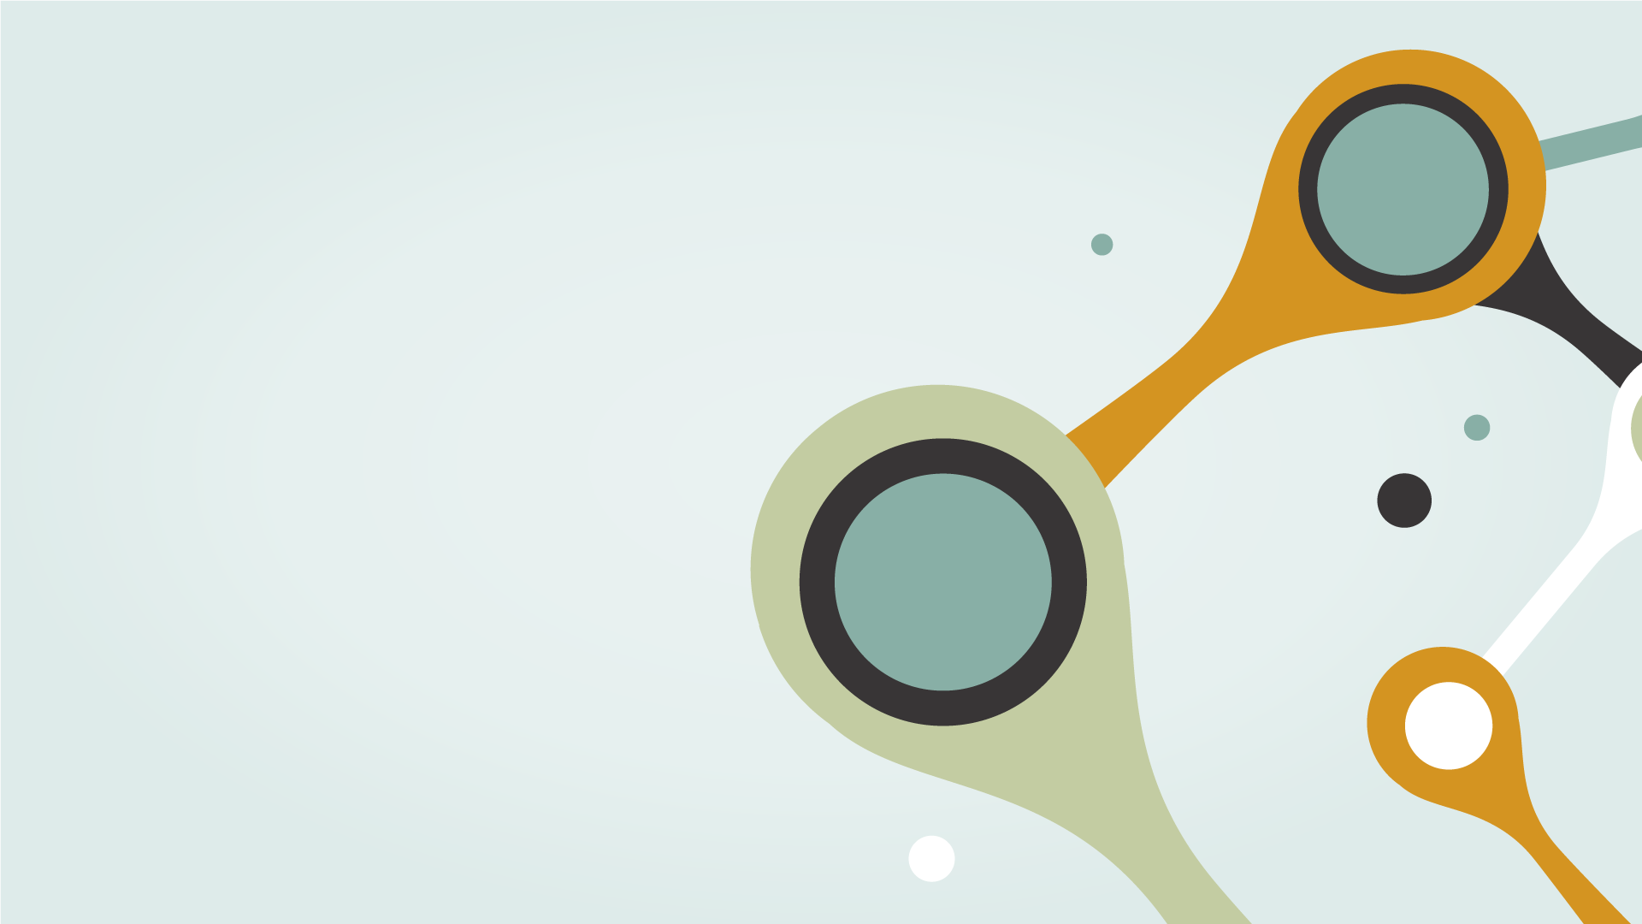
Once scientists have a scientific question, they form an idea or make an educated guess at what they think the answer is. This is called a hypothesis. It can be tested to see what parts (if any) can be confirmed. Exploring the results from the test can also lead to new information and better-informed hypotheses.

Slide 11
FIELD NOTES AND DATA
Taking field notes about your observations is an important part of being a scientist. Today, you'll be making field notes about the subject you've decided to study. What do you think you should make notes about?

Slide 12
FIELD NOTES & DATA
WHAT YOU SEE
WHAT YOU HEAR
WHERE YOU ARE
What else do you think you should make notes about?
EX) How big is it, how many, what color
EX) Types of sounds, volumes
EX.) how hot or cold it is, what the weather is like

Slide 13

TOOLS FOR DATA COLLECTION
Sketches
Photos
Recordings
Rulers
What would work best for what you are studying?

Slide 14
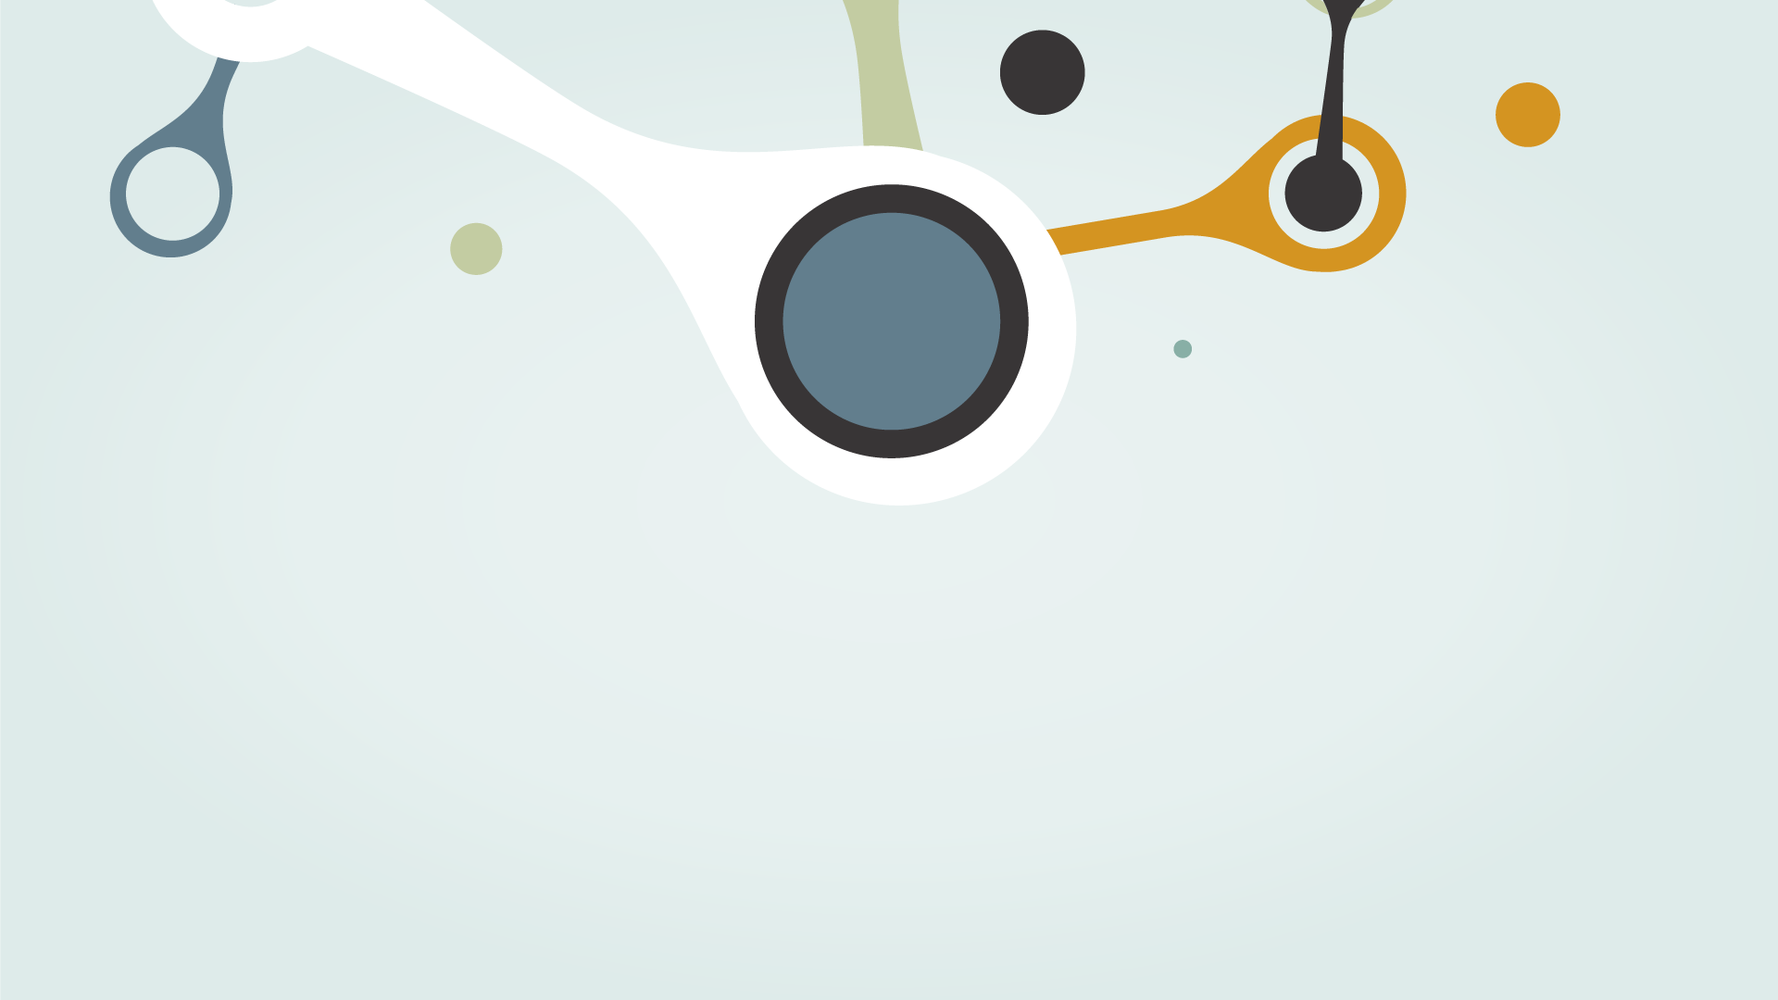
ANALYSIS
Analyze means that the scientist looks at all the information and finds patterns that help her to understand the world better. If you're able to, review and analyze your data to see what conclusion you can draw by comparing your original hypothesis to your results.

Slide 15
Second Call
May 26th @ 4:30pm
If you missed our first call and need to sign up. Please fill out this form.

Slide 16



Slide 17
