Slide 1
Cadette, Senior, & Ambassador
Think Like a Citizen Scientist Journey
Girl Scouts of Central Illinois

Slide 2
Welcome!
We’re excited to work on the Think Like a Citizen Scientist Journey with you!
This will be a combination of work done independently and three GoToMeetings with GSCI staff and other Girl Scouts working on the same project.
To get ready for the GoToMeetings, it would be a good idea to go ahead and download the GoToMeeting app or launcher at global.gotomeeting.com.
GoToMeetings will be held on the following dates and times:
Tuesday, May 19th @ 4:30 p.m.
Tuesday, May 26th @ 4:30 p.m.
Tuesday, June 2nd @ 4:30 p.m
To sign up for the GoToMeetings, use this form.

Slide 3
What is Citizen Science and why are we doing this???
Scientists study different parts of nature to understand how it works.
On this Journey, you'll learn how scientists use the scientific method to answer questions about the world and help other humans, animals, and the environment.
You'll use the scientific method (the steps scientists take to learn new things) to help real-life scientists learn more about the world.

Slide 4
As part of this Journey, you're going to do something called citizen science. That's when a scientist asks regular citizens to help her with her research. Citizen science is a way for everyday people to participate in research. The scientists can use this data to understand and help the planet.
GSUSA has partnered with an organization called SciStarter to help with this Journey. Later in these slides, there are videos where the scientists are going to explain what they want to learn and how you can help them with their research.
.

Slide 5
So how does this work?
First, we’ll spend some time looking at some citizen science projects and learning the skills to be good citizen scientists. During our first meeting, we’ll practice some observation skills and using the scientific method to make our own hypotheses. Then, you’ll go outside and make some real observations and the world around us. We’ll also pick our citizen science project.
During the second meeting, after we’ve practiced some of our science skills, we’ll get started on our citizen science project with SciStarter. Then you’ll have the week to make and record your observations.
At our final meeting, we’ll look at and reflect on what we’ve accomplished and come up with a plan for a Take Action Project!

Slide 6

SciStarter
The next few slides have some information about possible Citizen Science projects we can work on together. Watch the videos and decide which projects you’re interested in! We’ll decide which one to do at the first meeting.

Slide 7

Option One:
Stream Selfie

Slide 8
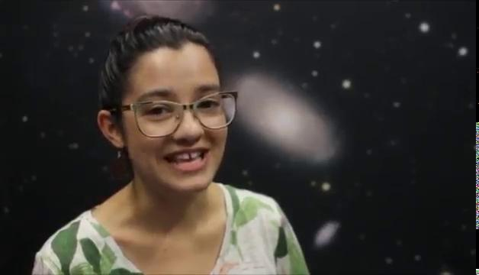
Option Two:
Globe at Night

Slide 9
Option Three:
TreeSnap

Slide 10
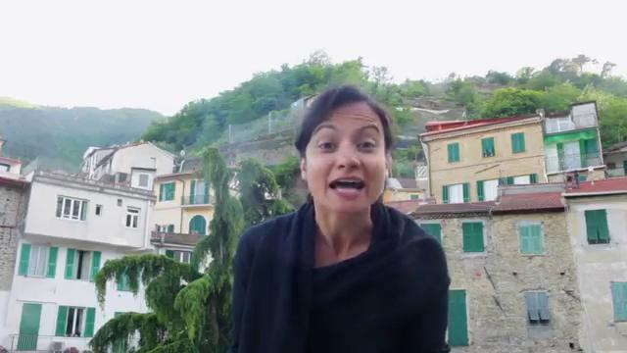
Option Four:
ISeeChange

Slide 11
Option Five:
Mosquito Habitat Mapper

Slide 12
Terminology
Look over the terminology in the following slides to prepare for our first meeting. Don’t worry--you don’t need to memorize them. Just take a minute to review and refresh your memory. You may have learned about many of these in science class.

Slide 13
Hypothesis

Slide 14
A hypothesis is an idea that can be tested to see if it’s true. After scientists pose a scientific question, they form a hypothesis as to what they think the answer is.

Slide 15
Iterate

Slide 16
Iterate means to repeat a process many times. Scientists use iteration with they run multiple trials or collect data multiple times for their research.

Slide 17
Observation

Slide 18
Observing is watching and noticing something using all of your senses, especially sight, to get information. Observation helps you better understand a situation or environment

Slide 19
Scientific Method

Slide 20
The Scientific Method is the process, or series of steps, that scientists take to conduct scientific research.

Slide 21
Scientific Question

Slide 22
A scientific question is a question that can be answered with a hypothesis and confirmed or denied with an experiment. Scientific questions are testable.

Slide 23
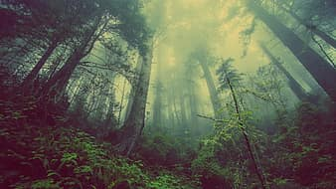
Don’t forget to sign up for the video calls!
Video call sign-up here

Slide 24

Please take a moment to complete our survey.
We would love to hear your feedback!

Slide 25

Free templates for all your presentation needs
For PowerPoint and Google Slides
100% free for personal or commercial use
Ready to use, professional and customizable
Blow your audience away with attractive visuals

