Slide 1
Think like a Citizen Scientist
Journey for Brownie Girl Scouts Part 2

Slide 2
Review...
Last week we discussed what a scientist is, a citizen scientist, the scientific method and the importance of observation.
You practiced observing by writing 5 things that your family members do to get ready for the day.
Now, let’s learn how to take notes during our observations..

Slide 3
Field notebooks
Scientists need somewhere to store their observations. Let’s create a field notebook to record our findings.
Supplies needed:
Blank paper (4 to 5 sheets)
Stapler
Markers, crayons, or colored pencils
Steps:
Put the sheets of paper together and make a nice neat stack.
Fold stack of paper in half meeting corner to corner.
Make a crease down the folded side.
Staple them together to make a small notebook
Decorate the front cover

Slide 4
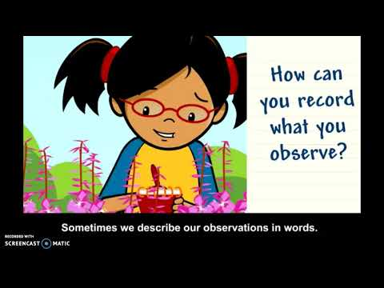
Using observations
Let’s talk about Recording observations. Click on the video to learn how you can record observations.

Slide 5
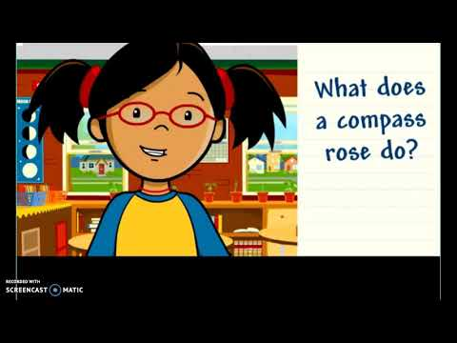
Key ideas for observing
One of the key ideas is the finding the location of the things you are observing. To do this it is important to know your cardinal directions. Let’s watch this video to help us learn about the cardinal directions.

Slide 6
Putting it all together
We have reviewed how to record observations and what a compass rose is and why we use it. Taking notes in our field notebooks helps us to remember what we have seen. Many scientists use the data many days after they have collected it so it is important for them to take notes that includes specific details to help them remember what they saw.

Slide 7
Let’s practice
Using your field notebook, write down observations that you have in your neighborhood.
How many houses are on your street?
What direction does your house face? How many other houses face that direction?
What other observations do you see in your neighborhood?

Slide 8

Next week..
We will use all the skills we learned in part 1 and part 2 to complete a take action project in part 3.

