Slide 1
Think Like a Citizen Scientist
Journey for Brownie Girl Scouts Part 1

Slide 2
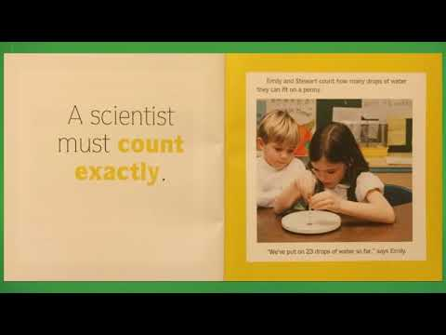
What is a scientist?
Lets learn about what a scientist is and what they do. Click on the video to listen to a book all about scientists.

Slide 3
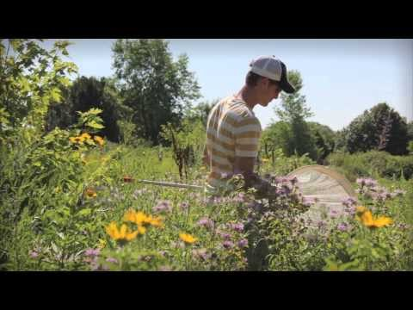
What is a Citizen Scientist?
Now that we know what a scientist does. Let’s divide a little further to see what a citizen scientist is and how they can help in the world of science.

Slide 4
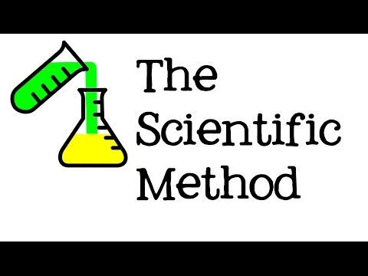
On this journey…..
On this journey you’re going to use the scientific method to help real-life scientists learn more about the world. Lets learn more about the scientific method!

Slide 5
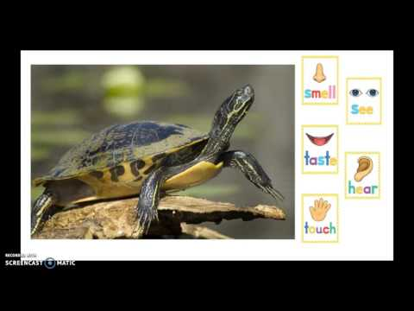
observation!
Observation is one of the steps of the scientific method. Let's divide into what observation really is! Click on this video to learn more on how to use our 5 senses to observe.

Slide 6
Practice your observation skills!
Each of us have a morning routine that we do to get ready for our day. Write down 5 things that your family members do in the morning to get ready for the day.

Slide 7

Stay tuned….
Next week we will continue our work through our journey!

