Slide 1
Brownie Space Science Adventurer
Girl scouts of Central Illinois

Slide 2
Whether you’ve searched for shooting stars or found shapes in the clouds, you’ve probably already spent some time looking at the sky. Now’s your chance to see the sky in a new way—like a space scientist does!

Slide 3
Step One: Meet the Neighbors
If you live in a city, your neighbors live close to you. If you’re in the country, they’re farther away. Think of your home planet—Earth—as part of a neighborhood. Earth’s neighborhood is our Solar System, and the other planets are the neighbors. Some planets are close, and some are farther away. Now get to know the neighbors!

Slide 4
Make a Mnemonic Device
Name those planets! A mnemonic device is a complicated name for a fun idea. It’s just a way to help you remember something, often in a very silly way. Come up with your own way to remember the names and the order of the planets in our Solar System by writing a sentence, a poem, or a song that uses the first letter of each planet in order. For example, My Very Excellent Map Just Showed Us North. Once you’ve come up with your mnemonic device, teach it to a friend or family member.

Slide 5
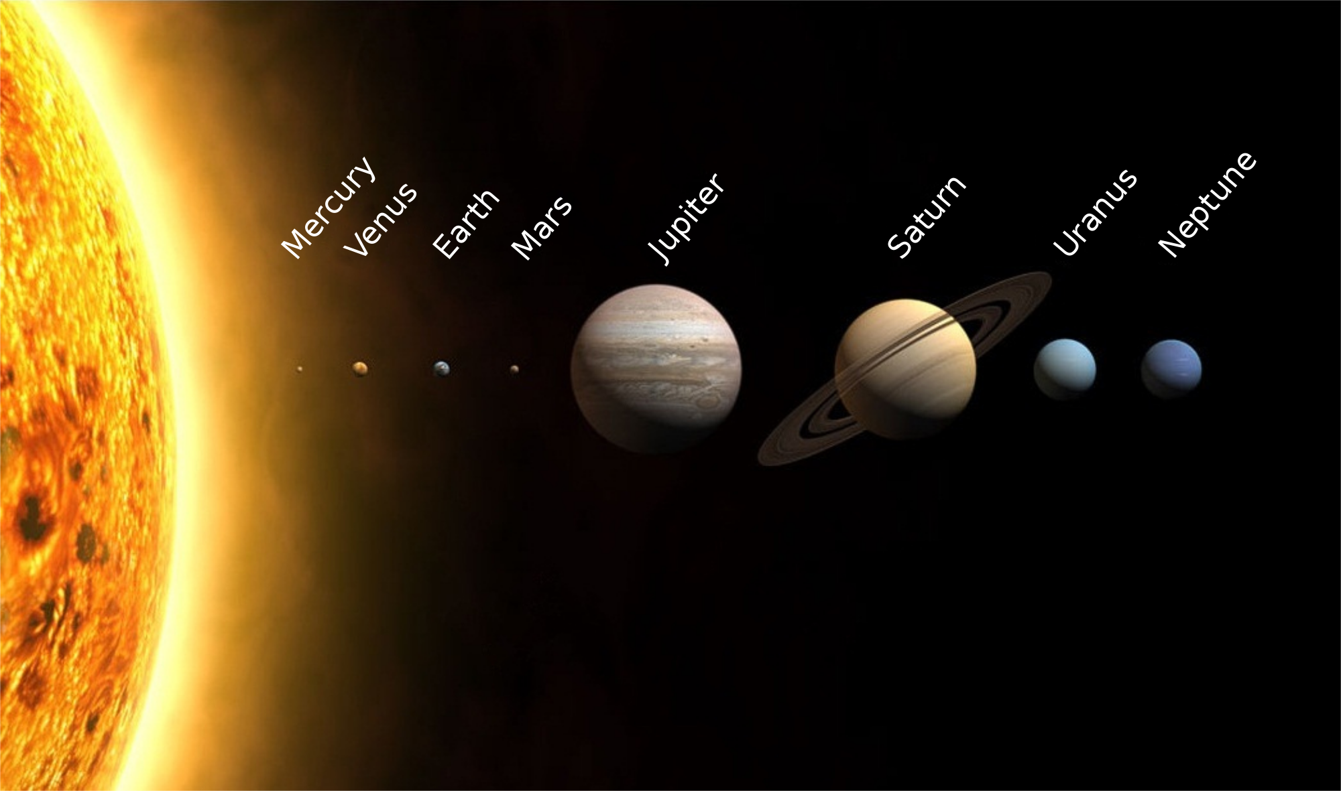

Slide 6
Step Two:
See more than before
The objects in our Solar System—and beyond—are far away. In order to look at them in more detail, space scientists need to use tools. You can use some of these tools too—give it a try!

Slide 7
If you have a telescope or binoculars, go outside and take a look at the moon and stars on a clear night. If you don’t you can explore from the comfort of your home! Have an adult help you and go to www.girlscouts.org/SpaceScienceEarthSky and see what’s visible tonight!

Slide 8
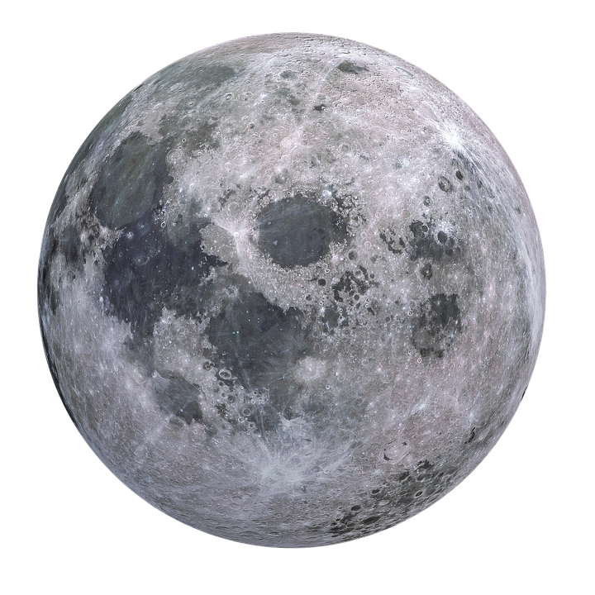
Step Three: Investigate the Moon
Have you ever noticed that the Moon looks different at different times of the month? It doesn’t actually change shape, but it looks different. As the Moon orbits (or moves around) the Earth, the Sun lights different parts of it. This makes the Moon look like it is changing shape. These shapes are called the “phases of the Moon.” Learn more about the Moon in this step!

Slide 9
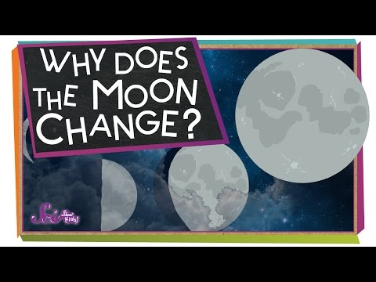

Slide 10
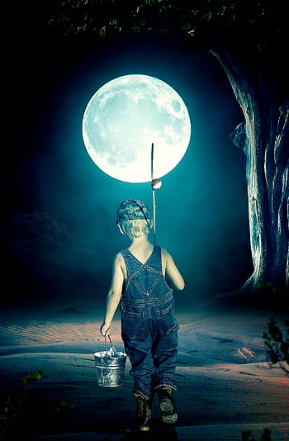
Make Moon Art
You’ve probably looked at the Moon at night lots of times, but have you ever seen it during the day? It doesn’t look as bright against a bright blue sky, but you can often see it in the daytime! Make an art project showing the Moon during the day or at night. Use any art form you’d like— be sure to include the shadows and textures you see when you look at the Moon!

Slide 11
Step Four: Be a Stargazer
For as long as people have been looking at the sky, they’ve noticed shapes and patterns in the stars. Groups of stars that form shapes are called constellations. Around the world, many people have created different constellations and stories about them. Today, astronomers have agreed to use the same 88 constellations to make maps of the sky for science.

Slide 12
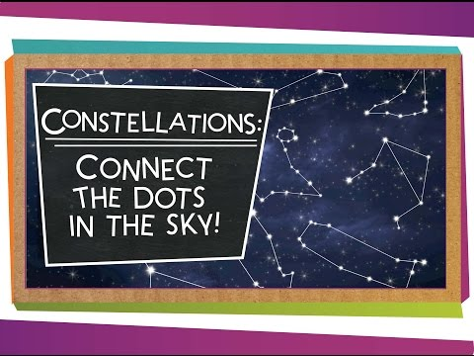
First, watch this video to learn about constellations!

Slide 13
Now it’s your turn! Tell a star Story!
Before people could read or use technology to communicate, they told stories. Stories about the constellations helped share information. Sometimes it was practical information, like how to use the constellations for directions. Other stories gave examples of values—like honesty or bravery—that people thought were important. Do you know one of these stories? Can you find one? Then,, come up with your own star story about a constellation. Then share your story with your family or friends—you could draw pictures, sing a song, write a poem, or act out your story in a skit.
Need help finding a constellation story? Here are some constellation stories for kids on YouTube.

Slide 14
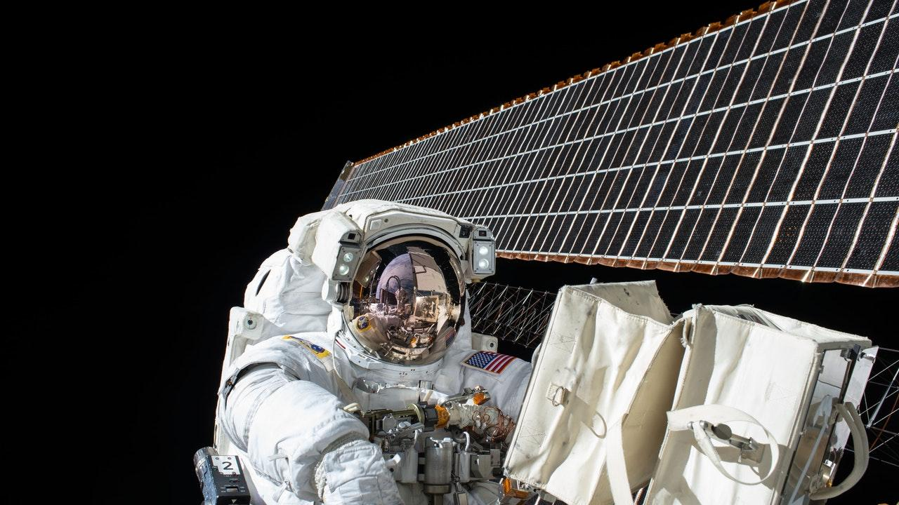
Step Five:
Celebrate and Share!

Slide 15
Have a Star Party!
Now that you’ve learned so much about space, it’s time to celebrate what you’ve learned! Have a party with your family at home, or have a virtual party with Zoom or another online service with your Girl Scout troop! Maybe you can make space-themed snacks, do space skits, or watch a space movie! Be creative and have fun!

Slide 16
Congratulations
You’ve now earned your Space Science Adventurer Badge!
#GSCIShinesOn

Slide 17


Slide 18

Free templates for all your presentation needs
For PowerPoint and Google Slides
100% free for personal or commercial use
Ready to use, professional and customizable
Blow your audience away with attractive visuals

