Slide 1


Leader Instructions & Meeting Prep:
Brownie Senses Badge
Brownie Senses Badge: :meeting plan supply list::
Something that you love the smell of (cinnamon, vanilla, perfume, play dough—you name it!)
A piece of onion (cut)
A small glass of juice (apple, orange, grape, etc) or another flavored beverage.
Some perfume on a napkin
Some toothpaste on a napkin
3 Bowls, and access to water and ice- one bowl with hot water (hot, but safe to touch), one with room temp. water, and one with ice water.
The following slides will walk your troop through a virtual meeting to earn the Brownie Senses Badge. When you share your screen during your meeting, be sure to click “Present” so girls see the full screen. Also, when you are sharing your screen in zoom, google meet, or another meeting app, please make sure you are sharing both picture and audio. For more information on using Zoom, visit gsnw.gl/VirtualMeetingHowTo
Many of the interactive activities included are shared through YouTube videos. Just click on the arrow in the center of the image to play the video, and the girls can see it too! You should try to review the slides before your meeting if possible, so you are familiar with the activities and any supplies needed.
This meeting will typically take approximately 60-90 minutes as written, depending on participation level and number of girls. As always, Girl Scouting is flexible, and troops may select the activities interest them most, add their own activities, or have girls do some of the steps afterward as “homework”.
When you send out your meeting invitation, be sure to let girls and parents know what supplies they should have on hand for the online troop meeting. They are things most girls likely have at home.

Slide 2

Welcome to
Brownie
Girl Scouts!
Senses Badge
Brought to you by Girl Scouts of the Northwestern Great Lakes

Slide 3
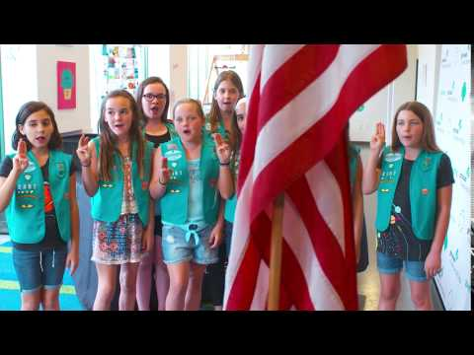
The Girl Scout Promise
The
Girl Scout Promise
On my honor, I will try:
To serve God and my country,
To help people at all times,
And to live by the Girl Scout Law.

Slide 4



Slide 5


Let’s Say the Pledge

Slide 6

Icebreaker:
Answer one of these sensory questions.
What is your favorite color?
What is your favorite food?
What is your favorite smell?
Do you have a favorite stuffed animal that you love to hold?
What is your favorite music?

Slide 7
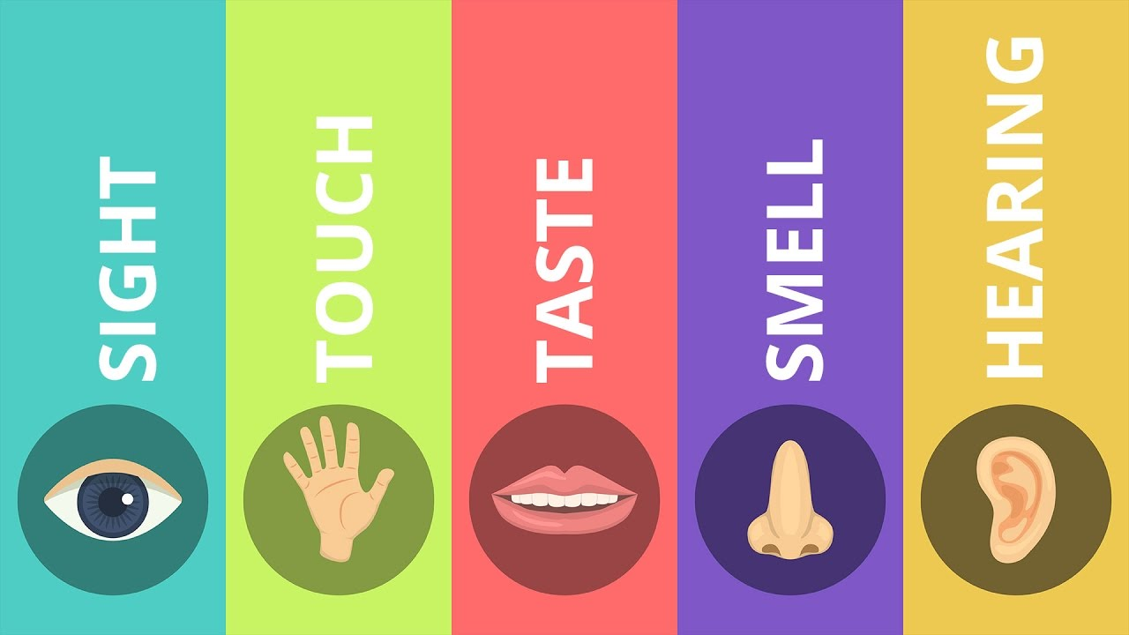
Senses Badge
You have 5 senses that work together to let you see, hear, smell, taste and touch the world around you! We will explore all 5 to earn this badge.

Slide 8


Step 1: Explore the Sense of Sight
Kim’s Game
This game has been enjoyed by Girl Scouts for over 100 years!

Slide 9
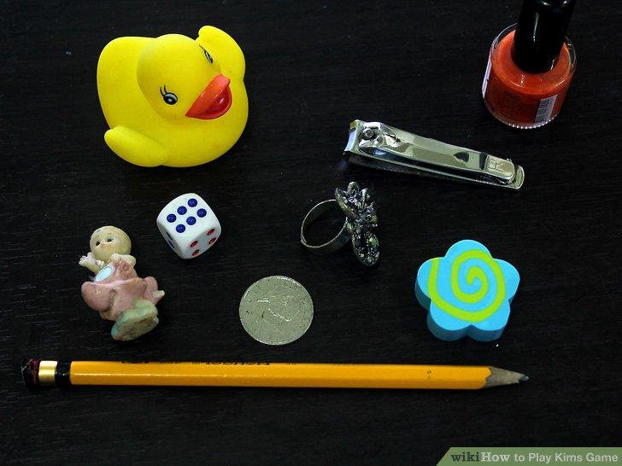

Slide 10

How many things do you remember?
?

Slide 11
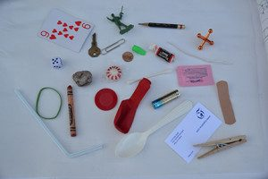

Slide 12
How many things do you remember?
?

Slide 13

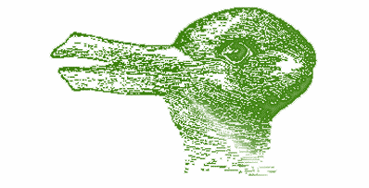
Optical Illusions
Use lines or shapes to trick your brain. These pictures can be seen as two different things, if you look at them long enough.

Slide 14
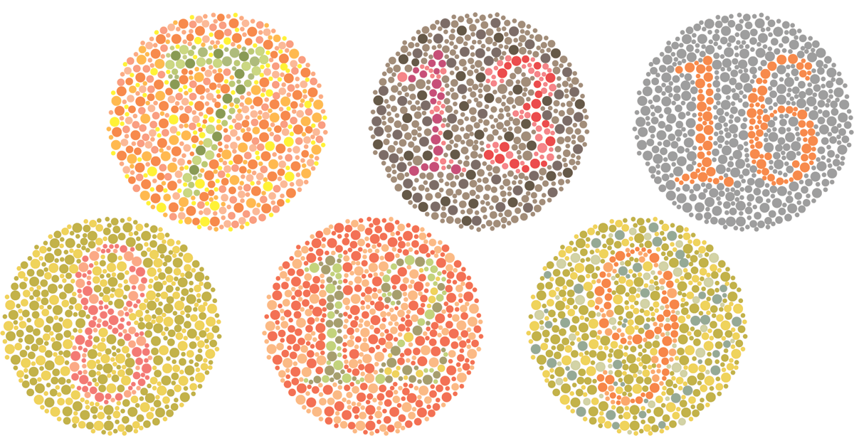
Color Blindness
Reduced ability to distinguish between certain colors
The condition is often inherited
More men than women are affected

Slide 15

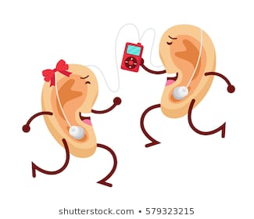
Step 2:
Explore the Sense of Sound
The inside of your ear has hundreds of bones. Some of these bones are the tiniest in your body, but they can deliver big sounds!

Slide 16
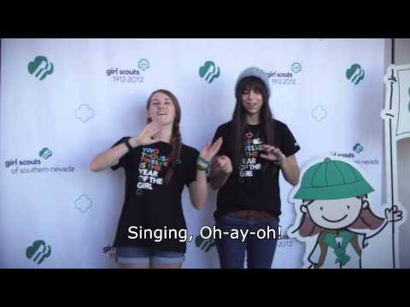

One of the best things about our sense of sound is listening to music! Let’s make some music together!

Slide 17

Guess the Sound Game

Slide 18



Animal Fun Facts!
Cats can see six times better than humans
Dolphins sleep with one eye open
An ostrich eye is bigger than its entire brain
Butterflies taste with their feet

Slide 19
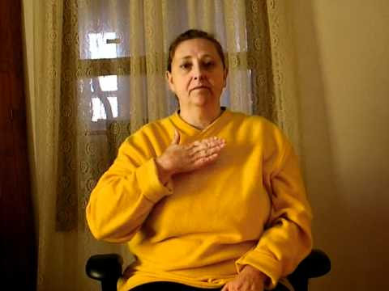
American Sign Language
Many people who can’t hear use American
Sign Language to communicate.
Let’s learn the Girl Scout Promise in ASL!

Slide 20

Step 3:
Explore the Sense of Smell
Did you know that smell, memory and emotion are linked very closely? Many smells conjure up strong memories or emotions for people.
Share an item that you love the smell of.
What memories does it bring up in your mind when you smell it?
What feelings does it trigger for you?
Looking for another activity? Draw a picture of how this smell makes you feel!

Slide 21

Step 4:
Test Your Sense of Taste
How is your sense of taste triggered by your other senses?
Experiment:
Try drinking some juice with your eyes closed and your nose plugged. Did it taste different?
Now, hold a piece of onion up to your nose while you drink the juice. How did it impact the taste? Try it again, holding up a tissue with some perfume or toothpaste on it. How about now?

Slide 22


Step 5:
Explore the Sense of Touch
You can use your hands and fingers to feel different textures and surfaces.

Slide 23
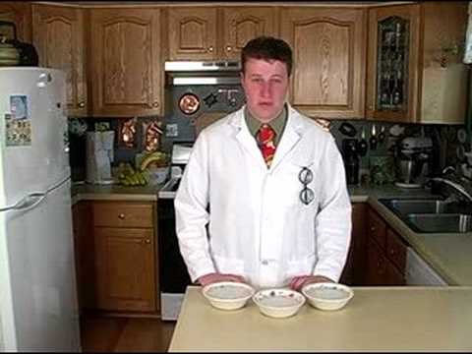
Try this experiment to test your sense of touch!

Slide 24
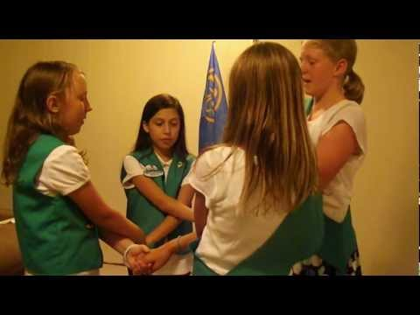
You have earned the Brownie Senses Badge! Let’s end with a virtual friendship circle!

Slide 25

See You Next Time!

