Slide 1

Brownie Safety Award
Girl Scouts of Central Illinois

Slide 2
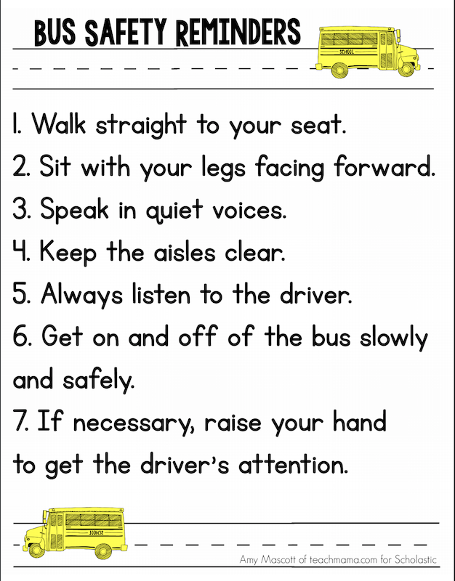
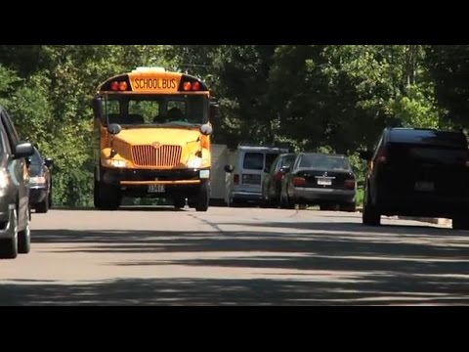
Step 1: Learn how to Stay Safe on the Bus
Taking the bus is one of the safest ways to travel to and from school! However, there are rules we need to follow to ensure our safety. Read the Bus Safety Reminders and watch the video below.

Slide 3

Learn how to Stay Safe on the Playground
Heading outside and playing on the playground is great- as long as it’s done safely! There are many ways you can play it safe to ensure you don’t accidentally hurt yourself or others. Watch the video to learn how!

Slide 4

Make a List:
Make a list of at least 3 different ways you can stay safe at school, on the bus, or at the playground!
1.)
2.) 3.)

Slide 5

Step 2: Map your Neighborhood
Use Google Maps to find your neighborhood or town and mark where the police station, fire station, and other important points are located.
Make a list of emergency numbers and post them somewhere in your home so you can easily find them when you need them.
Click the photo to go to Google Maps.

Slide 6

Step 3: Find out how your Smoke Alarm Works
Smoke alarms are simple devices and we can forget they are even there- but they can save your life! Ask an adult if you can test the smoke alarm at your home so you know what it sounds like and to make sure it is working. Mark your calendars to change the battery twice each year (Daylight savings are great days to use to remember to do this).
It’s always a good idea to have a planned escape route and meeting place for your family in case of fire. Go here to find a diagram to design an escape route with your family.

Slide 7
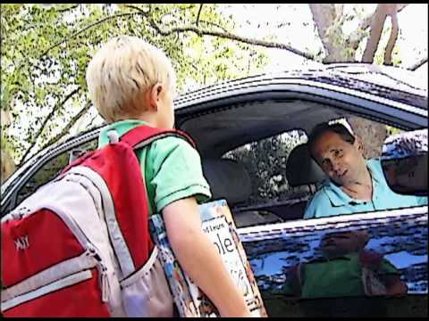
Step 4: Make a Safety Plan with an Adult
Choose one or more places that you visit frequently- the park, grocery store, mall, etc. Make a safety plan with an adult to determine what you should do if a stranger approaches you

Slide 8
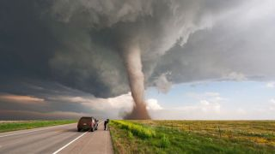
Step 5: Find out what Natural Disasters are Most Common in your Area
If you attend a public or private school chances are you have participated in certain safety drills. It is always good to be prepared for natural disasters anywhere they might occur. If a tornado strikes while you’re in school you might know where to go- but what if you’re at home? Or the grocery store?
Start by finding out what natural disasters are common in Illinois by clicking here.

Slide 9

Make a Plan:
Sit down with your family and create a plan for what to do or where to go during each type of emergency. Together, go through your home and determine where certain emergency materials will be located, such as: flashlights, batteries, fire extinguisher, etc.

Slide 10

Congratulations! You have completed the Brownie Safety Award. Be sure to share with others what you have learned!

