Slide 1


Leader Instructions & Prep
Brownie Philanthropist Badge
Supply List:
Paper
Coloring Utensils: markers, pencils, crayons
Tape or glue
Large empty box or garbage bag
The following slides will walk your troop through a virtual meeting to earn the Brownie Philanthropist Badge. When you share your screen during your meeting, be sure to click “Present” so girls see the full screen. Also, when you are sharing your screen in zoom, google meet, or another meeting app, please make sure you are sharing both picture and audio. For more information on using Zoom, visit gsnw.gl/VirtualMeetingHowTo
Many of the interactive activities included are shared through YouTube videos. Just click on the arrow in the center of the image to play the video, and the girls can see it too! You should try to review the slides before your meeting if possible, so you are familiar with the activities and any supplies needed.
This meeting will typically take approximately 60-90 minutes as written, depending on participation level and number of girls. As always, Girl Scouting is flexible, and troops may select the activities interest them most, add their own activities, or have girls do some of the steps afterward as “homework”.
When you send out your meeting invitation, be sure to let girls and parents know what supplies they should have on hand for the online troop meeting. They are things most girls likely have at home.

Slide 2

Brownie Philanthropist Badge
Brought to you by Girl Scouts of the Northwestern Great Lakes

Slide 3
Girl Scout Promise
On my honor, I will try:
to serve god* and my country,
to help people at all times,
and to live by the girl scout law.

Slide 4


Let’s say the pledge

Slide 5
Brownie Philanthropist Badge
Badge Details:
You will find out more about basic human needs and learn how you can be a "philanthropist"—a person who gives to people who need help!
Learn what every person needs
Investigate how to help people who are hungry
Find out how to help people who need clothing
Know how to help in times of emergency
Think and Act like a Philanthropist
When you’ve earned this badge, you’ll know how to help people in need.

Slide 6
Step 1: Learn what every person needs

Slide 7
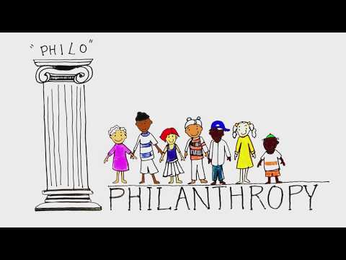
Let’s watch this video to learn more about philanthropy.

Slide 8
Needs
Things we we must have to stay alive.
Needs vs. Wants
Part of being a philanthropist is knowing what people want versus what they need! A want is something we don’t really need but would love to have. Needs are things we must have in order to stay alive.
You will be shown various items in the next few slides. In the chat, say whether each item is a want or a need.
Wants
Things we don’t really need but would like to have.

Slide 9

Is this a want or need?

Slide 10
Water is a need.

Slide 11
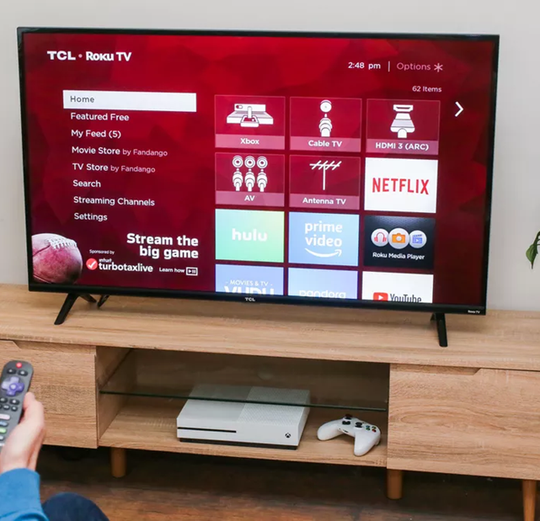
Is this a want or need?

Slide 12
Although tv keeps us entertained, we don’t need it.

Slide 13
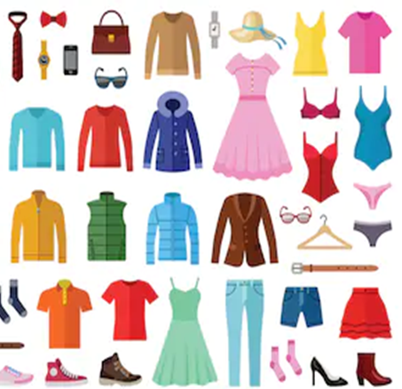
Is this a want or need?

Slide 14
Although high end or expensive brands are not needs, we do need some sort of clothing!

Slide 15

Is this a want or need?

Slide 16
Somewhere to live is a need.

Slide 17

Is this a want or need?

Slide 18
Although exercise is a need, exercise equipment is not a need.

Slide 19
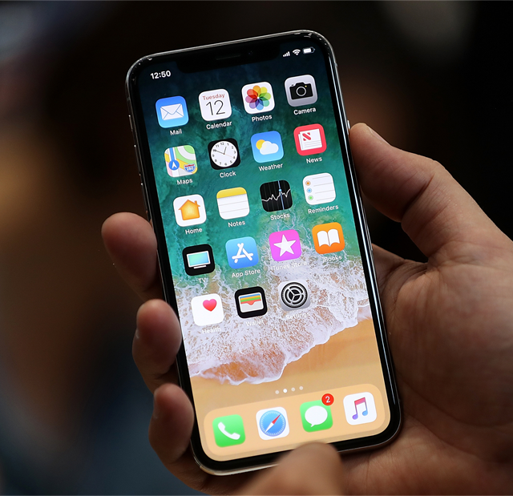
Is this a want or need?

Slide 20
It’s important to stay in touch, but a phone is not needed.

Slide 21

Is this a want or need?

Slide 22
Knowledge and learning is necessary, but a book is not a need.

Slide 23
Investigate how to help people who are hungry.

Slide 24
Let’s take a look at how to help the hungry.
We know that food is a basic human need, however many people around the world don’t have enough to eat, especially this year due to COVID.
Has anyone done anything to help support this cause? If so, type it in the chat. If you haven’t, type in the chat ideas you have to help fight hunger.
We’re going to watch a video on the next slide to learn more about how to help people who are hungry.

Slide 25
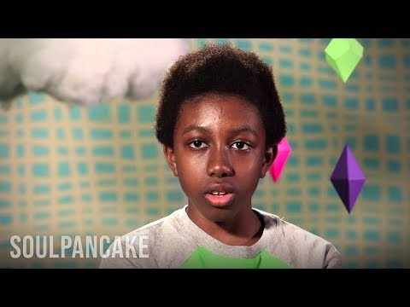

Slide 26
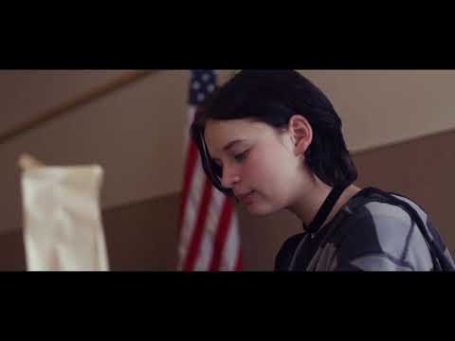

Slide 27
I feel hungry.
Food security:
My family can purchase or grow all of the food we need
When I feel hungry, I eat and feel better!
Food insecurity:
My family CANNOT purchase or grow all of the food we need.
When I feel hungry, there is not always food to eat. Sometimes, I stay hungry.

Slide 28
It’s unfortunate so many people do not have enough to eat. We are lucky to live in a country where we have access to programs to help people who are hungry.
Most food banks request that food donated be canned or boxed goods. Does anyone know why that is? Type your answer in the chat log!
It can also be helpful to donate money to food pantries because they can buy food in bulk cheaper!
Have you ever donated to your local food pantry? If you are able, it’s a great service project idea for your Troop, or even your family!

Slide 29
Let’s create a thank you card for food bank heroes.
Fold a piece of paper in half
Take time to decorate the outside
Write a thank you message inside!

Slide 30
How can we help during emergencies?

Slide 31
Let’s take a few moments to brainstorm some examples of emergencies!
Put them in the chat or say them out loud!
As a philanthropist...
You can help others in many ways!

Slide 32
Great job brainstorming!
Here are a few examples you may or may not have mentioned:
Fires, floods, and tornadoes
Food and clothing insecurity
Hurt Animals or Animals in need
On the next slide we’ll talk about ways to help!

Slide 33
Ways to help!
What ideas do you have to help people experiencing the emergencies we brainstormed?
Fires, floods, and tornadoes – call 911, help pick up afterwards, research for other ways to help.
Food and Clothing Insecurity – Donate canned goods or gently used clothing, organize a clothing or food drive, learn and share what organizations your community has that can help.
Hurt Animals or Animals in Need – Donate money or food to shelters or organizations that help endangered species, make or donate blankets and toys to your local shelter, or to adopt a pet rather than buy one from a breeder.

Slide 34
Let’s do some research…
With the help of an adult.
With a guardian, research how you can help individuals and animals who are in a state of emergency.
Spend some time looking for locations near you where individuals can buy 2nd hand clothing and share with others!
With your troop, brainstorm how you can use your cookie money to make a difference!
Ask organizations in your area what they need.

Slide 35
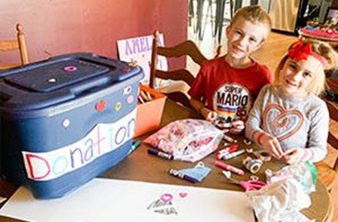
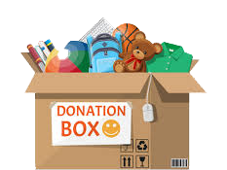
Time to make a donation box!
Supplies needed:
Paper
Markers or other coloring utensils
Tape or Glue
Large empty box or garbage bag (shoebox, cereal or other bigger food box, shipping box, tote etc.)
Once supplies are gathered, let’s decorate them!
While working on the donation box, let’s have the think and act conversation on the next slide!

Slide 36
Think - and - Act like a philanthropist
Let’s take some time and either split into break out rooms or in the large group and think about some organizations in our area to bring our donation box to!
Some questions to consider:
What cause do you want to support? Some causes are fighting hunger, emergency preparedness, or making sure people have the clothing they need!
How are you able to help and want to help? Will you collect money or items? Your own money and items or will you collect from other people?
How will you take out your plan? Cookie money? Donate lightly used items?

Slide 37
Add items to your donation box
Continue to be a philanthropist by adding items to your donation box! When it’s full, research organizations in your area, and donate it!
Continue looking and asking for other ways you can help your community!

Slide 38
Congrats, your have earned your Brownie Philanthropist Badge!

