Slide 1


Leader Instructions & Meeting Prep:
Brownie Pets Badge
Brownie Pets Badge: :meeting plan supply list::
For Pet Show and Tell:
Have the girls bring a picture of their pet to share or introduce their actual pet to the group. If they don’t have a pet, tell us about a pet you would like to have in the future, and share a picture of it if you wish.
For Dog Toys:
Long Sock, such as a man’s athletic sock or cotton knee high
Empty disposable water bottle
Scissors
The following slides will walk your troop through a virtual meeting to earn the Brownie Pets Badge. When you share your screen during your meeting, be sure to click “Present” so girls see the full screen. Also, when you are sharing your screen in zoom, google meet, or another meeting app, please make sure you are sharing both picture and audio. For more information on using Zoom, visit gsnw.gl/VirtualMeetingHowTo
Many of the interactive activities included are shared through YouTube videos. Just click on the arrow in the center of the image to play the video, and the girls can see it too! You should try to review the slides before your meeting if possible, so you are familiar with the activities and any supplies needed.
This meeting will typically take approximately 60-90 minutes as written, depending on participation level and number of girls. As always, Girl Scouting is flexible, and troops may select the activities interest them most, add their own activities, or have girls do some of the steps afterward as “homework”.
When you send out your meeting invitation, be sure to let girls and parents know what supplies they should have on hand for the online troop meeting. They are things most girls likely have at home.

Slide 2

Welcome
to Brownie
Girl Scouts!
Pets Badge
Brought to you by Girl Scouts of the Northwestern Great Lakes

Slide 3

The
Girl Scout Promise
On my honor, I will try:
To serve God and my country,
To help people at all times,
And to live by the Girl Scout Law.
The Girl Scout Promise

Slide 4



Slide 5


Let’s Say
the Pledge

Slide 6



Icebreaker
Show and tell pet time.
Introduce your pet, share a picture, or
tell us about your favorite animal!

Slide 7
Pets Badge
When you earn this badge, you will know how to take care of a pet.

Slide 8

Step 1:
Learn to care
for a pet.

Slide 9
What care do different pets needs?
How much does it cost to care for this pet?
How much space does this pet need?
How much food does this pet need?
What kind of human contact does this pet like?
How does this pet communicate its feelings?
Let/s Talk about Pets!
What unique animal have you always
wanted for a pet? Do you know the answers to these questions about it’s care?
If you don't know the answers, do some research after our meeting.

Slide 10
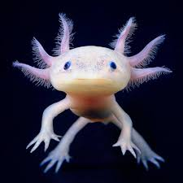
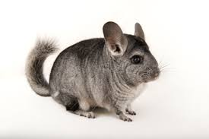
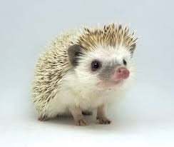
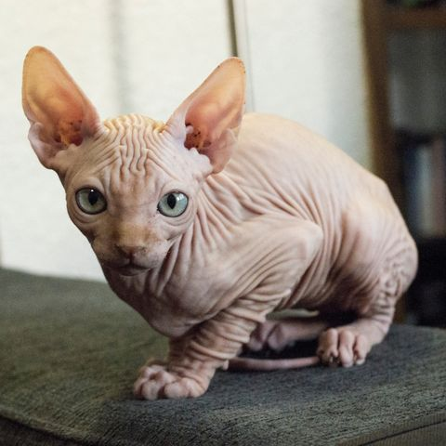
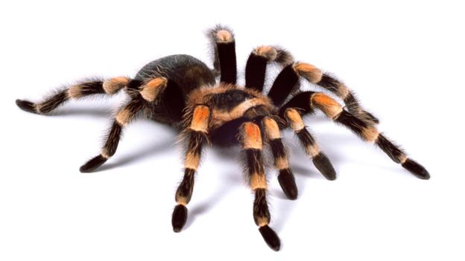
Can you identify these unusual pets?

Slide 11
Can you identify these unusual pets?
Axolotl
Chinchilla
Hedgehog
Hairless Cat
Tarantula

Slide 12

Step 2:
Keep a pet
comfy.

Slide 13
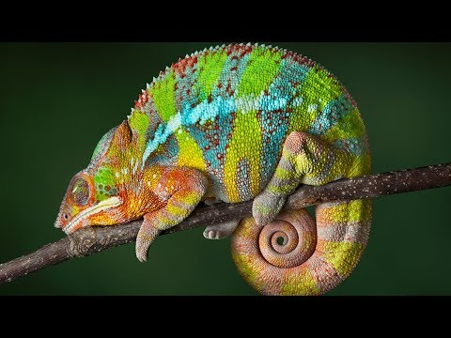
How do animals sleep?
Discuss:
How does your pet (or a pet you would like to have) sleep? How do you help this pet stay comfy when they sleep?

Slide 14

Step 3:
Help a pet stay
Healthy & safe.
What does a dog
Groomer do?

Slide 15
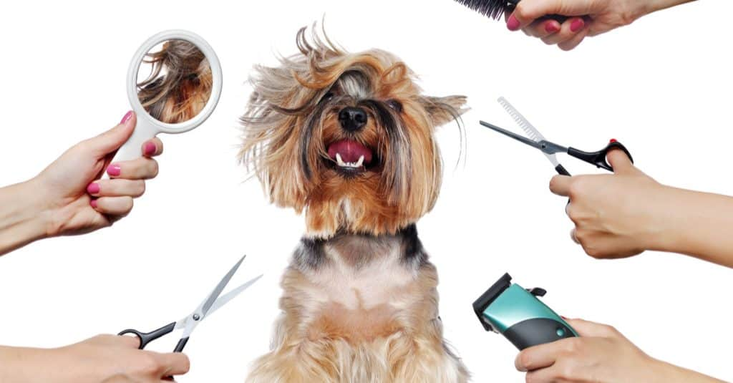
Badge Homework:
If you have a pet, learn how to groom them and create a grooming schedule. If you don’t have a pet, research grooming a pet you would like to have.

Slide 16

Step 4:
Make a pet
Feel loved.
DIY
Dog Toys!

Slide 17
Step 5
Badge Homework:
(Choose 1)
Do you have a pet? Feed your pet for 1 week over the next month.
Find a homemade pet treat recipe, and make it for a pet you know.
Don’t have a pet? Research a pet you wish you had and find out what their food schedule would be.

Slide 18

What do animals
sound like in
different
languages?

Slide 19

See you next time!

