Slide 1

Brownie
Outdoor Adventurer
Girl Scouts of Central Illinois

Slide 2

What happens when you invite a
friend to climb the tallest hill you
can find, or buddy up to take a walk around your neighborhood at night? What do you see? What do you hear?
There are so many amazing adventures waiting for you. So hang on, jump in, and get ready to explore the great outdoors!
When you’ve earned this badge,
you’ll have tried a lot of new things outdoors and learned which
activities you want to do again.

Slide 3

Step 1:
Play Outdoors in a New Way
Explore the night.
After the sun sets, find out how
the world outside changes. Grab a flashlight, team up with an adult,
and go for a nighttime walk around
your neighborhood. Search for nighttime critters. Chase fireflies.
Listen for sounds. Do you hear crickets or frogs? Do you see the Big Dipper
in the sky? Use the stars as
your disco ball and dance!

Slide 4
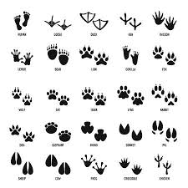
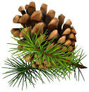

Step 2: Explore Nature
Go on a nature hike.
Go on a treasure hunt to collect leaves,
pinecones, shells, acorns, and odd-shaped rocks.
Follow tracks on a trail—
were they left by humans or
by other creatures?
Or go bird watching and count how many different kinds of birds you see.

Slide 5
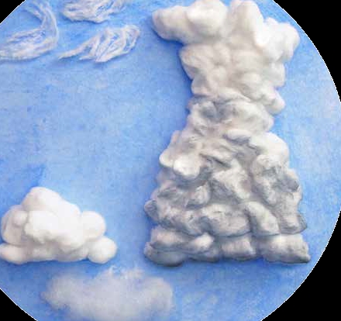
Sky Watch
Clouds are one way to
predict weather!
Clouds come in many
shapes and forms.
Weather forecasters
look at clouds to help find out if
it will be sunny, rainy, or snowy.
Learn more here
Go outside and give it a try!

Slide 6

Sky Watch
The best place to see the night
sky is away from the city lights.
Learn more about
constellations here.
The nighttime sky also changes
during the seasons.
Watch this video to learn
how the sky is different in different seasons.

Slide 7
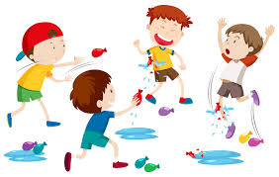
Step 3: Play Outdoors with a Family Member
On a warm day, play a water game. Experience fun ways to be around water and get wet! Fill small balloons with water, and use them to play catch with a family member. (Remember to pick up and throw away the balloons that break!) Who can stay dry the longest? Or do a water limbo dance: Try moving underneath a water stream from a hose without getting wet.

Slide 8

Step 4: Learn a Camp Skill
Watch this video on building a campfire, then prepare one of your own. Collect dry twigs, wood shavings, sticks, and large wood for a fire.
A fire needs air and fuel to burn. To make a fire that lasts, you need
three sizes of wood:
Tinder is thin material that burns as soon as it is lit with a match. Tinder can be tiny dry twigs, pine needles, or wood shavings. Kindling is larger than tinder, small sticks the same roundness of a pencil or your thumb. The stick should be dry enough to snap when you bend it. Fuel is larger, thicker pieces of wood that keep a fire going. Fuel should be dry wood found on the ground or in a woodpile.

Slide 9

Step 4: Learn a Camp Skill
Make an A frame with three pieces of kindling, leaving a space under the crossbar. Lay a handful of tinder against the crossbar inside.
If you’re somewhere you can safely build a campfire, ask an adult to check your fire setup. Then ask her to light it to see if it works! Don’t worry if it doesn’t. Try to figure out why, and then ask the adult to try it again!

Slide 10
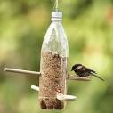
Step 5: Care for the Outdoors
Care for animals. How can you help other living things around you? You might put up a bird feeder or create a birdbath out of a recycled container. Check out this video for how to make a bird feeder out of a plastic bottle!
Find other ways to care for the outdoors as well! You could plant flowers like zinnias and marigolds to attract hummingbirds. Or pile up lots of dead branches and leaves to give small animals a place to nest and hide.

Slide 11

Congratulations!
You have earned the
Brownie Outdoor Adventurer badge.
Be sure to share with others what you have learned, and please take a moment to complete this short survey about our virtual badges.

